Slide 1
Thames Valley Berkshire Monthly Economic Briefing
December 2021

Slide 2
Key contents of this month’s briefing
Updated global and UK economic forecasts
Latest furlough, SEISS and claimant count figures by Local Authority
Latest remote working figures for Thames Valley Berkshire
Latest ‘notable business news’ by Local Authority
Latest job posting analytics by Local Authority

Slide 3
Global and National Economy
December 2021

Slide 4
Global Economy
Output in most OECD countries has now surpassed its late-2019 level and is converging on its pre-pandemic path but lower-income economies, particularly those where vaccination rates are low, are at risk of being left behind. The unevenness of the recovery is widespread. The recovery is also uneven within advanced economies. Employment is still relatively weak in the United States, but is already higher than its pre-pandemic level in the Euro Area. At the same time, United States GDP has recovered faster than Europe’s. Different protection models mean different challenges looking ahead.
The labour market is imbalanced. Many people are struggling to find jobs yet businesses in a number of sectors have difficulty recruiting workers. The skills demanded in the wake of the crisis are not necessarily the same as before. A shortage of workers in some sectors also reflects a decline in labour force participation rates in most OECD countries. Participation is expected to normalise as the effects of the pandemic wane increasing labour supply helping to keep wage growth moderate. Imbalances also remain across industries, with sectors dependent on interpersonal contact such as travel, tourism and leisure continuing to suffer, while demand for consumer goods has been strong, especially in the United States. Source: OECD, December 2021

Slide 5
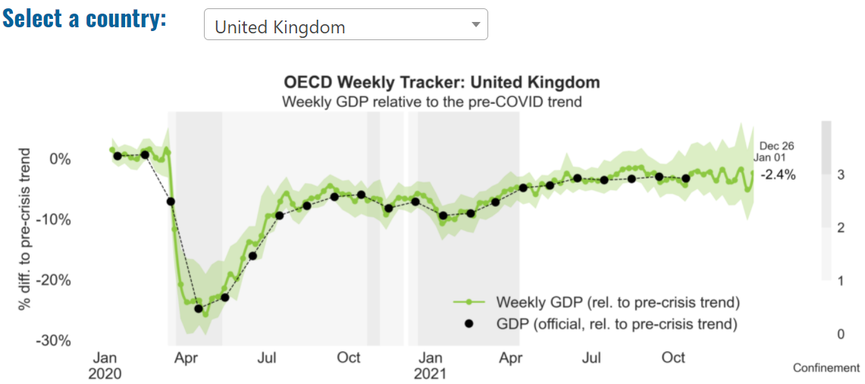
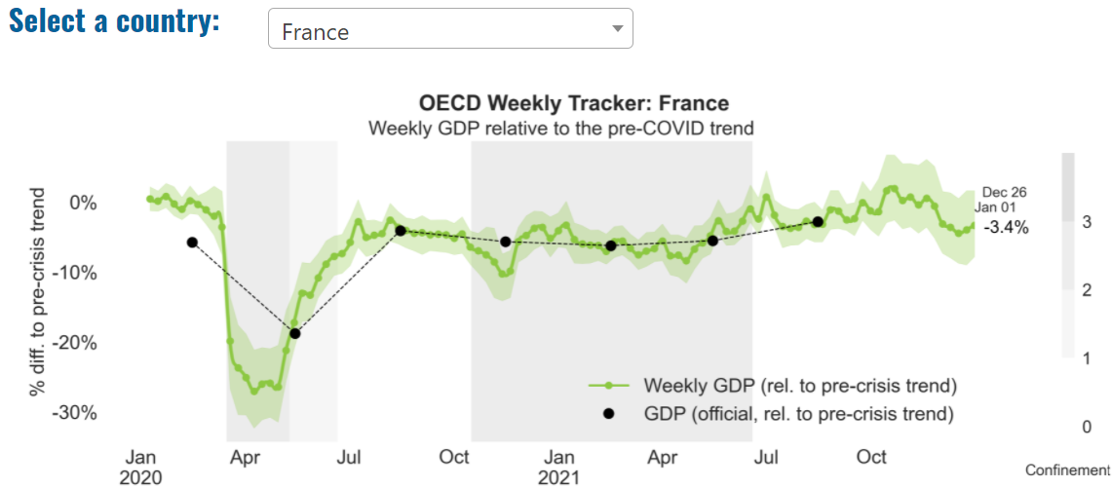
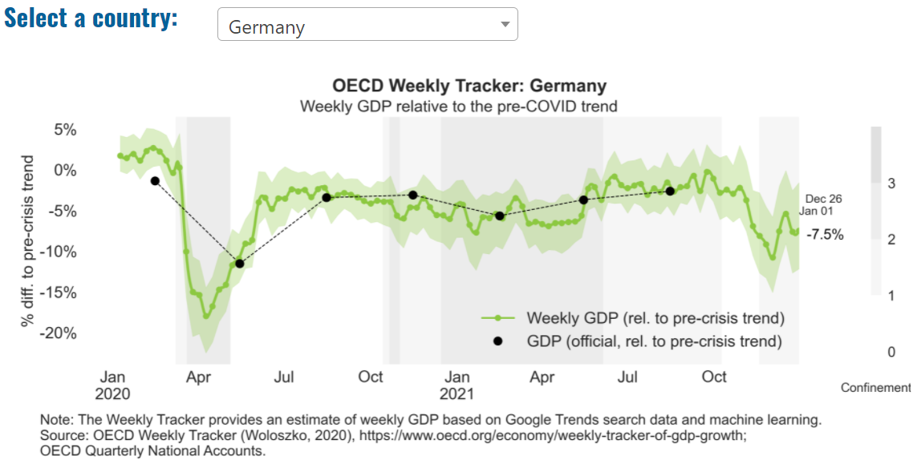
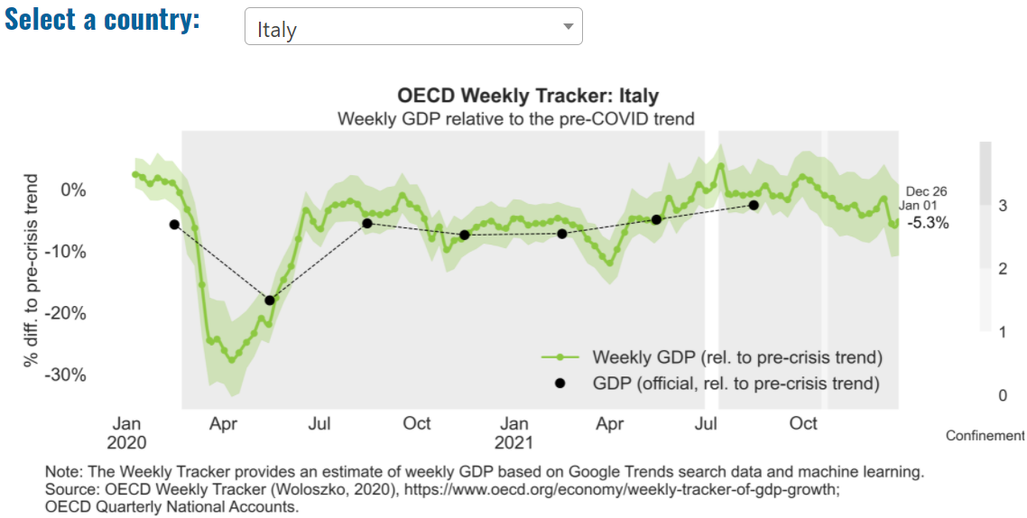
Global Economy – OECD GDP Tracker

Slide 6
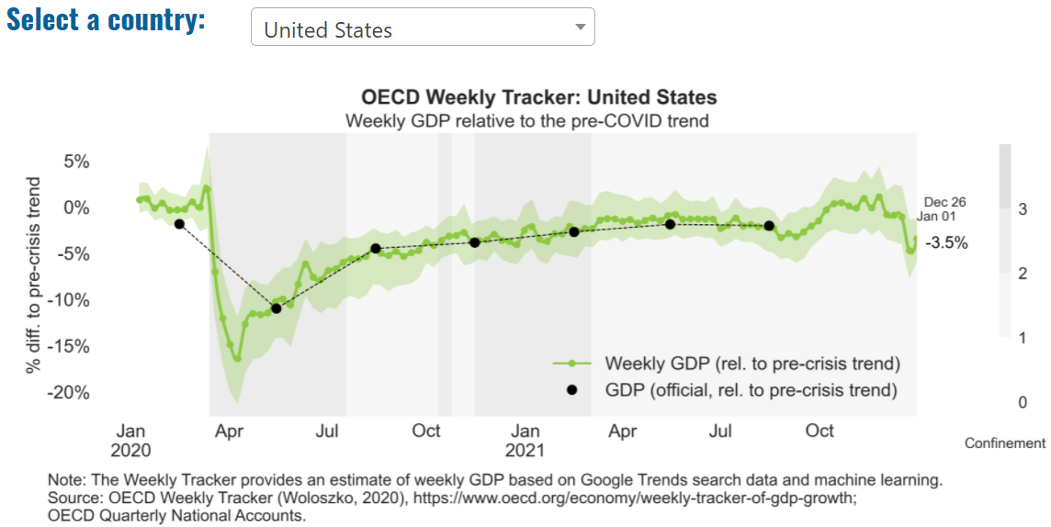
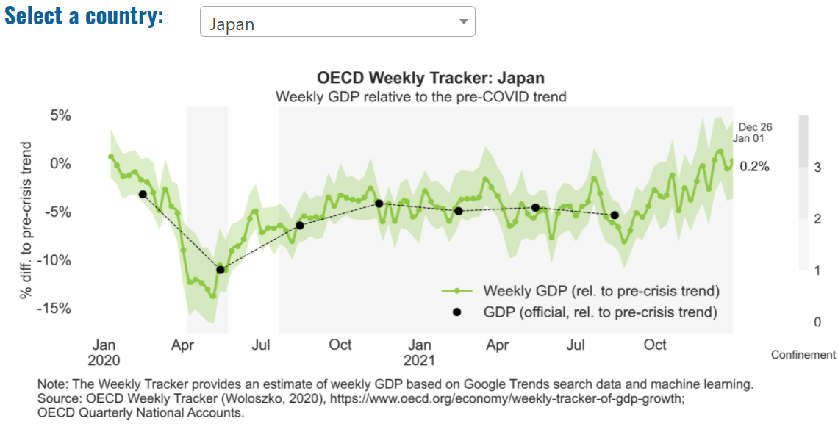
Global Economy – OECD GDP Tracker Continued
China
China is not included within the OECD GDP tracker and so the graph on the left has been compiled using statistics from the IMF and National Bureau of Statistics of China. The 2021 figure is a preliminary figure published by the National Bureau of Statistics of China in January 2021.
Note: The green confidence band shows 95% confidence intervals. The Weekly Tracker is an estimate of weekly GDP relative to the pre-crisis trend, which is proxied by the November 2019 OECD Economic Outlook forecasts. The darkness of the grey background reflects stay-at-home confinement requirement based on the Oxford Blavatnik database (0 - no measures, 1 - recommend not leaving house, 2 - require not leaving house with exceptions, 3 - require not leaving house with minimal exceptions). Source: OECD, December 2021

Slide 7
UK Economy
The emergence of a more contagious Omicron variant brings new uncertainties to the fight against the COVID-19 pandemic. While growth momentum is expected to decelerate until a booster is rolled out to halt the rise in cases, the full impact will depend on the rise in the number of acute COVID-19 cases and any social distancing restrictions that are introduced.
We expect GDP to grow between 1.8 - 4.2% in 2022, depending on the extent social distancing restrictions are introduced in the first half of the year (Table 1). Current government efforts to control the pandemic with minimal restrictions could see a relatively small impact on economic growth, as depicted in our Upside scenario.
Labour shortages have become a significant impediment to growth and pay pressures more pronounced. The labour market appears to have weathered the end of the furlough scheme with the unemployment rate expected to peak at 4.5% in our Upside scenario, while new restrictions to combat the Omicron variant could see unemployment peak at 5 - 5.7% in 2022.
A deteriorating pandemic outlook could once again increase the demand for goods and put more pressure on supply chains in the short-term. At the same time, cooling demand for energy and some services could ease inflationary pressures. Inflation could average between 4.3 - 4.8% in 2022 and 2.3 - 2.5% in 2023 depending on the evolution of the Omicron variant.
High level of uncertainty about the Omicron variant is expected to see the Bank of England hold off raising interest rates in December 2021. However, rates are expected to rise to 1-1.25% by the end of 2023 in order to prevent a ratcheting up of wage growth as the recovery gathers renewed momentum.
Rapid house prices growth seen during the past year is expected to moderate due to the rising cost of mortgages and the end of the temporary cut to stamp duty. Some locations may continue to benefit from buyers who can take advantage of a reduced need for commuting to move away from traditional market hotspots in favour of more affordable alternatives further afield.
While the Autumn Budget provided a modest fiscal loosening, overall fiscal policy is set to become a headwind to growth in 2022.
Source: KPMG, December 2021

Slide 8
UK Economy 2
UK output in September 2021 was just 0.6% lower than February 2020 levels.
Polarisation of sectors, regions and households are the key risk to UK economic growth outlook heading in 2022.
Households facing triple consumer squeeze over 2022/23 as inflation, higher interest rates and increased national insurance contributions bite.
Uneven recovery across sectors is expected to continue into next year, with growth in manufacturing impacted by ongoing supply disruptions and shortages while hospitality recovering in force post-lockdown.
Regional polarisation caused by the pandemic is significantly more severe than any previous economic downturns, especially those reliant on manufacturing, retail and wholesale, having a higher number of cases or an older population.
The UK economy continued its recovery in Q3 2021 but economic polarisation is likely to see a return to sluggish levels of growth as consumer spending is squeezed in 2022/23, according to new analysis from PwC.
UK output in September 2021 was just 0.6% lower than February 2020 levels due to a welcome acceleration in monthly growth. But sectoral data presents a stark picture of the uneven nature of the recovery, with the normalisation of everyday activity being the main driver of growth, according to the latest PwC UK Economic Outlook.
UK GDP growth is expected to remain strong in 2022, at around 4.5-5.1%, but our economists caution that this is primarily driven by the impact of base effects as the fall in output during the national lockdown a year ago skews the annual figures. Core underlying growth is expected to be relatively modest, marking a return to a low-growth period until at least 2023.
Source: PwC, December 2021

Slide 9
UK Economy 3
The UK and global economies have continued to recover from the effects of Covid.
As set out in the November 2021 MPR, global and UK GDP were expected to increase further in 2021.
Q4, and UK GDP was expected to reach its pre-pandemic level in 2022 Q1. Over the second half of the MPC’s forecast period, UK GDP growth was expected to be positive but subdued.
Despite the continued recovery, the outlook remains uncertain. For example, economic activity could be curtailed by persistent global supply bottlenecks that could cause inflationary pressures.
There could also be a greater impact from Covid on activity, especially given uncertainties about whether new variants of the virus reduce vaccine efficacy. Such risks could affect household and business finances.
Source: Bank of England, December 2021

Slide 10
Coronavirus and Recession: Implications for Thames Valley Berkshire

Slide 11
Furloughing (Final furlough data - October 2021)
18,500 jobs furloughed across Thames Valley Berkshire
2,300 jobs (4% of total eligible employments) furloughed in Bracknell Forest UA
4,700 (7% of total eligible employments) furloughed in Slough UA
2,800 jobs (3% of total eligible employments) furloughed in Reading UA
3,000 jobs (4% of total jobs) furloughed in Wokingham UA
3,500 jobs (5% of total jobs) furloughed in Windsor and Maidenhead
2,200 jobs (3% of total jobs) furloughed in West Berkshire
Across the UK, 1,143,600 people were furloughed (4% of total eligible employments)
Berkshire has a slightly lower-than-average number of furloughed workers, compared to the rest of the UK, because of its relative strength in sectors of industry that can be continued by workers from home.
Source: HMRC, November 2021

Slide 12
SEISS (Final SEISS data - October 2021)
Total value of claims made across Thames Valley Berkshire: £414,900,000
Total value of claims made for Bracknell Forest UA – All SEISS: £63,200,000
Total value of claims made for Slough UA – All SEISS: £83,500,000
Total value of claims made for Reading UA – All SEISS: £67,000,000
Total value of claims made for Wokingham – All SEISS: £68,800,000
Total value of claims made for Windsor and Maidenhead – All SEISS: £63,500,000
Total value of claims made in West Berkshire – All SEISS: £68,900,000
Total value of claims made for the whole of the United Kingdom: £28,105,000,000
Source: HMRC, November 2021

Slide 13
Claimant Count (Latest data - November 2021)
Total of 20,915 claimants (3.6% of the working age population) in Thames Valley Berkshire
2,165 claimants (2.7% of the working age population) in Bracknell Forest UA
6,025 claimants (6.4% of the working age population) in Slough UA
5,195 claimants (4.9% of the working age population) in Reading UA
2,175 claimants (2% of the working age population) in Wokingham UA
2,695 claimants (2.9% of the working age population) in Windsor and Maidenhead UA
2,675 claimants (2.8% of the working age population) in West Berkshire UA
Across Thames Valley Berkshire, claimant unemployment has fallen significantly from 29,845 in November 2020 to 20,915 in November 2021. Slough had 6.4% of its working age population claim unemployment in November 2021, down slightly from 8.5% in November 2020.
Source: ONS, November 2021

Slide 14
Strategic Issues: Heathrow
Heathrow Airport:
Heathrow has said passenger numbers were 60 per cent lower in November than before the Covid-19 pandemic. Just over three million people travelled from the airport last month, which was significantly up on the same month last year, but there remains a long way to go until numbers fully recover, the airport said. Heathrow said it does not expect that international travel will recover to 2019 levels until at least all travel restrictions (including testing) are removed from all markets, at both ends of the route, and there is no risk of new restrictions, such as quarantine, being imposed. This is likely to be several years away, the airport added. A statement added there were “high cancellations” among business travelers concerned about being trapped overseas for Christmas as Omicron spreads.
This week ministers said passengers arriving in the UK would have to take a pre-departure Covid-19 test, as well as a post-flight test, because of fears about the spread of the new variant. Arrivals from red list countries also face hotel quarantine again – a measure Heathrow said it would like to see scrapped. Source: Breaking Travel News, December 2021

Slide 15
Strategic Issues: Aviation
Aviation:
Air travel in and out of the UK slumped by 71% in 2021 as the second year of the Covid-19 crisis took its toll on international flying, according to a report.
Just over 406,000 international flights operated from the UK up to 22 December this year compared with almost 1.4m in 2019 before the pandemic struck and travel restrictions were imposed, the aviation analytics firm Cirium said. UK domestic flights were found to have declined by almost 60%.
International travel has been slow to recover because of testing and quarantine requirements, which have changed throughout the year, and fears of countries being added to the UK’s red list which involve mandatory hotel quarantine for 10 days.
Source: The Guardian, December 2021

Slide 16
Demand and Supply Conditions: Businesses, Hiring, Restructuring, Investment, Labour and Skills Supply

Slide 17
Household/Consumer Demand
Slough had an overall recovery index score of 79 at the end of August, putting it in a weaker position in terms of recovery (closer to pre-lockdown levels) than Reading which had a recovery index score of 88.
Source: Centre for Cities, November 2021 (latest release)
Retail sales volumes rose by 1.4% in November 2021 and were 7.2% higher than their pre-coronavirus (COVID-19) February 2020 levels.
Non-food stores sales volumes rose by 2.0% in November 2021, because of growth in clothing stores (2.9%) and other non-food stores (2.8%) such as computer stores, toy stores and jewelry stores, with retailers noting strong trading related to Black Friday and in the lead up to Christmas.
Clothing stores sales volumes in November 2021 were above pre-coronavirus levels for the first time; 3.2% above their level in February 2020.
Automotive fuel sales volumes rose by 3.7% in November 2021 following some disruption to supplies in the previous two months; volumes were 1.9% below their February 2020 levels.
Food store sales volumes fell by 0.2% in November 2021; despite the fall in November, volumes were 3.2% above levels in February 2020.
The proportion of retail sales online fell to 26.9% in November 2021, its lowest proportion since March 2020 (22.6%) and a continuation of a falling trend since its peak in February 2021 (36.8%). Source: ONS, November 2021 (latest release)

Slide 18
Industries at Risk
MANUFACTURING
28,000 people work in manufacturing in Berkshire – with 11,000 in West Berkshire alone and 2,487,000 across the whole of Great Britain (ONS, 2020)
Half of all UK manufacturing firms have made redundancies. A further 20% plan to make more redundancies in the next six months (Make UK, October 2020)
37% of manufacturers think it will take more than a year to return to normal trading conditions (Make UK, October 2020)
HOSPITALITY & TOURISM
The hospitality and tourism sector in Berkshire employed 35,842 people in 2020 – an increase of 0.8% on the previous year (EMSI, 2021)
In June, ‘Pathways to Recovery’, a report by the All Party Parliamentary Group on Hospitality and Tourism, found that just 11% of hospitality businesses had been able to operate normally during the first lockdown and international tourist arrivals were likely to be down 59% for the year.
Kate Nicholls, CEO of UK Hospitality, told the BBC (December 2020) that 30,000 hospitality businesses – most of them SMEs and one-third of the total – could be lost by the end of 2020.
According to Sky News in December, at least 38,653 hospitality jobs had been lost during the pandemic.
CONSTRUCTION
21,000 people work in construction in Berkshire – with only 1,500 of these working in Bracknell Forest and 2,164,000 across the whole of Great Britain (ONS, 2020)
The level of construction output in August 2020 was 10.8% below the February 2020 level (ONS, 2020)
Construction output grew by 18.5% in the three months to August 2020 compared with the previous three-month period, but this followed 10 consecutive periods of decline (ONS, 2020)
NON-FOOD RETAIL & WHOLESALE
More than 45,000 people work in non-motor vehicle retail in Berkshire – with 12,500 of them working in Reading (EMSI, 2021). The offline retail sector has struggled during the pandemic. At least 39,000 jobs had been lost in retail as of 3 December. Redundancy announcements include 7,000 at Marks and Spencer (August), 4,000 at Debenhams (August) and 4,000 at Boots (July) - Sky News, 2020.
The pre-pandemic trend of on-line shopping has strengthened in 2020; a record total of 31.4% of shopping was done on line in November 2020 (ONS, 2020), a trend that will have profound implications for the high street.
In November, retail sales volume decreased by 3.8% (vs October figures) as a result of COVID-19. Despite this, overall sales remain above their pre-pandemic levels (ONS, 2020).
ARTS, ENTERTAINMENT & RECREATION
12,000 people work in arts, entertainment and recreation in Berkshire. 4,500 of them – more than one third – work in Windsor and Maidenhead and 925,000 across the whole of Great Britain (ONS, 2020)
Between 19 Nov and 1 Dec, 24 per cent of arts, entertainment and recreation venues had temporarily closed or paused trading. (ONS, 2020)
52% of eligible employments in arts, entertainment and recreation were on furlough on 31 July 2020 – a figure that had fallen to 24% as at 31 October. (HMRC, 2020)
AVIATION
Aviation has an estimated value of £28 billion to the UK economy, employing 230,000 workers at over 40 commercial airports. (House of Commons Transport Committee, June 2020)
76,000 people work in over 400 business across Heathrow Airport. Many of these people live in Slough, in Berkshire. (Heathrow local recovery plan, 2020)
There were 5,800 passenger flights in April 2020 compared to 201,000 a year earlier: a reduction of 97%. The impact is several times more severe than the aftermath of the global financial crisis in 2008, when passenger flights reduced by around 67,000 to 134,000 per month. (House of Commons Transport Committee, June 2020)
The UK aviation industry has been hit harder than any European country by the pandemic with IATA calculating that the “coronavirus crisis will cost 780,000 British jobs and cost £46bn in lost GDP.” (International Air Transport Association, 2020).
ADMINISTRATION & SUPPORT
More than 51,000 people in Berkshire work in admin and support services – including 10,000 in Wokingham and 10,000 in West Berkshire and 2,752,000 across the whole of Great Britain (ONS, 2020)
More than 600,000 admin and support workers – 27% of the total – were furloughed as at 31 October (HMRC, 2020)

Slide 19
Remote working
In December of 2021, there were 4,737 unique job postings for remote positions at companies based in Berkshire, around 223% more than the figure of 1,468 for the same period one year before.
Compare this with the South East, in December 2021 there were 29,872 unique remote job postings for remote positions; rising from 10,512 in December of the previous year – an increase of over 184%.
A rise can also be seen at national level, with a recorded 185,770 unique remote job postings in England in December of 2021, rising from 65,958 in December 2020 – an increase of over 181%.
From these figures it’s apparent that the COVID-19 pandemic has, somewhat unsurprisingly, prompted a massive boost in job postings for explicitly remote roles. Berkshire has seen a larger boost in vacancies which are remote-based than both England and the South East.
Source: EMSI, December 2021

Slide 20
Local Profiles

Slide 21
Bracknell Forest

Slide 22
Impact of COVID-19 up to 10th January 2022
COVID-19 cases (to 10th January 2022) – Source: Public Health Berkshire COVID-19 Dashboard, 10th January 2022
26,325 total cases
185 new cases daily
Claimant unemployment (to November 2021)
2,165 claimants (2.7% of the working age population) in Bracknell Forest UA
Notable business news:
Bracknell-based Cawood, a UK independent provider of analytical laboratory testing services for the land-based industries, has acquired independent testing laboratory Chemtech Environmental. The addition of Chemtech expands Cawood’s waste testing, soil analysis, and environmental contamination testing services, extending its capacity and capability in these areas. ‘We are looking forward to continuing to provide fast, accurate, and reliable reporting to our customer base as well as working together to grow both our businesses,’ added John Campbell, Co-Owner and Director of Chemtech – LINK.

Slide 23
Industries hit hardest by COVID shutdown
As illustrated by the above graph, Bracknell Forest has suffered very similarly to Great Britain in terms of the percentage of jobs within industries which have been hit hardest by COVID shutdowns. Thames Valley Berkshire area has seen an additional 0.77% of jobs of jobs affected worst by the COVID shutdowns when compared to Bracknell Forest.
Source: EMSI, March 2021 (definition for industries hit hardest provided on slide 51)

Slide 24
Industry risks and opportunities (2020-2021)
Critical industries
Food and drink retail: 3,234 employees (1% below the national average)
Energy/utilities: 257 employees (65% below the national average)
Health and social care: 6,193 employees (25% below the national average)
Freight/logistics: 515 employees (70% below the national average)
Insurance: 186 employees (69% below the national average)
Banking and financial services: 1,291 employees (13% below the national average)
Sectors most impacted
Hospitality and tourism: 3,743 employees (26% below the national average)
Arts, entertainment and recreation: 1,148 (24% below the national average)
Admin and support: 2,694 (21% below the national average)
Aviation: 0 employees
Non-food retail and wholesale: 8,508 (75% above the national average)
Manufacturing: 1,549 (69% below the national average)
Construction: 1,771 (40% below the national average)
Source: EMSI, January 2021

Slide 25
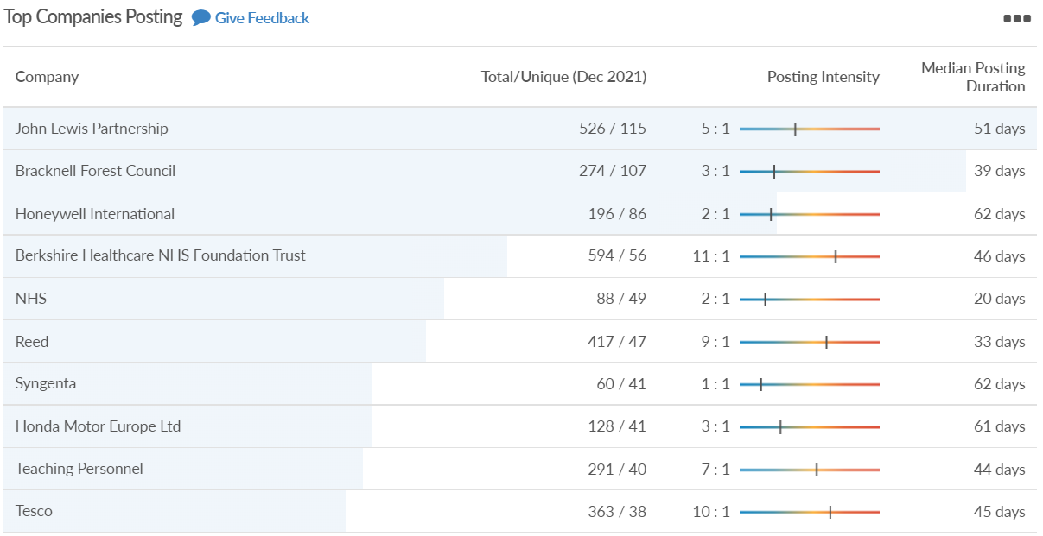
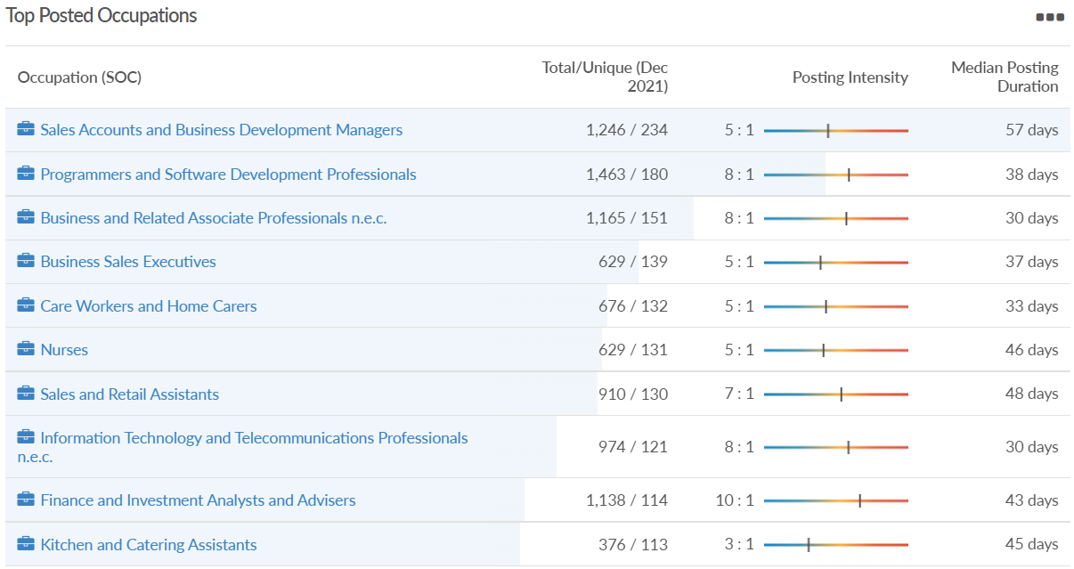
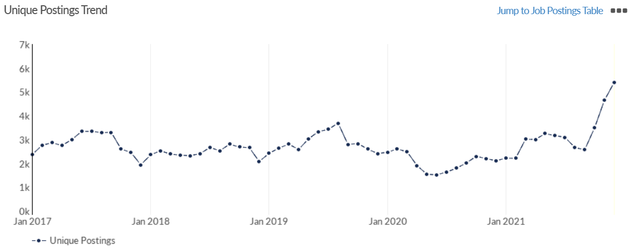
Job posting analytics (EMSI, December 2021)
Unique job postings: 5,407
Total job postings: 34,020
Job posting intensity: 6:1
Unique job postings (December 2020): 2,112

Slide 26
Slough

Slide 27
Impact of COVID-19 up to 10th January 2022
COVID-19 cases (to 10th January 2022) – Source: Public Health Berkshire COVID-19 Dashboard, 10th January 2022
35,247 total cases
284 new cases daily
Claimant unemployment (to November 2021)
6,025 claimants (6.4% of the working age population) in Slough UA
Notable business news:
An "iconic" seven-storey office block could be built in the heart of the Slough Trading Estate. Two vacant buildings dating back to the 1930s could be demolished, to make way for a “landmark” building that will host small businesses. Councillors on the council's planning committee will meet on Wednesday (December 15) to consider the application for 183-187 Liverpool Road from SEGRO. They have been recommended to defer and delegate the plans to the head of planning for approval – LINK.

Slide 28
Industries hit hardest by COVID shutdown
When compared to both Thames Valley Berkshire and Great Britain, Slough has seen a significantly lower percentage of jobs affected by COVID shutdowns – perhaps somewhat surprising given the LA’s proximity to Heathrow and the almost complete shutdown of the aviation sector.
Source: EMSI, March 2021 (definition for industries hit hardest provided on slide 51)

Slide 29
Industry risks and opportunities (2020-2021)
Critical industries
Food and drink retail: 6,656 employees (47% above the national average)
Energy/utilities: 2,820 employees (174% above the national average)
Health and social care: 8,201 employees (28% below the national average)
Freight/logistics: 4,640 employees (93% above the national average)
Insurance: 121 employees (86% below the national average)
Banking and financial services: 731 employees (65% below the national average)
Sectors most impacted
Hospitality and tourism: 3,780 employees (46% below the national average)
Arts, entertainment and recreation: 442 (79% below the national average)
Admin and support: 9,765 (107% above the national average)
Aviation: 262 employees (16% above the national average)
Non-food retail and wholesale: 6,719 (0% above the national average)
Manufacturing: 5,071 (28% below the national average)
Construction: 2,620 (36% below the national average)
Source: EMSI, January 2021

Slide 30
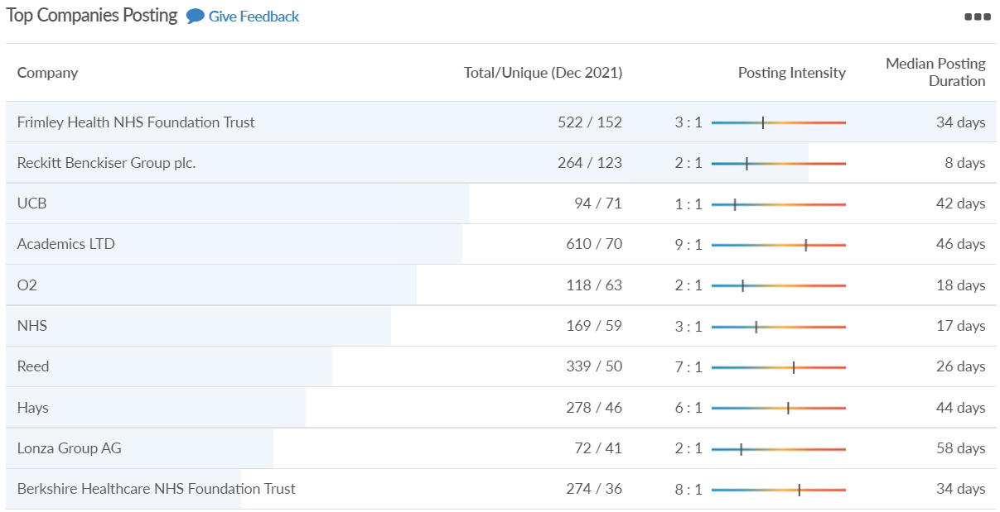
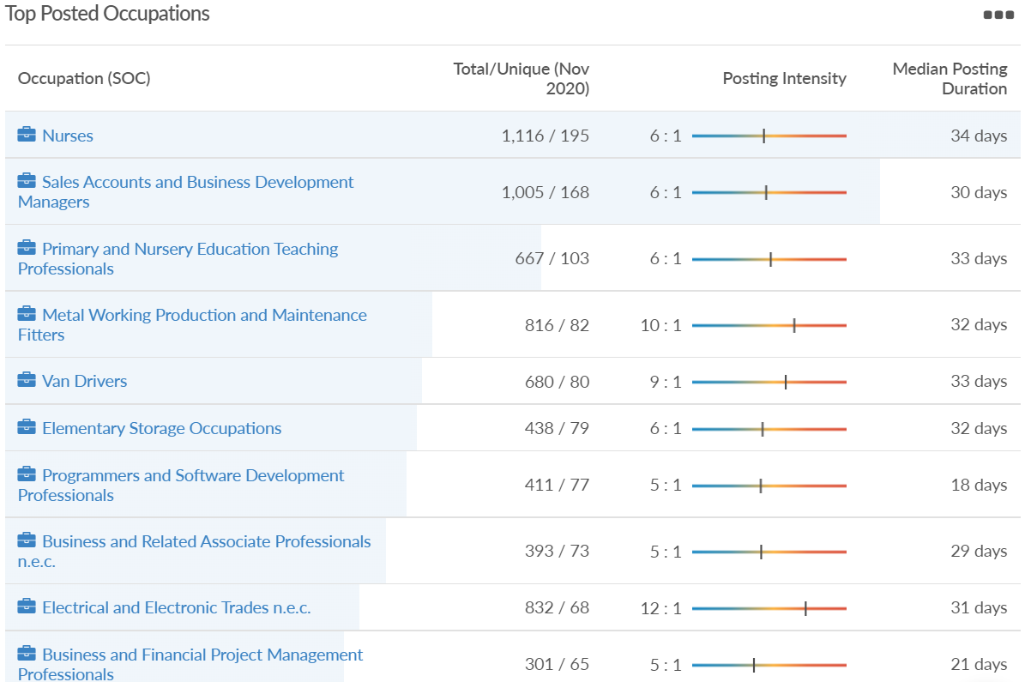
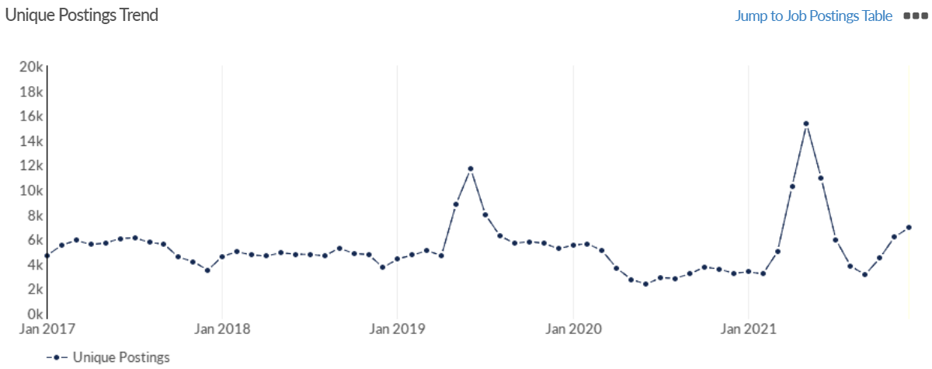
Job posting analytics (EMSI, December 2021)
Unique job postings: 6,931
Total job postings: 34,144
Job posting intensity: 5:1
Unique job postings (December 2020): 3,247

Slide 31
Reading

Slide 32
Impact of COVID-19 up to 10th January 2022
COVID-19 cases (to 10th January 2022) – Source: Public Health Berkshire COVID-19 Dashboard, 10th January 2022
35,603 total cases
211 new case daily
Claimant unemployment (to November 2021)
5,195 claimants (4.9% of the working age population) in Reading UA
Notable business news:
A consulting, technology and managed services provider has expanded with a Reading acquisition, in a move set to protect more than 100 jobs. SLR Dynamics provides digital engineering and automation services in the TMT industry. It is Prodapt's second acquisition of the year following its takeover of Silicon Valley outfit Innovative Logic in August. "I am excited to welcome Salim and the SLR Dynamics team to the Prodapt family," said Vedant Jhaver, chairman and chief executive of Prodapt. "The capabilities of SLR Dynamics in cloud, security, IoT and product design will play an important role as Prodapt continues to become the preferred digital transformation partner to the enablers of hyper-connectivity” – LINK.

Slide 33
Industries hit hardest by COVID shutdown
Reading has been marginally less affected by the COVID shutdowns as Great Britain has on average, with 15.16% of jobs within industries which have been most severely impacted by the shutdowns. The Local Authority is 1.26% better off than the average of the Thames Valley Berkshire area.
Source: EMSI, March 2021 (definition for industries hit hardest provided on slide 51)

Slide 34
Industry risks and opportunities (2020-2021)
Critical industries
Food and drink retail: 6,192 employees (11% above the national average)
Energy/utilities: 3,350 employees (163% above the national average)
Health and social care: 13,464 employees (5% below the national average)
Freight/logistics: 1,513 employees (49% below the national average)
Insurance: 2,076 employees (100% above the national average)
Banking and financial services: 1,688 employees (34% below the national average)
Sectors most impacted
Hospitality and tourism: 6,567 employees (25% below the national average)
Arts, entertainment and recreation: 1,811 (31% below the national average)
Admin and support: 9,212 (58% above the national average)
Aviation: <10 employees
Non-food retail and wholesale: 8,626 (18% above the national average)
Manufacturing: 2,000 (77% below the national average)
Construction: 2,273 (55% below the national average)
Source: EMSI, January 2021

Slide 35
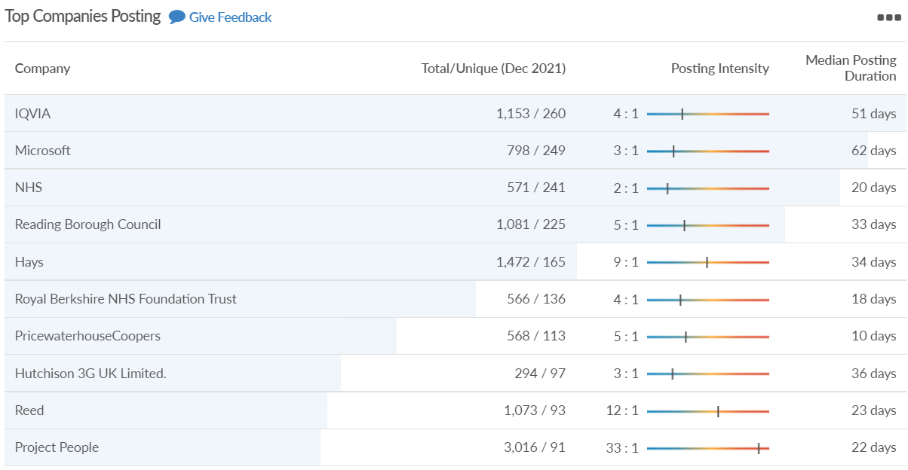
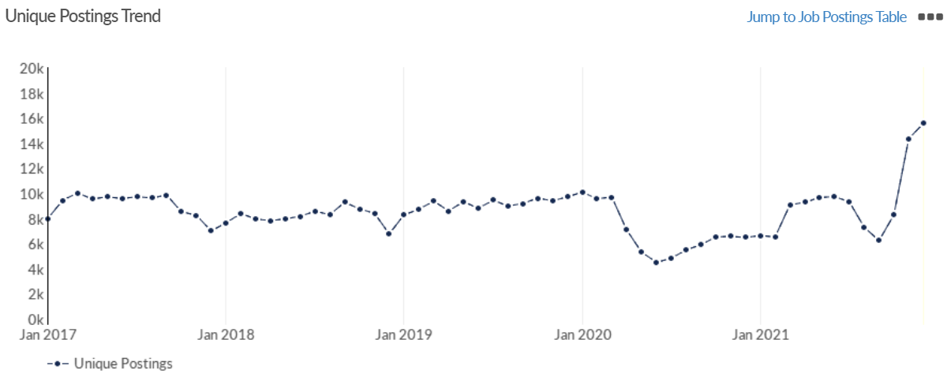
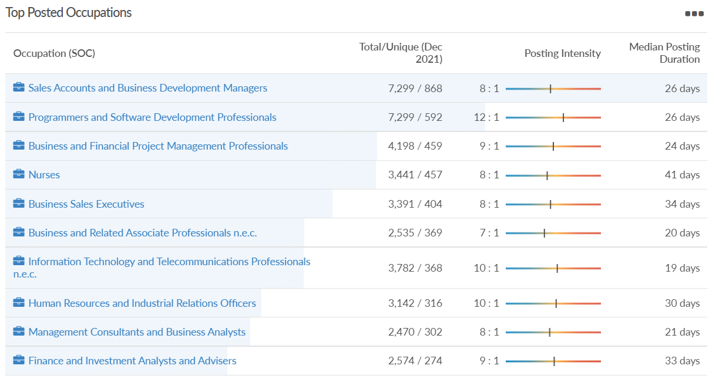
Job posting analytics (EMSI, December 2021)
Unique job postings: 15,568
Total job postings: 141,846
Job posting intensity: 9:1
Unique job postings (December 2020): 6,484

Slide 36
Wokingham

Slide 37
Impact of COVID-19 up to 10th January 2022
COVID-19 cases (to 10th January 2022) – Source: Public Health Berkshire COVID-19 Dashboard, 10th January 2022
34,930 total cases
199 new cases daily
Claimant unemployment (to November 2021)
2,175 claimants (2% of the working age population) in Wokingham UA
Notable business news:
A new medical clinic has secured premises near Wokingham with the help of the commercial property team at Thames Valley law firm Boyes Turner - Berkshire Medical Estates will operate the medical clinic from its new premises in Winnersh. The 2,500 sq. ft premises includes three clinic rooms, two treatment rooms that provide on-site medical investigations and pathology services, office space, and a reception area – LINK.

Slide 38
Industries hit hardest by COVID shutdown
Wokingham is in a similar position to Slough in that is has been significantly less affected by the COVID shutdowns than both the Thames Valley Berkshire area and Great Britain as a whole. This is likely due to the high levels of employment from the Tech sector (Microsoft etc. based at TVP) as this industry is able to work well from home.
Source: EMSI, March 2021 (definition for industries hit hardest provided on slide 51)

Slide 39
Industry risks and opportunities (2020-2021)
Critical industries
Food and drink retail: 3,883 employees (17% below the national average)
Energy/utilities: 1,434 employees (35% above the national average)
Health and social care: 7,283 employees (38% below the national average)
Freight/logistics: 886 employees (64% below the national average)
Insurance: 453 employees (48% below the national average)
Banking and financial services: 423 employees (80% below the national average)
Sectors most impacted
Hospitality and tourism: 5,410 employees (25% below the national average)
Arts, entertainment and recreation: 1,831 (16% below the national average)
Admin and support: 6,432 (33% above the national average)
Aviation: 0 employees
Non-food retail and wholesale: 6,494 (6% below the national average)
Manufacturing: 3,731 (48% below the national average)
Construction: 3,115 (26% below the national average)
Source: EMSI, January 2021

Slide 40
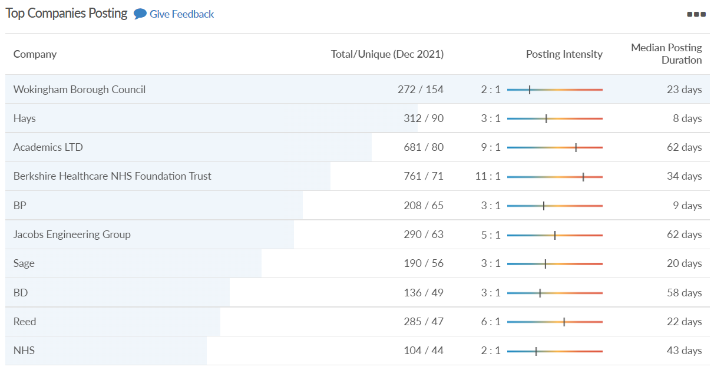
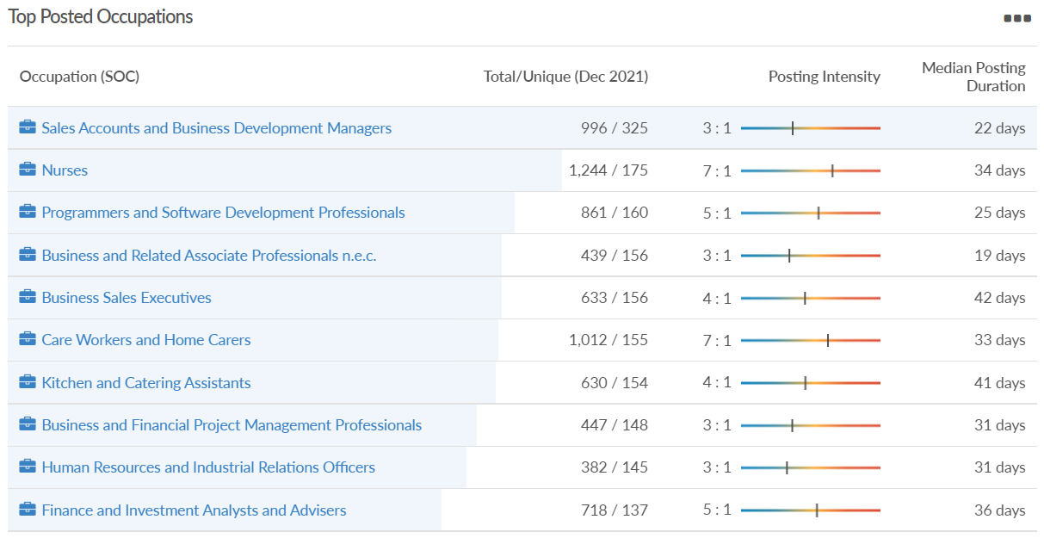
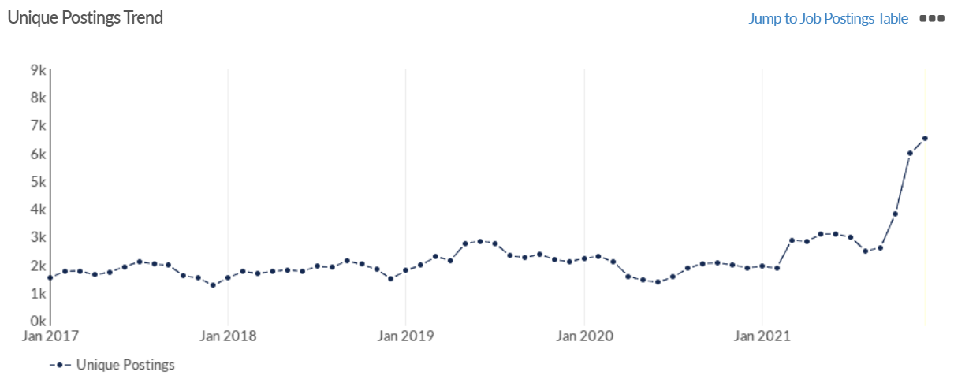
Job posting analytics (EMSI, December 2021)
Unique job postings: 6,509
Total job postings: 29,822
Job posting intensity: 5:1
Unique job postings (November 2020): 1,881

Slide 41
Windsor and Maidenhead

Slide 42
Impact of COVID-19 up to 10th January 2022
COVID-19 cases (to 10th January 2022) – Source: Public Health Berkshire COVID-19 Dashboard, 10th January 2022
32,174 total cases
248 new cases daily
Claimant unemployment (to November 2021)
2,695 claimants (2.9% of the working age population) in Windsor and Maidenhead UA
Notable business news:
Accountancy firm MHA has opened a new office at Foundation Park in Maidenhead. The new Thames Valley office will have eight partners and over 80 members of staff. The firm has had offices in the Thames Valley since 1900 and has clients in Reading, Windsor, Slough and High Wycombe from sectors such as technology, manufacturing and engineering, property and construction, pharma and life sciences, professional practices, not-for-profit, media and entertainment and motor. MHA works in partnership with the Baker Tilly network and has expanded its expertise in areas such as sustainability and ESG (Environmental, Social and Governance) – LINK.

Slide 43
Industries hit hardest by COVID shutdown
Windsor and Maidenhead appears to be the most severely affected of all the Local Authorities which make up Berkshire in terms of percentage of jobs hit hardest by the COVID shutdowns. This is likely due in part to the enormous hit the leisure/tourism sector has taken and how key of an employer Legoland Windsor to the region.
Source: EMSI, March 2021 (definition for industries hit hardest provided on slide 51)

Slide 44
Industry risks and opportunities (2020-2021)
Critical industries
Food and drink retail: 3,733 employees (17% below the national average)
Energy/utilities: 882 employees (13% below the national average)
Health and social care: 8017 employees (29% below the national average)
Freight/logistics: 748 employees (68% below the national average)
Insurance: 434 employees (48% below the national average)
Banking and financial services: 1,252 employees (39% below the national average)
Sectors most impacted
Hospitality and tourism: 9,437 employees (35% above the national average)
Arts, entertainment and recreation: 4,516 (117% above the national average)
Admin and support: 4,207 (10% below the national average)
Aviation: 11 employees (95% below the national average)
Non-food retail and wholesale: 7,834 (18% above the national average)
Manufacturing: 2,523 (64% below the national average)
Construction: 6,201 (54% above the national average)
Source: EMSI, January 2021

Slide 45
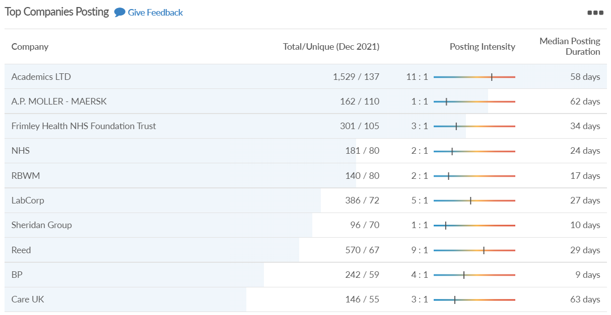
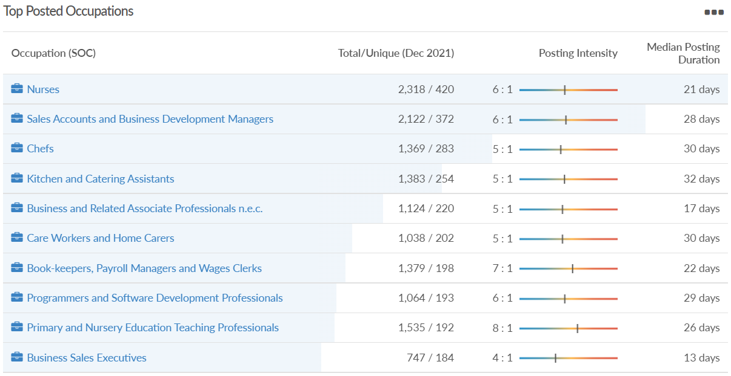
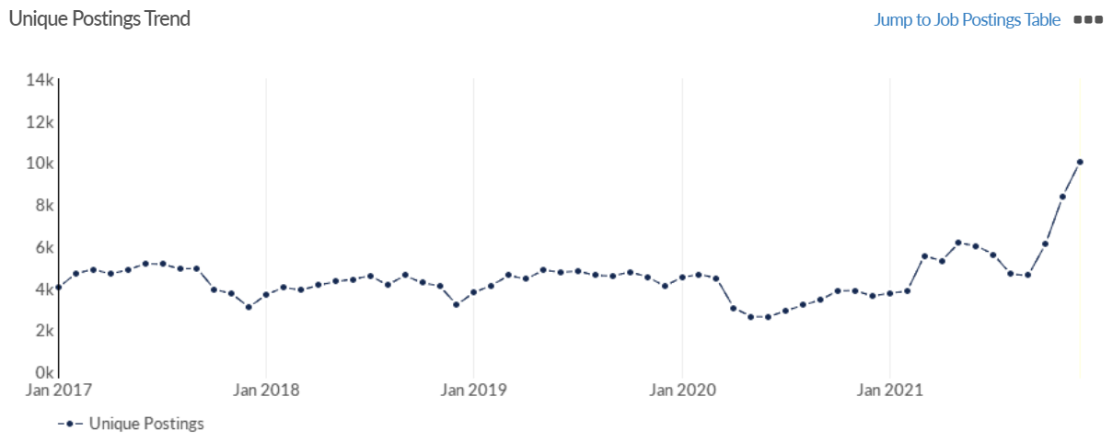
Job posting analytics (EMSI, December 2021)
Unique job postings: 10,040
Total job postings: 61,678
Job posting intensity: 6:1
Unique job postings (December 2020): 3,611

Slide 46
West Berkshire

Slide 47
Impact of COVID-19 up to 10th January 2022
COVID-19 cases (to 10th January 2021) – Source: Public Health Berkshire COVID-19 Dashboard, 10th January 2021
28,788 total cases
187 new case daily
Claimant unemployment (to November 2021)
2,675 claimants (2.8% of the working age population) in West Berkshire UA
Notable business news:
Azets, the regional accountancy and business advisor to SMEs, has relocated its Newbury staff to new offices in London Road, Newbury, just across from its previous site, in order to capitalise on the booming local economy. The new Newbury office opens after a refurbishment costing around £350,000 and extends to over 6,000 square feet. In addition to the new imminent recruits to the office of the three new Partners and a new Tax Director, the business plans to employ around 65 staff in Newbury over the next 12 months, to join the existing 53 employees who already include two Partners and a Director. The Azets satellite office in Reading offers accountancy and business advice for equine companies and corporate tax support – LINK.

Slide 48
Industries hit hardest by COVID shutdown
While West Berkshire hasn’t been as fortunate as Slough in terms of how great of a percentage of jobs have been directly affected by the COVID shutdown, it has fared significantly better than the Thames Valley Berkshire area and better than Great Britain.
Source: EMSI, March 2021 (definition for industries hit hardest provided on slide 51)

Slide 49
Industry risks and opportunities (2020-2021)
Critical industries
Food and drink retail: 4,289 employees (17% below the national average)
Energy/utilities: 1,343 employees (14% above the national average)
Health and social care: 6,773 employees (48% below the national average)
Freight/logistics: 1,574 employees (43% below the national average)
Insurance: 262 employees (73% below the national average)
Banking and financial services: 692 employees (71% below the national average)
Sectors most impacted
Hospitality and tourism: 6,617 employees (18% below the national average)
Arts, entertainment and recreation: 2,674 (10% above the national average)
Admin and support: 4,803 (11% below the national average)
Aviation: <10 employees
Non-food retail and wholesale: 8,432 (9% above the national average)
Manufacturing: 11,330 (41% above the national average)
Construction: 4,813 (3% above the national average)
Source: EMSI, January 2021

Slide 50
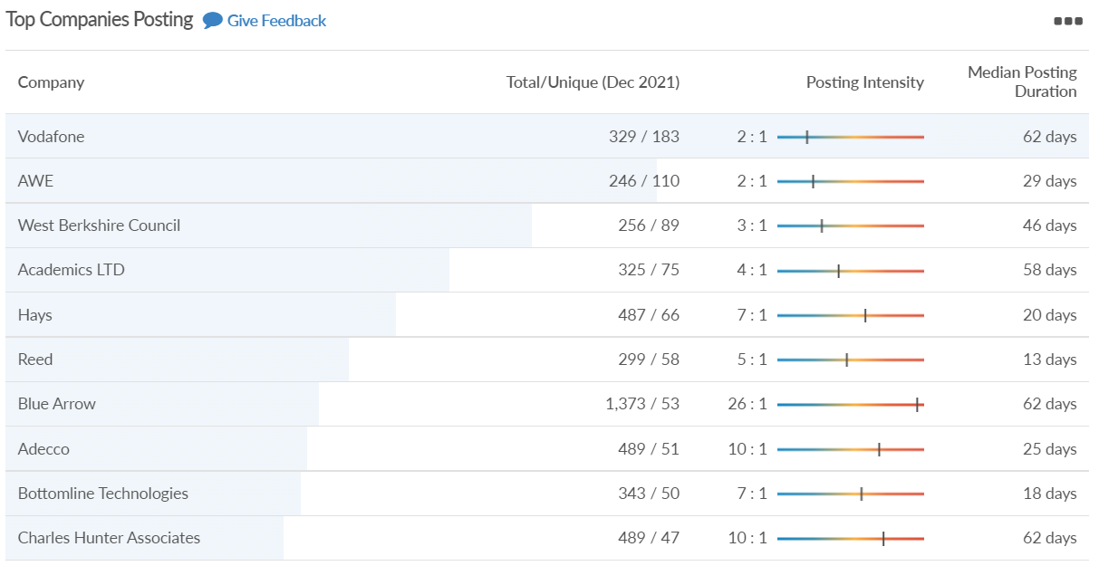
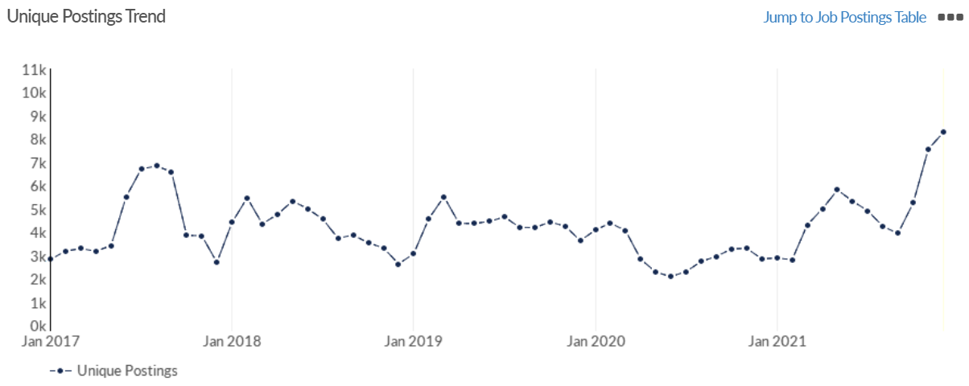
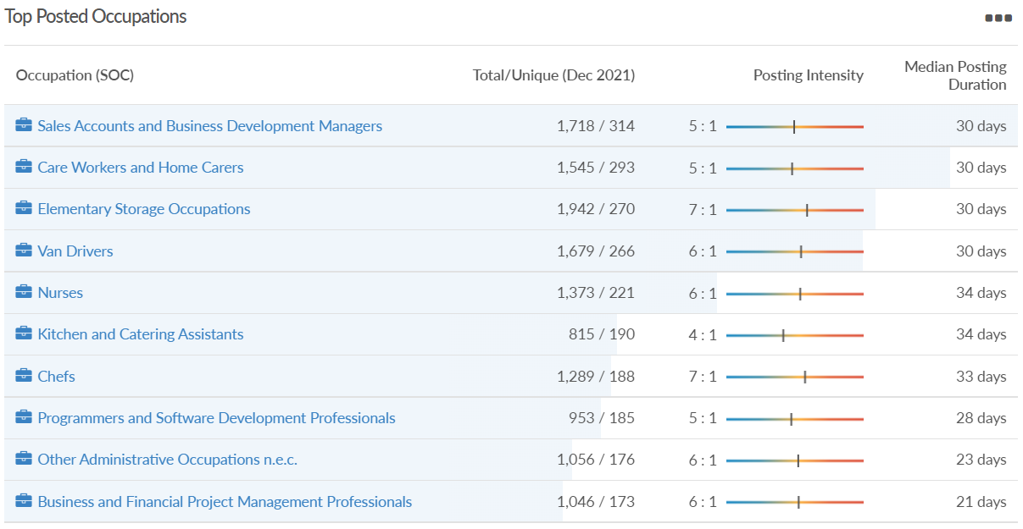
Job posting analytics (EMSI, December 2021)
Unique job postings: 8,286
Total job postings: 46,067
Job posting intensity: 6:1
Unique job postings (December 2020): 2,852

Slide 51
Definitions
Source: Institute for Fiscal Studies, April 2020

