Slide 1
Thames Valley Berkshire Monthly Economic Briefing
March 2022

Slide 2
2022 Refresh
Following on from stakeholder feedback as well as discussions within the LEP over the course of the last year, we have decided to make some additions to the content of our economic briefings, whilst still continuing to report on the bulk of the areas we were last year.
Each month, we aim to have a themed feature. This month we will be looking at the Spring Statement and Office for Budget Responsibility (OBR) Economic and Fiscal Outlook.
These monthly economic briefings are constantly evolving documents and their content is dictated in part by data/information requests from our readers.
If there is an economic aspect not currently covered within these reports which you think would be beneficial to include/expand upon (or you have any queries), we will do our best to help. Please contact Dex in the LEP’s research team at dexterlevick@thamesvalleyberkshire.co.uk.

Slide 3
Key contents of this month’s briefing
Updated global and UK economic forecasts
Monthly Event Spotlight – Spring Statement and Office for Budget Responsibility (OBR) Economic and Fiscal Outlook, 23rd March 2022 – A roundup by Thames Valley Berkshire Local Enterprise Partnership
Key points from the latest Labour Force Survey data
Latest claimant count figures by Local Authority
Latest remote working figures for Thames Valley Berkshire
Latest ‘notable business news’ by Local Authority
Latest job posting analytics by Local Authority

Slide 4
Global and National Economy
March 2022

Slide 5
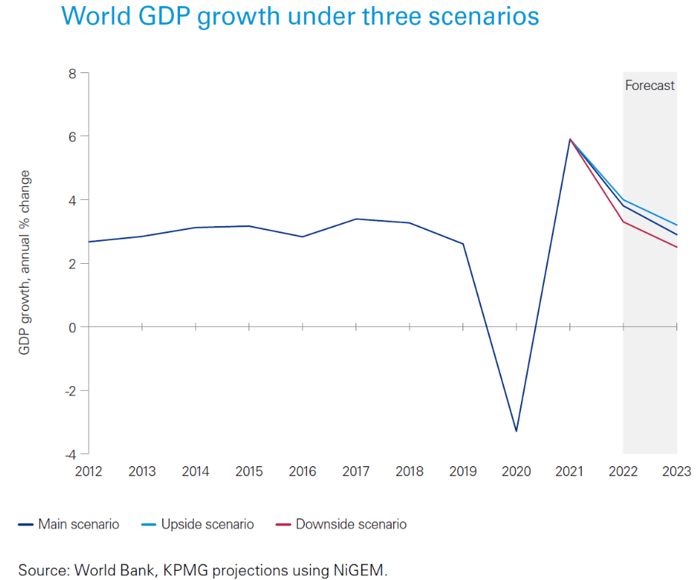
Global Economy
Global growth outlook
The outlook for the next two years will depend on how the conflict between Russia and Ukraine evolves. KPMG’s Global Economic Outlook has developed three scenarios to examine the prospects for the world economy:
The main scenario assumes that world oil prices will be US$30 higher than their path prior to the escalation of the crisis, while gas prices will be 50% higher across Europe.
A more severe scenario looks at the potential impact with world oil prices US$40 higher together with a 100% rise in gas prices for Europe and 50% rise in gas prices for the rest of the world.
The report’s upside scenario looks at the possible outcome should the conflict resolve sooner than anticipated.
The report’s analysis found that global GDP growth could range between 3.3%-4% this year and between 2.5%-3.2% in 2023, depending on the scenario.
Source: KPMG, March 2022

Slide 6
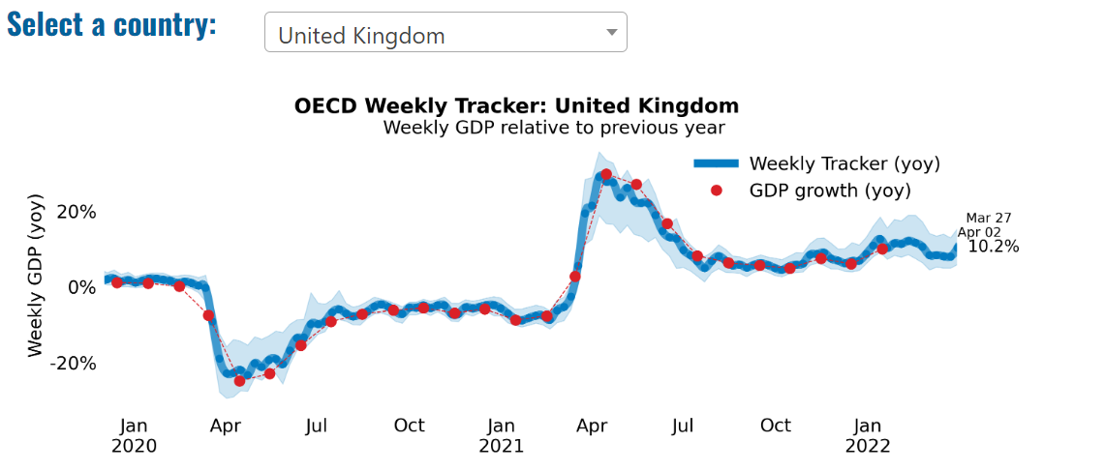
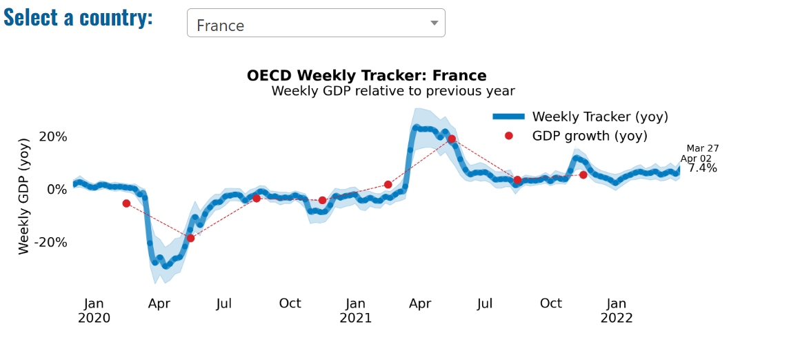
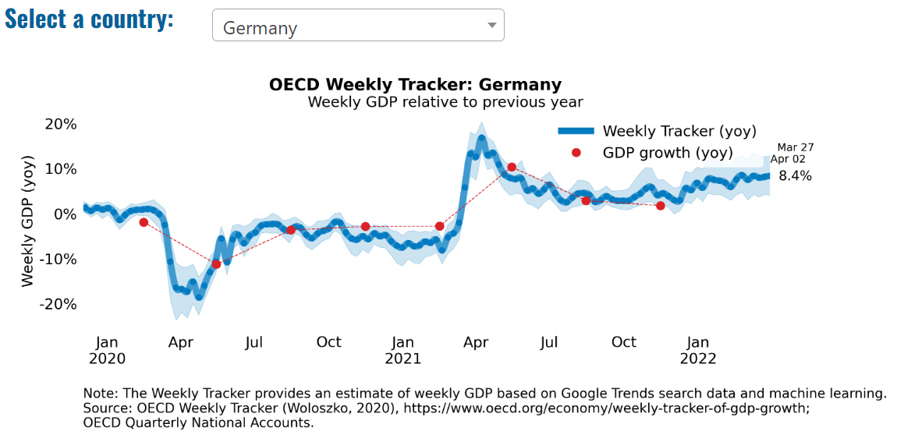
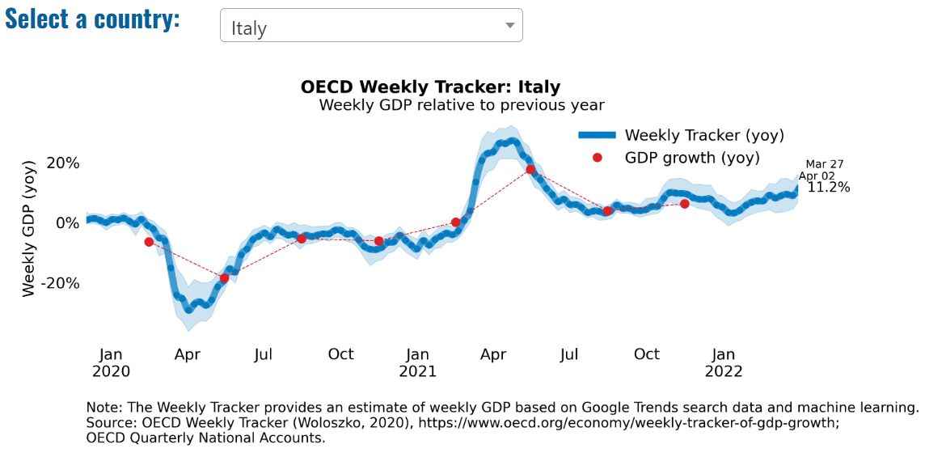
Global Economy – OECD GDP Tracker

Slide 7
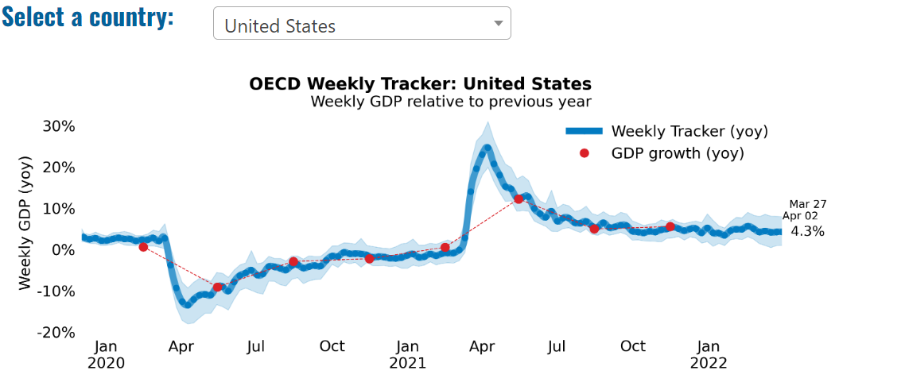
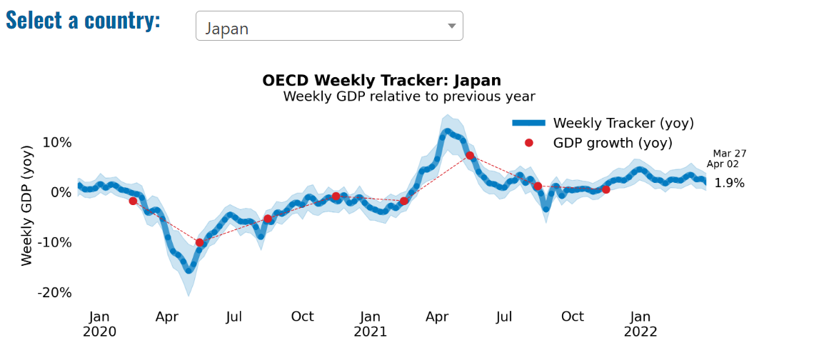
Global Economy – OECD GDP Tracker Continued
Note: The green confidence band shows 95% confidence intervals. The Weekly Tracker is an estimate of weekly GDP relative to the pre-crisis trend, which is proxied by the November 2019 OECD Economic Outlook forecasts. The darkness of the grey background reflects stay-at-home confinement requirement based on the Oxford Blavatnik database (0 - no measures, 1 - recommend not leaving house, 2 - require not leaving house with exceptions, 3 - require not leaving house with minimal exceptions).
Source: OECD, March 2022

Slide 8
UK Economy
Two years since the start of the pandemic, the OBR’s Economic and fiscal outlook (EFO) is presented against the backdrop of another unfolding global shock. The Russian invasion of Ukraine has major repercussions for the global economy, whose recovery from the worst of the pandemic was already being buffeted by Omicron, supply bottlenecks, and rising inflation. A fortnight into the invasion, gas and oil prices peaked over 200 and 50 per cent above their end-2021 levels respectively. Prices have since fallen back but remain well above historical averages.
As a net energy importer with a high degree of dependence on gas and oil to meet its energy needs, higher global energy prices will weigh heavily on a UK economy that has only just recovered its pre-pandemic level. Petrol prices are already up a fifth since our October forecast and household energy bills are set to jump by 54 per cent in April. If wholesale energy prices remain as high as markets expect, energy bills are set to rise around another 40 per cent in October, pushing inflation to a 40-year high of 8.7 per cent in the fourth quarter of 2022
Higher inflation will erode real incomes and consumption, cutting GDP growth this year from 6.0 per cent in our October forecast to 3.8 per cent.
With inflation outpacing growth in nominal earnings and net taxes due to rise in April, real livings standards are set to fall by 2.2 per cent in 2022-23 – their largest financial year fall on record – and not recover their pre-pandemic level until 2024-25.
Source: OBR, March 2022

Slide 9
UK Economy 2
The British Chambers of Commerce has downgraded its expectations for UK GDP growth in 2022 to 3.6%, from 4.2% in its previous forecast in December 2021 and less than half the growth of 7.5% recorded last year. The downgrade largely reflects a deteriorating outlook for consumer spending and a weaker than expected rebound in business investment:
Consumer spending is forecast to grow at 4.4% in 2022, down from its previous forecast of 6.9%. The downgrade reflects the historic squeeze on real household incomes from high inflation. Inflation is projected to outpace wage growth until Q2 2024, maintaining the squeeze on household finances. Weakening consumer confidence is expected to limit households’ willingness to support spending by running down savings built-up during Covid.
Business investment is forecast to grow at 3.5% in 2022. This is down from the previous forecast of 5.1% and materially lower than the Bank of England’s latest projection of 13.75%. The downgrade reflects the expected weakening in investment intentions from rising cost pressures, higher taxes and weakening confidence amid deteriorating UK and global outlooks, including the current impact of Russia’s invasion of Ukraine.
Source: British Chambers of Commerce, March 2022

Slide 10
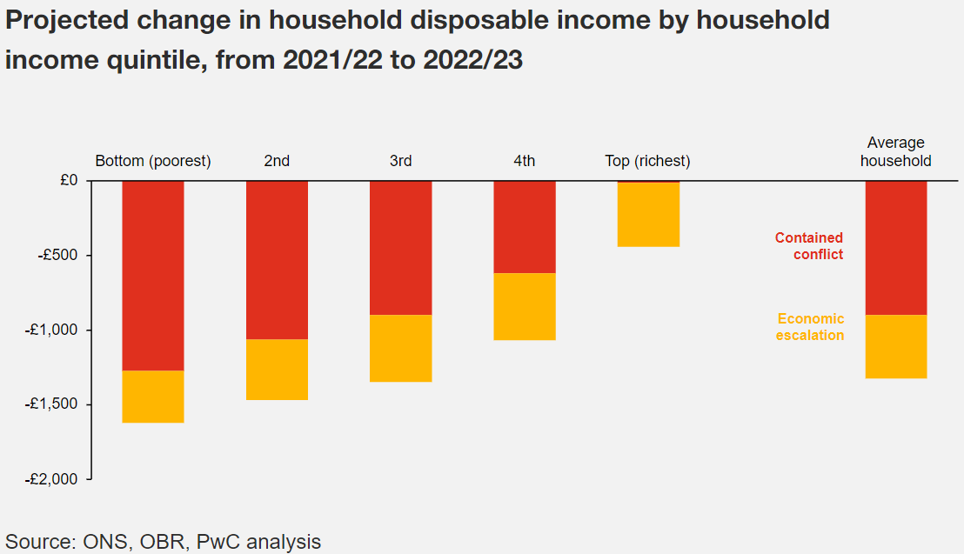
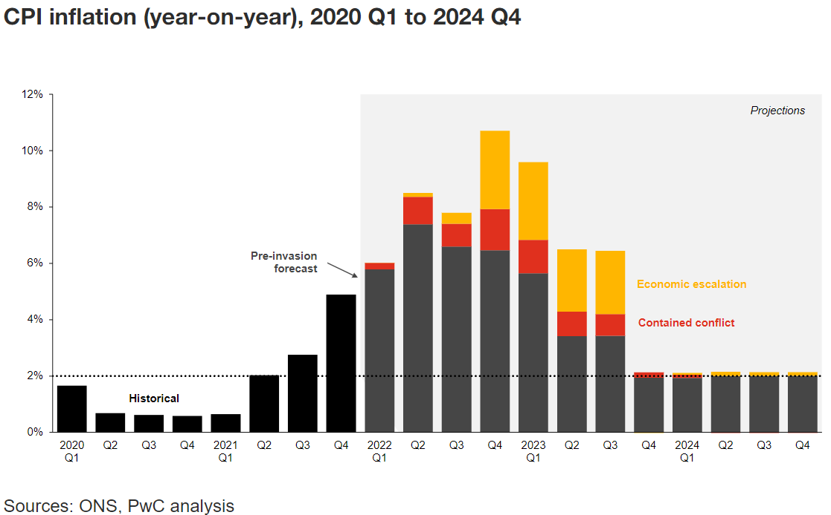
UK Economy 3
UK growth outlook:
The UK growth outlook has deteriorated. Our outlook is based on two scenarios with different assumptions on how our reliance on Russian crude oil and natural gas will be resolved, along with more detailed assumptions on military performance and the nature of economic sanctions.
Contained conflict scenario: assumes there are no further sanctions imposed on Russia.
Economic escalation scenario: assumes further sanctions are imposed on Russia, leading to a dramatic restriction of crude oil and natural gas imports into the EU.
Depending on the scenario, we expect UK GDP growth to average between 2.8% - 3.8% this year, compared to a previous consensus GDP growth of 4.5%.
UK inflation outlook:
Contained conflict scenario: the war in Ukraine adds an extra one percentage point to our average annual inflation projection
Economic escalation scenario: UK inflation hits a 40 year high of around 11% in Q4 2022, with the energy price cap to increase by around 75%.

Slide 11
Monthly Event Spotlight: Spring Statement 23rd March 2022
23 March 2022 saw the Chancellor of the Exchequer, Rishi Sunak, deliver his Spring Statement. On the same day, the Office for Budget Responsibility (OBR) published its Economic and Fiscal Outlook for March 2022. The Spring Statement says:
“The sanctions and strong response by the UK and its allies are vital in supporting the Ukrainian people, but these decisions will inevitably have an adverse effect on the UK economy and other economies too. Higher than expected global energy and goods prices have already led to an unavoidable increase in the cost of living in the UK. The repercussions of Putin’s invasion of Ukraine will add to these pressures and increase inflation further in the coming months, with the long-term consequences not yet being clear.”
The Spring Statement argues that the UK has enjoyed a quicker than expected recovery and a strong labour market, with the total number of payrolled employees now over 600,000 above pre-pandemic levels. Tax receipts have been stronger than expected, which has contributed to borrowing falling this year and over the forecast period.

Slide 12
Monthly Event Spotlight: Spring Statement 23rd March 2022
Referring to the cost-of-living crisis, the Spring Statement says the Government is taking further action in the Spring Statement to help households:
A temporary 12-month cut will be introduced to duty on petrol and diesel of 5p per litre, representing a saving worth around £100 for the average car driver, £200 for the average van driver, and £1500 for the average haulier, when compared with uprating fuel duty in 2022-23.
The government will expand the scope of VAT relief available for energy saving materials and ensure that households having energy saving materials installed pay 0% VAT.
The Spring Statement builds on previously announced support for SMEs, including business rates relief worth £7 billion over the next five years; increasing the Annual Investment Allowance from £200,000 to £1 million until March 2023; subsidising the cost of high-quality training through the Help to Grow: Management scheme; and helping firms to adopt new digital technologies with Help to Grow: Digital.
Businesses will also benefit from the cut to fuel duty, and the Employment Allowance will increase to £5,000 from April – a tax cut of up to £1,000 for around half a million small businesses.

Slide 13
Monthly Event Spotlight: Spring Statement 23rd March 2022
The Spring Statement sets out the government’s plans to reform and reduce taxes. This will be done in three ways:
Increasing the annual National Insurance Primary Threshold and Lower Profits Limit from £9,880 to £12,570, from July 2022. This aligns the Primary Threshold and Lower Profits Limit with the income tax personal allowance. This will help almost 30 million working people, with a typical employee benefitting from a tax cut worth over £330 in the year from July.
Boosting productivity and growth by creating the conditions for the private sector to invest more, train more and innovate more – fostering a new culture of enterprise. To do this, the government intends to cut and reform business taxes, to create a culture of enterprise and the conditions for private sector-led growth. Following consultation with business, more details will become available in the Autumn.
The government will reduce the basic rate of income tax to 19% from April 2024. This is a tax cut of over £5 billion a year and represents the first cut in the basic rate of income tax in 16 years.

Slide 14
Monthly Event Spotlight: Spring Statement 23rd March 2022
Speaking at the Institute for Fiscal Studies’ (IFS) post-Spring Statement briefing on the day after the statement (24 March), the IFS Director, Paul Johnson, said that the Chancellor had proved to be something of a ‘fiscal illusionist’; the spring statement contained big new tax cuts, but had also allowed taxes to rise.
Robert Joyce described how the Spring Statement changes real post-tax incomes over the coming financial year: a median earner (£27.5k per year) would be 1.6% worse off; a 75th percentile earner (£41.6k per year) would be 2.5% worse off. A full-time worker on the National Living wage (£16.2k per year) would be 0.9% better off, but a full-time worker on the National Living Wage and Universal Credit would be 2.4% worse off.
Speaking at the Resolution Foundation on the morning after the Spring Statement, James Smith, its Research Director, said that typical incomes will fall by over £1,000 next year. This was nearly four per cent of typical incomes. There would be a large rise in poverty; society generally expects absolute poverty to fall over time, but we are now looking at a rise of about 1.3 million people in poverty, including half a million children.
Robert Peston, Political Editor of ITV, told the Resolution Foundation that we face bigger economic uncertainties than at any time in his adult life. A big question for him was: are we seeing a big structural change to the balance of the global economy, in which case this rise in inflation is a one-off adjustment, albeit a painful one, or do we face a more prolonged problem over time?

Slide 15
Employment in the UK: Labour Force Survey – March 2022
Key points:
November 2021 to January 2022 estimates show a continuing recovery in the labour market compared with the previous three-month period (August to October 2021), with an increase in the employment rate and a decrease in the unemployment rate, while economic inactivity increased on the quarter.
Total hours worked increased compared with the previous three-month period but are still below pre-coronavirus (COVID-19) pandemic levels.
The UK employment rate was estimated at 75.6%, 0.1 percentage points higher than the previous three-month period, but 1.0 percentage points lower than before the coronavirus pandemic (December 2019 to February 2020).
The UK unemployment rate was estimated at 3.9%, 0.2 percentage points lower than the previous three-month period, and returning to pre-coronavirus pandemic levels.
The UK economic inactivity rate was estimated at 21.3%, 0.1 percentage points higher than the previous quarter, and 1.1 percentage point higher than before the coronavirus pandemic.
Source: ONS, March 2022

Slide 16
Coronavirus and Recession: Implications for Thames Valley Berkshire

Slide 17
Claimant Count (Latest data - March 2022)
Total of 18,780 claimants (3.3% of the working age population) in Thames Valley Berkshire
1,865 claimants (2.3% of the working age population) in Bracknell Forest UA
5,565 claimants (5.9% of the working age population) in Slough UA
4,640 claimants (4.4% of the working age population) in Reading UA
1,850 claimants (1.7% of the working age population) in Wokingham UA
2,415 claimants (2.6% of the working age population) in Windsor and Maidenhead UA
2,445 claimants (2.5% of the working age population) in West Berkshire UA
Across Thames Valley Berkshire, claimant unemployment has fallen significantly from 30,830 in March 2021 to 18,780 in March 2022. Slough had 5.9% of its working age population claim unemployment in March 2022, down significantly from 9% in March 2021.
Source: ONS, March 2022

Slide 18
Strategic Issues: Heathrow
Heathrow Airport:
Heathrow Airport has recorded its busiest month since the start of the coronavirus pandemic. The west London airport said it was used by 4.2 million passengers in March. This represents nearly an eight-fold increase on the total during the same month in 2021.
A spike in coronavirus-related staff absences, combined with difficulties finding and passing security checks for new recruits, means the aviation sector has struggled to cope with the number of people flying in recent weeks. Heathrow admitted “resources are stretched” but described how it is “working closely with airlines and ground handlers to make sure this increase in demand can be met while keeping passengers safe”.
Chief executive John Holland-Kaye said: “It is fantastic to see the airport coming back to life after two years, and I want to thank all team Heathrow colleagues for working together to serve our passengers. “Everyone at Heathrow is doing everything we can to make sure passengers get on their way as smoothly and safely as possible.” The rise in passengers was attributed to the Government’s removal of all coronavirus travel restrictions.
Source: Yahoo News, April 2022

Slide 19
An important note on the EMSI figures contained on the following slides: 20, 24, 27, 30, 33, 36 and 39
From February 2022, there has been a methodological change in how EMSI calculates job posting figures compared to those from prior months following a merger between EMSI and Burning Glass Technologies.
Those of you who have read previous economic briefings from Thames Valley Berkshire LEP may notice that the job posting figures contained in post-January 2022 briefings are lower across the board – in some cases quite significantly.
This change in methodology does not invalidate previous figures, but it is important to consider when reporting on job posting data longitudinally.

Slide 20
Remote working
In March of 2022, there were 5,035 unique job postings for remote positions at companies based in Berkshire, around 57% more than the figure of 3,204 for the same period one year before.
Compare this with the South-East, in March 2022 there were 27,983 unique remote job postings for remote positions; rising from 17,552 in March of the previous year – an increase of over 59%.
A rise can also be seen at national level, with a recorded 198,483 unique remote job postings in England in March of 2022, rising from 116,173 in March 2021 – an increase of over 70%.
From these figures it’s apparent that the COVID-19 pandemic has, somewhat unsurprisingly, prompted a massive boost in job postings for explicitly remote roles. Berkshire has seen a smaller boost in vacancies which are remote-based than both the South-East and England.
Source: EMSI, March 2022

Slide 21
Local Profiles

Slide 22
Bracknell Forest

Slide 23
Impact of COVID-19 up to 11th April 2022
COVID-19 cases (to 11th April 2022) – Source: Public Health Berkshire COVID-19 Dashboard, 11th April 2022
41,738 total cases
187 new cases daily
Claimant unemployment (to March 2022)
1,865 claimants (2.3% of the working age population) in Bracknell Forest UA
Notable business news:
Construction work to develop the new Binfield Community and Health Hub is now underway. The development of the site, being undertaken by Osborne, will see a double height hall, multi-use meeting and activity space, GP consultation and examination rooms and minor procedures room being built in the heart of the Blue Mountain site in Binfield. – LINK.

Slide 24
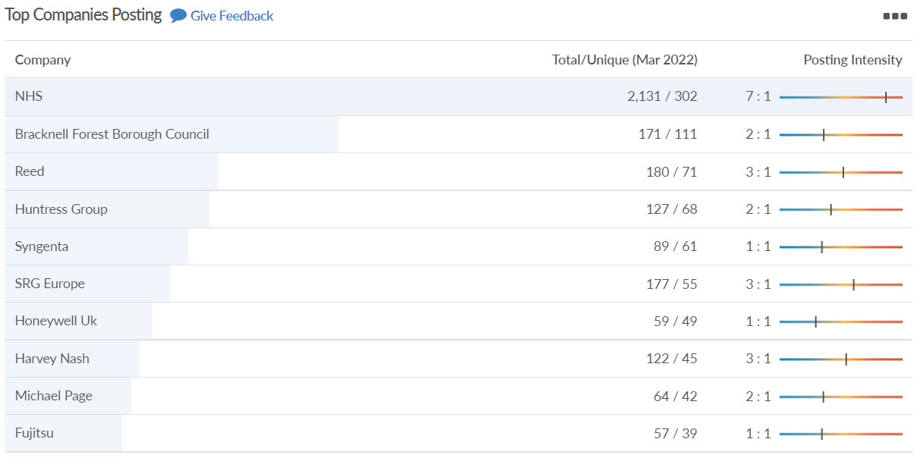
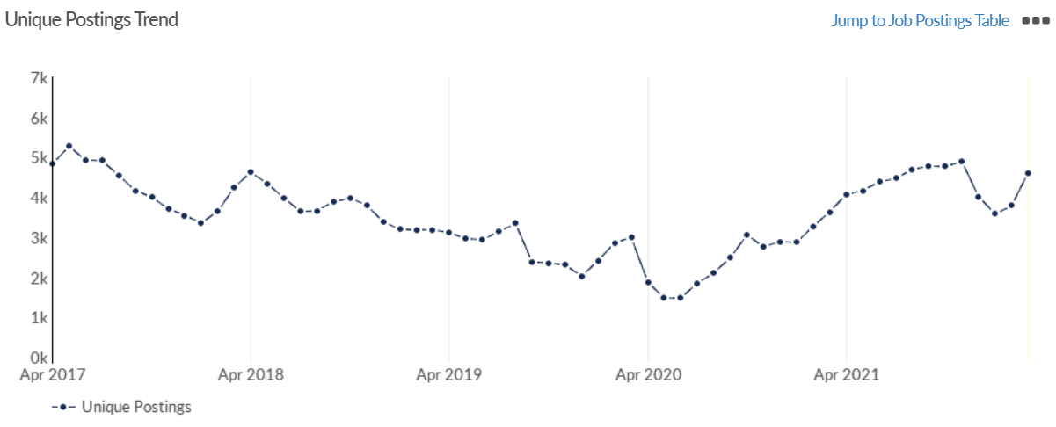
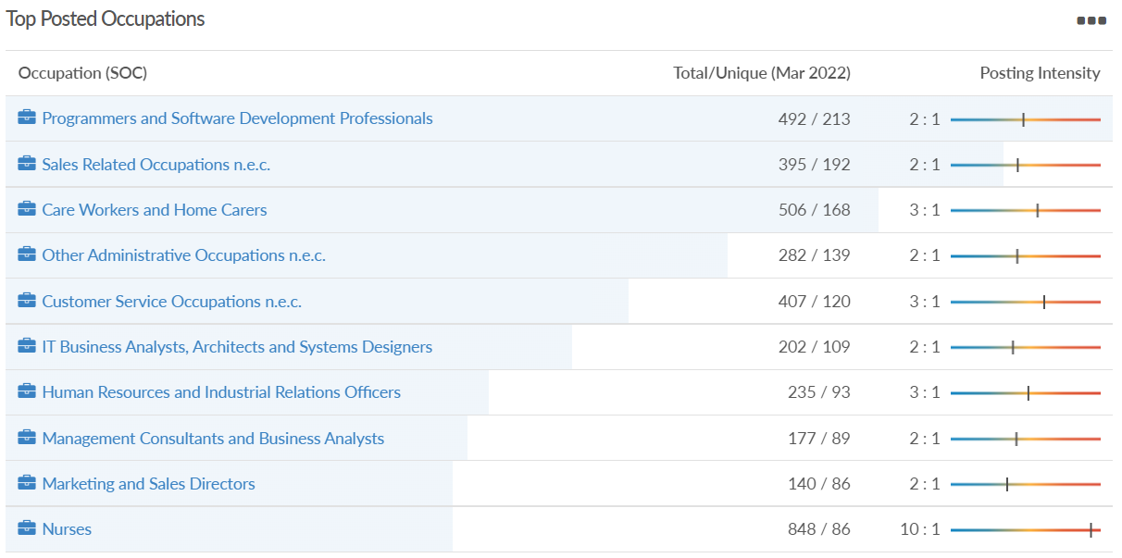
Job posting analytics (EMSI, March 2022)
Unique job postings: 4,611
Total job postings: 11,047
Job posting intensity: 2:1
Unique job postings (March 2021): 3,630

Slide 25
Slough

Slide 26
Impact of COVID-19 up to 11th April 2022
COVID-19 cases (to 11th April 2022) – Source: Public Health Berkshire COVID-19 Dashboard, 11th April 2022
51,067 total cases
96 new cases daily
Claimant unemployment (to March 2022)
5,565 claimants (5.9% of the working age population) in Slough UA
Notable business news:
AkzoNobel has opened a £10m global research and development centre at its Slough site. The facility – home to 120 specialists – will act as a major hub within the company's worldwide R&D network and help to further advance AkzoNobel's innovation capabilities, especially in the area of decorative paints. – LINK.

Slide 27
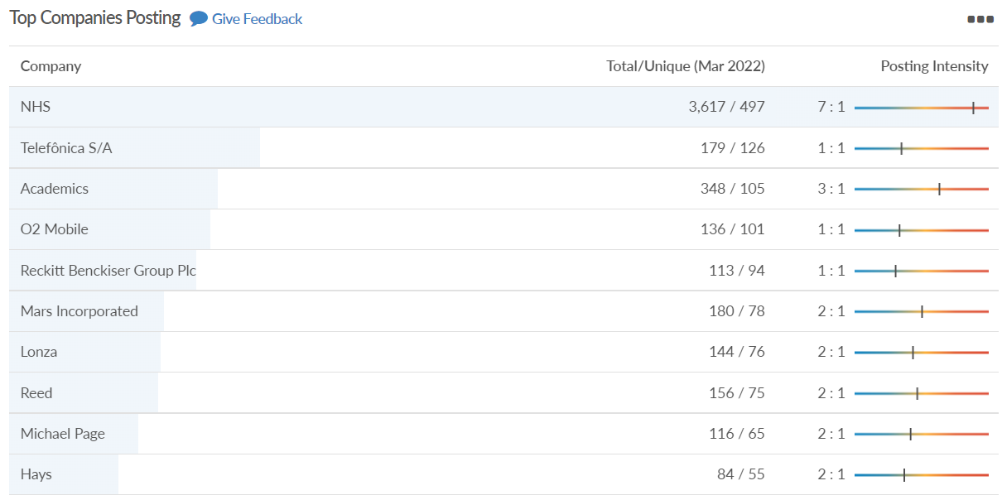
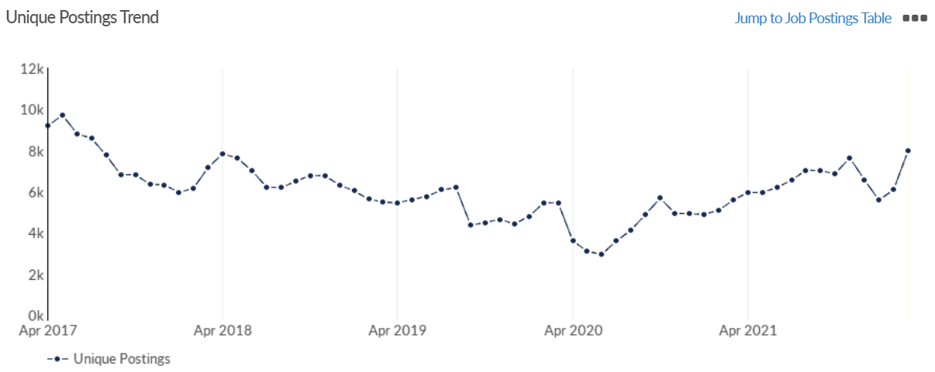
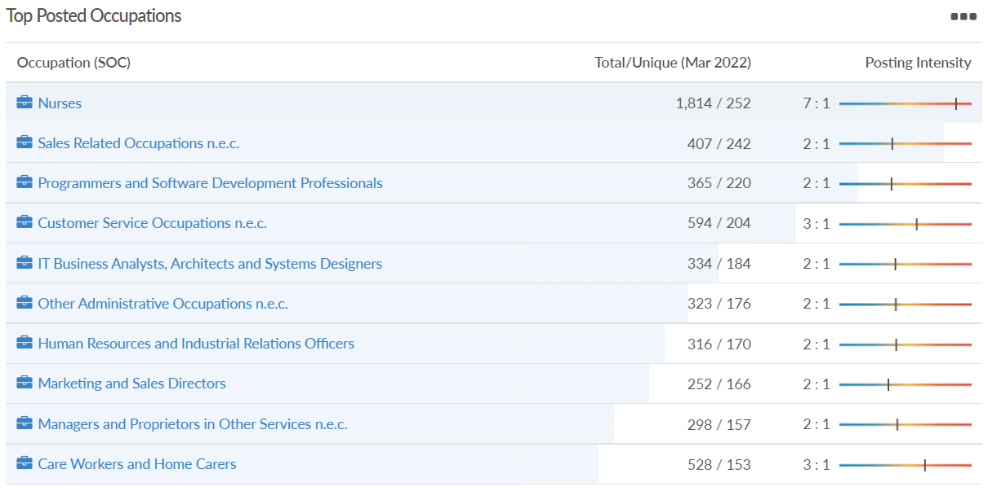
Job posting analytics (EMSI, March 2022)
Unique job postings: 7,973
Total job postings: 18,220
Job posting intensity: 2:1
Unique job postings (March 2021): 5,585

Slide 28
Reading

Slide 29
Impact of COVID-19 up to 11th April 2022
COVID-19 cases (to 11th April 2022) – Source: Public Health Berkshire COVID-19 Dashboard, 11th April 2022
56,299 total cases
256 new case daily
Claimant unemployment (to March 2022)
4,640 claimants (4.4% of the working age population) in Reading UA
Notable business news:
A consortium, led by Reading-based Altitude Angel, and which includes BT, other private sector businesses as well as local authorities in some of those areas, has bid for cash from Innovate UK’s Future Flight Challenge to create Project Skyway, a 165-mile route linking all those centres for drone deliveries to operate in. If the funding is approved there is an option to extend the superhighway to Southampton and Ipswich. As well as commercial uses, the drone superhighway would be used for medical deliveries such as the transfer of time-critical organs and medicines – LINK.

Slide 30
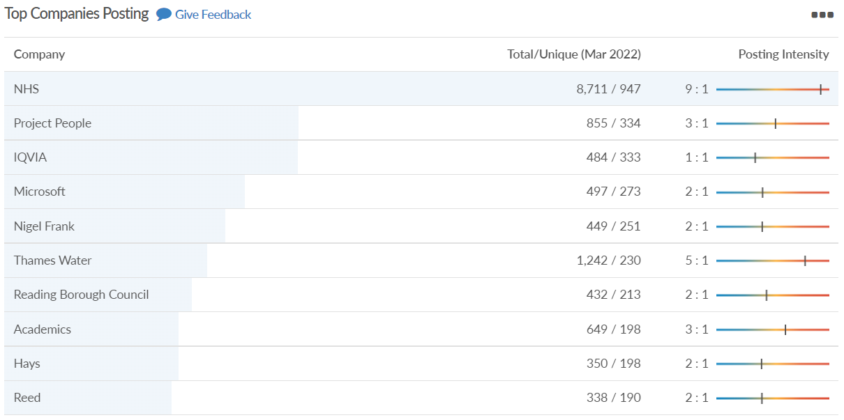
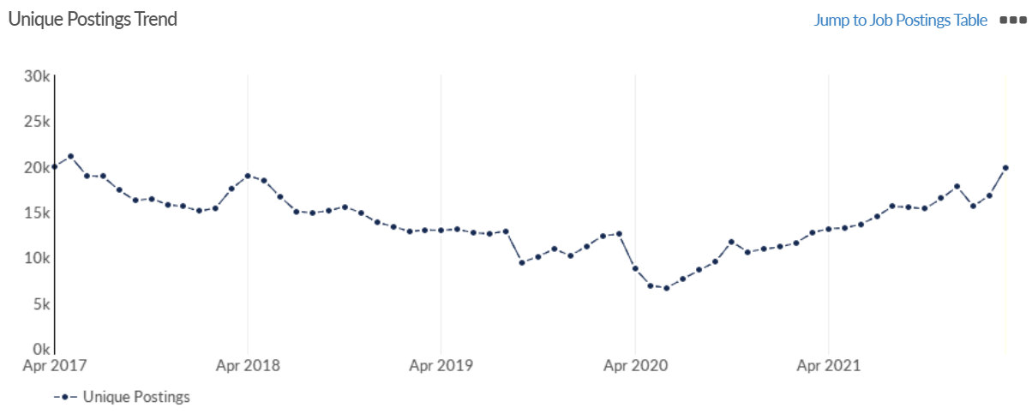
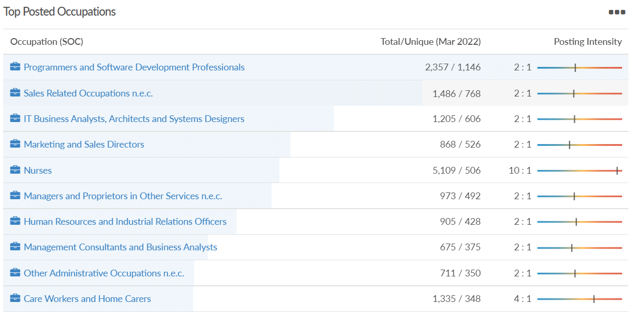
Job posting analytics (EMSI, March 2022)
Unique job postings: 19,835
Total job postings: 47,402
Job posting intensity: 2:1
Unique job postings (March 2021): 12,698

Slide 31
Wokingham

Slide 32
Impact of COVID-19 up to 11th April 2022
COVID-19 cases (to 11th April 2022) – Source: Public Health Berkshire COVID-19 Dashboard, 11th April 2022
57,966 total cases
353 new cases daily
Claimant unemployment (to March 2022)
1,850 claimants (1.7% of the working age population) in Wokingham UA
Notable business news:
Finchampstead brewery Siren has won a national business award. It was named as the winner of the Marketing Implementation category at the annual Society of Independent Brewers Business Awards, held on Wednesday, March 16. The brewery were awarded the accolade for their 8th anniversary beer festival, The Grateful Eight, which was held online in early April 2021. Siren’s managing director, Darron Anley, said that the award was a validation of the brewery’s strong brand image and desire to try something different during lockdown – LINK.

Slide 33
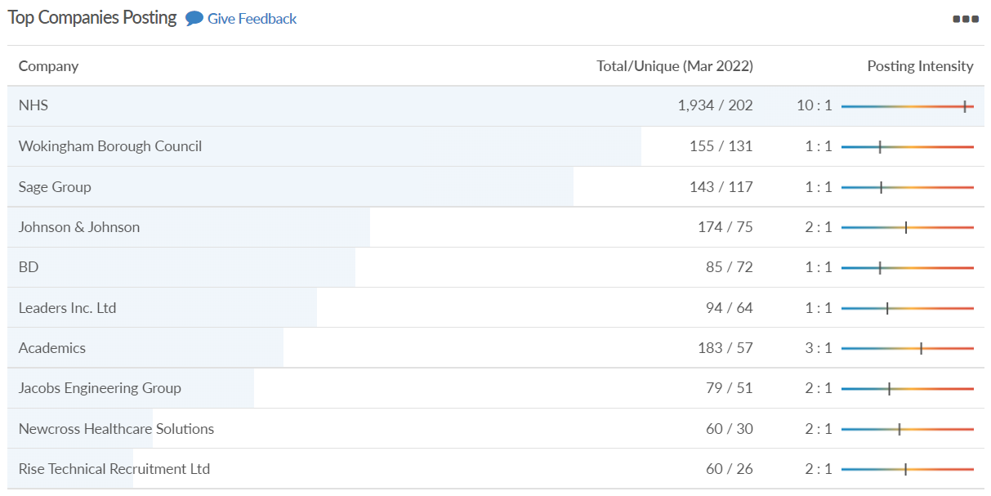
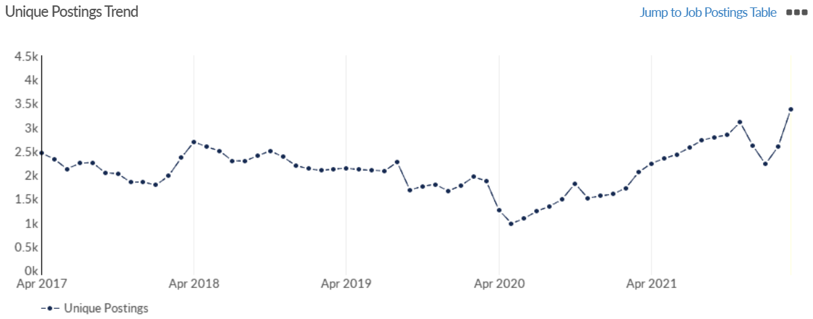
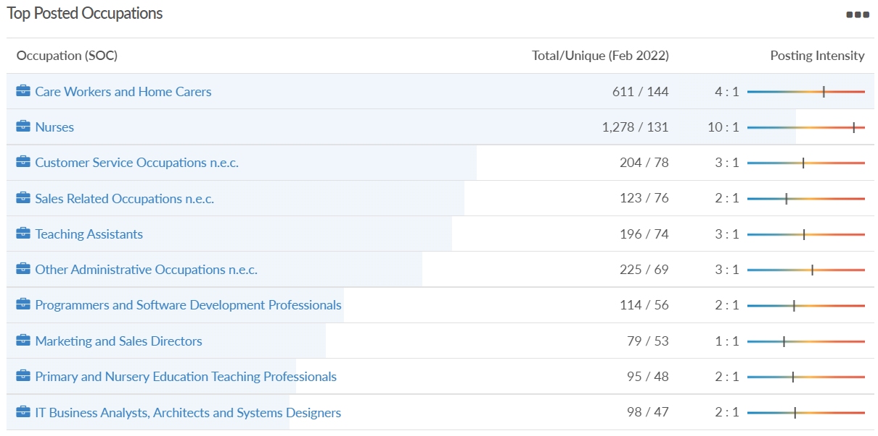
Job posting analytics (EMSI, March 2022)
Unique job postings: 3,383
Total job postings: 8,088
Job posting intensity: 2:1
Unique job postings (March 2021): 2,052

Slide 34
Windsor and Maidenhead

Slide 35
Impact of COVID-19 up to 11th April 2022
COVID-19 cases (to 11th April 2022) – Source: Public Health Berkshire COVID-19 Dashboard, 11th April 2022
50,299 total cases
244 new cases daily
Claimant unemployment (to March 2022)
2,415 claimants (2.6% of the working age population) in Windsor and Maidenhead UA
Notable business news:
The former Three building in Maidenhead town centre is now undergoing a £40 million revamp into a multi-occupied workspace. After a year-long wait, the ‘tired’ and ‘outdated’ office block building has begun work to transform the development into one of the greenest buildings in the Thames Valley region. The building block is the former home of phone company Three, which is now currently based in Green Park, Reading. Legal & General Investment Management Real Assets (LGIMRA) has begun construction work after entering a £40 million contract with construction engineering company ISG – LINK.

Slide 36
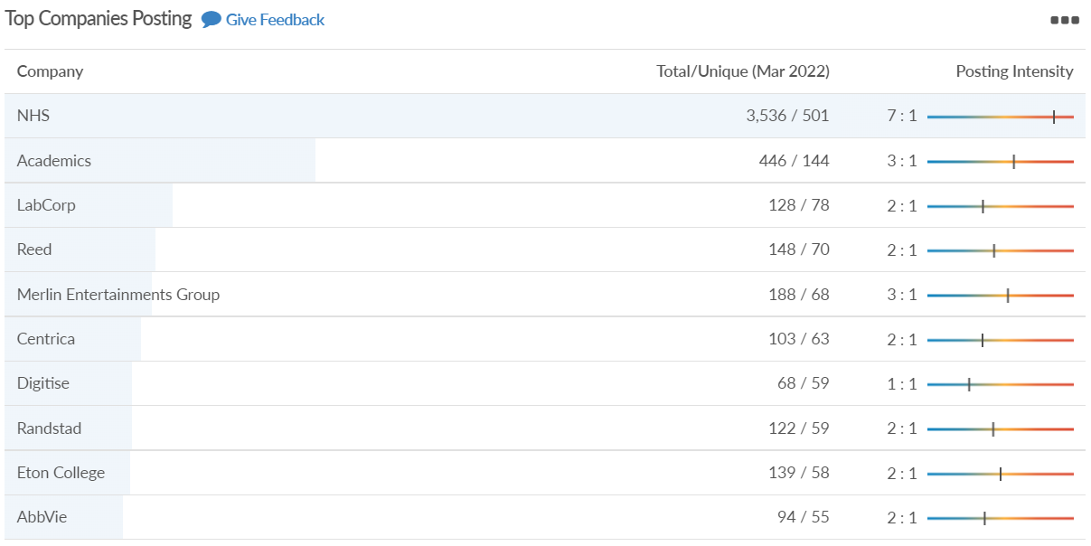
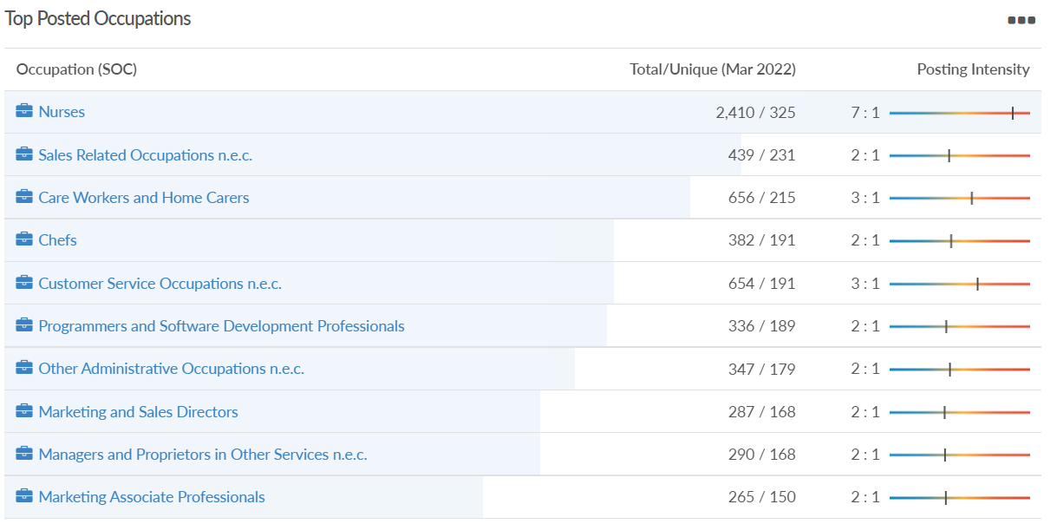
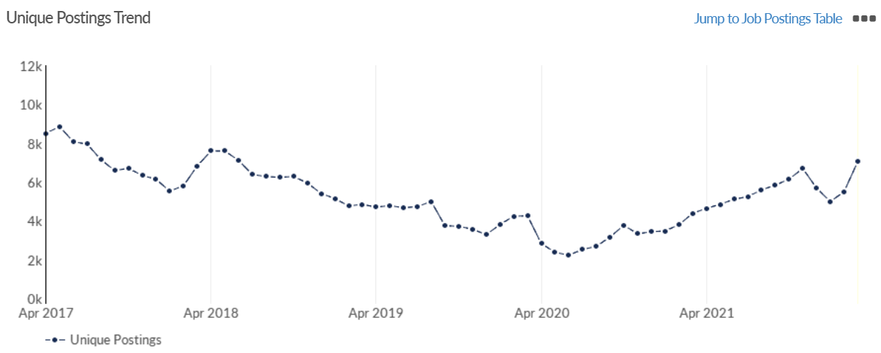
Job posting analytics (EMSI, March 2022)
Unique job postings: 7,056
Total job postings: 16,870
Job posting intensity: 2:1
Unique job postings (March 2021): 4,388

Slide 37
West Berkshire

Slide 38
Impact of COVID-19 up to 11th April 2022
COVID-19 cases (to 11th April 2022) – Source: Public Health Berkshire COVID-19 Dashboard, 11th April 2022
48,370 total cases
266 new case daily
Claimant unemployment (to March 2022)
2,445 claimants (2.5% of the working age population) in West Berkshire UA
Notable business news:
The lido in Newbury’s Northcroft Leisure Centre will be reopening after a £5 million refurbishment. The facility will be closed over the summer while major works are underway, and the outdoor pool will be closed to the public while undergoing refurbishment. Once the planning application has been approved, the pool will have racer slides, water fountains, a new cafe and a toddler splash pad. In addition to this, the lido would also be reduced in length, going from 72 metres to 50 metres, which would qualify as the length of an Olympic swimming pool – LINK.

Slide 39
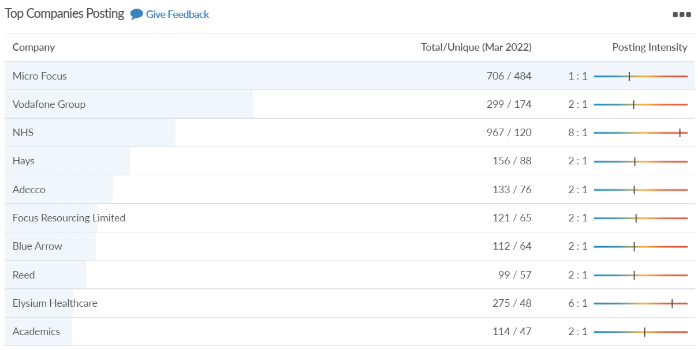
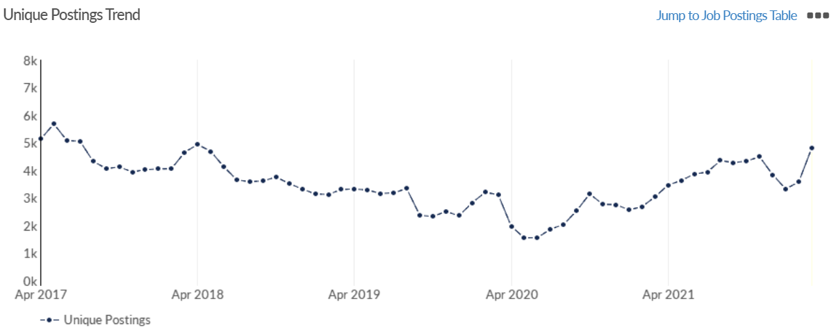
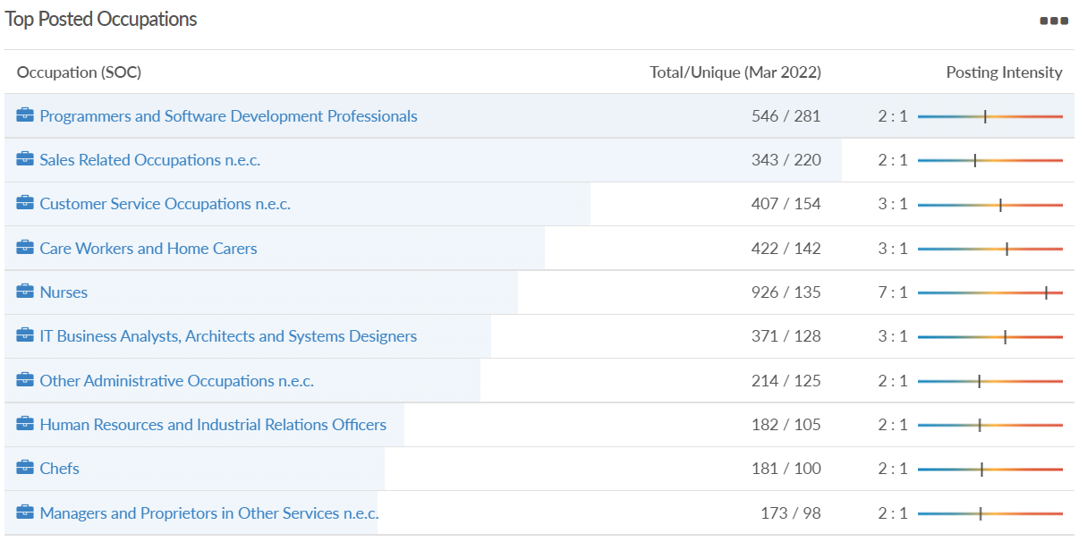
Job posting analytics (EMSI, March 2022)
Unique job postings: 4,825
Total job postings: 10,376
Job posting intensity: 2:1
Unique job postings (March 2021): 3,044

