Slide 1
Thames Valley Berkshire Monthly Economic Briefing
November 2021

Slide 2
Key contents of this month’s briefing
Updated global and UK economic forecasts
Latest furlough, SEISS and claimant count figures by Local Authority
Latest remote working figures for Thames Valley Berkshire
Latest ‘notable business news’ by Local Authority
Latest job posting analytics by Local Authority

Slide 3
Global and National Economy
November 2021

Slide 4
Global Economy
Spring brought a positive growth surprise. The EU economy is rebounding from the pandemic recession faster than expected. Households responded to the improving epidemiological situation and the gradual relaxation of containment measures with a spending spree that propelled EU private consumption growth to 3.3% q-o-q (3.5% in the euro area) in the second quarter of 2021. The rebound of economic activity was broad-based, with all components of domestic demand contributing positively to the 2.0% q-o-q rebound in GDP (2.1% in the euro area).
In summer the EU economy regained its pre-pandemic output level. Economic indicators suggest that growth continued unabated in the summer, also underpinned by a revival of intra-EU travel that benefited in particular EU touristic regions. The projected growth rate of 2.1% for the third quarter – corroborated by Eurostat’s preliminary flash estimate released after the cut-off date – allowed the EU as a whole to virtually close the gap with its pre-pandemic output level and move from recovery into expansion.
Source: European Commission, November 2021

Slide 5
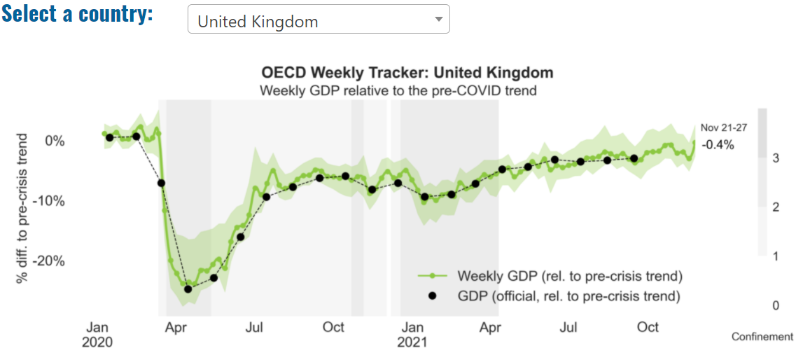
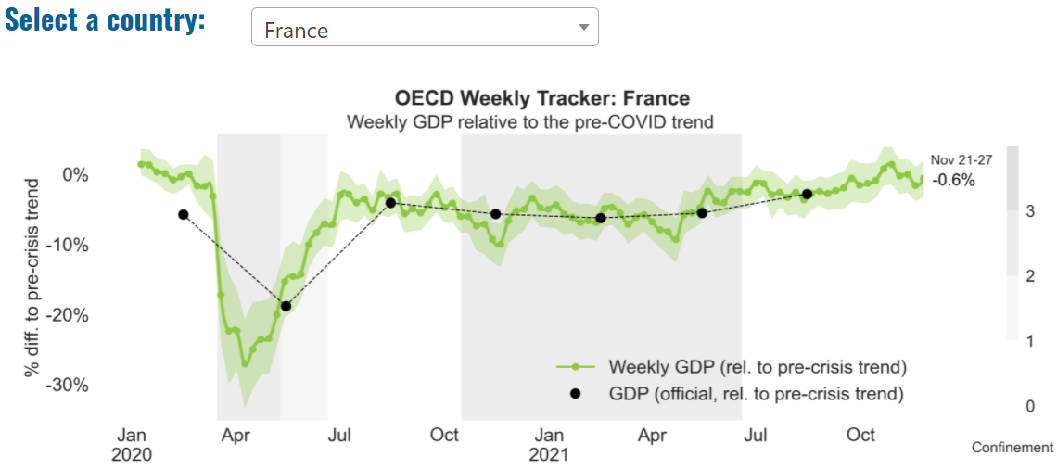
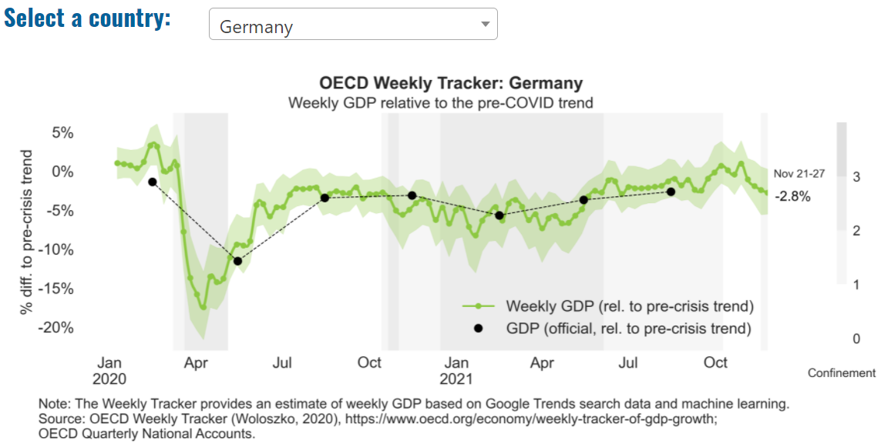
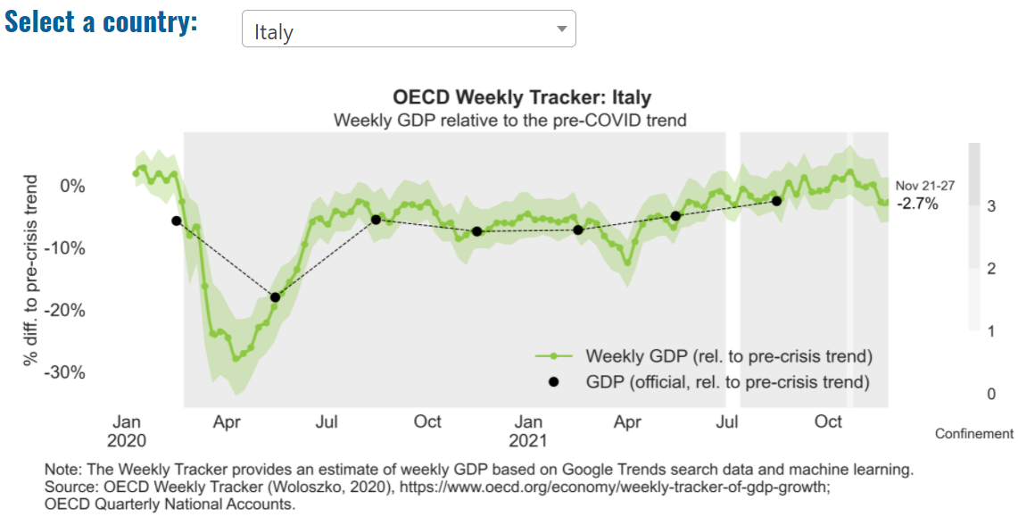
Global Economy – OECD GDP Tracker

Slide 6
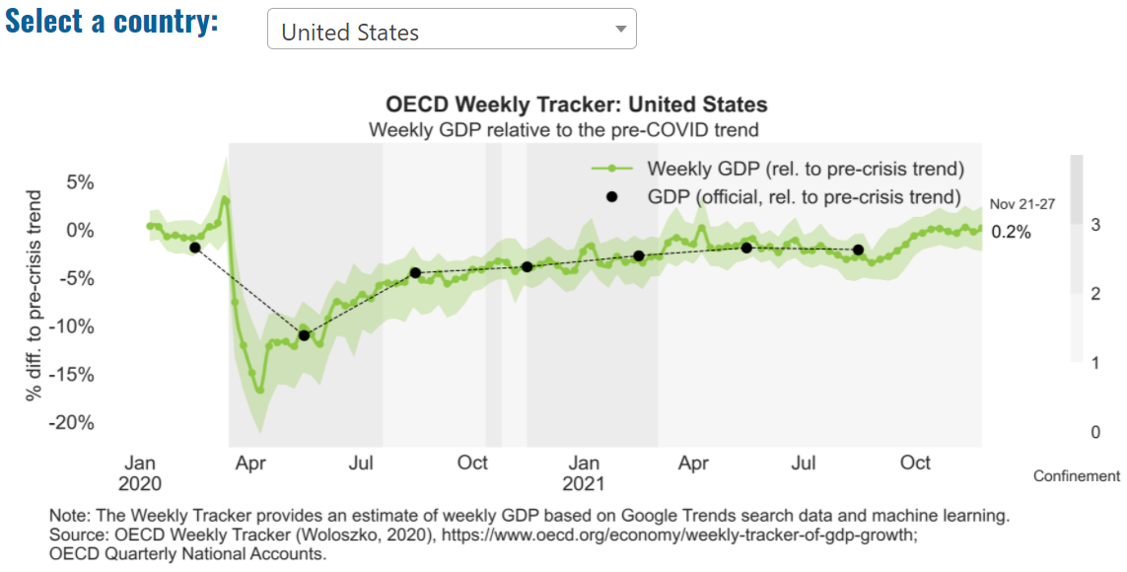
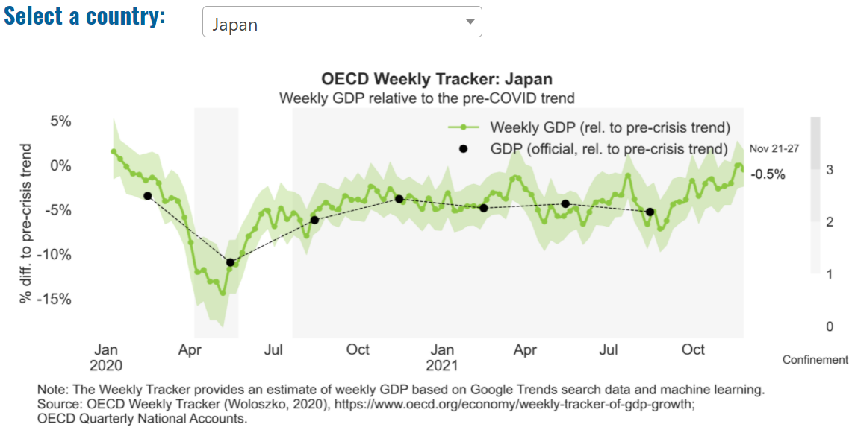
Global Economy – OECD GDP Tracker Continued
China
China is not included within the OECD GDP tracker and so the graph on the left has been compiled using statistics from the IMF and National Bureau of Statistics of China. The 2021 figure is a preliminary figure published by the National Bureau of Statistics of China in January 2021.
Note: The green confidence band shows 95% confidence intervals. The Weekly Tracker is an estimate of weekly GDP relative to the pre-crisis trend, which is proxied by the November 2019 OECD Economic Outlook forecasts. The darkness of the grey background reflects stay-at-home confinement requirement based on the Oxford Blavatnik database (0 - no measures, 1 - recommend not leaving house, 2 - require not leaving house with exceptions, 3 - require not leaving house with minimal exceptions). Source: OECD, November 2021

Slide 7
UK Economy
In the Monetary Policy Committee’s (MPC’s) central forecasts, global and UK GDP continue to recover from the effects of Covid-19 (Covid) in the near term. Growth is somewhat restrained by disruption to supply chains. That disruption, alongside the rapid pace at which global demand for goods has risen, has led to bottlenecks, which have exerted upward pressure on inflation globally, including in the UK. Inflation has also been boosted by higher energy prices, which have risen significantly further in recent months. In the UK, as a result, CPI inflation has risen markedly, to over 3%, and is projected to rise further in the near term, peaking at around 5% in April 2022.
Over the second half of the forecast period, and conditioned on the market-implied path for Bank Rate, UK GDP growth is expected to be relatively subdued. The pace of growth slows as potential supply growth eases back to close to pre-Covid rates, and as higher energy prices and the fading of monetary and fiscal policy support temper demand growth. A margin of spare capacity is expected to emerge by the end of the forecast period.
The upward pressure on inflation is expected to dissipate over time as supply disruption eases, global demand rebalances, and energy prices stop rising. Underlying wage growth is projected to decline from current rates, which are above the pre-Covid period. As a result, CPI inflation is projected to fall back materially. Conditioned on the market-implied path for Bank Rate, which rises to around 1% by the end of 2022, CPI inflation is projected to be a little above the 2% target in two years’ time and just below the target in three years. Inflation would probably fall a little further beyond that point, given the margin of excess supply in the third year of the forecast.
There is a high level of uncertainty around the outlook, including for energy prices. The futures curves for energy prices are downward sloping, in contrast to the MPC’s central conditioning assumptions in which prices remain flat after six months. In an alternative scenario that is conditioned on energy prices following their futures curves throughout the forecast period, and the market-implied path for Bank Rate, CPI inflation falls back towards the target more rapidly than in the MPC’s central projection, and is materially lower over the second half of the forecast period (Box A). While the risks around energy prices are judged to be to the downside, those to wage growth are judged to be skewed to the upside.
Source: Bank of England, November 2021

Slide 8
UK Economy 2
The economy lost momentum in Q3, buffeted by a surge in Covid-19 cases, shortages of staff and inputs, and trade tensions with the EU. Private consumption, government consumption and business investment lost notable steam, while exports slipped into contraction. Turning to Q4, most early indicators are fairly positive. In October, both the manufacturing and services PMIs rose, while employment continued to surge, suggesting a negligible impact from the recent end of the government’s wage subsidy scheme. However, overall momentum is likely to slow compared to Q3 amid supply bottlenecks and the effect of climbing price pressures on purchasing power. On the fiscal front, at end-October the chancellor presented the autumn budget. Notably higher public spending over the coming years will only be partly offset by tax hikes, although the budget deficit is still seen falling sharply ahead.
The economy will slow next year following the initial post-pandemic surge in economic activity, although extra spending announced in the budget should provide some support. A potential prolongation of supply handicaps and new Covid-19 variants pose downside risks. Tense relations with the EU—in particular over the Northern Ireland protocol—further cloud the outlook. Focus Economics panelists expect the economy to expand 5.0% in 2022, which is down 0.2 percentage points from last month’s forecast, and 2.1% in 2023.
Source: Focus Economics, November 2021

Slide 9
UK Economy 3
Deloitte, November 2021

Slide 10
Coronavirus and Recession: Implications for Thames Valley Berkshire

Slide 11
Furloughing (Latest data - October 2021)
18,500 jobs furloughed across Thames Valley Berkshire
2,300 jobs (4% of total eligible employments) furloughed in Bracknell Forest UA
4,700 (7% of total eligible employments) furloughed in Slough UA
2,800 jobs (3% of total eligible employments) furloughed in Reading UA
3,000 jobs (4% of total jobs) furloughed in Wokingham UA
3,500 jobs (5% of total jobs) furloughed in Windsor and Maidenhead
2,200 jobs (3% of total jobs) furloughed in West Berkshire
Across the UK, 1,143,600 people were furloughed (4% of total eligible employments)
Berkshire has a slightly lower-than-average number of furloughed workers, compared to the rest of the UK, because of its relative strength in sectors of industry that can be continued by workers from home.
Source: HMRC, November 2021

Slide 12
SEISS (Latest data - October 2021)
Total value of claims made across Thames Valley Berkshire: £414,200,000
Total value of claims made for Bracknell Forest UA – All SEISS: £64,100,000
Total value of claims made for Slough UA – All SEISS: £82,200,000
Total value of claims made for Reading UA – All SEISS: £66,300,000
Total value of claims made for Wokingham – All SEISS: £68,800,000
Total value of claims made for Windsor and Maidenhead – All SEISS: £63,700,000
Total value of claims made in West Berkshire – All SEISS: £69,100,000
Total value of claims made for the whole of the United Kingdom: £28,102,000,000
Source: HMRC, November 2021

Slide 13
Claimant Count (Latest data - November 2021)
Total of 20,915 claimants (3.6% of the working age population) in Thames Valley Berkshire
2,165 claimants (2.7% of the working age population) in Bracknell Forest UA
6,025 claimants (6.4% of the working age population) in Slough UA
5,195 claimants (4.9% of the working age population) in Reading UA
2,175 claimants (2% of the working age population) in Wokingham UA
2,695 claimants (2.9% of the working age population) in Windsor and Maidenhead UA
2,675 claimants (2.8% of the working age population) in West Berkshire UA
Across Thames Valley Berkshire, claimant unemployment has fallen significantly from 29,845 in November 2020 to 20,915 in November 2021. Slough had 6.4% of its working age population claim unemployment in November 2021, down slightly from 8.5% in November 2020.
Source: ONS, November 2021

Slide 14
Strategic Issues: Heathrow
Heathrow Airport:
Heathrow has begun recruiting for over 600 new frontline roles as the restart of transatlantic travel and easing of international restrictions boosts confidence in the aviation sector. While passenger numbers at the hub remain 56 per cent down on pre-pandemic levels, the airport has begun replacing staff let go over the past 18 months. The move to end the US travel ban has revived the airport, as the market accounts for a fifth of passenger traffic and a third of cargo tonnage. The airport is kicking off this recruitment drive now to ensure that it is well equipped to handle a predicted rise in passenger numbers ahead of next summer. The new security and engineering jobs will be among the first frontline roles to have been created at Heathrow since the start of the pandemic.
Heathrow chief people officer, Paula Stannett, said: “This is an incredible time to start a career in aviation and to be at the forefront of a world-class organisation determined to build back better as we recover from the impacts of the pandemic. “Many of Heathrow’s security officers have gone on to have long and fulfilling careers in various parts of our airport and the wider aviation sector, so this really is a rewarding opportunity at a pivotal time for our industry. “We look forward to welcoming our new joiners before the summer, at the beginning of what we are sure will be an enriching time at the UK’s only hub airport.” Source: Breaking Travel News, November 2021

Slide 15
Strategic Issues: Aviation
Aviation:
The general secretary of the British Airline Pilots’ Association (Balpa), has accused the aviation minister, Robert Courts, of being “completely out of touch”. Martin Chalk, told The Independent: “The aviation minister seemed to be on a different page to the rest of the industry. “The industry is talking about being behind in the UK compared to Europe, and he seemed unwilling to accept that.”
Mr. Chalk was speaking after Robert Courts had addressed the Airlines 2021 conference in London. The aviation minister told delegates there had been “a lot of good news for the aviation industry over the past few weeks”. Mr. Courts said: “The UK aviation sector will emerge in a better place than it’s been in the past
“We want to make sure the sector bounces back as soon and as far as possible.” The minister rejected criticism of the travel restrictions imposed by the UK government, saying: “We’ve already simplified the passenger locator form.” But Shai Weiss, chief executive of Virgin Atlantic, criticised the amount of bureaucracy and testing required for arrivals to the UK. “We’re behaving as though we don’t have a vaccine,” he said.
Source: The Independent, November 2021

Slide 16
Demand and Supply Conditions: Businesses, Hiring, Restructuring, Investment, Labour and Skills Supply

Slide 17
Household/Consumer Demand
Slough had an overall recovery index score of 79 at the end of August, putting it in a weaker position in terms of recovery (closer to pre-lockdown levels) than Reading which had a recovery index score of 88.
Source: Centre for Cities, November 2021 (latest release)
Retail sales volumes rose by 1.4% in November 2021 and were 7.2% higher than their pre-coronavirus (COVID-19) February 2020 levels.
Non-food stores sales volumes rose by 2.0% in November 2021, because of growth in clothing stores (2.9%) and other non-food stores (2.8%) such as computer stores, toy stores and jewelry stores, with retailers noting strong trading related to Black Friday and in the lead up to Christmas.
Clothing stores sales volumes in November 2021 were above pre-coronavirus levels for the first time; 3.2% above their level in February 2020.
Automotive fuel sales volumes rose by 3.7% in November 2021 following some disruption to supplies in the previous two months; volumes were 1.9% below their February 2020 levels.
Food store sales volumes fell by 0.2% in November 2021; despite the fall in November, volumes were 3.2% above levels in February 2020.
The proportion of retail sales online fell to 26.9% in November 2021, its lowest proportion since March 2020 (22.6%) and a continuation of a falling trend since its peak in February 2021 (36.8%). Source: ONS, November 2021 (latest release)

Slide 18
Industries at Risk
MANUFACTURING
28,000 people work in manufacturing in Berkshire – with 11,000 in West Berkshire alone and 2,487,000 across the whole of Great Britain (ONS, 2020)
Half of all UK manufacturing firms have made redundancies. A further 20% plan to make more redundancies in the next six months (Make UK, October 2020)
37% of manufacturers think it will take more than a year to return to normal trading conditions (Make UK, October 2020)
HOSPITALITY & TOURISM
The hospitality and tourism sector in Berkshire employed 35,842 people in 2020 – an increase of 0.8% on the previous year (EMSI, 2021)
In June, ‘Pathways to Recovery’, a report by the All Party Parliamentary Group on Hospitality and Tourism, found that just 11% of hospitality businesses had been able to operate normally during the first lockdown and international tourist arrivals were likely to be down 59% for the year.
Kate Nicholls, CEO of UK Hospitality, told the BBC (December 2020) that 30,000 hospitality businesses – most of them SMEs and one-third of the total – could be lost by the end of 2020.
According to Sky News in December, at least 38,653 hospitality jobs had been lost during the pandemic.
CONSTRUCTION
21,000 people work in construction in Berkshire – with only 1,500 of these working in Bracknell Forest and 2,164,000 across the whole of Great Britain (ONS, 2020)
The level of construction output in August 2020 was 10.8% below the February 2020 level (ONS, 2020)
Construction output grew by 18.5% in the three months to August 2020 compared with the previous three-month period, but this followed 10 consecutive periods of decline (ONS, 2020)
NON-FOOD RETAIL & WHOLESALE
More than 45,000 people work in non-motor vehicle retail in Berkshire – with 12,500 of them working in Reading (EMSI, 2021). The offline retail sector has struggled during the pandemic. At least 39,000 jobs had been lost in retail as of 3 December. Redundancy announcements include 7,000 at Marks and Spencer (August), 4,000 at Debenhams (August) and 4,000 at Boots (July) - Sky News, 2020.
The pre-pandemic trend of on-line shopping has strengthened in 2020; a record total of 31.4% of shopping was done on line in November 2020 (ONS, 2020), a trend that will have profound implications for the high street.
In November, retail sales volume decreased by 3.8% (vs October figures) as a result of COVID-19. Despite this, overall sales remain above their pre-pandemic levels (ONS, 2020).
ARTS, ENTERTAINMENT & RECREATION
12,000 people work in arts, entertainment and recreation in Berkshire. 4,500 of them – more than one third – work in Windsor and Maidenhead and 925,000 across the whole of Great Britain (ONS, 2020)
Between 19 Nov and 1 Dec, 24 per cent of arts, entertainment and recreation venues had temporarily closed or paused trading. (ONS, 2020)
52% of eligible employments in arts, entertainment and recreation were on furlough on 31 July 2020 – a figure that had fallen to 24% as at 31 October. (HMRC, 2020)
AVIATION
Aviation has an estimated value of £28 billion to the UK economy, employing 230,000 workers at over 40 commercial airports. (House of Commons Transport Committee, June 2020)
76,000 people work in over 400 business across Heathrow Airport. Many of these people live in Slough, in Berkshire. (Heathrow local recovery plan, 2020)
There were 5,800 passenger flights in April 2020 compared to 201,000 a year earlier: a reduction of 97%. The impact is several times more severe than the aftermath of the global financial crisis in 2008, when passenger flights reduced by around 67,000 to 134,000 per month. (House of Commons Transport Committee, June 2020)
The UK aviation industry has been hit harder than any European country by the pandemic with IATA calculating that the “coronavirus crisis will cost 780,000 British jobs and cost £46bn in lost GDP.” (International Air Transport Association, 2020).
ADMINISTRATION & SUPPORT
More than 51,000 people in Berkshire work in admin and support services – including 10,000 in Wokingham and 10,000 in West Berkshire and 2,752,000 across the whole of Great Britain (ONS, 2020)
More than 600,000 admin and support workers – 27% of the total – were furloughed as at 31 October (HMRC, 2020)

Slide 19
Remote working
In November of 2021, there were 4,679 unique job postings for remote positions at companies based in Berkshire, around 196% more than the figure of 1,581 for the same period one year before.
Compare this with the South East, in November 2021 there were 28,039 unique remote job postings for remote positions; rising from 10,767 in November of the previous year – an increase of over 160%.
A rise can also be seen at national level, with a recorded 175,278 unique remote job postings in England in November of 2021, rising from 69,985 in November 2020 – an increase of over 150%.
From these figures it’s apparent that the COVID-19 pandemic has, somewhat unsurprisingly, prompted a massive boost in job postings for explicitly remote roles. Berkshire has seen a slightly smaller boost in vacancies which are remote-based than both England and the South East.
Source: EMSI, November 2021

Slide 20
Local Profiles

Slide 21
Bracknell Forest

Slide 22
Impact of COVID-19 up to 13th December 2021
COVID-19 cases (to 13th December 2021) – Source: Public Health Berkshire COVID-19 Dashboard, 13th December 2021
18,705 total cases
150 new cases daily
Claimant unemployment (to November 2021)
2,165 claimants (2.7% of the working age population) in Bracknell Forest UA
Notable business news:
Pies, pizza, pies and ice-creams are coming to Bracknell's Poundland as the store expands into its neighbouring unit. The company has confirmed it is bringing both chilled and frozen food to the store at the Peel Centre. The business has expanded into the former Maplin store next door, which will add more than 3,000 sq. ft of floorspace, making the store to more than 7,000 sq. ft. The move means 12 new jobs have been created and is part of the company's Diamond Ice project to roll-out the new chilled and frozen food – LINK.

Slide 23
Industries hit hardest by COVID shutdown
As illustrated by the above graph, Bracknell Forest has suffered very similarly to Great Britain in terms of the percentage of jobs within industries which have been hit hardest by COVID shutdowns. Thames Valley Berkshire area has seen an additional 0.77% of jobs of jobs affected worst by the COVID shutdowns when compared to Bracknell Forest.
Source: EMSI, March 2021 (definition for industries hit hardest provided on slide 51)

Slide 24
Industry risks and opportunities (2020-2021)
Critical industries
Food and drink retail: 3,234 employees (1% below the national average)
Energy/utilities: 257 employees (65% below the national average)
Health and social care: 6,193 employees (25% below the national average)
Freight/logistics: 515 employees (70% below the national average)
Insurance: 186 employees (69% below the national average)
Banking and financial services: 1,291 employees (13% below the national average)
Sectors most impacted
Hospitality and tourism: 3,743 employees (26% below the national average)
Arts, entertainment and recreation: 1,148 (24% below the national average)
Admin and support: 2,694 (21% below the national average)
Aviation: 0 employees
Non-food retail and wholesale: 8,508 (75% above the national average)
Manufacturing: 1,549 (69% below the national average)
Construction: 1,771 (40% below the national average)
Source: EMSI, January 2021

Slide 25
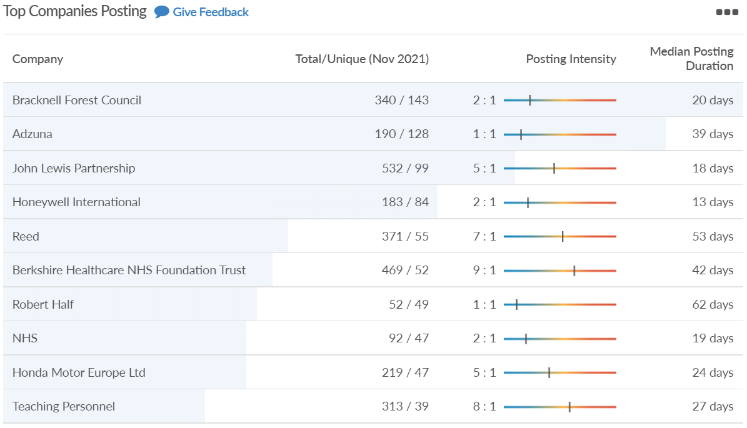
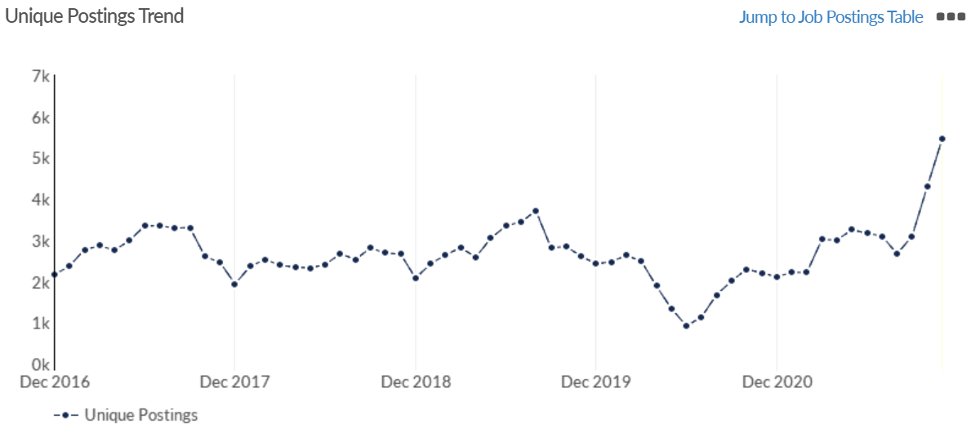
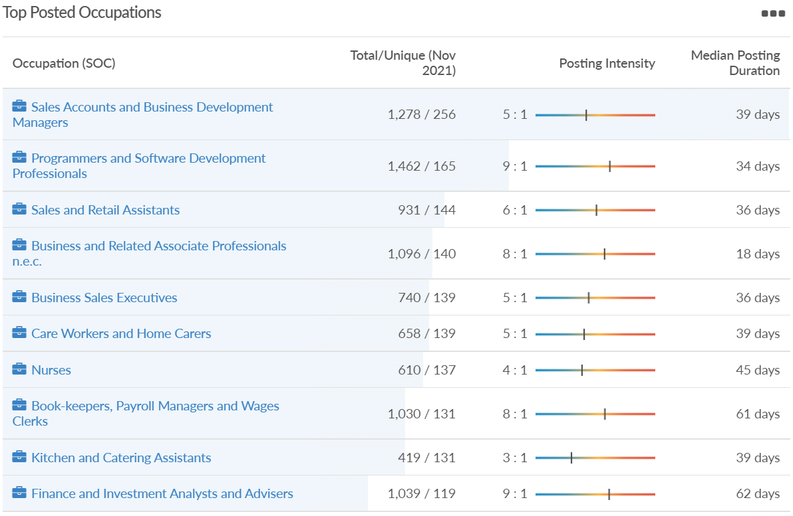
Job posting analytics (EMSI, November 2021)
Unique job postings: 5,452
Total job postings: 34,210
Job posting intensity: 6:1
Unique job postings (October 2020): 2,205

Slide 26
Slough

Slide 27
Impact of COVID-19 up to 13th December 2021
COVID-19 cases (to 13th December 2021) – Source: Public Health Berkshire COVID-19 Dashboard, 13th December 2021
28,306 total cases
119 new cases daily
Claimant unemployment (to November 2021)
6,025 claimants (6.4% of the working age population) in Slough UA
Notable business news:
Hundreds of homes, shops, offices and a new town square could all be built in Slough. Ambitious new plans have been submitted to Slough Borough Council, which would see nearly five acres of land in the town centre completely rebuilt, including the Queensmere Shopping Centre. The scheme is being run by by British Land, which is acting as the development manager for a wholly-owned subsidiary of the Abu Dhabi Investment Authority on the scheme. This is not a full application, which was submitted at the end of October, as the local authority is being asked if it agrees with the development in principle. The plans include: up to 1,600 homes, up to c. 12,000 sqm of flexible town centre spaces for future shops, restaurants, community, leisure and education facilities, up to 40,000 sqm of high-quality office space and up to 3,750 sqm for a potential cinema or live music venue – LINK.

Slide 28
Industries hit hardest by COVID shutdown
When compared to both Thames Valley Berkshire and Great Britain, Slough has seen a significantly lower percentage of jobs affected by COVID shutdowns – perhaps somewhat surprising given the LA’s proximity to Heathrow and the almost complete shutdown of the aviation sector.
Source: EMSI, March 2021 (definition for industries hit hardest provided on slide 51)

Slide 29
Industry risks and opportunities (2020-2021)
Critical industries
Food and drink retail: 6,656 employees (47% above the national average)
Energy/utilities: 2,820 employees (174% above the national average)
Health and social care: 8,201 employees (28% below the national average)
Freight/logistics: 4,640 employees (93% above the national average)
Insurance: 121 employees (86% below the national average)
Banking and financial services: 731 employees (65% below the national average)
Sectors most impacted
Hospitality and tourism: 3,780 employees (46% below the national average)
Arts, entertainment and recreation: 442 (79% below the national average)
Admin and support: 9,765 (107% above the national average)
Aviation: 262 employees (16% above the national average)
Non-food retail and wholesale: 6,719 (0% above the national average)
Manufacturing: 5,071 (28% below the national average)
Construction: 2,620 (36% below the national average)
Source: EMSI, January 2021

Slide 30
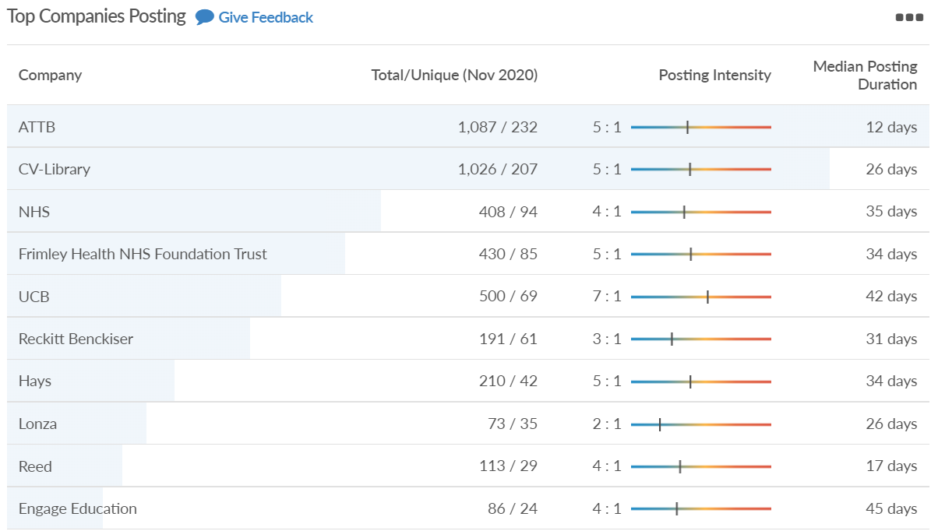
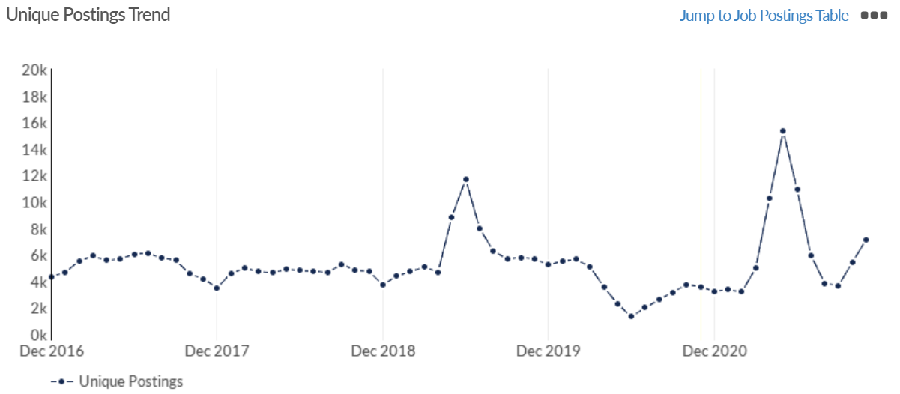
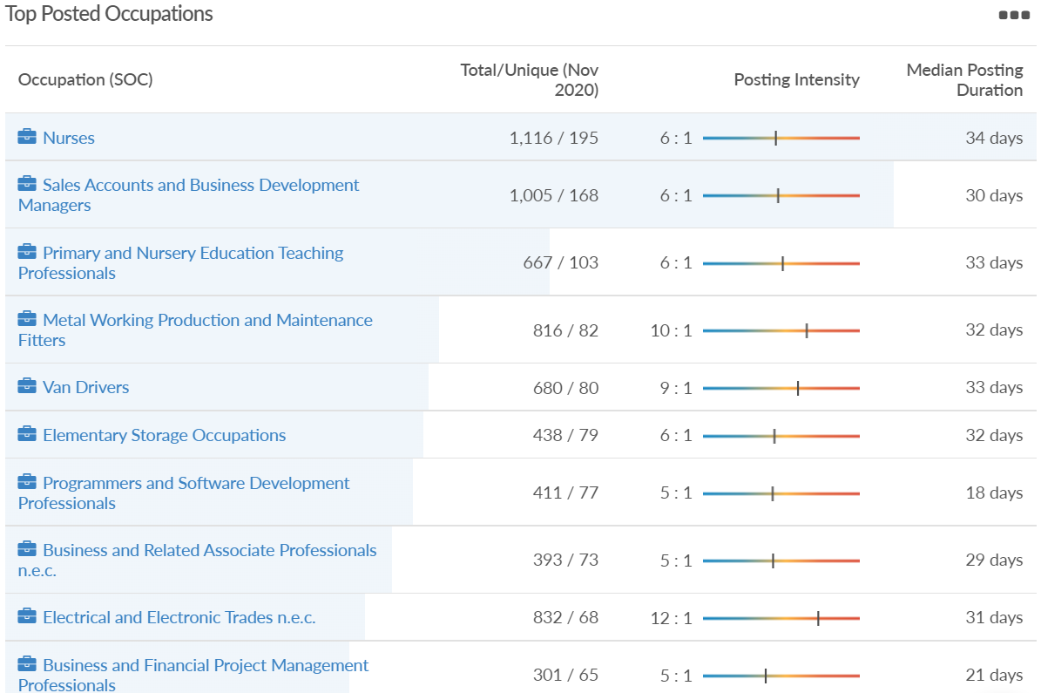
Job posting analytics (EMSI, November 2021)
Unique job postings: 7,124
Total job postings: 33,677
Job posting intensity: 5:1
Unique job postings (November 2020): 3,586

Slide 31
Reading

Slide 32
Impact of COVID-19 up to 13th December 2021
COVID-19 cases (to 13th December 2021) – Source: Public Health Berkshire COVID-19 Dashboard, 13th December 2021
26,972 total cases
162 new case daily
Claimant unemployment (to November 2021)
5,195 claimants (4.9% of the working age population) in Reading UA
Notable business news:
Business advisory firm Grant Thornton UK LLP is moving to the heart of Reading as part of its continued investment in the Thames Valley. The new base at One Valpy marks the company's continued focus in the area and follows its relocation to a collaborative workplace in Oxford in September. Designed by Peldon Rose, the 7,851 sq. ft Reading base incorporates feedback and insight from across the Grant Thornton team. The firm's Thames Valley and Southampton operations of 320 people will be able to work flexibly across One Valpy in Reading, Sea Court Tower in Oxford and Benham 5 on the University of Southampton Science Park - LINK.

Slide 33
Industries hit hardest by COVID shutdown
Reading has been marginally less affected by the COVID shutdowns as Great Britain has on average, with 15.16% of jobs within industries which have been most severely impacted by the shutdowns. The Local Authority is 1.26% better off than the average of the Thames Valley Berkshire area.
Source: EMSI, March 2021 (definition for industries hit hardest provided on slide 51)

Slide 34
Industry risks and opportunities (2020-2021)
Critical industries
Food and drink retail: 6,192 employees (11% above the national average)
Energy/utilities: 3,350 employees (163% above the national average)
Health and social care: 13,464 employees (5% below the national average)
Freight/logistics: 1,513 employees (49% below the national average)
Insurance: 2,076 employees (100% above the national average)
Banking and financial services: 1,688 employees (34% below the national average)
Sectors most impacted
Hospitality and tourism: 6,567 employees (25% below the national average)
Arts, entertainment and recreation: 1,811 (31% below the national average)
Admin and support: 9,212 (58% above the national average)
Aviation: <10 employees
Non-food retail and wholesale: 8,626 (18% above the national average)
Manufacturing: 2,000 (77% below the national average)
Construction: 2,273 (55% below the national average)
Source: EMSI, January 2021

Slide 35
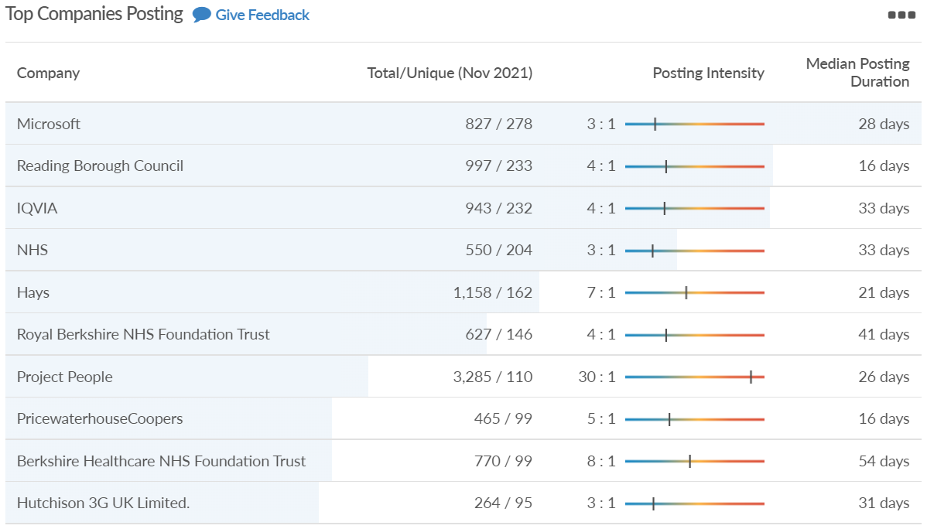
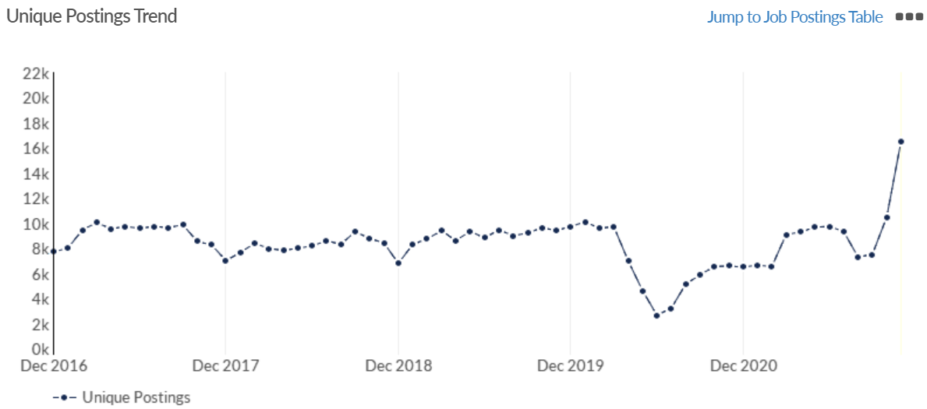
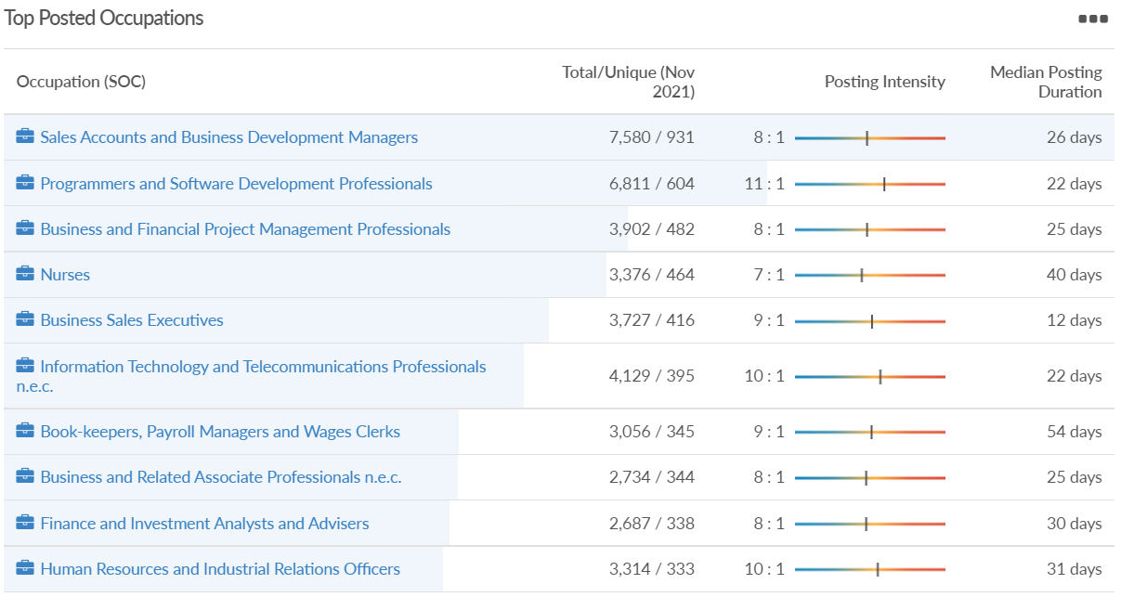
Job posting analytics (EMSI, November 2021)
Unique job postings: 16,532
Total job postings: 141,970
Job posting intensity: 9:1
Unique job postings (November 2020): 6,575

Slide 36
Wokingham

Slide 37
Impact of COVID-19 up to 13th December 2021
COVID-19 cases (to 13th December 2021) – Source: Public Health Berkshire COVID-19 Dashboard, 13th December 2021
25,595 total cases
163 new cases daily
Claimant unemployment (to November 2021)
2,175 claimants (2% of the working age population) in Wokingham UA
Notable business news:
Since the vision for 15,000 homes at Grazeley was ruled out by the extended emergency planning zone around AWE Burghfield, other sites are now being considered, including a new 4,500 home garden village between Shinfield, Arborfield and Sindlesham. There is also a potential full or partial relocation of the Royal Berkshire Hospital, subject to funding. The revised growth strategy also proposes an additional allocation of around 800 homes within the council’s existing South Wokingham major development area, south of the railway line and Waterloo Road. This is in addition to the 2,500 homes allocated to South Wokingham in the current Local Plan – LINK.

Slide 38
Industries hit hardest by COVID shutdown
Wokingham is in a similar position to Slough in that is has been significantly less affected by the COVID shutdowns than both the Thames Valley Berkshire area and Great Britain as a whole. This is likely due to the high levels of employment from the Tech sector (Microsoft etc. based at TVP) as this industry is able to work well from home.
Source: EMSI, March 2021 (definition for industries hit hardest provided on slide 51)

Slide 39
Industry risks and opportunities (2020-2021)
Critical industries
Food and drink retail: 3,883 employees (17% below the national average)
Energy/utilities: 1,434 employees (35% above the national average)
Health and social care: 7,283 employees (38% below the national average)
Freight/logistics: 886 employees (64% below the national average)
Insurance: 453 employees (48% below the national average)
Banking and financial services: 423 employees (80% below the national average)
Sectors most impacted
Hospitality and tourism: 5,410 employees (25% below the national average)
Arts, entertainment and recreation: 1,831 (16% below the national average)
Admin and support: 6,432 (33% above the national average)
Aviation: 0 employees
Non-food retail and wholesale: 6,494 (6% below the national average)
Manufacturing: 3,731 (48% below the national average)
Construction: 3,115 (26% below the national average)
Source: EMSI, January 2021

Slide 40
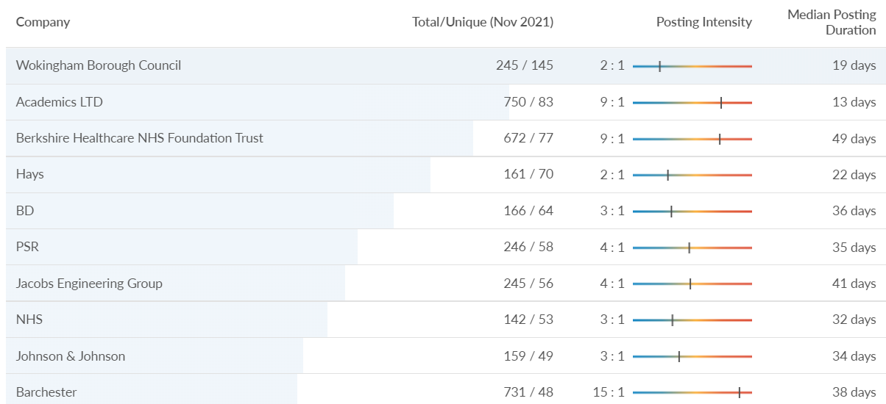
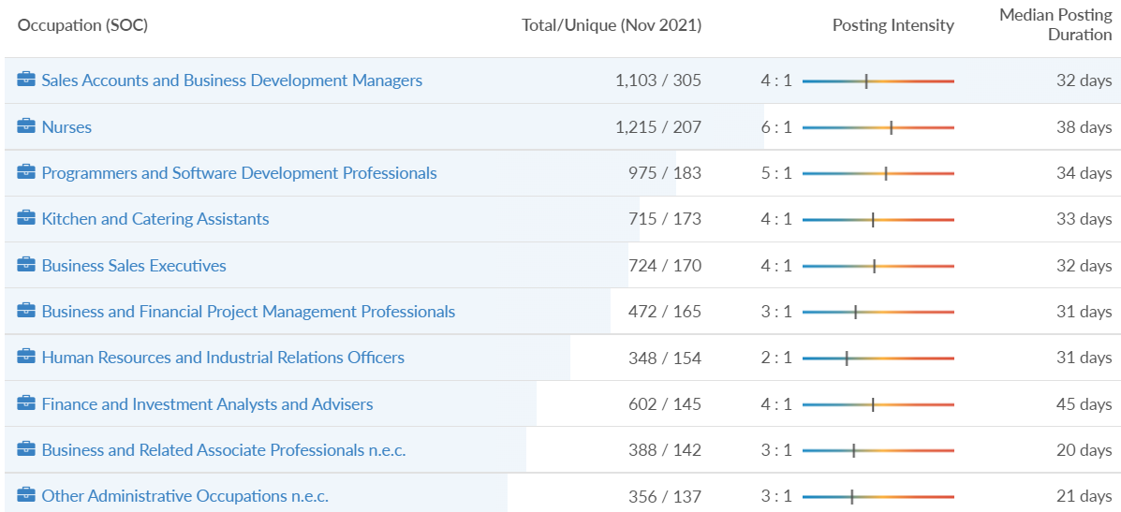
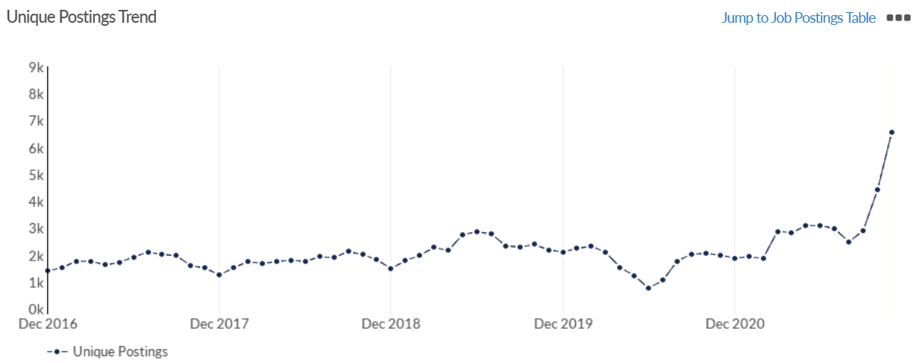
Job posting analytics (EMSI, November 2021)
Unique job postings: 6,578
Total job postings: 30,172
Job posting intensity: 5:1
Unique job postings (November 2020): 1,992

Slide 41
Windsor and Maidenhead

Slide 42
Impact of COVID-19 up to 13th December 2021
COVID-19 cases (to 13th December 2021) – Source: Public Health Berkshire COVID-19 Dashboard, 13th December 2021
23,726 total cases
158 new cases daily
Claimant unemployment (to November 2021)
2,695 claimants (2.9% of the working age population) in Windsor and Maidenhead UA
Notable business news:
Seventy years after it was first established, Bray Film Studios’ plans for a major expansion have been approved by councillors. The new lease of life for the famous old studios will mean the creation of almost 3,000 jobs, plus many further economic benefits. The Royal Borough’s Maidenhead development management committee voted by seven to two to approve the scheme at its November 8 meeting. The scheme includes around 30,000 sq. m of commercial floor space consisting of: nine sound stages (four of them existing ones), four workshops, a rehearsal building, offices and production facilities and parking for 750 cars and 174 bikes – LINK.

Slide 43
Industries hit hardest by COVID shutdown
Windsor and Maidenhead appears to be the most severely affected of all the Local Authorities which make up Berkshire in terms of percentage of jobs hit hardest by the COVID shutdowns. This is likely due in part to the enormous hit the leisure/tourism sector has taken and how key of an employer Legoland Windsor to the region.
Source: EMSI, March 2021 (definition for industries hit hardest provided on slide 51)

Slide 44
Industry risks and opportunities (2020-2021)
Critical industries
Food and drink retail: 3,733 employees (17% below the national average)
Energy/utilities: 882 employees (13% below the national average)
Health and social care: 8017 employees (29% below the national average)
Freight/logistics: 748 employees (68% below the national average)
Insurance: 434 employees (48% below the national average)
Banking and financial services: 1,252 employees (39% below the national average)
Sectors most impacted
Hospitality and tourism: 9,437 employees (35% above the national average)
Arts, entertainment and recreation: 4,516 (117% above the national average)
Admin and support: 4,207 (10% below the national average)
Aviation: 11 employees (95% below the national average)
Non-food retail and wholesale: 7,834 (18% above the national average)
Manufacturing: 2,523 (64% below the national average)
Construction: 6,201 (54% above the national average)
Source: EMSI, January 2021

Slide 45
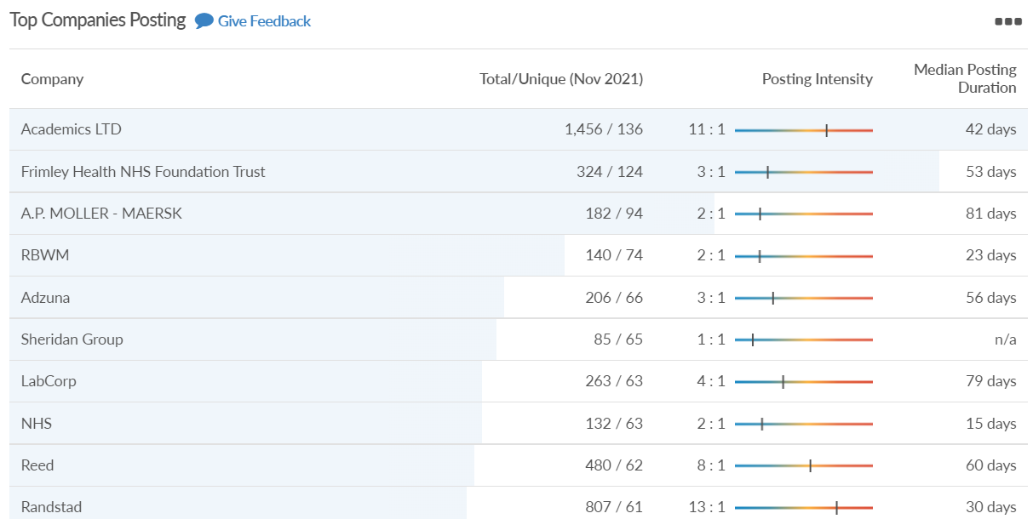
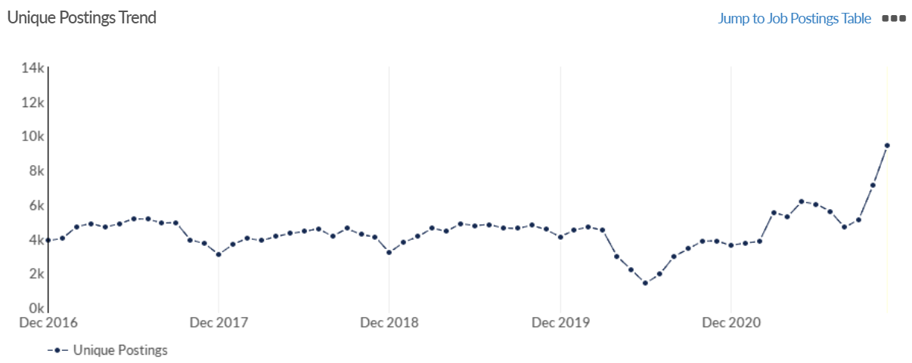
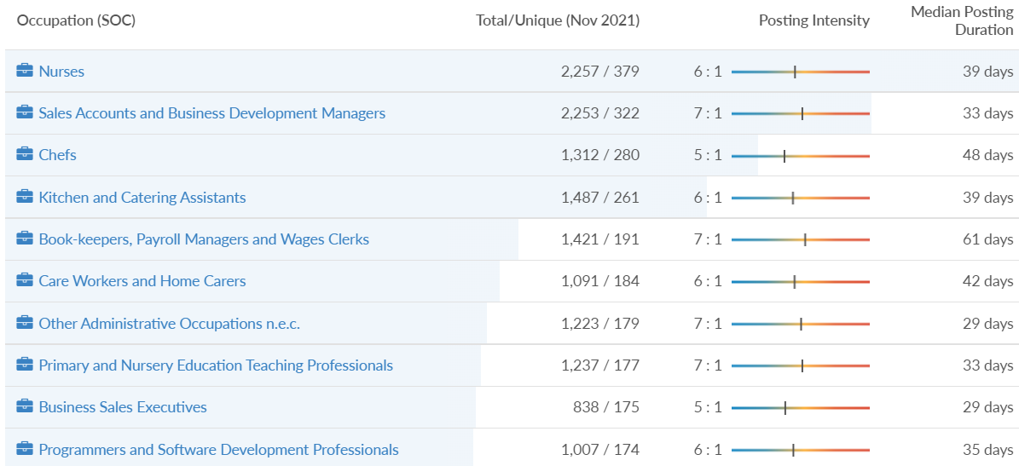
Job posting analytics (EMSI, November 2021)
Unique job postings: 9,404
Total job postings: 63,281
Job posting intensity: 7:1
Unique job postings (November 2020): 3,881

Slide 46
West Berkshire

Slide 47
Impact of COVID-19 up to 13th December 2021
COVID-19 cases (to 13th December 2021) – Source: Public Health Berkshire COVID-19 Dashboard, 13th December 2021
21,371 total cases
165 new case daily
Claimant unemployment (to November 2021)
2,675 claimants (2.8% of the working age population) in West Berkshire UA
Notable business news:
TSB has announced it will be closing 70 branches in 2022, including one in Berkshire. According to the bank, the change comes as a result of a shift in the way people use their services, with the vast majority of customers making transactions digitally instead of in-person. Despite remaining “committed to face-to-face service”, a long list of branches will now be closed, including one in Newbury – LINK.

Slide 48
Industries hit hardest by COVID shutdown
While West Berkshire hasn’t been as fortunate as Slough in terms of how great of a percentage of jobs have been directly affected by the COVID shutdown, it has fared significantly better than the Thames Valley Berkshire area and better than Great Britain.
Source: EMSI, March 2021 (definition for industries hit hardest provided on slide 51)

Slide 49
Industry risks and opportunities (2020-2021)
Critical industries
Food and drink retail: 4,289 employees (17% below the national average)
Energy/utilities: 1,343 employees (14% above the national average)
Health and social care: 6,773 employees (48% below the national average)
Freight/logistics: 1,574 employees (43% below the national average)
Insurance: 262 employees (73% below the national average)
Banking and financial services: 692 employees (71% below the national average)
Sectors most impacted
Hospitality and tourism: 6,617 employees (18% below the national average)
Arts, entertainment and recreation: 2,674 (10% above the national average)
Admin and support: 4,803 (11% below the national average)
Aviation: <10 employees
Non-food retail and wholesale: 8,432 (9% above the national average)
Manufacturing: 11,330 (41% above the national average)
Construction: 4,813 (3% above the national average)
Source: EMSI, January 2021

Slide 50
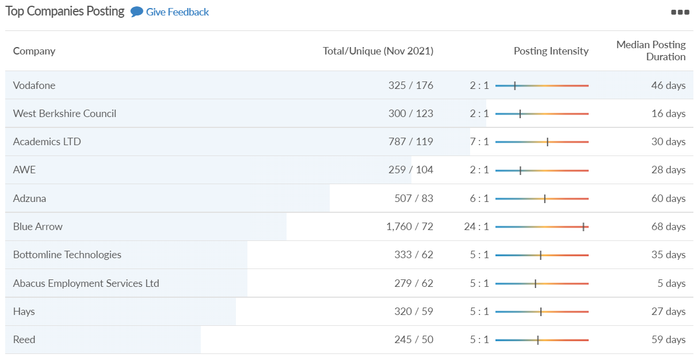
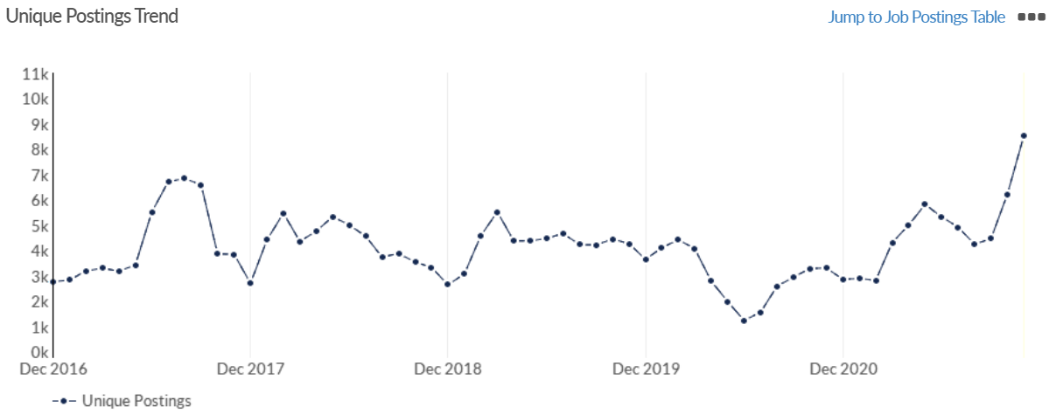
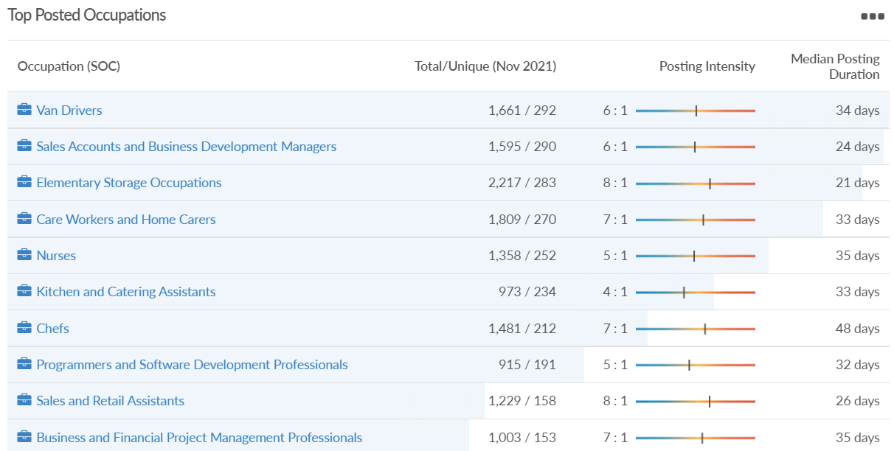
Job posting analytics (EMSI, November 2021)
Unique job postings: 8,532
Total job postings: 47,503
Job posting intensity: 6:1
Unique job postings (November 2020): 3,297

Slide 51
Definitions
Source: Institute for Fiscal Studies, April 2020

