Slide 1
Thames Valley Berkshire Monthly Economic Briefing
August 2021

Slide 2
Key contents of this month’s briefing
Updated global and UK economic forecasts
Latest furlough, SEISS and claimant count figures by Local Authority
Latest remote working figures for Thames Valley Berkshire
Latest ‘notable business news’ by Local Authority
Latest job posting analytics by Local Authority

Slide 3
Global and National Economy
August 2021

Slide 4
Global Economy
As the vaccination rollout gets underway, economies are gradually opening up, leading to a global GDP recovery of 6.2% in 2021, followed by a forecast 4.7% growth in 2022. We expect a robust and broad-based recovery of global trade in 2021. China´s economy was outperforming in early-2021, but other regions have caught up in recent months. Global trade is expected to grow by 6% in 2021, followed by a similar amount in 2022.
Advanced economies are expected to surpass pre-crisis activity levels in 2021. Despite the ongoing vaccination campaign, eurozone economies are still struggling with the Covid-19 virus. We expect a recovery of 5.0% in 2021, followed by a slightly lower increase in 2022. All member states are expected to see GDP levels recovering to pre-pandemic levels by the end of 2022. However, the rebound is uneven, with tourism-dependent countries in Southern Europe lagging behind their Northern peers.
The US economic outlook has strengthened markedly since our February Economic Outlook. Apart from the UK, the US is well ahead of most other advanced countries in vaccinating its population, and the economy reopened during the first half of the year. Additional support is coming from a major (USD 1.9 trillion) fiscal stimulus package, approved by Congress in March 2021, and a USD 1.0 infrastructure bill approved in August.
The economic recovery of many emerging market economies (EMEs) lags behind, mainly due to a slower vaccine rollout. Additionally, the scope for fiscal stimulus is more limited. Asia is the region with the highest growth rate among EMEs, while particularly MENA and Sub-Saharan Africa lag behind. Economic growth across EMEs is forecast to recover by 6.9% this year, followed by another 5.3% growth in 2022.
Source: Atradius, August 2021

Slide 5
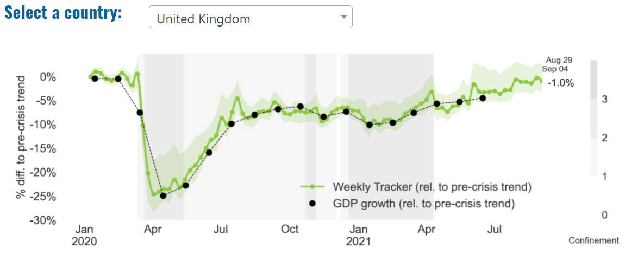
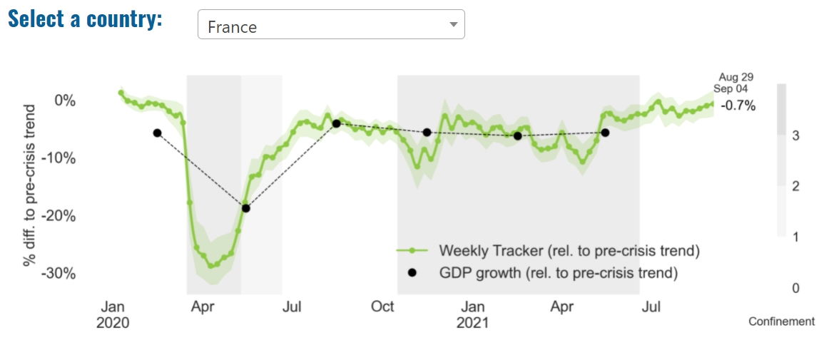
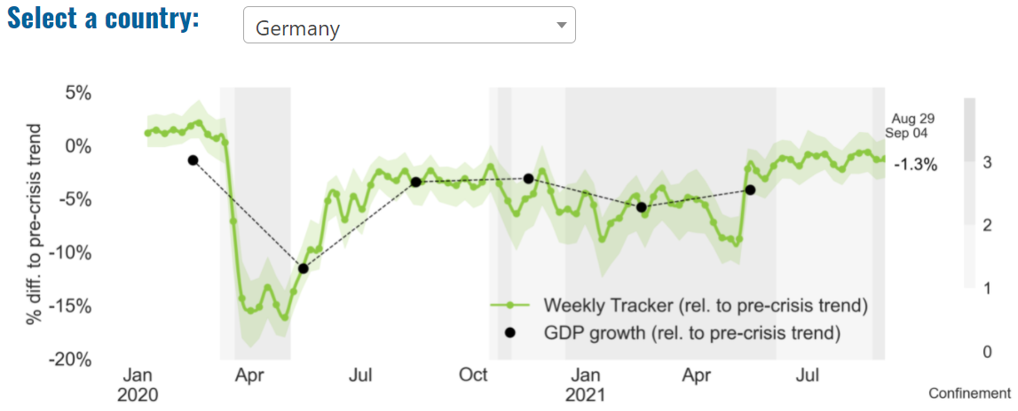
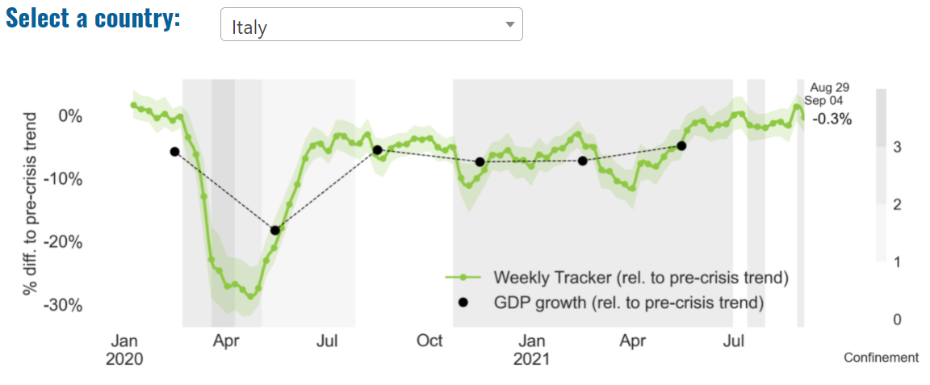
Global Economy – OECD GDP Tracker

Slide 6
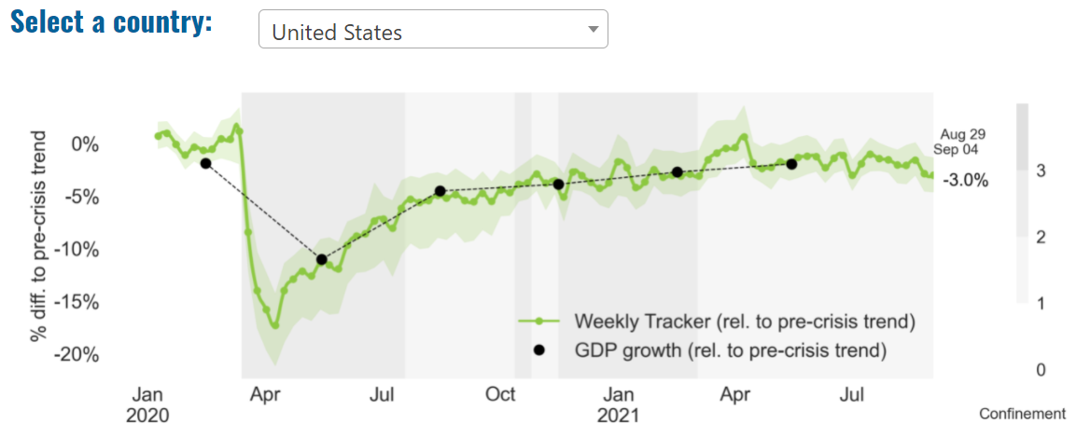
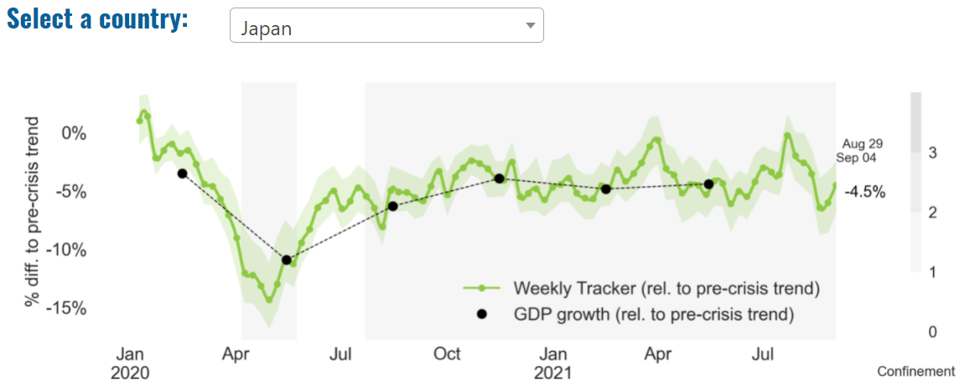
Global Economy – OECD GDP Tracker Continued
China
China is not included within the OECD GDP tracker and so the graph on the left has been compiled using statistics from the IMF and National Bureau of Statistics of China. The 2021 figure is a preliminary figure published by the National Bureau of Statistics of China in January 2021.
Note: The green confidence band shows 95% confidence intervals. The Weekly Tracker is an estimate of weekly GDP relative to the pre-crisis trend, which is proxied by the November 2019 OECD Economic Outlook forecasts. The darkness of the grey background reflects stay-at-home confinement requirement based on the Oxford Blavatnik database (0 - no measures, 1 - recommend not leaving house, 2 - require not leaving house with exceptions, 3 - require not leaving house with minimal exceptions). Source: OECD, August 2021

Slide 7
UK Economy
According to a report released by the Office for National Statistics (ONS), UK gross domestic product (GDP) is estimated to have increased by 4.8% in Q2 (Apr to June) 2021 following the easing of coronavirus restrictions. This means that the level of GDP is now 4.4% below where it was pre-coronavirus pandemic at Q4 (Oct to Dec) 2019.
However, the pattern of growth was erratic, with a 2.2% burst of growth in April slowing sharply to just 0.6% in May before accelerating once more to +1.0% in June. Fears that the arrival of the Delta variant and the ‘Pingdemic’ that followed might impact growth have so far not really materialised. The pattern of growth was driven by the reopening of the economy after lockdown. Consumer expenditure jumped by 7.3%, more than offsetting the weakness of the previous two quarters. Wage growth remains sluggish, despite many reports of hard to fill vacancies, with the ONS reporting employee compensation just 1.7% ahead.
Sources: Business Leader, August 2021; Deloitte, August 2021

Slide 8
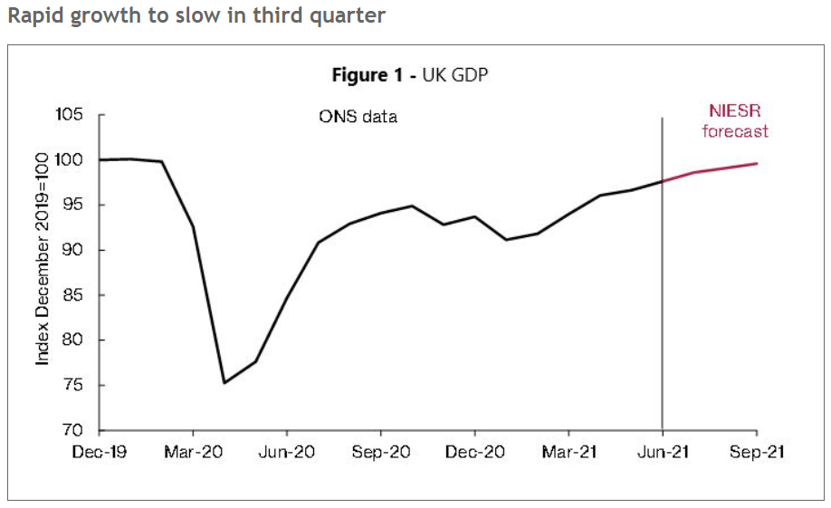
UK Economy 2
June’s month-on-month growth of 1 per cent in GDP was mainly driven by the effects of reopening which led to a 1.5 per cent growth in services sector in June 2021. Return to some normality in health activities and increased demand for indoor dining were the main contributors to rapid growth in services output. Meanwhile, production output contracted by 0.7 per cent in the same period.
In line with our GDP tracker a month ago, GDP increased by 4.8 per cent in the second quarter of 2021 driven by a strong rebound in consumption expenditure as Covid-19 restrictions were gradually lifted. Most of the rapid rise in GDP is due to services output which increased by 5.8 per cent in second quarter while growth in production output was much weaker with 0.5 per cent.
With catch-up potential still evident in consumer-facing services and the continued effects of reopening, we expect growth in July of 1 per cent, and 2.4 per cent for the third quarter of 2021 overall. This reflects our assumption that Covid-19 cases will continue to wane and remaining domestic restrictions imposed by governments and businesses will be lifted over the course of the third quarter.
With the level of GDP still below its pre-pandemic level by 4.4 per cent as of the second quarter and continued disparities at sector, household and region level, ensuring a sustainable and balanced recovery from the pandemic remains the biggest policy challenge. Source: NIESR, August 2021

Slide 9
UK Economy 3
Inflation in the UK in August jumped from two per cent to 3.2 per cent. This was the fastest one month rise since the Bank of England gained independence in 1997.
Policy makers have feared higher inflation for some time. Some expect it to remain high. Recruitment difficulties, supply chain issues and structural changes to the economy post-Covid are all having an effect.
Higher inflation creates a policy dilemma. The Bank of England could raise interest rates to try to dampen activity, but this would also dampen growth in the economy.
Furthermore, whilst many have saved money during Covid and are now in a position to spend – which risks fueling inflation further – others, especially the poorest and lowest paid, have suffered falls in living standards throughout the pandemic and higher interest rates would hit them too, raising fears of more division between the haves and the have-nots.

Slide 10
UK Economy 4
Political controversy followed the Government’s decision in September to increase National Insurance Contributions (NICs) by 1.25p more in the pound from April 2022 to pay for social care.
Criticisms came in various forms. Some argued that by using NICs rather than income tax, pensioners were protected – feeding the narrative that the young continue to subsidise the elderly, many of whom are relatively wealthy.
Some argued that the Government should tax wealth rather than earnings.
Some, including among Boris Johnson’s own MPs, said this undermined the Conservatives as a low tax party.
From April 2023, NICs will return to their current rate, and the extra tax will be collected as a new Health and Social Care Levy. This levy - unlike NICs - will also be paid by state pensioners who are still working, meeting one of the objections.
Furthermore, despite the criticisms, paying for social care is a long-standing problem and some commentators praise the Government for getting to grips with the issue.

Slide 11
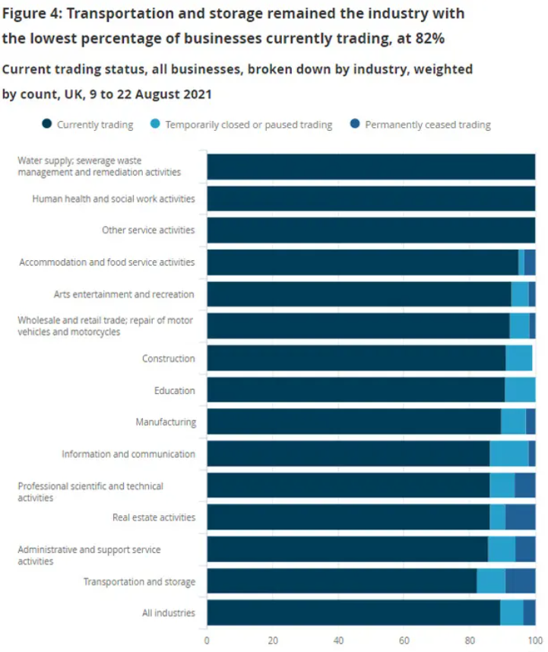
UK Economy 5
UK’s lorry driver shortage ‘could push food prices up’, as supply chain crisis hits confidence. The UK’s shortage of HGV drivers appears to be forcing some transportation and storage firms to suspend trading, according to the latest Office for National Statistics weekly healthcheck on the UK economy under the pandemic.
The Office for National Statistics says that, in 9 to 22 August 2021, 82% of transportation and storage business were currently trading. The report found that 9.1% of transport and storage firms have permanently ceased trading, while 8.5% are paused. In its Business insights and impact on the UK economy report, the ONS says: The high percentage of paused and not permanently ceased traders is partly driven by the freight transport by road industry and the unlicensed carriers industry. It has been reported that this industry has been experiencing a shortage of lorry drivers. Source: The Guardian, August 2021

Slide 12
Coronavirus and Recession: Implications for Thames Valley Berkshire

Slide 13
Furloughing (Latest data - June 2021)
28,900 jobs furloughed across Thames Valley Berkshire
3,700 jobs (6% of total eligible employments) furloughed in Bracknell Forest UA
7,100 (10% of total eligible employments) furloughed in Slough UA
4,700 jobs (5% of total eligible employments) furloughed in Reading UA
4,500 jobs (5% of total jobs) furloughed in Wokingham UA
5,200 jobs (8% of total jobs) furloughed in Windsor and Maidenhead
3,700 jobs (5% of total jobs) furloughed in West Berkshire
Source: HMRC, July 2021
Berkshire has a lower-than-average number of furloughed workers, compared to the rest of the UK, because of its relative strength in sectors of industry that can be continued by workers from home.

Slide 14
SEISS (Latest data - June 2021)
Total value of claims made across Thames Valley Berkshire: £371,600,000
Total value of claims made for Bracknell Forest UA – All SEISS: £57,700,000
Total value of claims made for Slough UA – All SEISS: £72,300,000
Total value of claims made for Reading UA – All SEISS: £59,400,000
Total value of claims made for Wokingham – All SEISS: £62,400,000
Total value of claims made for Windsor and Maidenhead – All SEISS: £56,800,000
Total value of claims made in West Berkshire – All SEISS: £63,000,000
Source: HMRC, July 2021

Slide 15
Claimant Count (Latest data - July 2021)
Total of 25,170 claimants (4.4% of the working age population) in Thames Valley Berkshire
2,725 claimants (3.4% of the working age population) in Bracknell Forest UA
7,115 claimants (7.6% of the working age population) in Slough UA
6,160 claimants (5.8% of the working age population) in Reading UA
2,755 claimants (2.6% of the working age population) in Wokingham UA
3,265 claimants (3.5% of the working age population) in Windsor and Maidenhead UA
3,150 claimants (3.3% of the working age population) in West Berkshire UA
Across Thames Valley Berkshire, claimant unemployment has fallen significantly from 29,290 in July 2020 to 25,170 in July 2021. Slough had 7.6% of its working age population claim unemployment in July 2021, down slightly from 8.1% in July 2020.
Source: ONS, July 2021

Slide 16
Strategic Issues: Heathrow
Heathrow Airport
Heathrow passenger numbers remained 71% down in August over the same pre-pandemic summer peak month in 2020. The London hub blamed ever-changing travel restrictions, expensive and unnecessary testing requirements and lack of a common approach across borders continue to hinder the UK’s economic recovery. Heathrow has dropped from being the busiest airport in Europe in 2019 to 10th busiest, as rivals including Schiphol, Paris and Frankfurt are all recovering at a much faster pace. The airport said: “The current traffic light system is an outlier and is delaying the government’s ‘global Britain’ ambitions, handing rivals a competitive advantage while the UK loses market share.
Heathrow urged ministers at the upcoming Global Travel Taskforce to streamline the system to get travel levels and the economic activity safely back to pre-pandemic levels, “otherwise the UK will continue to lose trade and face lower levels of foreign tourism, impacting jobs and slowing the UK’s economic recovery”. Source: Travel Weekly, September 2021

Slide 17
Strategic Issues: Aviation
Aviation:
The UK Civil Aviation Authority has published aviation statistics for the second quarter of 2021. Overall, 6.3 million passengers flew in and out of the UK between April and June this year (compared to 3.4 million in quarter one 2021), across 124,000 flights (81,000 flights in quarter one 2021). This represents a 92% fall in passenger numbers compared to the same period in 2019, before the coronavirus pandemic. The latest quarter saw several updates to Government travel guidance. International leisure travel started to reopen from 17 May 2021 with the 'traffic light' system introduced.
Overall levels of cargo transport were down 9% compared to the same period in 2019, with 605,436 tonnes of cargo carried. However, cargo-only flights saw a 114% increase in goods transported, with 444,643 tonnes carried. The average flight delay also improved, with an average wait of six minutes per flight (down from nine minutes in quarter one 2021) and 89.2% of flights departing on time.
We are beginning to see an increase in international leisure travel, particularly across Portugal and Spain, as the travel sector looks to safely recover from the coronavirus pandemic. Following the steady relaxation of isolation rules for a variety of destinations, including those for double vaccinated UK citizens, we expect further recovery of the number of flights and passengers in quarter three 2021. Source: Civil Aviation Authority, August 2021

Slide 18
Demand and Supply Conditions: Businesses, Hiring, Restructuring, Investment, Labour and Skills Supply

Slide 19
Household/Consumer Demand
Slough had an overall recovery index score of 62 at the end of August, putting them in a weaker position in terms of recovery (closer to pre-lockdown levels) than Reading which had a recovery index score of 95.
Source: Centre for Cities, August 2021 (latest release)
Retail sales volumes fell by 2.5% between June and July 2021; looking more broadly, however, they were up by 5.2% in the three months to July compared with the previous three months and are 5.8% higher than their pre-coronavirus (COVID-19) pandemic February 2020 levels.
Food store sales volumes fell by 1.5% in July 2021, following an increase in the previous month when sales were positively boosted by the start of the Euro 2020 football championship.
Non-food stores reported a fall of 4.4% in sales volumes in July 2021 when compared with June 2021, driven by falls in other stores (negative 10.1%), such as second-hand goods stores and computer and telecoms equipment stores.
Automotive fuel sales volumes fell by 2.9% over the month, its first monthly fall since February 2021; with heavy rainfall in early July impacting road traffic volumes, automotive fuel sales volumes are now 6.7% below their pre-coronavirus pandemic February 2020 levels.
The proportion of retail sales online increased to 27.9% in July from 27.1% in June and remains substantially higher than the proportion of online retail spending in February 2020 (pre-coronavirus pandemic) of 19.8%. Source: ONS, August 2021 (latest release)

Slide 20
Industries at Risk
MANUFACTURING
28,000 people work in manufacturing in Berkshire – with 11,000 in West Berkshire alone and 2,487,000 across the whole of Great Britain (ONS, 2020)
Half of all UK manufacturing firms have made redundancies. A further 20% plan to make more redundancies in the next six months (Make UK, October 2020)
37% of manufacturers think it will take more than a year to return to normal trading conditions (Make UK, October 2020)
HOSPITALITY & TOURISM
The hospitality and tourism sector in Berkshire employed 35,842 people in 2020 – an increase of 0.8% on the previous year (EMSI, 2021)
In June, ‘Pathways to Recovery’, a report by the All Party Parliamentary Group on Hospitality and Tourism, found that just 11% of hospitality businesses had been able to operate normally during the first lockdown and international tourist arrivals were likely to be down 59% for the year.
Kate Nicholls, CEO of UK Hospitality, told the BBC (December 2020) that 30,000 hospitality businesses – most of them SMEs and one-third of the total – could be lost by the end of 2020.
According to Sky News in December, at least 38,653 hospitality jobs had been lost during the pandemic.
CONSTRUCTION
21,000 people work in construction in Berkshire – with only 1,500 of these working in Bracknell Forest and 2,164,000 across the whole of Great Britain (ONS, 2020)
The level of construction output in August 2020 was 10.8% below the February 2020 level (ONS, 2020)
Construction output grew by 18.5% in the three months to August 2020 compared with the previous three-month period, but this followed 10 consecutive periods of decline (ONS, 2020)
NON-FOOD RETAIL & WHOLESALE
More than 45,000 people work in non-motor vehicle retail in Berkshire – with 12,500 of them working in Reading (EMSI, 2021). The offline retail sector has struggled during the pandemic. At least 39,000 jobs had been lost in retail as of 3 December. Redundancy announcements include 7,000 at Marks and Spencer (August), 4,000 at Debenhams (August) and 4,000 at Boots (July) - Sky News, 2020.
The pre-pandemic trend of on-line shopping has strengthened in 2020; a record total of 31.4% of shopping was done on line in November 2020 (ONS, 2020), a trend that will have profound implications for the high street.
In November, retail sales volume decreased by 3.8% (vs October figures) as a result of COVID-19. Despite this, overall sales remain above their pre-pandemic levels (ONS, 2020).
ARTS, ENTERTAINMENT & RECREATION
12,000 people work in arts, entertainment and recreation in Berkshire. 4,500 of them – more than one third – work in Windsor and Maidenhead and 925,000 across the whole of Great Britain (ONS, 2020)
Between 19 Nov and 1 Dec, 24 per cent of arts, entertainment and recreation venues had temporarily closed or paused trading. (ONS, 2020)
52% of eligible employments in arts, entertainment and recreation were on furlough on 31 July 2020 – a figure that had fallen to 24% as at 31 October. (HMRC, 2020)
AVIATION
Aviation has an estimated value of £28 billion to the UK economy, employing 230,000 workers at over 40 commercial airports. (House of Commons Transport Committee, June 2020)
76,000 people work in over 400 business across Heathrow Airport. Many of these people live in Slough, in Berkshire. (Heathrow local recovery plan, 2020)
There were 5,800 passenger flights in April 2020 compared to 201,000 a year earlier: a reduction of 97%. The impact is several times more severe than the aftermath of the global financial crisis in 2008, when passenger flights reduced by around 67,000 to 134,000 per month. (House of Commons Transport Committee, June 2020)
The UK aviation industry has been hit harder than any European country by the pandemic with IATA calculating that the “coronavirus crisis will cost 780,000 British jobs and cost £46bn in lost GDP.” (International Air Transport Association, 2020).
ADMINISTRATION & SUPPORT
More than 51,000 people in Berkshire work in admin and support services – including 10,000 in Wokingham and 10,000 in West Berkshire and 2,752,000 across the whole of Great Britain (ONS, 2020)
More than 600,000 admin and support workers – 27% of the total – were furloughed as at 31 October (HMRC, 2020)

Slide 21
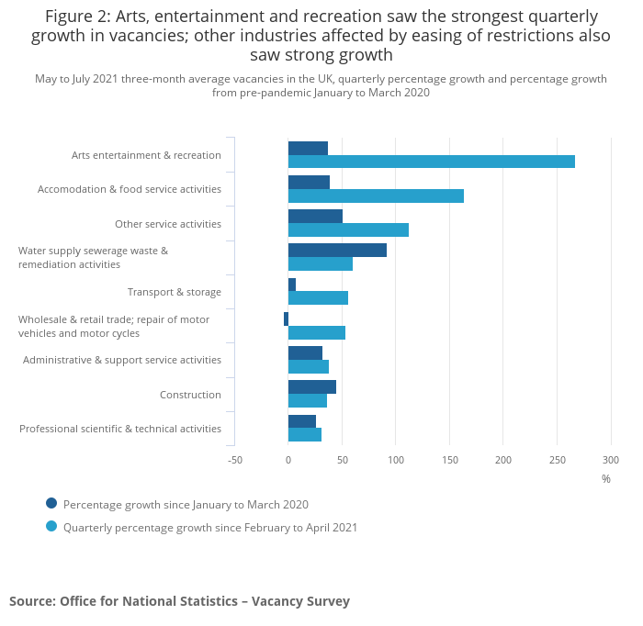
Industries showing strong growth in advertised vacancies as a result of easing of COVID-19 restrictions
Quarterly growth was seen across all industries. The fastest rate of growth was seen in arts, entertainment and recreation, which grew by 267.1% (23,000).
The largest increase in levels was seen in accommodation and food service activities, which grew by 73,000 (163.7%).
Both industries are likely to have seen demand for labour increase, as coronavirus restrictions eased through the spring into the summer. In 10 of the 18 industries, the number of vacancies equalled or reached record-high levels in May to July 2021.
Source: ONS, August 2021.

Slide 22
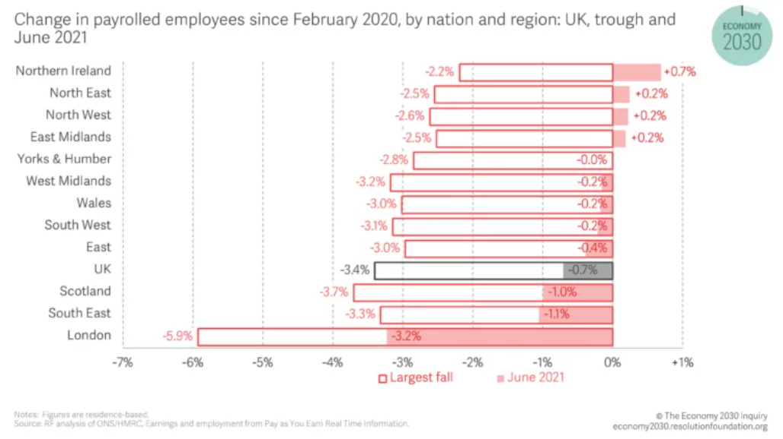
Supply of labour and skills
Figure 1 provides a broad overview of the Covid-19 labour market hit and bounce-back to date. Here, we show the percentage change in the number of payrolled employees since February 2020 for nations of the UK and regions of England (furloughed workers are counted as employed on this measure). As this makes clear, those areas which experienced the weakest Covid-19 jobs hit in the first instance have now returned to form: employee numbers in Northern Ireland, the North East, the North West and East Midlands in June 2021 were above pre-pandemic levels.
Source: Resolution Foundation, August 2021

Slide 23
Remote working
In August of 2021, there were 3,166 unique job postings for remote positions at companies based in Berkshire, around 249% more than the figure of 906 for the same period one year previous.
Compare this with the South East, in August 2021 there were 20,935 unique remote job postings for remote positions; rising from 5,844 in August of the previous year – an increase of over 258%
A rise can also be seen at national level, with a recorded 133,185 unique remote job postings in England in August of 2021, rising from 37,571 in August 2020 – an increase of over 254%.
From these figures it’s apparent that the COVID-19 pandemic has, somewhat unsurprisingly, prompted a massive boost in job postings for explicitly remote roles. Berkshire has seen a slightly smaller boost in vacancies which are remote-based than both England and the South East.
Source: EMSI, August 2021

Slide 24
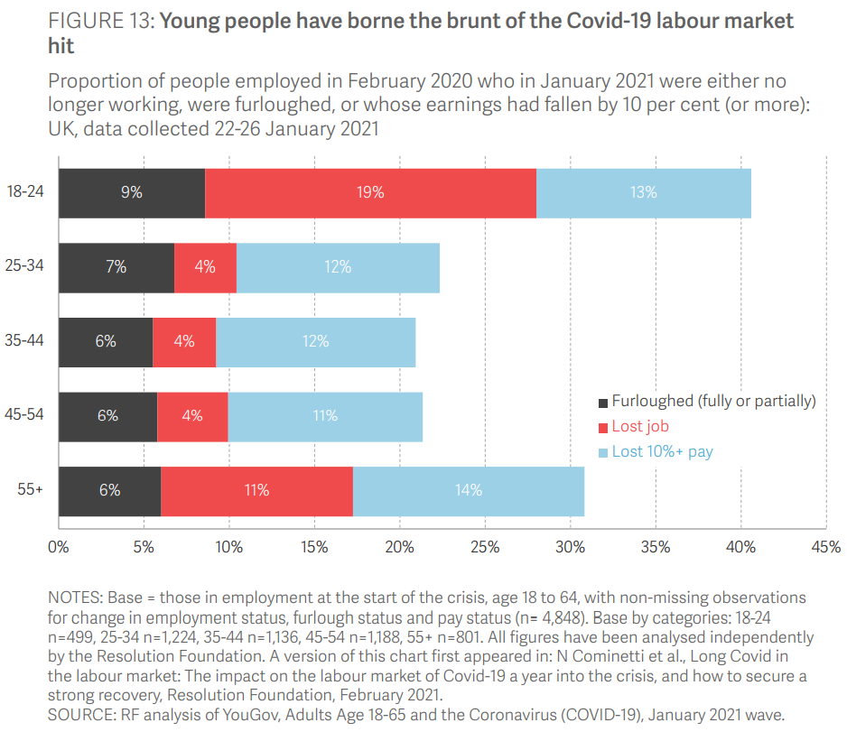
The labour market and mental health impact of COVID-19 on young people
Young people have been hit hardest by the Covid-19 crisis when it comes to jobs. By January 2021, almost one-in-five (19 per cent) 18-24-year-olds who were in work before the pandemic were no longer working, compared to just 4 per cent of 25-54-year-olds and 11 per cent of over-55s.
Economic downturns often do have a disproportionate effect on young people: entering work in the first place is harder when opportunities are scarce, and with shorter tenures, young workers are frequently the first to be let go. But the Covid-19 crisis has hit young people’s jobs especially hard for two key reasons. First, hospitality and parts of retail, sectors that provide so much youth employment, have effectively ground to a halt over the last year. Second, and not unrelated, young people who were in insecure work on the eve of the crisis have been more vulnerable to losing their jobs: more than one-third (36 per cent) of 18-24-year-olds on a zero-hours, agency or temporary contract before the crisis were no longer working in January 2021, compared to 14 per cent of their peers in more typical forms of work.
Young people’s mental health has been especially affected over the past year compared to older age groups. One-half (51 percent) of 18-24-year-olds had Common Mental Health Disorders (CMD) in April 2020, up from 30 percent in the pre-crisis period. In contrast, the CMD rate for older age groups rose less steeply, and of course from a lower base (23 percent in 2018-2019 for those aged 55-64, for example, rising to 34 percent in April 2020).
Source: Resolution Foundation, May 2021

Slide 25
Local Profiles

Slide 26
Bracknell Forest

Slide 27
Impact of COVID-19 up to 7th September 2021
COVID-19 cases (to 7th September 2021) – Source: Public Health Berkshire COVID-19 Dashboard, 7th September 2021
11,462 total cases
52 new cases daily
Claimant unemployment (to July 2021)
2,725 claimants (3.4% of the working age population) in Bracknell Forest UA
Notable business news:
The Bracknell Forest Cambium Partnership has secured planning permission, subject to a Section 106 agreement, for its vision to develop the Coopers Hill site on the edge of Bracknell town centre – furthering the town’s continued regeneration. Coopers Hill is the first site to be developed by the joint-venture (JV) partnership between Countryside, the UK’s leading mixed-tenure developer, and Bracknell Forest Council. This £124m partnership is continuing the council’s regeneration efforts, that began with the redevelopment of The Lexicon in 2017, to provide a fully revitalised town centre. The Coopers Hill development will provide 52 new homes, with 25% affordable (15% affordable rent and 10% shared ownership). These will comprise 12 two-bedroom flats, six three-bedroom flats, 22 two-bedroom houses and 12 three-bedroom houses.
Source: Building Design and Construction Magazine, August 2021

Slide 28
Industries hit hardest by COVID shutdown
As illustrated by the above graph, Bracknell Forest has suffered very similarly to Great Britain in terms of the percentage of jobs within industries which have been hit hardest by COVID shutdowns. Thames Valley Berkshire area has seen an additional 0.77% of jobs of jobs affected worst by the COVID shutdowns when compared to Bracknell Forest.
Source: EMSI, March 2021 (definition for industries hit hardest provided on slide 56)

Slide 29
Industry risks and opportunities (2020-2021)
Critical industries
Food and drink retail: 3,234 employees (1% below the national average)
Energy/utilities: 257 employees (65% below the national average)
Health and social care: 6,193 employees (25% below the national average)
Freight/logistics: 515 employees (70% below the national average)
Insurance: 186 employees (69% below the national average)
Banking and financial services: 1,291 employees (13% below the national average)
Sectors most impacted
Hospitality and tourism: 3,743 employees (26% below the national average)
Arts, entertainment and recreation: 1,148 (24% below the national average)
Admin and support: 2,694 (21% below the national average)
Aviation: 0 employees
Non-food retail and wholesale: 8,508 (75% above the national average)
Manufacturing: 1,549 (69% below the national average)
Construction: 1,771 (40% below the national average)
Source: EMSI, January 2021

Slide 30
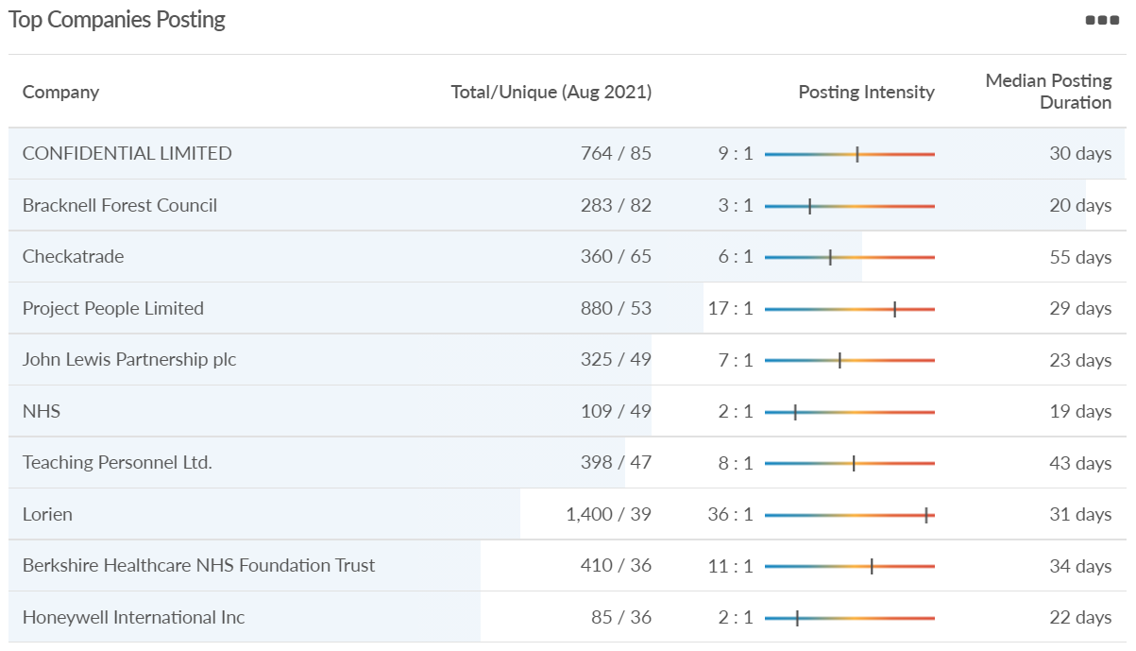
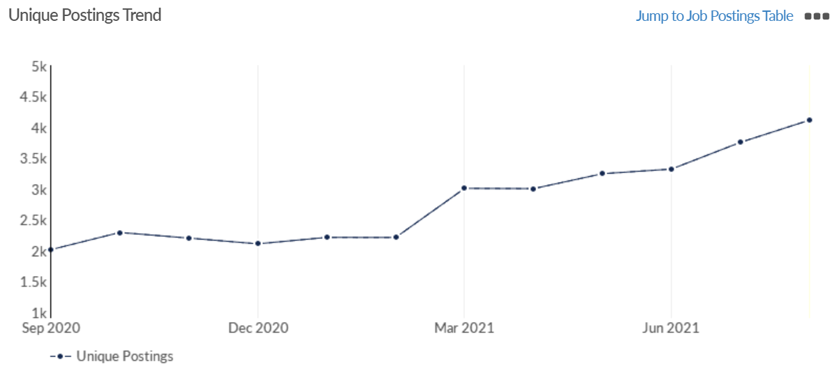
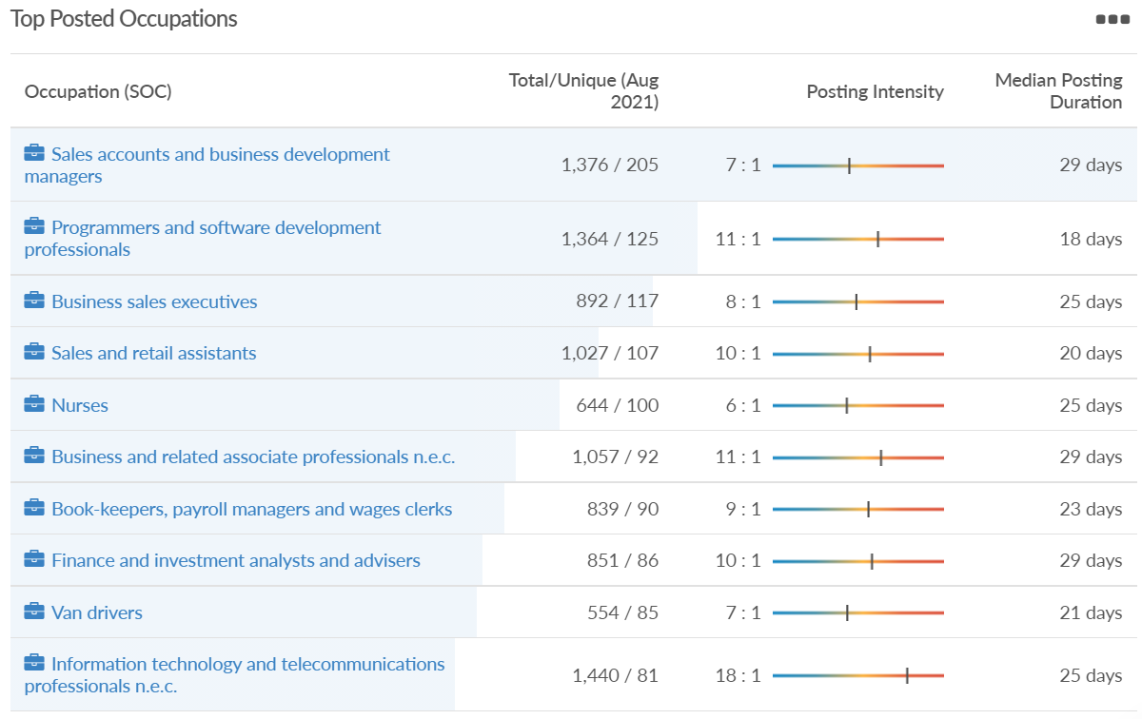
Job posting analytics (EMSI, August 2021)
Unique job postings: 4,117
Total job postings: 32,388
Job posting intensity: 8:1
Unique job postings (July 2020): 1,797

Slide 31
Slough

Slide 32
Impact of COVID-19 up to 7th September 2021
COVID-19 cases (to 7th September 2021) – Source: Public Health Berkshire COVID-19 Dashboard, 7th September 2021
20,047 total cases
72 new cases daily
Claimant unemployment (to July 2021)
7,115 claimants (7.6% of the working age population) in Slough UA
Notable business news:
A Greggs drive-thru is set to open in Slough. The building is located just off of Bath Road near the Westgate Retail Park. Unlike the conventional high street shop where customers walk in, drivers can simply pull up, order and collect their food.
Source: Slough Observer, August 2021

Slide 33
Industries hit hardest by COVID shutdown
When compared to both Thames Valley Berkshire and Great Britain, Slough has seen a significantly lower percentage of jobs affected by COVID shutdowns – perhaps somewhat surprising given the LA’s proximity to Heathrow and the almost complete shutdown of the aviation sector.
Source: EMSI, March 2021 (definition for industries hit hardest provided on slide 56)

Slide 34
Industry risks and opportunities (2020-2021)
Critical industries
Food and drink retail: 6,656 employees (47% above the national average)
Energy/utilities: 2,820 employees (174% above the national average)
Health and social care: 8,201 employees (28% below the national average)
Freight/logistics: 4,640 employees (93% above the national average)
Insurance: 121 employees (86% below the national average)
Banking and financial services: 731 employees (65% below the national average)
Sectors most impacted
Hospitality and tourism: 3,780 employees (46% below the national average)
Arts, entertainment and recreation: 442 (79% below the national average)
Admin and support: 9,765 (107% above the national average)
Aviation: 262 employees (16% above the national average)
Non-food retail and wholesale: 6,719 (0% above the national average)
Manufacturing: 5,071 (28% below the national average)
Construction: 2,620 (36% below the national average)
Source: EMSI, January 2021

Slide 35
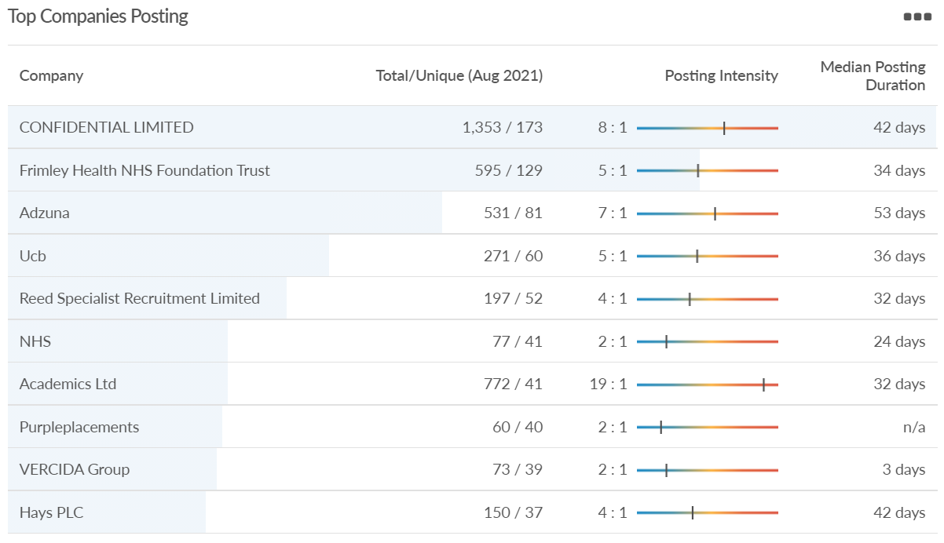
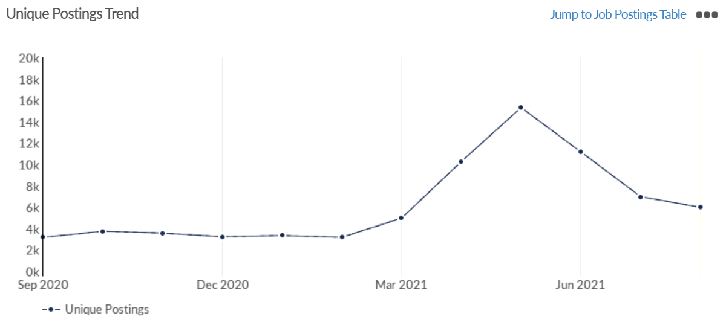
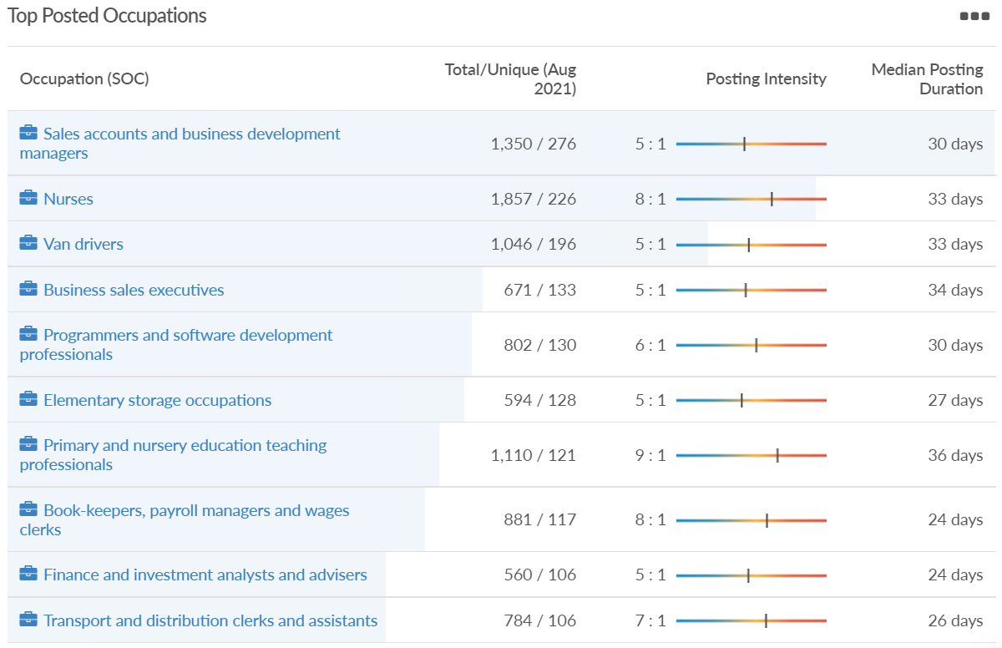
Job posting analytics (EMSI, August 2021)
Unique job postings: 5,997
Total job postings: 33,645
Job posting intensity: 6:1
Unique job postings (July 2020): 2,835

Slide 36
Reading

Slide 37
Impact of COVID-19 up to 7th September 2021
COVID-19 cases (to 7th September 2021) – Source: Public Health Berkshire COVID-19 Dashboard, 7th September 2021
17,280 total cases
80 new case daily
Claimant unemployment (to July 2021)
6,160 claimants (5.8% of the working age population) in Reading UA
Notable business news:
A Reading-based company which wants to revolutionise the monitoring of diseases such as diabetes and Alzheimer’s, is seeking to raise £1,800,000 on Seedrs. The company has been supported by the Berkshire Growth Hub. Source: Business Innovation Magazine, August 2021

Slide 38
Industries hit hardest by COVID shutdown
Reading has been marginally less affected by the COVID shutdowns as Great Britain has on average, with 15.16% of jobs within industries which have been most severely impacted by the shutdowns. The Local Authority is 1.26% better off than the average of the Thames Valley Berkshire area.
Source: EMSI, March 2021 (definition for industries hit hardest provided on slide 56)

Slide 39
Industry risks and opportunities (2020-2021)
Critical industries
Food and drink retail: 6,192 employees (11% above the national average)
Energy/utilities: 3,350 employees (163% above the national average)
Health and social care: 13,464 employees (5% below the national average)
Freight/logistics: 1,513 employees (49% below the national average)
Insurance: 2,076 employees (100% above the national average)
Banking and financial services: 1,688 employees (34% below the national average)
Sectors most impacted
Hospitality and tourism: 6,567 employees (25% below the national average)
Arts, entertainment and recreation: 1,811 (31% below the national average)
Admin and support: 9,212 (58% above the national average)
Aviation: <10 employees
Non-food retail and wholesale: 8,626 (18% above the national average)
Manufacturing: 2,000 (77% below the national average)
Construction: 2,273 (55% below the national average)
Source: EMSI, January 2021

Slide 40
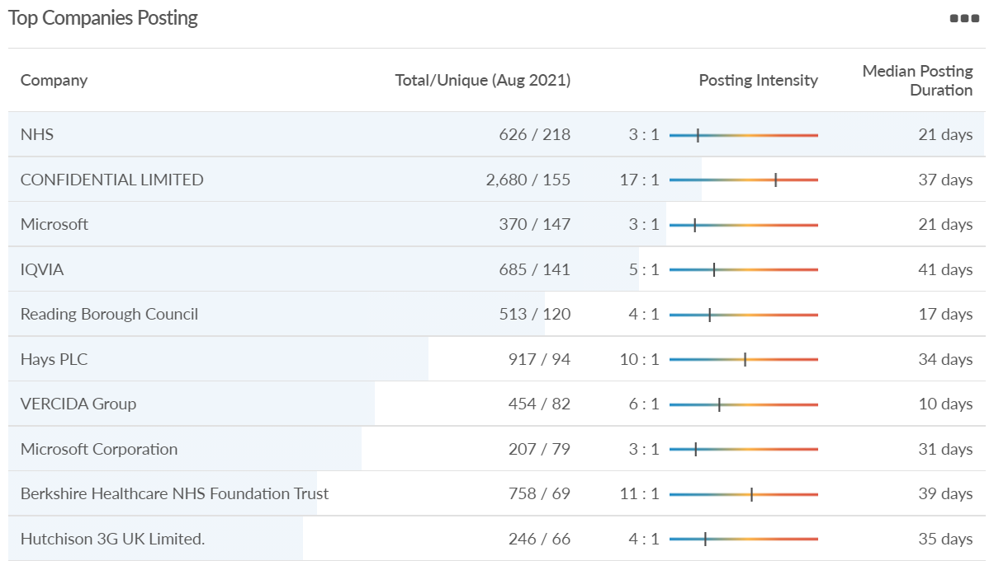
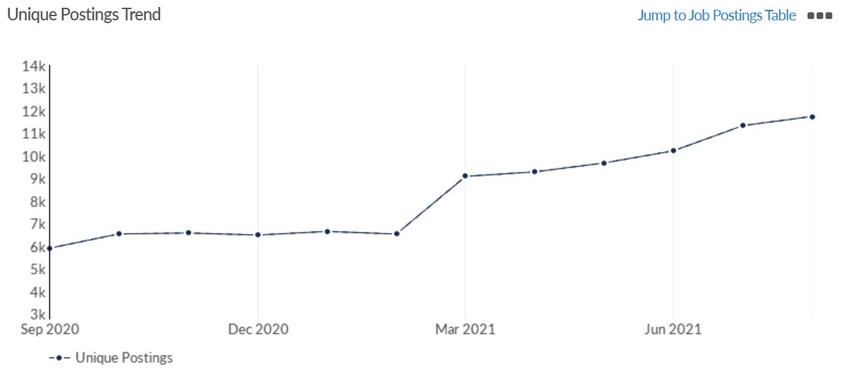
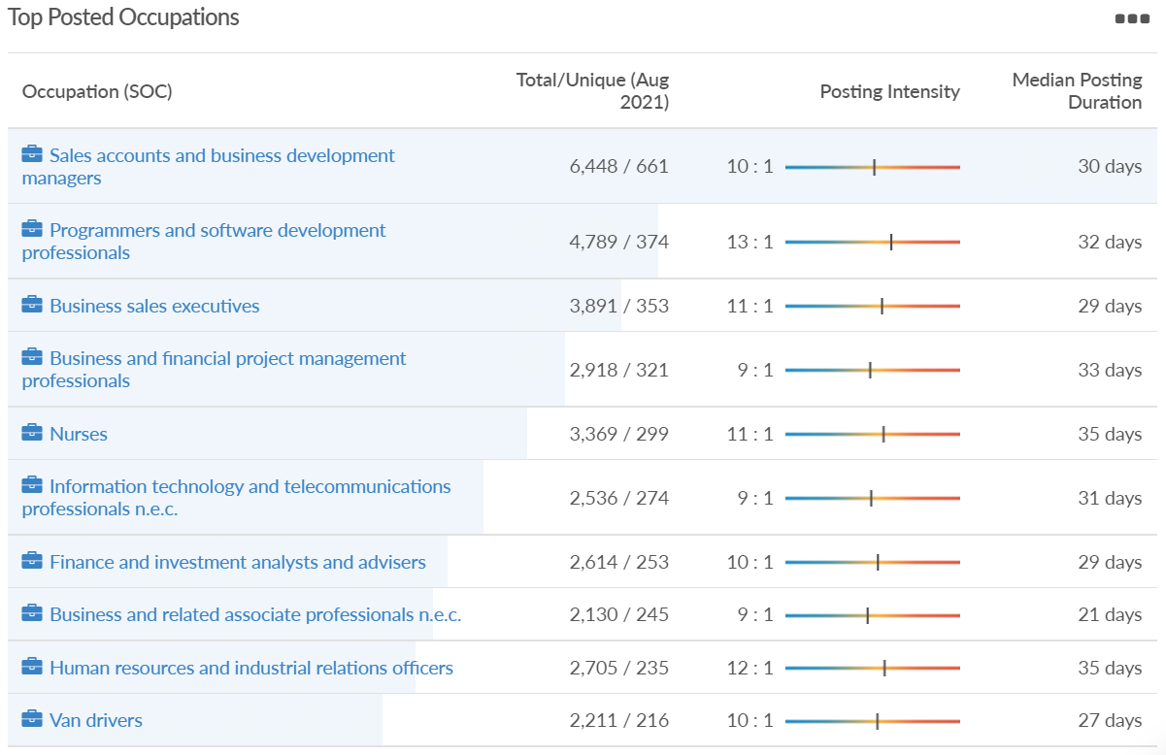
Job posting analytics (EMSI, August 2021)
Unique job postings: 11,738
Total job postings: 110,728
Job posting intensity: 9:1
Unique job postings (June 2020): 5,505

Slide 41
Wokingham

Slide 42
Impact of COVID-19 up to 7th September 2021
COVID-19 cases (to 7th September 2021) – Source: Public Health Berkshire COVID-19 Dashboard, 7th September 2021
13,900 total cases
85 new cases daily
Claimant unemployment (to July 2021)
2,755 claimants (2.6% of the working age population) in Wokingham UA
Notable business news:
Henley Business School is getting technical with its latest research project. It has partnered with Huawei UK as part of a 12-month programme to investigate the factors that impacted the phone company’s 5G roll-out. The study, led by Professor Yinshan Tang, will consider the strategies, tactics, environmental and cross-cultural reasons why its 5G tech was excluded in Europe. “We are aiming to provide a holistic and balanced view on why Huawei’s 5G technology has been facing such challenges in the rolling out of the new technology,” Professor Tan said. “It is hoped that the findings from the research may identify important learnings for similar 5G infrastructure projects in future.”
Source: Wokingham Today, August 2021

Slide 43
Industries hit hardest by COVID shutdown
Wokingham is in a similar position to Slough in that is has been significantly less affected by the COVID shutdowns than both the Thames Valley Berkshire area and Great Britain as a whole. This is likely due to the high levels of employment from the Tech sector (Microsoft etc. based at TVP) as this industry is able to work well from home.
Source: EMSI, March 2021 (definition for industries hit hardest provided on slide 56)

Slide 44
Industry risks and opportunities (2020-2021)
Critical industries
Food and drink retail: 3,883 employees (17% below the national average)
Energy/utilities: 1,434 employees (35% above the national average)
Health and social care: 7,283 employees (38% below the national average)
Freight/logistics: 886 employees (64% below the national average)
Insurance: 453 employees (48% below the national average)
Banking and financial services: 423 employees (80% below the national average)
Sectors most impacted
Hospitality and tourism: 5,410 employees (25% below the national average)
Arts, entertainment and recreation: 1,831 (16% below the national average)
Admin and support: 6,432 (33% above the national average)
Aviation: 0 employees
Non-food retail and wholesale: 6,494 (6% below the national average)
Manufacturing: 3,731 (48% below the national average)
Construction: 3,115 (26% below the national average)
Source: EMSI, January 2021

Slide 45
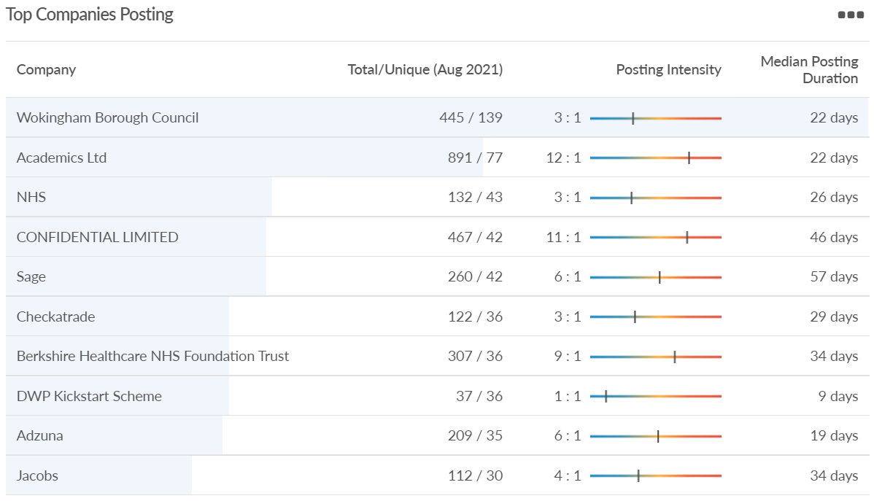
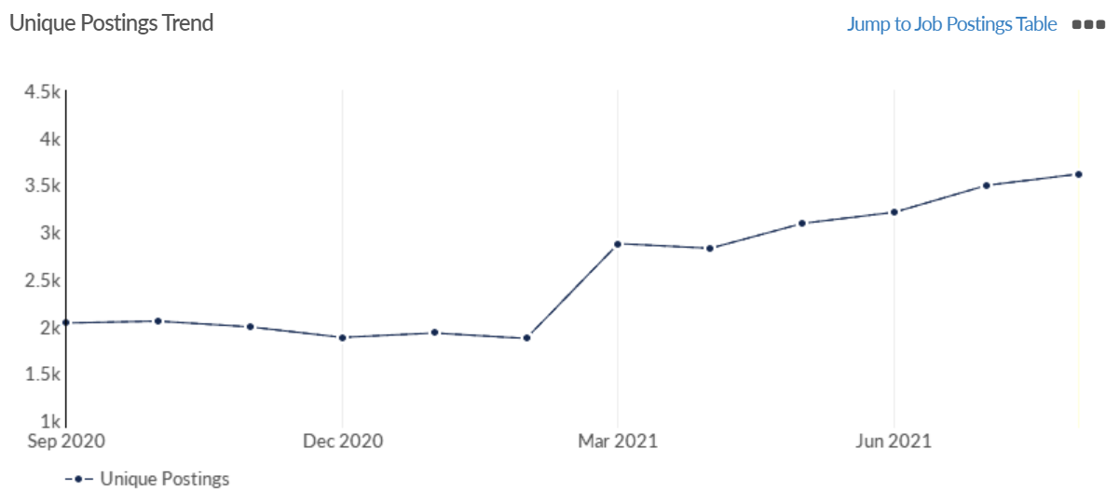
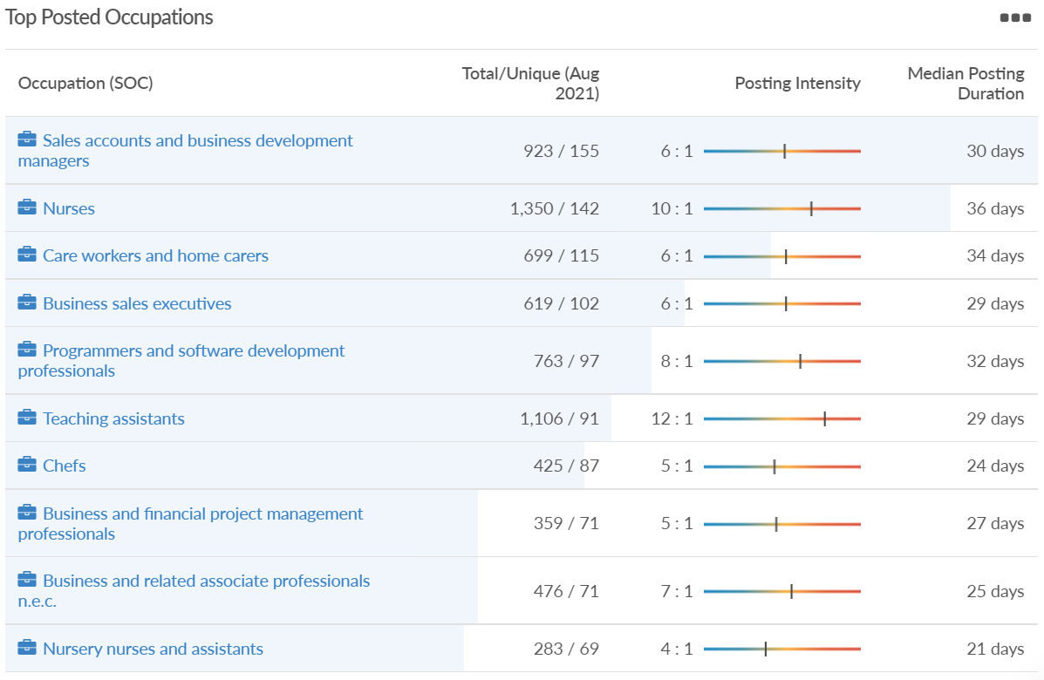
Job posting analytics (EMSI, August 2021)
Unique job postings: 3,614
Total job postings: 20,454
Job posting intensity: 6:1
Unique job postings (August 2020): 1,863

Slide 46
Windsor and Maidenhead

Slide 47
Impact of COVID-19 up to 7th September 2021
COVID-19 cases (to 7th September 2021) – Source: Public Health Berkshire COVID-19 Dashboard, 7th September 2021
13,396 total cases
98 new cases daily
Claimant unemployment (to July 2021)
3,265 claimants (3.5% of the working age population) in Windsor and Maidenhead UA
Notable business news:
A country pub in Berkshire has found itself on the top 100 list at the Estrella Damm National Restaurant Awards 2021. The list features the top 100 places to eat across the UK as voted for by an elite academy of chefs, restaurateurs and food writers nationwide. Maidenhead's The Crown in Burchett's Green came in at number 68 in the top 100 and was described as a pub which provides "classical dishes with personality and flavour“.
Source: Windsor Observer, August 2021

Slide 48
Industries hit hardest by COVID shutdown
Windsor and Maidenhead appears to be the most severely affected of all the Local Authorities which make up Berkshire in terms of percentage of jobs hit hardest by the COVID shutdowns. This is likely due in part to the enormous hit the leisure/tourism sector has taken and how key of an employer Legoland Windsor to the region.
Source: EMSI, March 2021 (definition for industries hit hardest provided on slide 56)

Slide 49
Industry risks and opportunities (2020-2021)
Critical industries
Food and drink retail: 3,733 employees (17% below the national average)
Energy/utilities: 882 employees (13% below the national average)
Health and social care: 8017 employees (29% below the national average)
Freight/logistics: 748 employees (68% below the national average)
Insurance: 434 employees (48% below the national average)
Banking and financial services: 1,252 employees (39% below the national average)
Sectors most impacted
Hospitality and tourism: 9,437 employees (35% above the national average)
Arts, entertainment and recreation: 4,516 (117% above the national average)
Admin and support: 4,207 (10% below the national average)
Aviation: 11 employees (95% below the national average)
Non-food retail and wholesale: 7,834 (18% above the national average)
Manufacturing: 2,523 (64% below the national average)
Construction: 6,201 (54% above the national average)
Source: EMSI, January 2021

Slide 50
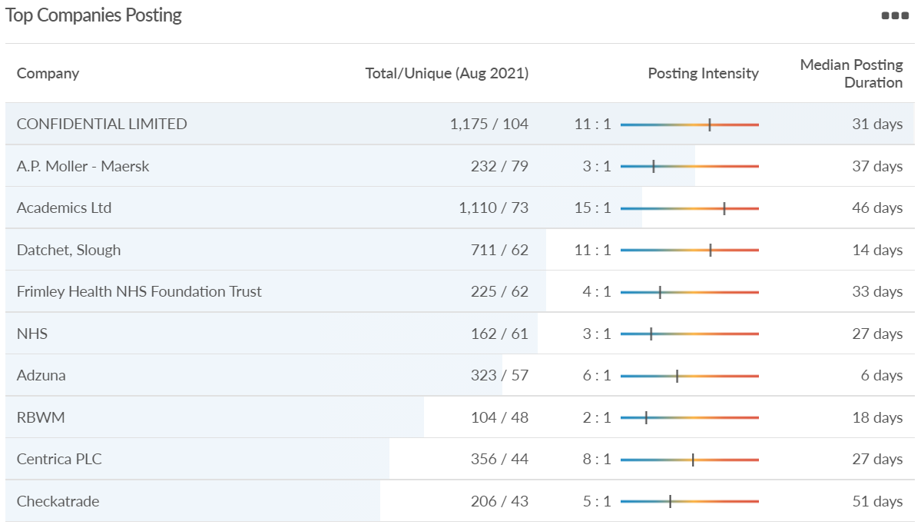
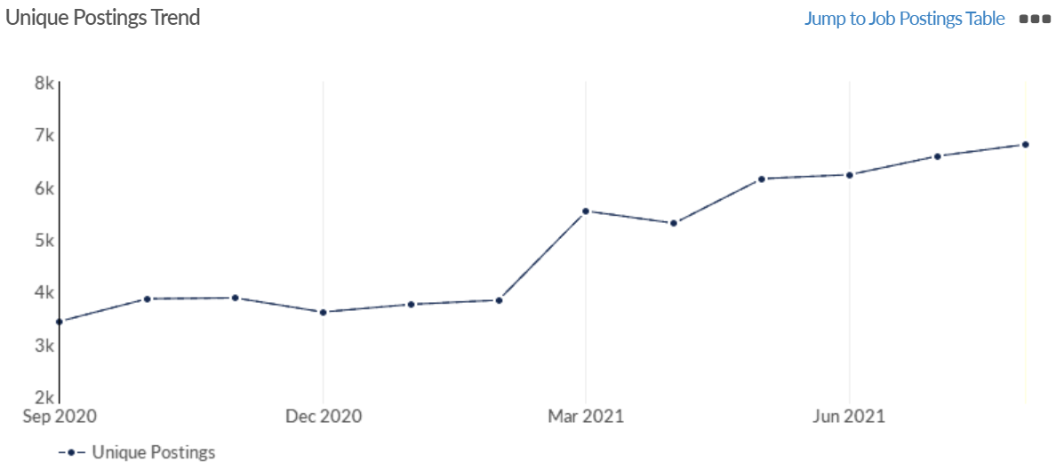
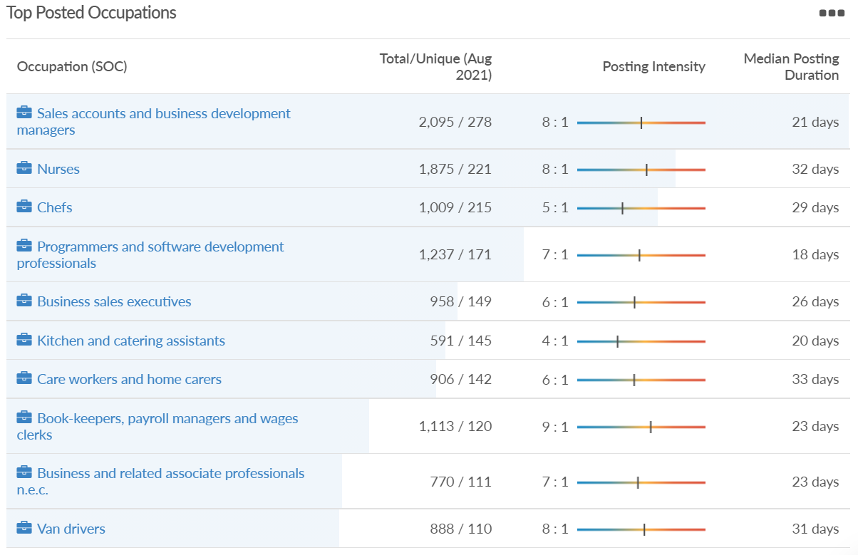
Job posting analytics (EMSI, August 2021)
Unique job postings: 6,808
Total job postings: 51,043
Job posting intensity: 7:1
Unique job postings (August 2020): 3,177

Slide 51
West Berkshire

Slide 52
Impact of COVID-19 up to 7th September 2021
COVID-19 cases (to 7th September 2021) – Source: Public Health Berkshire COVID-19 Dashboard, 7th September 2021
11,278 total cases
76 new case daily
Claimant unemployment (to July 2021)
3,150 claimants (3.3% of the working age population) in West Berkshire UA
Notable business news:
West Berkshire residents can now get their first glimpse of the proposed Newbury Sports Hub with new images showing the club house and playing pitch. A planning application has been submitted for the Sports Hub site which will be located on land at Newbury Rugby Football Club. West Berkshire Council and Newbury Rugby Football Club have worked in partnership so that football teams and rugby teams can use the new pitch alongside the existing rugby club facilities.
Source: West Berkshire Council, August 2021.

Slide 53
Industries hit hardest by COVID shutdown
While West Berkshire hasn’t been as fortunate as Slough in terms of how great of a percentage of jobs have been directly affected by the COVID shutdown, it has fared significantly better than the Thames Valley Berkshire area and better than Great Britain.
Source: EMSI, March 2021 (definition for industries hit hardest provided on slide 56)

Slide 54
Industry risks and opportunities (2020-2021)
Critical industries
Food and drink retail: 4,289 employees (17% below the national average)
Energy/utilities: 1,343 employees (14% above the national average)
Health and social care: 6,773 employees (48% below the national average)
Freight/logistics: 1,574 employees (43% below the national average)
Insurance: 262 employees (73% below the national average)
Banking and financial services: 692 employees (71% below the national average)
Sectors most impacted
Hospitality and tourism: 6,617 employees (18% below the national average)
Arts, entertainment and recreation: 2,674 (10% above the national average)
Admin and support: 4,803 (11% below the national average)
Aviation: <10 employees
Non-food retail and wholesale: 8,432 (9% above the national average)
Manufacturing: 11,330 (41% above the national average)
Construction: 4,813 (3% above the national average)
Source: EMSI, January 2021

Slide 55
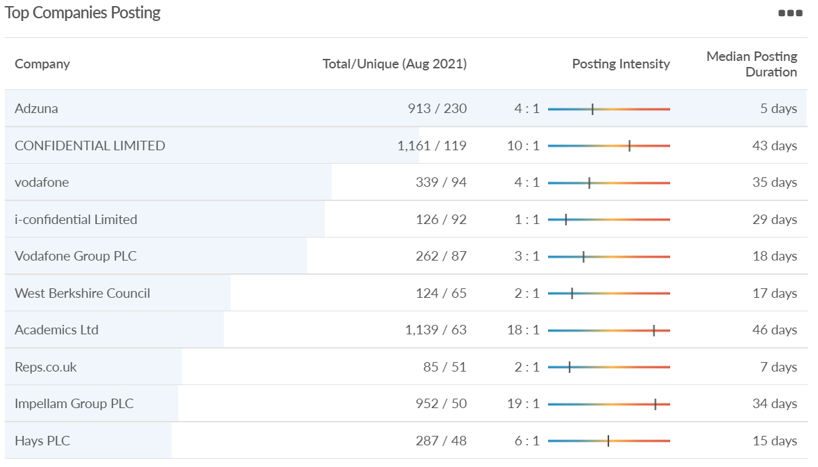
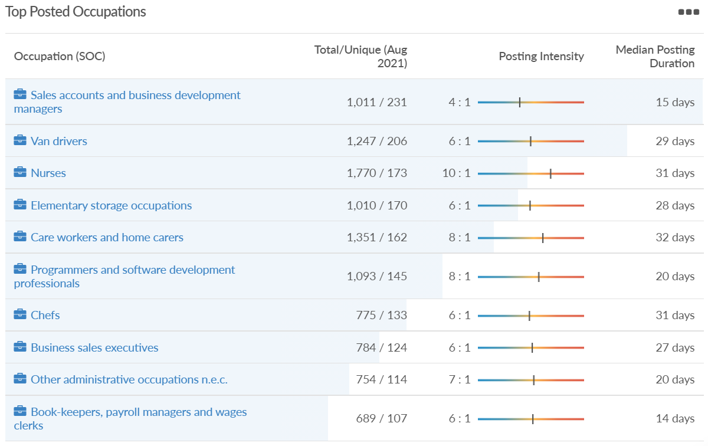
Job posting analytics (EMSI, August 2021)
Unique job postings: 6,141
Total job postings: 37,316
Job posting intensity: 6:1
Unique job postings (June 2020): 2,743

Slide 56
Definitions
Source: Institute for Fiscal Studies, April 2020

