Slide 1
Thames Valley Berkshire Monthly Economic Briefing
May 2021

Slide 2
Key contents of this month’s briefing
Updated global and UK economic forecasts
2021 Legatum Institute Prosperity Index rankings for TVB
Latest furlough, SEISS and claimant count figures by Local Authority
Latest remote working figures for Thames Valley Berkshire
Latest ‘notable business news’ by Local Authority
Latest job posting analytics by Local Authority

Slide 3
Global and National Economy
May 2021

Slide 4
Global Economy
Global prospects are improving but performance diverges strongly across countries
Prospects for the world economy have brightened but this is no ordinary recovery. It is likely to remain uneven and dependent on the effectiveness of vaccination programmes and public health policies. Some countries are recovering much faster than others. Korea and the United States are reaching pre-pandemic per capita income levels after about 18 months. Much of Europe is expected to take nearly 3 years to recover. In Mexico and South Africa, it could take between 3 and 5 years.
Economic growth projections have been revised upwards
Global economic growth is now expected to be 5.8% this year, a sharp upwards revision from the OECD’s December 2020 Economic Outlook projection of 4.2% for 2021. The vaccines rollout in many of the advanced economies has been driving the improvement, as has the massive fiscal stimulus by the United States. World GDP growth is expected to be 4.4% next year but global income will still be some USD 3 trillion less by end 2022 than was expected before the crisis hit.
More jabs, more jobs
Countries that have been quick to vaccinate their population against COVID-19 and that are managing to control infections through effective public health strategies are seeing their economies recover more quickly. Job vacancy postings in the United States are picking up, including in sectors such as tourism. But while vaccination rates are progressing well in many advanced economies, poorer and emerging-market countries are being left behind. Unless everyone is protected, no one is protected.
Trade pick-up adding to an uneven recovery
Differences in the strength of economic recovery across countries are being driven by the extent of government support to vulnerable workers and businesses, by a country’s dependency on particular sectors such as tourism (Rebuilding tourism for the future), as well as by public health and vaccination policies. Trade is also playing a role. Consumers have been spending less on services and more on goods since the pandemic began. The pick-up in merchandise trade has benefitted countries heavily involved in supply chains, particularly pharmaceuticals, medical supplies and IT material.
Source: OECD, May 2021

Slide 5
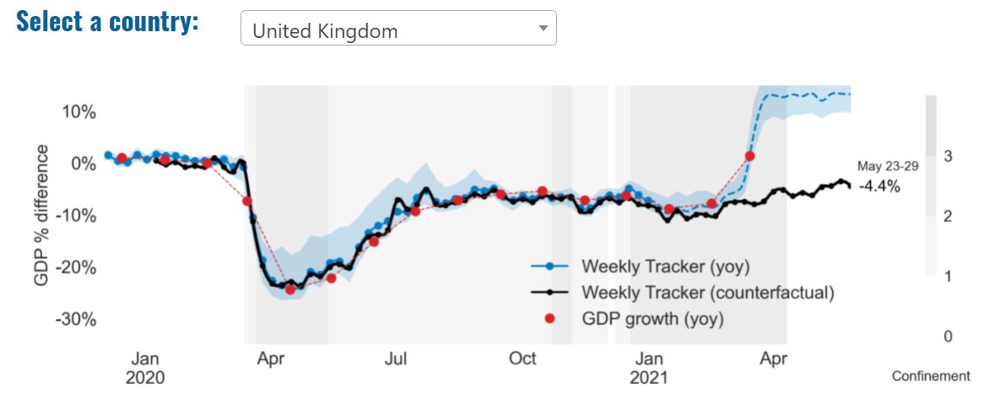
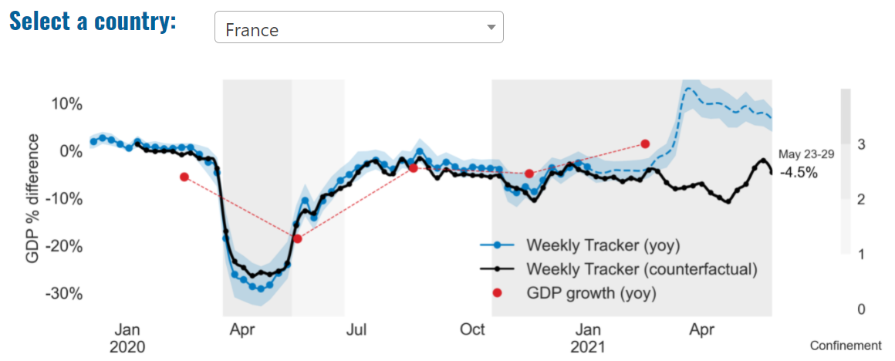
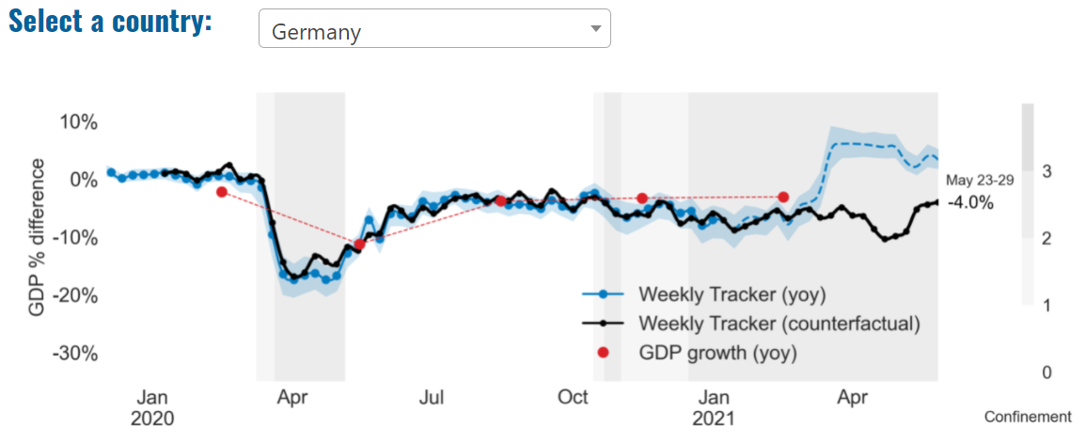
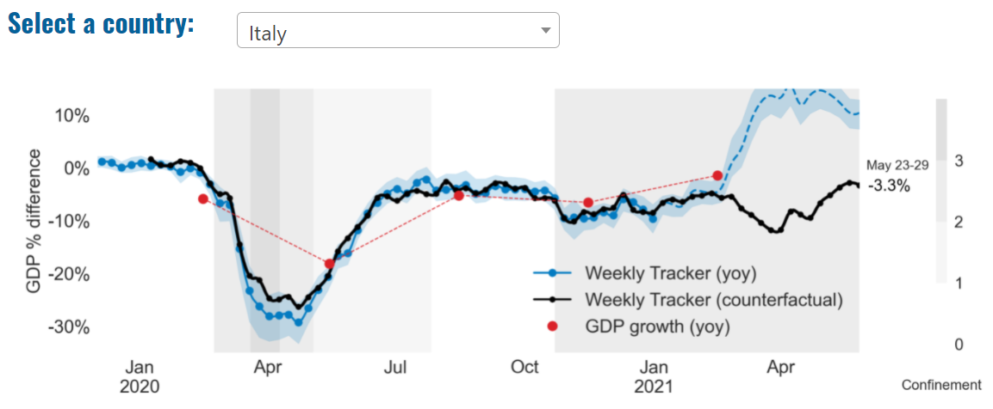
Global Economy – OECD GDP Tracker

Slide 6
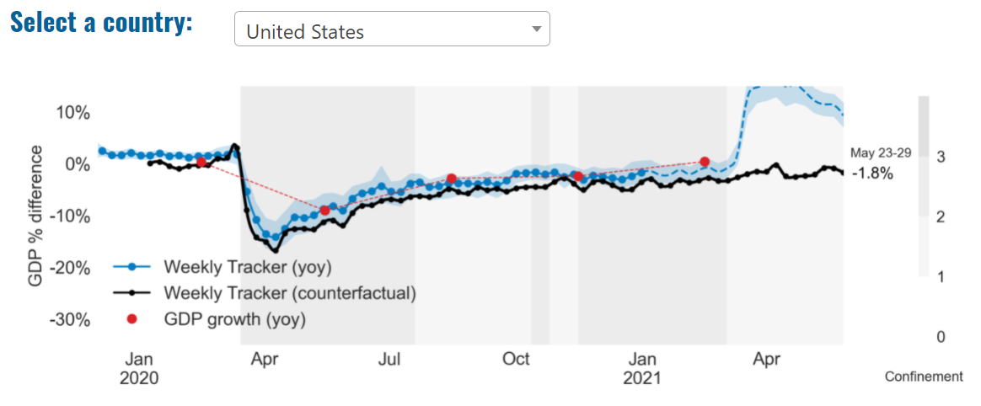
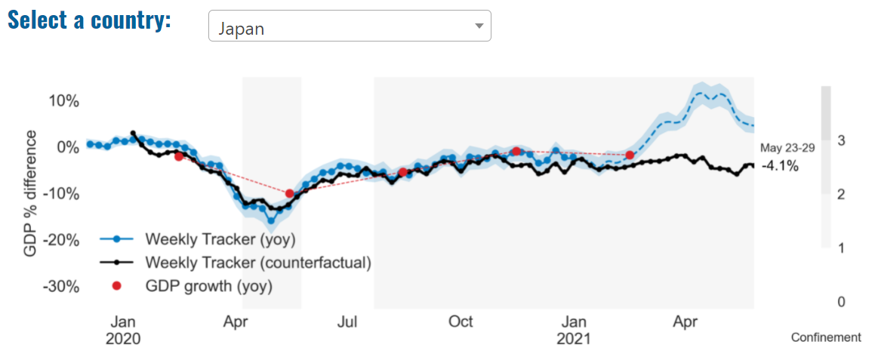
Global Economy – OECD GDP Tracker Continued
China
China is not included within the OECD GDP tracker and so the graph on the left has been compiled using statistics from the IMF and National Bureau of Statistics of China. The 2021 figure is a preliminary figure published by the National Bureau of Statistics of China in January 2021.
Note: The blue confidence band shows 95% confidence intervals. The darkness of the grey background reflects stay-at-home confinement requirement based on the Oxford Blavatnik database (0 - no measures, 1 - recommend not leaving house, 2 - require not leaving house with exceptions, 3 - require not leaving house with minimal exceptions).
Source: OECD, May 2021

Slide 7
UK Economy
In early May, the BoE revealed its latest predictions for the UK economy, which included a growth forecast of 7.25% for 2021. This was significantly above February’s 5.0% estimate and represents the fastest annual rate of growth in over 70 years. The upgrade largely reflects the successful vaccination rollout, which the BoE believes will boost consumer confidence and pave the way for a mini-spending boom as lockdown restrictions continue to ease.
Deloitte’s latest forecast for UK GDP expects stronger growth in 2021 than previously projected, in light of strong economic data in March and April and steady progress in easing restrictions, rolling out vaccinations and a low rate of new COVID-19 infections. The global outlook has also improved, driven by the large US fiscal stimulus and a faster pace of vaccinations in the EU. Deloitte has incorporated a slowdown in the recovery in the final quarter of 2021 and the first quarter of 2022 as the economy returns close to its pre-pandemic size and to reflect to possibility the some restrictions (albeit not as disruptive as the previous lockdowns) may be imposed to prevent a resurgence of the virus.
Sources: Source: Aesir, May 2021; Deloitte, May 2021

Slide 8
UK Economy 2
The central forecast of the National Institute for Economic and Social Research (NIESR) for UK economic growth in 2021 has been revised up to 5.7 per cent, compared to 3.4 per cent in February, with 4.5 per cent growth forecast for 2022. The significant upward revision reflects a better-than-expected first quarter – a greater resilience to further lockdowns – and the large rise in Covid-related public spending in the 2021-22 fiscal year announced in the March Budget.
The immediate economic effects of the virus, which have been concentrated in low waged service sectors, are expected to wane, while remaining negative consequences of Brexit will make themselves felt over the long-run and largely in sectors less affected by Covid-19.
The private non-traded services sector, which includes badly affected industries such as hospitality, is likely to see its output increase by 9 per cent this year after its pandemic-induced 14.75 per cent fall last year. But NIESR expects it to shed a further 190,000 jobs after the furlough scheme comes to an end later this year.
What NIESR calls the UK’s poor Covid-19 performance has greater permanent cost compared with other major economies. The size of the economic contraction means that the level of GDP is nearly 4 per cent lower in 2025 than forecast before the Covid19 pandemic, equivalent to around £1,350 per person per year (2018 prices) falling further behind the US and Germany as a result. Source: NIESR, May 2021

Slide 9
UK Economy 3
Thanks to the extension of furlough and other support measures to the autumn, NIESR now forecasts unemployment to peak at 6.5 per cent in the final quarter of this year (compared to 7.5 per cent in February). This central forecast is compatible with an assumption that around 450,000 of those remaining on furlough in September will not be taken back after the scheme ends.
Income growth and a degree of forced savings under lockdown provide a strong basis for a consumption growth forecast of 5.9 per cent in 2021. NIESR forecasts household saving then to fall to a level higher than that seen before the pandemic but close to historical averages: a faster or further fall constitutes the principal upside risk to its consumption and GDP forecasts in 2021.
NIESR’s central forecast is for CPI inflation to rise over the coming months, reaching 1.8 per cent in the final quarter of 2021 before falling to 1.5 per cent at the end of 2022 and settling just below its 2 per cent target between 2023 and 2025. Bank Rate is not forecast to rise until 2023 but there is considerable uncertainty regarding both the direction and instruments of monetary policy.
Source: NIESR, May 2021

Slide 10
Legatum Rankings 2021
The Index tracks prosperity across all 379 local authorities of the United Kingdom. Its unique data allows policymakers at the national, regional and local level to assess the development, growth and extent of prosperity across all areas of the UK, as well as how different areas and ‘archetypes’ are changing over time. The rankings are based on twelve key ‘pillars’: safety and security, personal freedom, governance, social capital, investment environment, enterprise conditions, infrastructure, economic quality, living conditions, health, education and natural environment.
TVB 2021 rankings out of all 379 local authorities:
Wokingham – 1st (2nd in 2020)
Windsor and Maidenhead – 8th (18th in 2020)
West Berkshire – 32nd (20th in 2020)
Bracknell Forest – 39th (33rd in 2020)
Slough – 127th (127th in 2020)
Reading – 156th (156th in 2020)
Source: Legatum Institute, May 2021

Slide 11
Coronavirus and Recession: Implications for Thames Valley Berkshire

Slide 12
Furloughing (Latest data - April 2021)
6,700 jobs (11% of total eligible employments) furloughed in Bracknell Forest UA
10,300 (14% of total eligible employments) furloughed in Slough UA
9,100 jobs (10% of total eligible employments) furloughed in Reading UA
7,800 jobs (9% of total jobs) furloughed in Wokingham UA
8,500 jobs (13% of total jobs) furloughed in Windsor and Maidenhead
7,300 jobs (10% of total jobs) furloughed in West Berkshire
Source: HMRC, April 2021
Berkshire has a lower-than-average number of furloughed workers, compared to the rest of the UK, because of its relative strength in sectors of industry that can be continued by workers from home.

Slide 13
SEISS (Latest data - May 2021)
Total value of claims made for Bracknell Forest UA – SEISS 4: £10,700,000
Total value of claims made for Slough UA – SEISS 4: £15,100,000
Total value of claims made for Reading UA – SEISS 4: £10,900,000
Total value of claims made for Wokingham – SEISS 4: £10,800,000
Total value of claims made for Windsor and Maidenhead – SEISS 4: £10,600,000
Total value of claims made in West Berkshire – SEISS 4: £11,000,000
Source: HMRC, June 2021

Slide 14
Claimant Count (Latest data - April 2021)
Total of 30,570 claimants (5.3% of the working age population) in Thames Valley Berkshire
3,455 claimants (4.4% of the working age population) in Bracknell Forest UA
8,450 claimants (8.9% of the working age population) in Slough UA
7,190 claimants (6.7% of the working age population) in Reading UA
3,485 claimants (3.3% of the working age population) in Wokingham UA
4,165 claimants (4.5% of the working age population) in Windsor and Maidenhead UA
3,830 claimants (4% of the working age population) in West Berkshire UA
Across Thames Valley Berkshire, claimant unemployment has risen by just over 11,000, rising from 19,445 in March 2020 to 30,570 in April 2021. Slough had 8.9% of its working age population claim unemployment in April 2021, up from 5% in April 2020.
Source: ONS, June 2021

Slide 15
Strategic Issues: Heathrow
Heathrow Airport
Heathrow is to create a separate terminal for flights coming from “red list” countries, to address concerns over passengers from destinations with high rates of Covid-19 mixing with other travelers in the arrivals hall. Britain’s biggest airport said it would introduce the dedicated arrivals facility in Terminal 3 from 1 June. It follows increasing disquiet over incoming flights, particularly from India, where the B.1.617.2 variant was first detected. Under the new traffic light system, only returning UK citizens are allowed to fly home from red list countries, while holidays are permitted in green list countries – and potentially amber, with quarantine measures. Ministers had urged Heathrow to segregate arrivals from higher-risk countries, with the transport secretary, Grant Shapps, saying he wanted to “see people separated out as much as is practically possible”.
Source: The Guardian, May 2021

Slide 16
Strategic Issues: Aviation
Aviation:
The UK government must suspend all airport expansion plans until it sets out how they fit with its legally binding climate targets and the advice of its own experts, campaigners have warned. In a letter to ministers, groups opposing planned expansions at eight airports around the country say the government’s recent decision to include aviation in its binding climate targets mean the expansion plans must be halted. “Until the government has consulted on its preferred strategy for net zero aviation, and published its policy, it is impossible to see how local authorities or the government could justify any given airport expansion as conforming to binding carbon budgets and targets,” states the letter to Grant Shapps, the transport secretary, and Robert Jenrick, the communities and local government secretary. There are expansions planned at seven airports in England: Leeds Bradford, Luton, Bristol, Southampton, Heathrow, Stansted and Manston – all of which are at various stages in the process. Campaigners are also expecting Gatwick to imminently submit plans to increase capacity. Source: The Guardian, May 2021

Slide 17
Demand and Supply Conditions: Businesses, Hiring, Restructuring, Investment, Labour and Skills Supply

Slide 18
Household/Consumer Demand
Slough had an overall recovery index score of 41 at the start of April, putting them in a stronger position in terms of recovery (closer to pre-lockdown levels) than Reading which had a recovery index score of 23.
Source: Centre for Cities, May 2021
Retail sales volumes continued to recover in March 2021, with an increase of 5.4% when compared with the previous month reflecting the effect of the easing of coronavirus (COVID-19) restrictions on consumer spending; sales were 1.6% higher than February 2020 before the impact of the coronavirus pandemic. Non-food stores provided the largest positive contribution to the monthly growth in March 2021 sales volumes, aided by strong increases of 17.5% and 13.4% in clothing stores and other non-food stores respectively.
Food stores reported monthly growth of 2.5% in March 2021, with strong growth in specialist food stores (butchers and bakers) likely reflecting the continued closure of the hospitality sector during the Easter period. Automotive fuel retailers also reported strong monthly growth of 11.1% as travel restrictions were eased towards the end of the reporting period. Despite strong March figures, retail sales for the quarter have been subdued overall; in the three months to March 2021, retail sales volume fell by 5.8% when compared with the previous three months, with strong declines in both clothing stores and other non-food stores as a result of the tighter lockdown restrictions in place. Source: ONS, April 2021 (latest release)

Slide 19
Industries at Risk
MANUFACTURING
28,000 people work in manufacturing in Berkshire – with 11,000 in West Berkshire alone and 2,487,000 across the whole of Great Britain (ONS, 2020)
Half of all UK manufacturing firms have made redundancies. A further 20% plan to make more redundancies in the next six months (Make UK, October 2020)
37% of manufacturers think it will take more than a year to return to normal trading conditions (Make UK, October 2020)
HOSPITALITY & TOURISM
The hospitality and tourism sector in Berkshire employed 35,842 people in 2020 – an increase of 0.8% on the previous year (EMSI, 2021)
In June, ‘Pathways to Recovery’, a report by the All Party Parliamentary Group on Hospitality and Tourism, found that just 11% of hospitality businesses had been able to operate normally during the first lockdown and international tourist arrivals were likely to be down 59% for the year.
Kate Nicholls, CEO of UK Hospitality, told the BBC (December 2020) that 30,000 hospitality businesses – most of them SMEs and one-third of the total – could be lost by the end of 2020.
According to Sky News in December, at least 38,653 hospitality jobs had been lost during the pandemic.
CONSTRUCTION
21,000 people work in construction in Berkshire – with only 1,500 of these working in Bracknell Forest and 2,164,000 across the whole of Great Britain (ONS, 2020)
The level of construction output in August 2020 was 10.8% below the February 2020 level (ONS, 2020)
Construction output grew by 18.5% in the three months to August 2020 compared with the previous three-month period, but this followed 10 consecutive periods of decline (ONS, 2020)
NON-FOOD RETAIL & WHOLESALE
More than 45,000 people work in non-motor vehicle retail in Berkshire – with 12,500 of them working in Reading (EMSI, 2021). The offline retail sector has struggled during the pandemic. At least 39,000 jobs had been lost in retail as of 3 December. Redundancy announcements include 7,000 at Marks and Spencer (August), 4,000 at Debenhams (August) and 4,000 at Boots (July) - Sky News, 2020.
The pre-pandemic trend of on-line shopping has strengthened in 2020; a record total of 31.4% of shopping was done on line in November 2020 (ONS, 2020), a trend that will have profound implications for the high street.
In November, retail sales volume decreased by 3.8% (vs October figures) as a result of COVID-19. Despite this, overall sales remain above their pre-pandemic levels (ONS, 2020).
ARTS, ENTERTAINMENT & RECREATION
12,000 people work in arts, entertainment and recreation in Berkshire. 4,500 of them – more than one third – work in Windsor and Maidenhead and 925,000 across the whole of Great Britain (ONS, 2020)
Between 19 Nov and 1 Dec, 24 per cent of arts, entertainment and recreation venues had temporarily closed or paused trading. (ONS, 2020)
52% of eligible employments in arts, entertainment and recreation were on furlough on 31 July 2020 – a figure that had fallen to 24% as at 31 October. (HMRC, 2020)
AVIATION
Aviation has an estimated value of £28 billion to the UK economy, employing 230,000 workers at over 40 commercial airports. (House of Commons Transport Committee, June 2020)
76,000 people work in over 400 business across Heathrow Airport. Many of these people live in Slough, in Berkshire. (Heathrow local recovery plan, 2020)
There were 5,800 passenger flights in April 2020 compared to 201,000 a year earlier: a reduction of 97%. The impact is several times more severe than the aftermath of the global financial crisis in 2008, when passenger flights reduced by around 67,000 to 134,000 per month. (House of Commons Transport Committee, June 2020)
The UK aviation industry has been hit harder than any European country by the pandemic with IATA calculating that the “coronavirus crisis will cost 780,000 British jobs and cost £46bn in lost GDP.” (International Air Transport Association, 2020).
ADMINISTRATION & SUPPORT
More than 51,000 people in Berkshire work in admin and support services – including 10,000 in Wokingham and 10,000 in West Berkshire and 2,752,000 across the whole of Great Britain (ONS, 2020)
More than 600,000 admin and support workers – 27% of the total – were furloughed as at 31 October (HMRC, 2020)

Slide 20
Industries more likely to be resilient/grow – Digital tech, logistics and home improvement
Telecoms
Cybersecurity and data management
eCommerce
Logistics and delivery services
Subscription services
eLearning
Streaming and gaming services
Online casinos
Health and home fitness
Gardening and DIY
Sources: Talk Business, April 2021.
From this analysis, it is apparent that (as alluded to in previous monthly reports) IT, and e-commerce by extension, as well as home improvement and fitness related industries and those which have so far demonstrated the greatest resilience in the face of the COVID-19 pandemic and are predicted to see some of the highest growth throughout 2021.

Slide 21
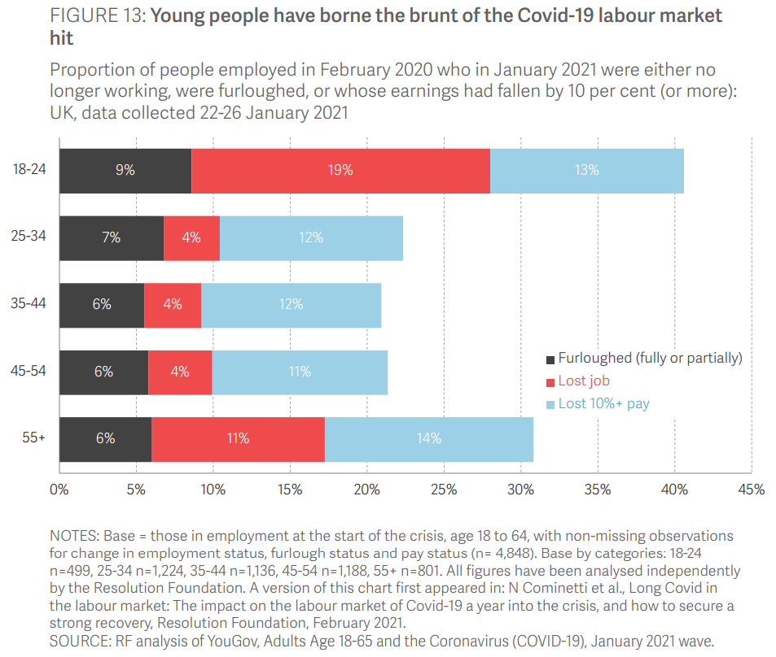
Supply of labour and skills
It is now well-established that the Covid-19 crisis has had a disproportionate impact on young people in the labour market. Early on in the crisis, survey evidence showed that 18-24-year-olds were much more likely than older age groups to have lost their job, been furloughed, or lost hours alongside pay due to Covid-19. This pattern persisted throughout the summer and autumn, and by January 2021, Resolution Foundation research showed that almost one-in-five (19 per cent) of 18-24-year-olds who were employed before the crisis had lost their job, close to one-in-ten (9 per cent) were furloughed, and a further 13 per cent had lost more than 10 per cent of their pay outside of furlough. Altogether, payroll data shows that more than half (54 per cent) of employee job losses since March 2020 have been among under-25s.
Source: Resolution Foundation, May 2021

Slide 22
Remote working
In May of 2021, there were 4,229 unique job postings for remote positions at companies based in Berkshire, around 570% more than the figure of 624 for the same period one year previous.
Compare this with the South East, in May 2021 there were 22,255 unique remote job postings for remote positions; rising from 4,075 in May of the previous year – an of over 445%
A rise can also be seen at national level, with a recorded 133,845 unique remote job postings in England in May of 2021, rising from 27,111 in May 2020 – an increase of over 390%.
From these figures it’s apparent that the COVID-19 pandemic has, somewhat unsurprisingly, prompted a massive boost in job postings for explicitly remote roles. Berkshire has seen a larger boost in vacancies which are remote-based than both England and the South East.
Source: EMSI, May 2021

Slide 23
Local Profiles

Slide 24
Bracknell Forest

Slide 25
Impact of COVID-19 up to 13th June 2021
COVID-19 cases (to 13th June 2021) – Source: Public Health Berkshire COVID-19 Dashboard, June 2021
7,393 total cases
11 new cases daily
Claimant unemployment (to April 2021)
3,455 claimants (4.4% of the working age population) in Bracknell Forest UA
Notable business news
A care home in Bracknell, Berkshire is celebrating after being named as a finalist for a national award. Care UK’s Bickerton House, on Warfield Road, has been shortlisted in the ‘Best New Care Home’ category at the Care Home Awards, thanks to its focus on innovation, creativity, and its person-centered approach to care since it opened its doors in January 2020. The Care Home Awards recognise and reward excellence and innovation in UK care home management, operation, and delivery. Understanding the need for a person-centered approach to residents’ care, the team at Bickerton House captures each resident’s life history in detail when they move into the care home. This is put into a life storybook and used by the team to support each individual to continue to live a fulfilled life.
Source: InYourArea, May 2021

Slide 26
Industries hit hardest by COVID shutdown
As illustrated by the above graph, Bracknell Forest has suffered very similarly to Great Britain in terms of the percentage of jobs within industries which have been hit hardest by COVID shutdowns. Thames Valley Berkshire area has seen an additional 0.77% of jobs of jobs affected worst by the COVID shutdowns when compared to Bracknell Forest.
Source: EMSI, March 2021 (definition for industries hit hardest provided on slide 54)

Slide 27
Industry risks and opportunities (2020-2021)
Critical industries
Food and drink retail: 3,234 employees (1% below the national average)
Energy/utilities: 257 employees (65% below the national average)
Health and social care: 6,193 employees (25% below the national average)
Freight/logistics: 515 employees (70% below the national average)
Insurance: 186 employees (69% below the national average)
Banking and financial services: 1,291 employees (13% below the national average)
Sectors most impacted
Hospitality and tourism: 3,743 employees (26% below the national average)
Arts, entertainment and recreation: 1,148 (24% below the national average)
Admin and support: 2,694 (21% below the national average)
Aviation: 0 employees
Non-food retail and wholesale: 8,508 (75% above the national average)
Manufacturing: 1,549 (69% below the national average)
Construction: 1,771 (40% below the national average)
Source: EMSI, January 2021

Slide 28
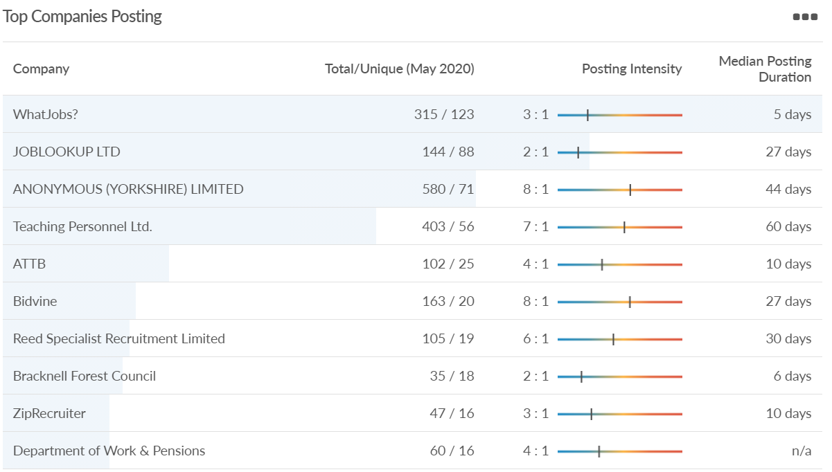
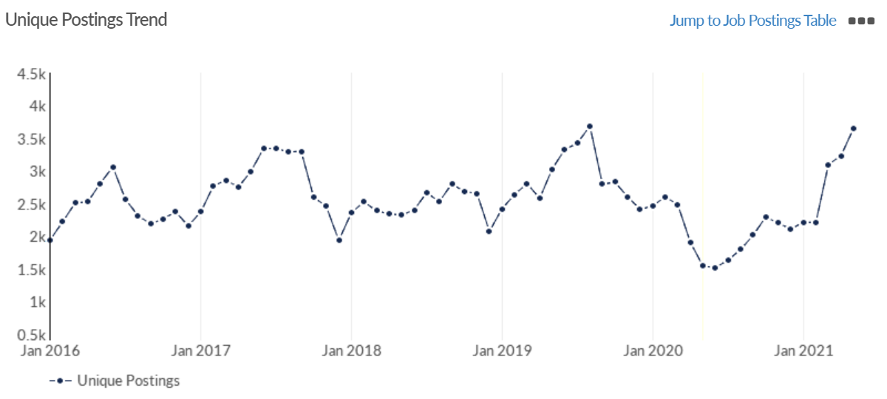
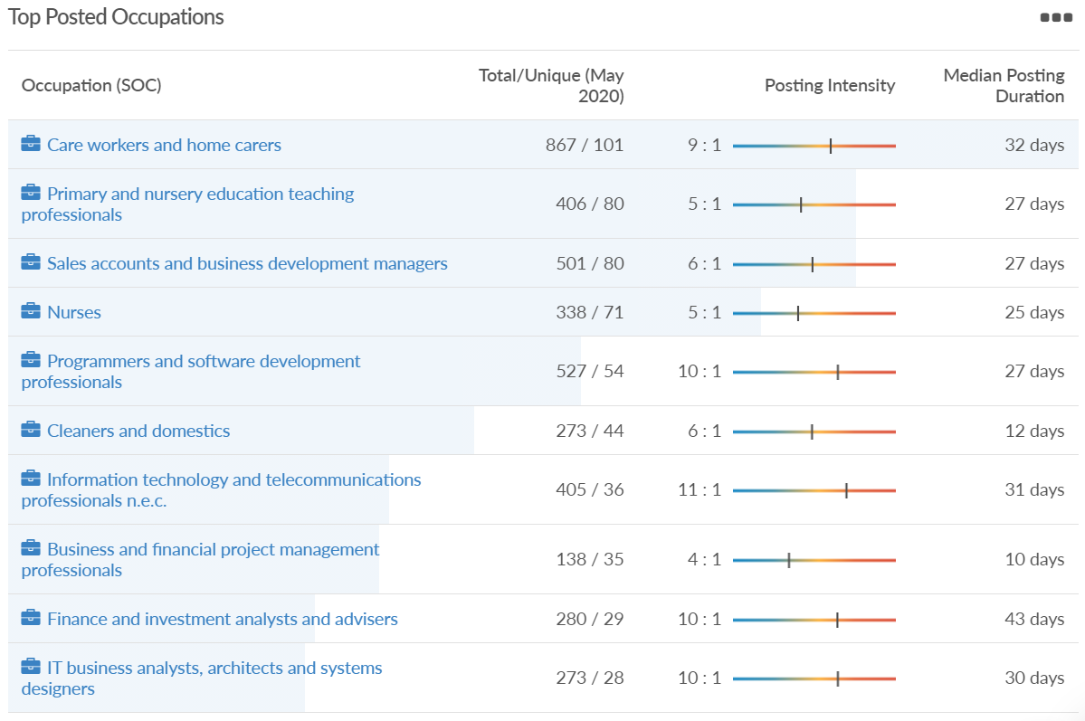
Job posting analytics (EMSI, May 2021)
Unique job postings: 3,654
Total job postings: 28,777
Job posting intensity: 8:1
Unique job postings (May 2020): 1,545

Slide 29
Slough

Slide 30
Impact of COVID-19 up to 13th June 2021
COVID-19 cases (to 13th June 2021) – Source: Public Health Berkshire COVID-19 Dashboard, 13th June 2021
16,007 total cases
7 new cases daily
Claimant unemployment (to April 2021)
8,450 claimants (8.9% of the working age population) in Slough UA
Notable business news
With charities facing several challenges in terms of fundraising and delivery of services during the pandemic, a local business coaching practice is offering a year’s free guidance to one organisation. Simac Konkader, an expert business coach at ActionCOACH, is leading the search for a local charitable organisation. One charity will be chosen as the recipient of gifted business coaching sessions to help achieve its operational and financial goals over the next year.
Source: InYourArea, May 2021

Slide 31
Industries hit hardest by COVID shutdown
When compared to both Thames Valley Berkshire and Great Britain, Slough has seen a significantly lower percentage of jobs affected by COVID shutdowns – perhaps somewhat surprising given the LA’s proximity to Heathrow and the almost complete shutdown of the aviation sector.
Source: EMSI, March 2021 (definition for industries hit hardest provided on slide 54)

Slide 32
Industry risks and opportunities (2020-2021)
Critical industries
Food and drink retail: 6,656 employees (47% above the national average)
Energy/utilities: 2,820 employees (174% above the national average)
Health and social care: 8,201 employees (28% below the national average)
Freight/logistics: 4,640 employees (93% above the national average)
Insurance: 121 employees (86% below the national average)
Banking and financial services: 731 employees (65% below the national average)
Sectors most impacted
Hospitality and tourism: 3,780 employees (46% below the national average)
Arts, entertainment and recreation: 442 (79% below the national average)
Admin and support: 9,765 (107% above the national average)
Aviation: 262 employees (16% above the national average)
Non-food retail and wholesale: 6,719 (0% above the national average)
Manufacturing: 5,071 (28% below the national average)
Construction: 2,620 (36% below the national average)
Source: EMSI, January 2021

Slide 33
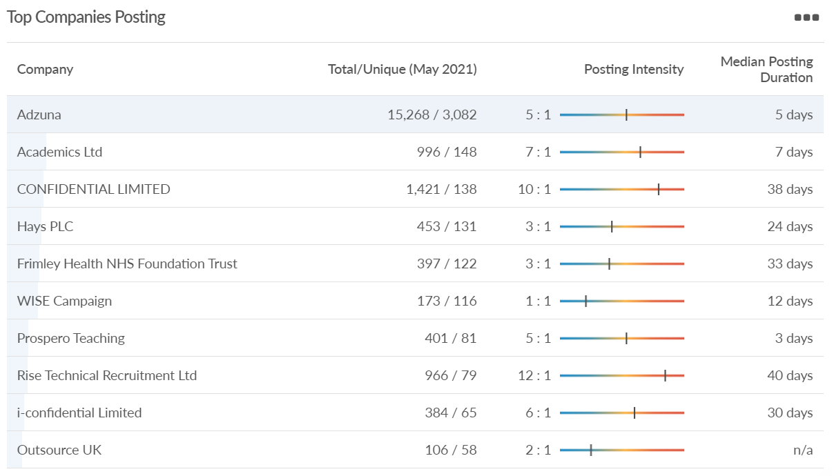
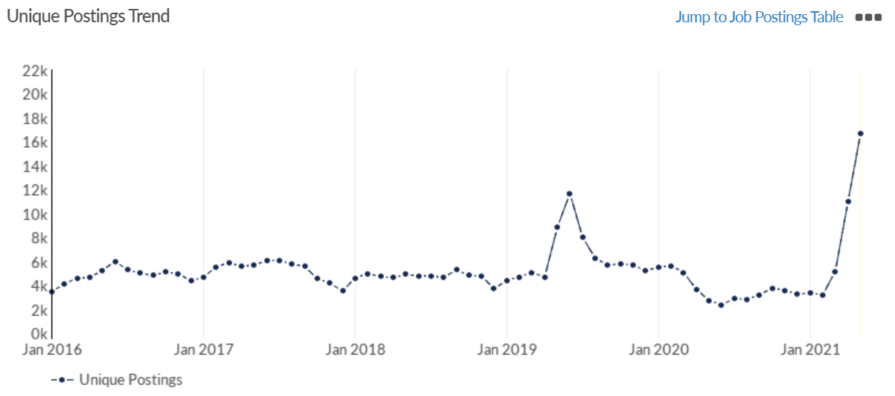
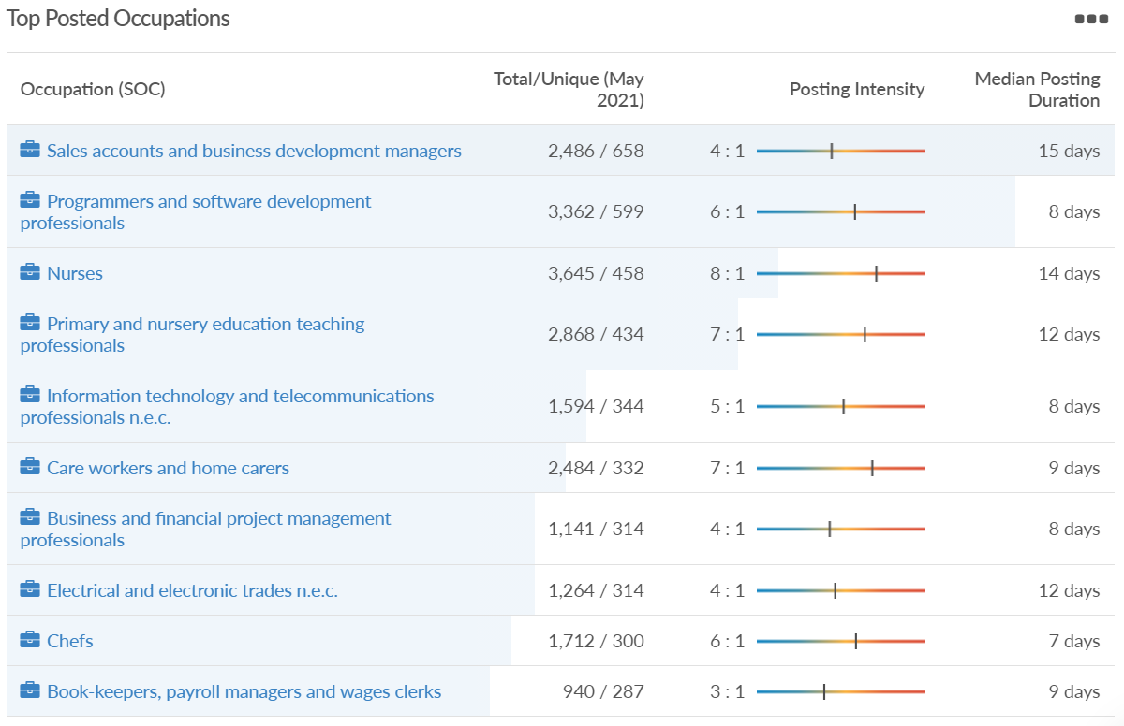
Job posting analytics (EMSI, May 2021)
Unique job postings: 16,710
Total job postings: 74,173
Job posting intensity: 4:1
Unique job postings (May 2020): 2,748

Slide 34
Reading

Slide 35
Impact of COVID-19 up to 13th June 2021
COVID-19 cases (to 13th June 2021) – Source: Public Health Berkshire COVID-19 Dashboard, 13th June 2021
11,491 total cases
21 new case daily
Claimant unemployment (to April 2021)
7,190 claimants (6.7% of the working age population) in Reading UA
Notable business news
A cocktail venue is set to take over Smash at 5-6 Gun Street, if it manages to secure a licence from the council. London Cocktail Club has applied to Reading Borough Council (RBC) for a license at the venue on Gun Street, with Smash confirming it has now permanently closed. Anne Ackroyd, CEO of The Brighton Pier Group PLC, which owns Smash through its Eclectic Bars subsidiary said: “The closure of Smash is part of our rationalisation plan for the company’s bars division and, whilst the pandemic has been a factor, we are focusing on our core estate of premium bars all of which we are confident will return stronger than ever before.”
Source: Reading Chronicle, May 2021

Slide 36
Industries hit hardest by COVID shutdown
Reading has been marginally less affected by the COVID shutdowns as Great Britain has on average, with 15.16% of jobs within industries which have been most severely impacted by the shutdowns. The Local Authority is 1.26% better off than the average of the Thames Valley Berkshire area.
Source: EMSI, March 2021 (definition for industries hit hardest provided on slide 54)

Slide 37
Industry risks and opportunities (2020-2021)
Critical industries
Food and drink retail: 6,192 employees (11% above the national average)
Energy/utilities: 3,350 employees (163% above the national average)
Health and social care: 13,464 employees (5% below the national average)
Freight/logistics: 1,513 employees (49% below the national average)
Insurance: 2,076 employees (100% above the national average)
Banking and financial services: 1,688 employees (34% below the national average)
Sectors most impacted
Hospitality and tourism: 6,567 employees (25% below the national average)
Arts, entertainment and recreation: 1,811 (31% below the national average)
Admin and support: 9,212 (58% above the national average)
Aviation: <10 employees
Non-food retail and wholesale: 8,626 (18% above the national average)
Manufacturing: 2,000 (77% below the national average)
Construction: 2,273 (55% below the national average)
Source: EMSI, January 2021

Slide 38
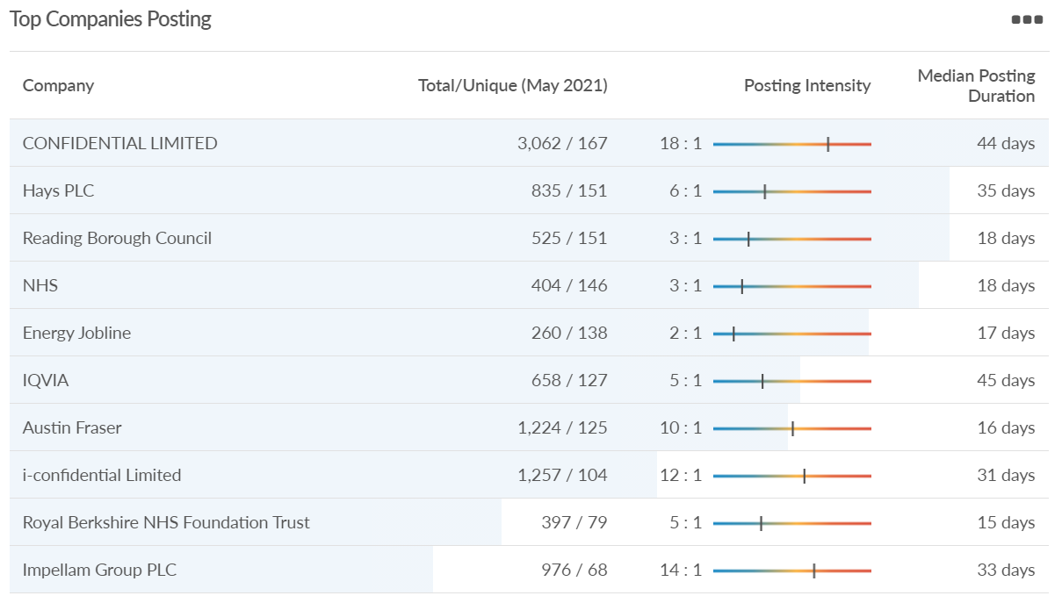
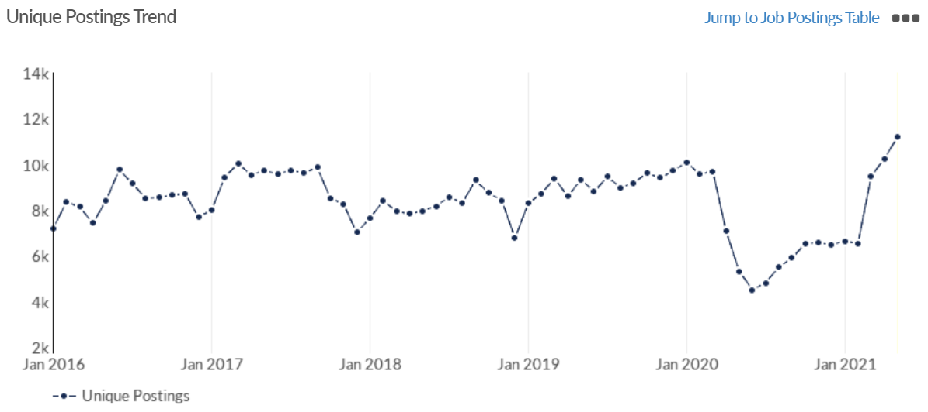
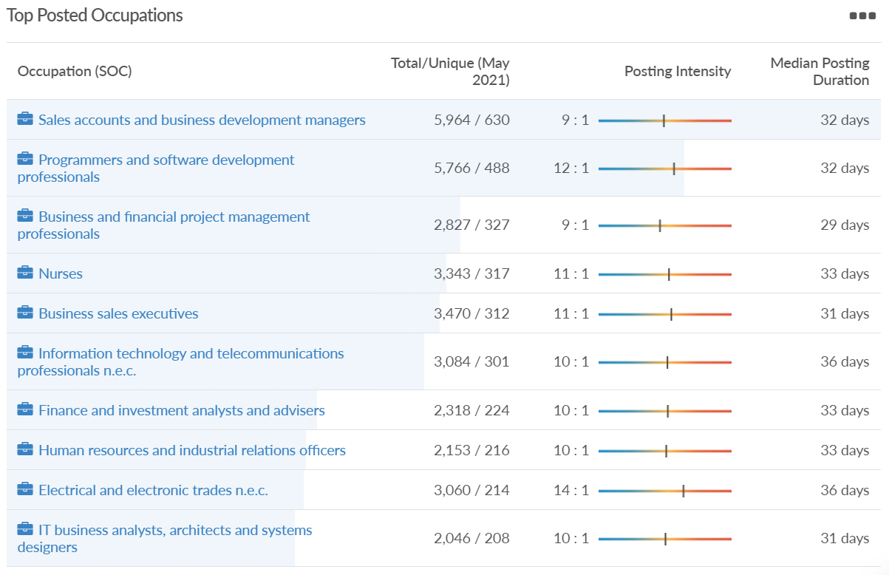
Job posting analytics (EMSI, May 2021)
Unique job postings: 11,116
Total job postings: 108,289
Job posting intensity: 10:1
Unique job postings (May 2020): 5,325

Slide 39
Wokingham

Slide 40
Impact of COVID-19 up to 13th June 2021
COVID-19 cases (to 13th June 2021) – Source: Public Health Berkshire COVID-19 Dashboard, 13th June 2021
8,702 total cases
8 new cases daily
Claimant unemployment (to April 2021)
3,485 claimants (3.3% of the working age population) in Wokingham UA
Notable business news
Something is brewing in Wokingham town center, as new taproom The Outhouse Brewery prepares to open its doors on Denmark Street next month. Part of the Elms Field redevelopment, the independent business will brew its beers on site. Owner Peter Rhodes said it should be one of a kind and something never seen before in the town center. “The pub will just be one room,” Mr Rhodes explained. “In essence, people will be sitting in the brewery itself, having a pint and looking at the vessels that made the very beer they’re drinking.”
Source: Wokingham Today, May 2021

Slide 41
Industries hit hardest by COVID shutdown
Wokingham is in a similar position to Slough in that is has been significantly less affected by the COVID shutdowns than both the Thames Valley Berkshire area and Great Britain as a whole. This is likely due to the high levels of employment from the Tech sector (Microsoft etc. based at TVP) as this industry is able to work well from home.
Source: EMSI, March 2021 (definition for industries hit hardest provided on slide 54)

Slide 42
Industry risks and opportunities (2020-2021)
Critical industries
Food and drink retail: 3,883 employees (17% below the national average)
Energy/utilities: 1,434 employees (35% above the national average)
Health and social care: 7,283 employees (38% below the national average)
Freight/logistics: 886 employees (64% below the national average)
Insurance: 453 employees (48% below the national average)
Banking and financial services: 423 employees (80% below the national average)
Sectors most impacted
Hospitality and tourism: 5,410 employees (25% below the national average)
Arts, entertainment and recreation: 1,831 (16% below the national average)
Admin and support: 6,432 (33% above the national average)
Aviation: 0 employees
Non-food retail and wholesale: 6,494 (6% below the national average)
Manufacturing: 3,731 (48% below the national average)
Construction: 3,115 (26% below the national average)
Source: EMSI, January 2021

Slide 43
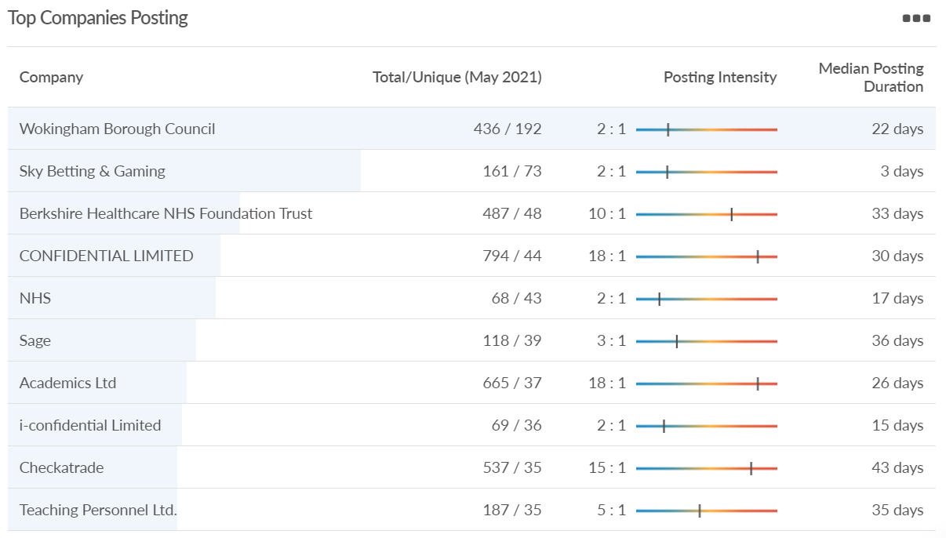
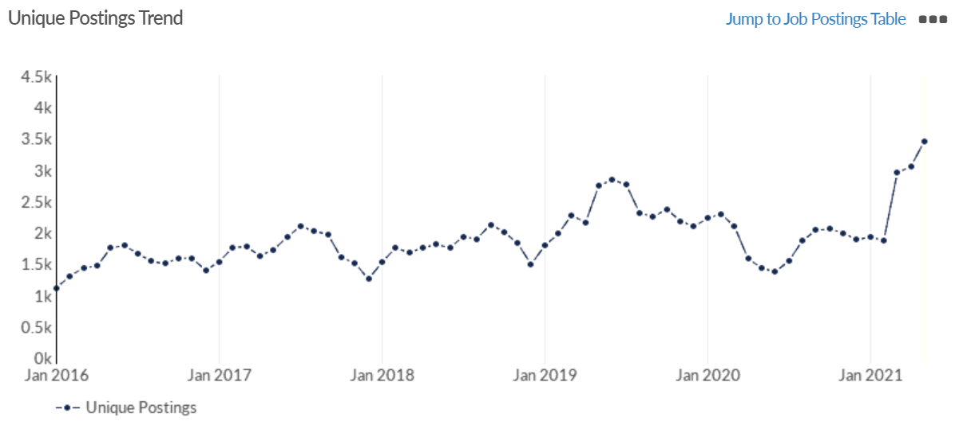
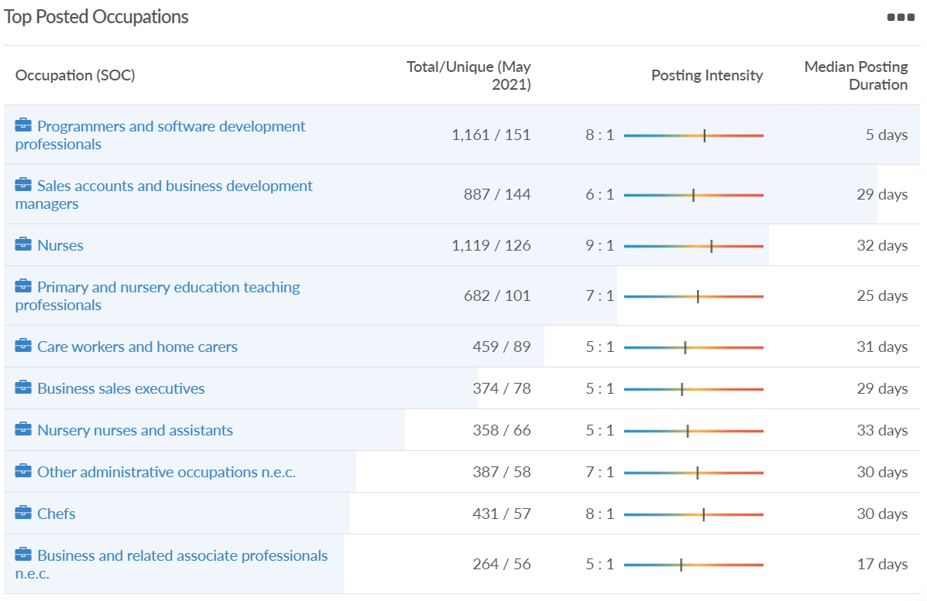
Job posting analytics (EMSI, May 2021)
Unique job postings: 3,460
Total job postings: 21,382
Job posting intensity: 6:1
Unique job postings (May 2020): 1,431

Slide 44
Windsor and Maidenhead

Slide 45
Impact of COVID-19 up to 13th June 2021
COVID-19 cases (to 13th June 2021) – Source: Public Health Berkshire COVID-19 Dashboard, 13th June 2021
8,671 total cases
8 new cases daily
Claimant unemployment (to April 2021)
4,165 claimants (4.5% of the working age population) in Windsor and Maidenhead UA
Notable business news
A new Aldi store in Windsor is ‘progressing well’ and is expected to open near the end of summer. A spokesperson has given an update on how the development of the new discount supermarket in Dedworth Road is going since its approval last year. Councilors on the Royal Borough Development Management Panel approved for the old Windsor Garden Centre to be demolished for an Aldi store.
Source: Windsor Observer, May 2021

Slide 46
Industries hit hardest by COVID shutdown
Windsor and Maidenhead appears to be the most severely affected of all the Local Authorities which make up Berkshire in terms of percentage of jobs hit hardest by the COVID shutdowns. This is likely due in part to the enormous hit the leisure/tourism sector has taken and how key of an employer Legoland Windsor to the region.
Source: EMSI, March 2021 (definition for industries hit hardest provided on slide 54)

Slide 47
Industry risks and opportunities (2020-2021)
Critical industries
Food and drink retail: 3,733 employees (17% below the national average)
Energy/utilities: 882 employees (13% below the national average)
Health and social care: 8017 employees (29% below the national average)
Freight/logistics: 748 employees (68% below the national average)
Insurance: 434 employees (48% below the national average)
Banking and financial services: 1,252 employees (39% below the national average)
Sectors most impacted
Hospitality and tourism: 9,437 employees (35% above the national average)
Arts, entertainment and recreation: 4,516 (117% above the national average)
Admin and support: 4,207 (10% below the national average)
Aviation: 11 employees (95% below the national average)
Non-food retail and wholesale: 7,834 (18% above the national average)
Manufacturing: 2,523 (64% below the national average)
Construction: 6,201 (54% above the national average)
Source: EMSI, January 2021

Slide 48
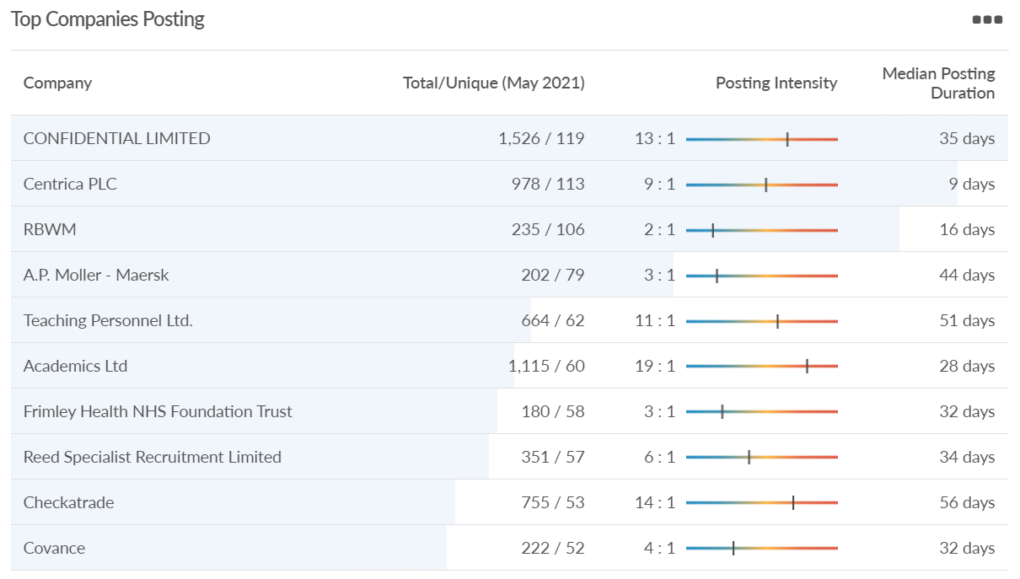
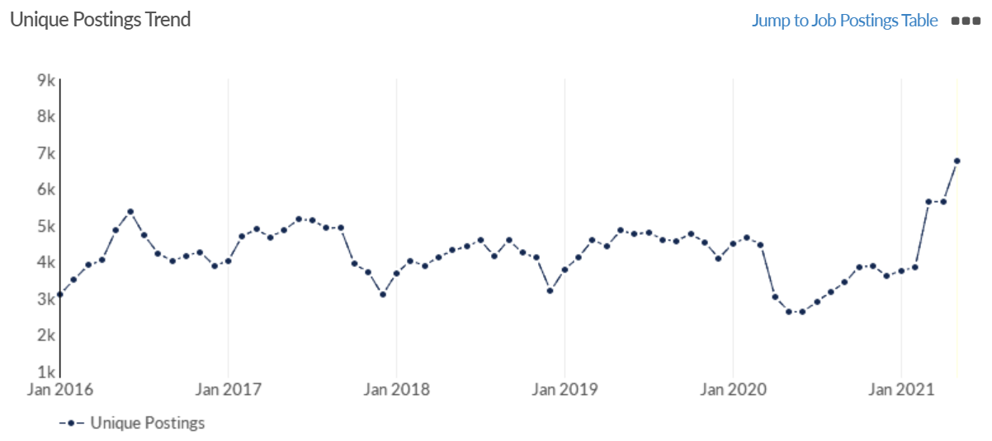
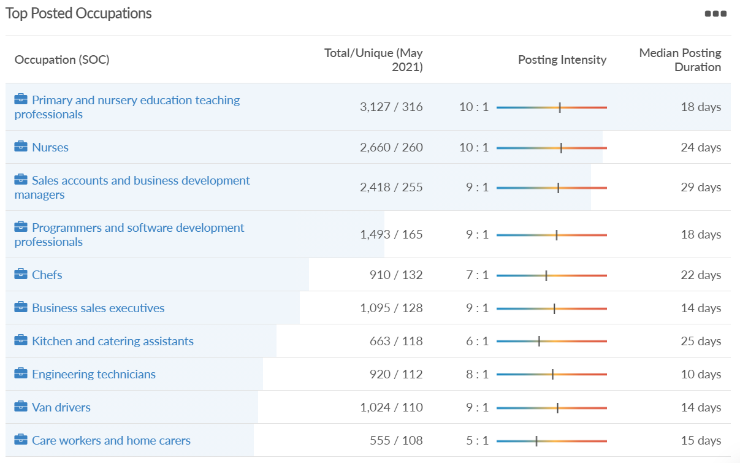
Job posting analytics (EMSI, May 2021)
Unique job postings: 6,746
Total job postings: 53,783
Job posting intensity: 8:1
Unique job postings (May 2020): 2,635

Slide 49
West Berkshire

Slide 50
Impact of COVID-19 up to 13th June 2021
COVID-19 cases (to 13th June 2021) – Source: Public Health Berkshire COVID-19 Dashboard, 13th June 2021
6,653 total cases
10 new case daily
Claimant unemployment (to April 2021)
3,880 claimants (4% of the working age population) in West Berkshire UA
Notable business news
A Mr Simms Olde Sweet Shoppe was opened by Newbury Mayor Billy Drummond in May. The shop is based in Northbrook Street, in the premises of the former Ernest Jones store. The shop is returning to the town, having previously been based at the other end of Northbrook Street a few years ago.
Source: Newbury Today, May 2021

Slide 51
Industries hit hardest by COVID shutdown
While West Berkshire hasn’t been as fortunate as Slough in terms of how great of a percentage of jobs have been directly affected by the COVID shutdown, it has fared significantly better than the Thames Valley Berkshire area and better than Great Britain.
Source: EMSI, March 2021 (definition for industries hit hardest provided on slide 54)

Slide 52
Industry risks and opportunities (2020-2021)
Critical industries
Food and drink retail: 4,289 employees (17% below the national average)
Energy/utilities: 1,343 employees (14% above the national average)
Health and social care: 6,773 employees (48% below the national average)
Freight/logistics: 1,574 employees (43% below the national average)
Insurance: 262 employees (73% below the national average)
Banking and financial services: 692 employees (71% below the national average)
Sectors most impacted
Hospitality and tourism: 6,617 employees (18% below the national average)
Arts, entertainment and recreation: 2,674 (10% above the national average)
Admin and support: 4,803 (11% below the national average)
Aviation: <10 employees
Non-food retail and wholesale: 8,432 (9% above the national average)
Manufacturing: 11,330 (41% above the national average)
Construction: 4,813 (3% above the national average)
Source: EMSI, January 2021

Slide 53
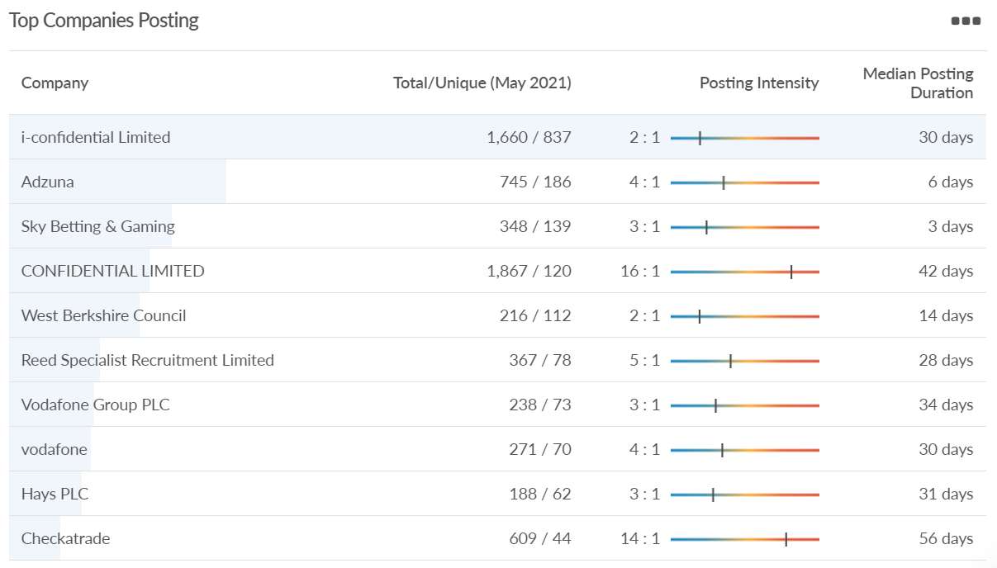
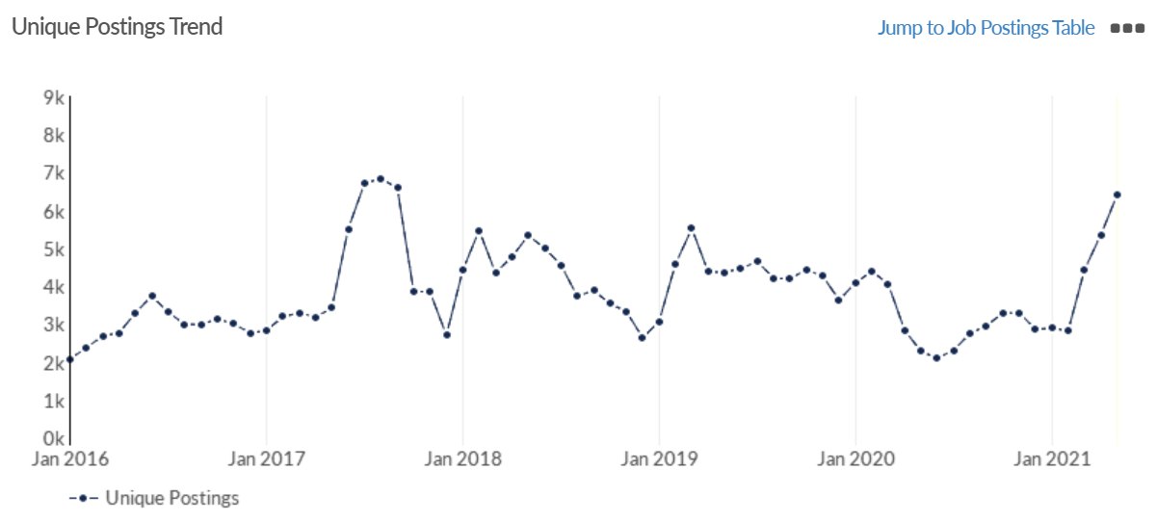
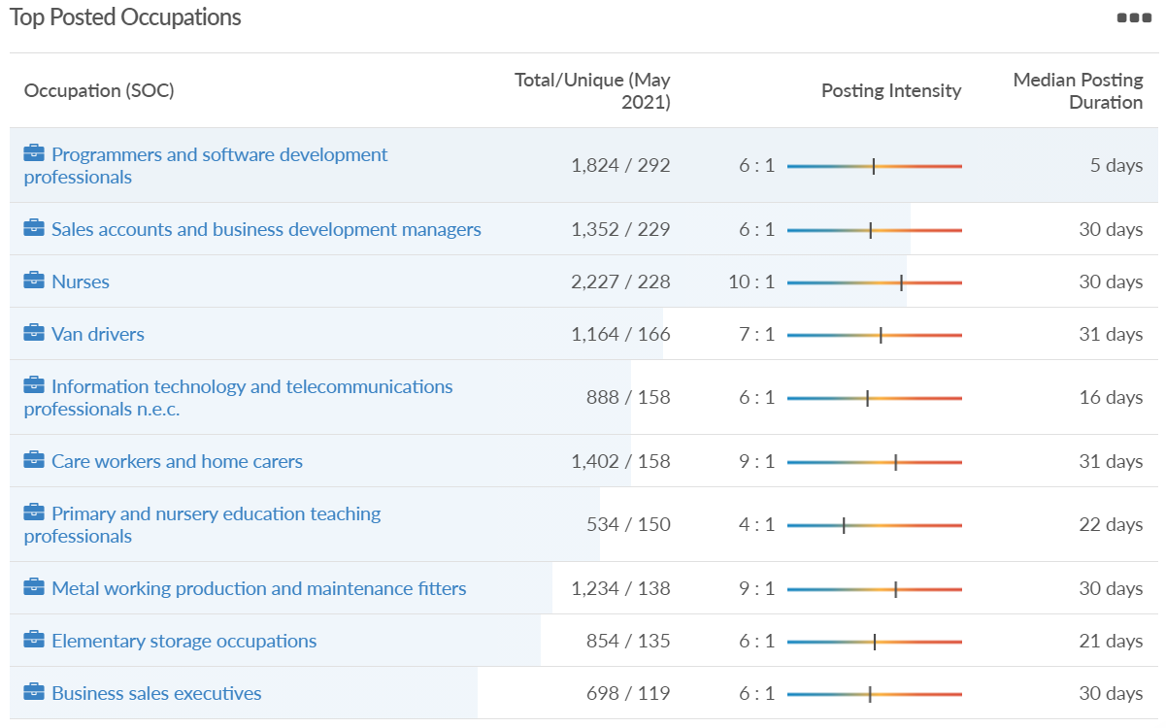
Job posting analytics (EMSI, May 2021)
Unique job postings: 6,412
Total job postings: 40,531
Job posting intensity: 6:1
Unique job postings (May 2020): 2,276

Slide 54
Definitions
Source: Institute for Fiscal Studies, April 2020

