Slide 1
Thames Valley Berkshire Monthly Economic Briefing
June 2021

Slide 2
Key contents of this month’s briefing
Updated global and UK economic forecasts
Latest furlough, SEISS and claimant count figures by Local Authority
Latest remote working figures for Thames Valley Berkshire
Latest ‘notable business news’ by Local Authority
Latest job posting analytics by Local Authority

Slide 3
Global and National Economy
June 2021

Slide 4
Global Economy
The global economy is expected to expand 5.6% in 2021, the fastest post-recession pace in 80 years, largely on strong rebounds from a few major economies. However, many emerging market and developing economies continue to struggle with the COVID-19 pandemic and its aftermath, the World Bank says in its June 2021 Global Economic Prospects.
Despite the recovery, global output will be about 2% below pre-pandemic projections by the end of this year. Per capita income losses will not be unwound by 2022 for about two-thirds of emerging market and developing economies. Among low-income economies, where vaccination has lagged, the effects of the pandemic have reversed poverty reduction gains and aggravated insecurity and other long-standing challenges.
Among major economies, U.S. growth is projected to reach 6.8% this year, reflecting large-scale fiscal support and the easing of pandemic restrictions. Growth in other advanced economies is also firming, but to a lesser extent. Among emerging markets and developing economies, China is anticipated to rebound to 8.5% this year, reflecting the release of pent-up demand.
Emerging market and developing economies as a group are forecast to expand 6% this year, supported by higher demand and elevated commodity prices. However, the recovery in many countries is being held back by a resurgence of COVID-19 cases and lagging vaccination progress, as well as the withdrawal of policy support in some instances. Excluding China, the rebound in this group of countries is anticipated to be a more modest 4.4%. The recovery among emerging market and developing economies is forecast to moderate to 4.7% in 2022. Even so, gains in this group of economies are not sufficient to recoup losses experienced during the 2020 recession, and output in 2022 is expected to be 4.1% below pre-pandemic projections.
Source: World Bank, June 2021

Slide 5
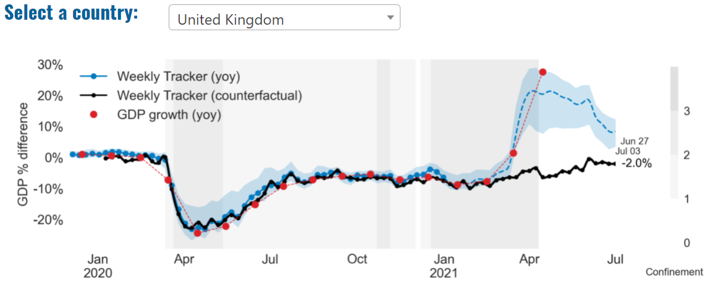
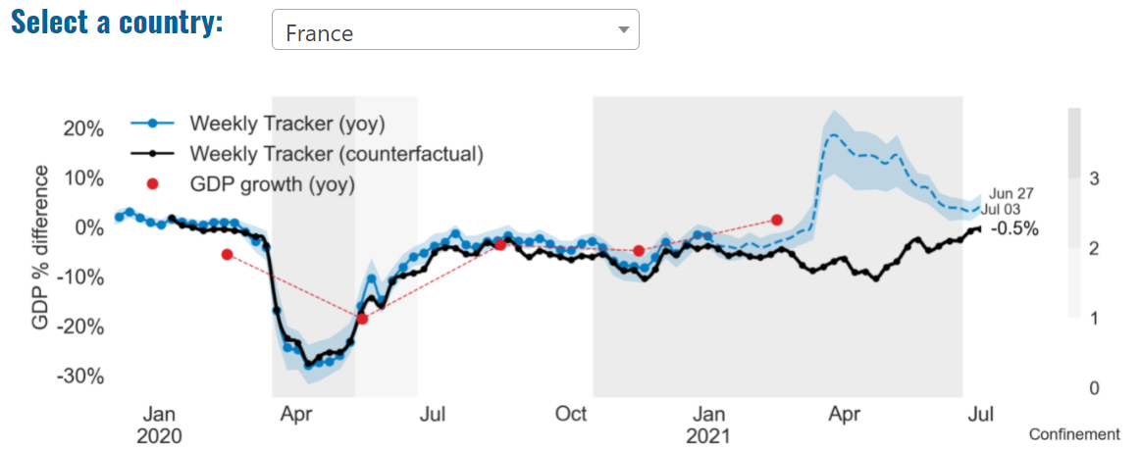
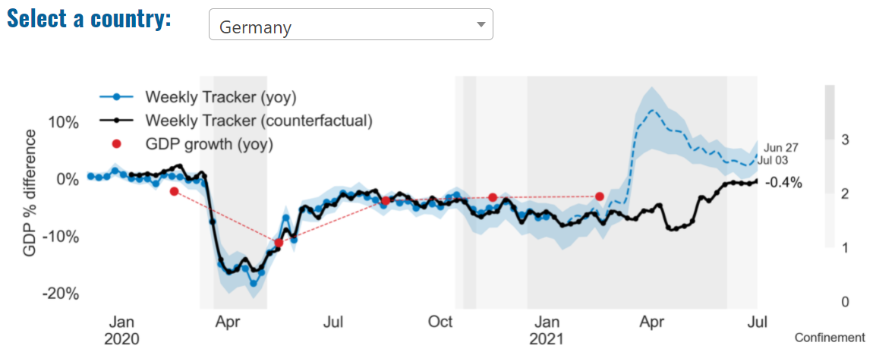
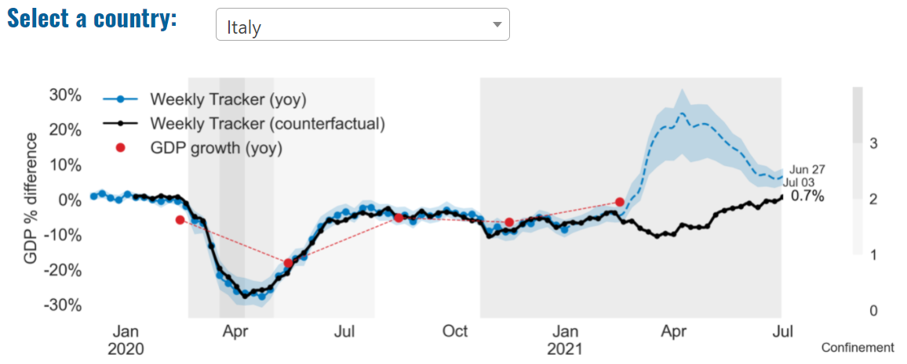
Global Economy – OECD GDP Tracker

Slide 6
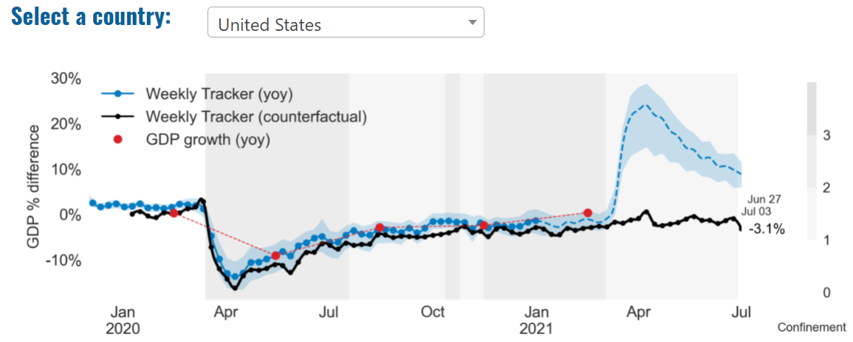
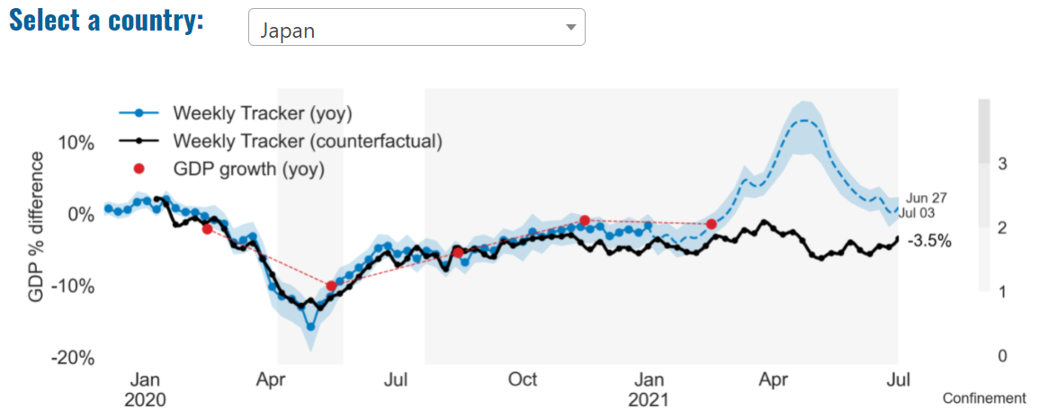
Global Economy – OECD GDP Tracker Continued
China
China is not included within the OECD GDP tracker and so the graph on the left has been compiled using statistics from the IMF and National Bureau of Statistics of China. The 2021 figure is a preliminary figure published by the National Bureau of Statistics of China in January 2021.
Note: The blue confidence band shows 95% confidence intervals. The darkness of the grey background reflects stay-at-home confinement requirement based on the Oxford Blavatnik database (0 - no measures, 1 - recommend not leaving house, 2 - require not leaving house with exceptions, 3 - require not leaving house with minimal exceptions).
Source: OECD, June 2021

Slide 7
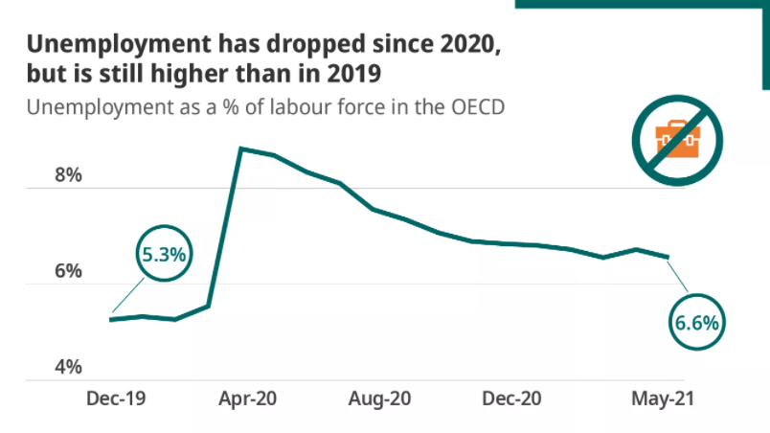
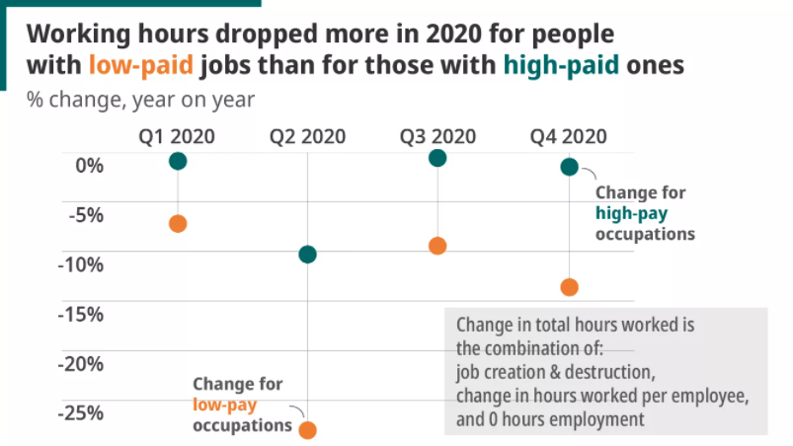
Global Employment Outlook
A slow rebound in jobs increases the risk of long-term unemployment while the COVID-19 pandemic has exacerbated social and economic divides, a situation that risks continuing into the recovery.
According to OECD research, more than 60% of people who lost their jobs during the pandemic fear that they won’t have the right skills for work a decade from now.
Those jobs most vulnerable to being lost as we move to digital technology and net zero are also those most able to be transformed into greener, digital alternatives.
OECD unemployment fell to 6.6% in May 2021, having reached 8.8%. However, if lost working hours are factored in, rather than simply lost jobs, many countries (including the UK) lost much more working time.
Employment levels across the OECD will not recover until Q32023 (in the case of the UK, Q42023)
In 2019, just before the pandemic, the OECD celebrated that the employment rate for young people had finally got back to its level pre-the 2008 economic crisis – only for it to fall off a cliff again.
The possibility to work remotely is much greater among college graduates than those without a high school education – once again, speaking to the digital divide.
49% of 16-65 year olds in England have low digital skills, compared to an OECD average of 43%. In Korea, the figure is 39%; in Germany it is 45%.
Source: OECD Employment Outlook, 2021

Slide 8
UK Economy
The dual impact of Covid-19 and Brexit means that the UK faces deeper economic scarring than any other country, according to forecasts from the Organisation for Economic Co-operation and Development (OECD). In its latest economic outlook, the OECD suggests that overall global growth will continue to accelerate as Covid-19 vaccines are rolled out and fiscal stimulus programmes are introduced. But although the UK’s GDP is forecast to rise by 7.2 per cent in 2021 – higher than most G20 countries – the OECD also predicts that the UK will suffer the deepest economic scarring, or long-term damage, of any G7 country.
Deloitte’s latest forecast for UK GDP expects stronger growth in 2021 than previously projected, in light of strong economic data in March and April and steady progress in easing restrictions, rolling out vaccinations and a low rate of new COVID-19 infections. The global outlook has also improved, driven by the large US fiscal stimulus and a faster pace of vaccinations in the EU. Deloitte has incorporated a slowdown in the recovery in the final quarter of 2021 and the first quarter of 2022 as the economy returns close to its pre-pandemic size and to reflect to possibility the some restrictions (albeit not as disruptive as the previous lockdowns) may be imposed to prevent a resurgence of the virus.
Sources: New Statesman, June 2021; Deloitte, June 2021

Slide 9
UK Economy 2
Robust recovery in the short-term to see UK economy return to pre-Covid level by Q1 2022, with GDP growth of 6.6% forecast for 2021 and 5.4% for 2022. Despite interest rates remaining low in the short term, the withdrawal of government support schemes could coincide with a significant uptick in the number of company insolvencies. Recovery is unlikely to be even across the UK with strongest growth expected in the West Midlands, London, and the East of England.
A combination of restrictions lifting, pent-up consumer demand, accumulated excess savings and a range of government incentives are expected to spark a strong lift-off for the UK economy this summer. This will see GDP grow by 6.6% (up from 4.6% forecast in March) in 2021 and 5.4% in 2022*, allowing the economy to reach its pre-Covid level by the first quarter of next year, according to the latest analysis in KPMG’s UK Economic Outlook.
Meanwhile, rising cost pressures and the reversal of temporary tax cuts will add to inflation this year, but the analysis shows it should moderate towards the second half of next year, and average 1.7% in 2021 and 2.1% in 2022. With spare capacity still in place, KPMG expect the Bank of England to keep interest rates on hold in the short-term in order to allow the economy to fully recover and mitigate the downside risks to the outlook.
From the onset of the pandemic, businesses have been partially shielded from insolvency both by the direct financial support on offer as well as by temporary measures suspending and relaxing insolvency procedures. So, once the temporary regime is over and businesses are forced to confront a new normal, there could be a significant uptick in the number of company insolvencies, despite interest rates remaining low in the short term. This could mean a peak of about 8,000 insolvencies around the turn of the year before numbers fall back again to around 4,000 per quarter.
The outlook beyond the short-term paints a less strong picture, with the end of the super deduction allowance and the rise in corporate tax causing a sharp fall in business investment from 2023, while consumers readjust their spending patterns.
Source: KPMG, June 2021

Slide 10
UK Economy 3
Another month of rapid service sector growth in April was driven by the re-opening of sectors affected by Covid-19 restrictions, resulting in a 2.3 per cent growth in monthly GDP almost in line with our May Tracker forecast. We expect the recovery to have continued in May and June, forecasting monthly growth of 1.5 per cent and 0.9 per cent respectively.
Expansion in April was driven by the retail and education sectors, with manufacturing and construction declining. We expect retail and hospitality to contribute significantly to growth in May.
This leads us to slightly revise up our forecasts for the second quarter of 2021 to 5.3 per cent, the fastest quarterly growth rate since the summer of last year and the initial recovery phase after the Covid-19 shock.
While the lifting of restrictions has helped return the economy overall to just 3.7 per cent below its pre-Covid peak, some sectors remain badly affected. In April hospitality was still 40 per cent below its level in February 2020 while arts and recreation was down by more than 30 per cent. Postponing the last step of re-opening may delay the recovery in arts and recreation by a few weeks but, if it helps avoid a third wave of infections, it could contribute to sustained recovery in the second half of the year
Source: NIESR, June 2021

Slide 11
Coronavirus and Recession: Implications for Thames Valley Berkshire

Slide 12
Furloughing (Latest data - May 2021)
36,800 jobs furloughed across Thames Valley Berkshire
4,600 jobs (8% of total eligible employments) furloughed in Bracknell Forest UA
8,300 (12% of total eligible employments) furloughed in Slough UA
7,100 jobs (7% of total eligible employments) furloughed in Reading UA
5,500 jobs (7% of total jobs) furloughed in Wokingham UA
6,400 jobs (10% of total jobs) furloughed in Windsor and Maidenhead
4,900 jobs (7% of total jobs) furloughed in West Berkshire
Source: HMRC, May 2021
Berkshire has a lower-than-average number of furloughed workers, compared to the rest of the UK, because of its relative strength in sectors of industry that can be continued by workers from home.

Slide 13
SEISS (Latest data - June 2021)
Total value of claims made across Thames Valley Berkshire: £80,500,000
Total value of claims made for Bracknell Forest UA – SEISS 4: £12,400,000
Total value of claims made for Slough UA – SEISS 4: £17,500,000
Total value of claims made for Reading UA – SEISS 4: £12,900,000
Total value of claims made for Wokingham – SEISS 4: £12,800,000
Total value of claims made for Windsor and Maidenhead – SEISS 4: £12,200,000
Total value of claims made in West Berkshire – SEISS 4: £12,700,000
Source: HMRC, July 2021

Slide 14
Claimant Count (Latest data - May 2021)
Total of 28,410 claimants (4.9% of the working age population) in Thames Valley Berkshire
3,145 claimants (4% of the working age population) in Bracknell Forest UA
7,965 claimants (8.4% of the working age population) in Slough UA
6,845 claimants (6.4% of the working age population) in Reading UA
3,135 claimants (3% of the working age population) in Wokingham UA
3,775 claimants (4.1% of the working age population) in Windsor and Maidenhead UA
3,545 claimants (3.7% of the working age population) in West Berkshire UA
Across Thames Valley Berkshire, claimant unemployment has fallen marginally from 29,165 in May 2020 to 28,410 in May 2021. Slough had 8.4% of its working age population claim unemployment in May 2021, up from 7.8% in May 2020.
Source: ONS, June 2021

Slide 15
Strategic Issues: Heathrow
Heathrow Airport
Britain’s busiest airport handled just one-10th of pre-pandemic passengers in the first half of 2021. Heathrow’s latest figures showed only 3.8 million travelers passing through what used to be Europe’s busiest airport between January and June 2021, compared with 39 million during the same spell in 2019. Numbers are expected to increase from next week, with British travelers who have been fully vaccinated by the NHS allowed to return from “amber list” countries without quarantine. But no such concession applies to passengers who have received their jabs abroad. The chief executive of Heathrow, John Holland-Kaye said: “While it’s fantastic news that some double-vaccinated passengers will no longer need to quarantine from amber countries, ministers need to extend this policy to US and EU nationals if they want to kickstart the economic recovery.
Source: The Independent, July 2021

Slide 16
Strategic Issues: Aviation
Aviation:
Unite, the UK’s leading aviation union, is fully supporting a unique cross-sector alliance of all key participants in the industry, who will come together for a day of action (Wednesday 23 June) to demand that the government takes immediate action to ensure that travel survives the Covid-19 pandemic. Unite’s key call is for the Coronavirus Job Retention Scheme (CJRS) to be extended for the aviation sector beyond the current cut-off date of September, while government restrictions are preventing travel, in order to protect jobs, routes and airports and to ensure that the UK still has a viable industry when travel can safely return to something approaching normality. As part of the day of action, Unite members who are aviation workers and other key stakeholders in the industry will be taking part, with other unions and the TUC, in a lobby of Parliament organised by trade association Airlines UK, and the travel industry.
Source: Unite, June 2021

Slide 17
Demand and Supply Conditions: Businesses, Hiring, Restructuring, Investment, Labour and Skills Supply

Slide 18
Household/Consumer Demand
Slough had an overall recovery index score of 62 at the end of May, putting them in a stronger position in terms of recovery (closer to pre-lockdown levels) than Reading which had a recovery index score of 58.
Source: Centre for Cities, July 2021 (latest release)
Retail sales volumes declined by 1.4% between April and May 2021 following a sharp increase in April when retail restrictions were eased; despite the monthly decline, over April and May combined, average total retail sales volumes were still 7.7% higher than in March 2021, and were 9.1% higher than in February 2020 before the impact of the coronavirus (COVID-19) pandemic. The largest contribution to the monthly decline in May 2021 came from food stores where sales volumes fell by 5.7%; anecdotal evidence suggests the easing of hospitality restrictions had had an impact on sales as people returned to eating and drinking at locations such as restaurants and bars. Non-food stores reported a 2.3% increase in monthly sales volumes in May 2021 with household goods stores (for example, hardware and furniture stores) and “other” non-food stores reporting the largest growth of 9.0% and 7.7% respectively.
The large increase in sales volumes in April, followed by a relatively small fall in May, has resulted in the volume of sales for the three months to May 2021 being 8.3% higher than in the previous three months; there was strong growth in automotive fuel sales and non-food retailers of 19.3% and 17.8% respectively. The proportion of retail sales conducted online remains substantially higher than before the pandemic, but in May all retail sectors, with the exception of food stores, reported a fall in their proportions of online sales as consumers returned to physical stores; the total proportion of sales online decreased to 28.5% in May 2021, down from 29.8% in April 2021. In comparison with February 2020, the value of total online retail sales in May 2021 was 58.8% higher, whereas in-store sales were 1.3% lower. Retail sales volumes in May 2021 were 24.6% higher than in May 2020, which was affected by the first national lockdown when the tightest restrictions were in place; however, these growth rates are distorted by base effects and are not a reliable guide. Source: ONS, June 2021 (latest release)

Slide 19
Industries at Risk
MANUFACTURING
28,000 people work in manufacturing in Berkshire – with 11,000 in West Berkshire alone and 2,487,000 across the whole of Great Britain (ONS, 2020)
Half of all UK manufacturing firms have made redundancies. A further 20% plan to make more redundancies in the next six months (Make UK, October 2020)
37% of manufacturers think it will take more than a year to return to normal trading conditions (Make UK, October 2020)
HOSPITALITY & TOURISM
The hospitality and tourism sector in Berkshire employed 35,842 people in 2020 – an increase of 0.8% on the previous year (EMSI, 2021)
In June, ‘Pathways to Recovery’, a report by the All Party Parliamentary Group on Hospitality and Tourism, found that just 11% of hospitality businesses had been able to operate normally during the first lockdown and international tourist arrivals were likely to be down 59% for the year.
Kate Nicholls, CEO of UK Hospitality, told the BBC (December 2020) that 30,000 hospitality businesses – most of them SMEs and one-third of the total – could be lost by the end of 2020.
According to Sky News in December, at least 38,653 hospitality jobs had been lost during the pandemic.
CONSTRUCTION
21,000 people work in construction in Berkshire – with only 1,500 of these working in Bracknell Forest and 2,164,000 across the whole of Great Britain (ONS, 2020)
The level of construction output in August 2020 was 10.8% below the February 2020 level (ONS, 2020)
Construction output grew by 18.5% in the three months to August 2020 compared with the previous three-month period, but this followed 10 consecutive periods of decline (ONS, 2020)
NON-FOOD RETAIL & WHOLESALE
More than 45,000 people work in non-motor vehicle retail in Berkshire – with 12,500 of them working in Reading (EMSI, 2021). The offline retail sector has struggled during the pandemic. At least 39,000 jobs had been lost in retail as of 3 December. Redundancy announcements include 7,000 at Marks and Spencer (August), 4,000 at Debenhams (August) and 4,000 at Boots (July) - Sky News, 2020.
The pre-pandemic trend of on-line shopping has strengthened in 2020; a record total of 31.4% of shopping was done on line in November 2020 (ONS, 2020), a trend that will have profound implications for the high street.
In November, retail sales volume decreased by 3.8% (vs October figures) as a result of COVID-19. Despite this, overall sales remain above their pre-pandemic levels (ONS, 2020).
ARTS, ENTERTAINMENT & RECREATION
12,000 people work in arts, entertainment and recreation in Berkshire. 4,500 of them – more than one third – work in Windsor and Maidenhead and 925,000 across the whole of Great Britain (ONS, 2020)
Between 19 Nov and 1 Dec, 24 per cent of arts, entertainment and recreation venues had temporarily closed or paused trading. (ONS, 2020)
52% of eligible employments in arts, entertainment and recreation were on furlough on 31 July 2020 – a figure that had fallen to 24% as at 31 October. (HMRC, 2020)
AVIATION
Aviation has an estimated value of £28 billion to the UK economy, employing 230,000 workers at over 40 commercial airports. (House of Commons Transport Committee, June 2020)
76,000 people work in over 400 business across Heathrow Airport. Many of these people live in Slough, in Berkshire. (Heathrow local recovery plan, 2020)
There were 5,800 passenger flights in April 2020 compared to 201,000 a year earlier: a reduction of 97%. The impact is several times more severe than the aftermath of the global financial crisis in 2008, when passenger flights reduced by around 67,000 to 134,000 per month. (House of Commons Transport Committee, June 2020)
The UK aviation industry has been hit harder than any European country by the pandemic with IATA calculating that the “coronavirus crisis will cost 780,000 British jobs and cost £46bn in lost GDP.” (International Air Transport Association, 2020).
ADMINISTRATION & SUPPORT
More than 51,000 people in Berkshire work in admin and support services – including 10,000 in Wokingham and 10,000 in West Berkshire and 2,752,000 across the whole of Great Britain (ONS, 2020)
More than 600,000 admin and support workers – 27% of the total – were furloughed as at 31 October (HMRC, 2020)

Slide 20
Industries more likely to be resilient/grow – Digital tech, logistics and home improvement
Telecoms
Cybersecurity and data management
eCommerce
Logistics and delivery services
Subscription services
eLearning
Streaming and gaming services
Online casinos
Health and home fitness
Gardening and DIY
Sources: Talk Business, April 2021.
From this analysis, it is apparent that (as alluded to in previous monthly reports) IT, and e-commerce by extension, as well as home improvement and fitness related industries and those which have so far demonstrated the greatest resilience in the face of the COVID-19 pandemic and are predicted to see some of the highest growth throughout 2021.

Slide 21
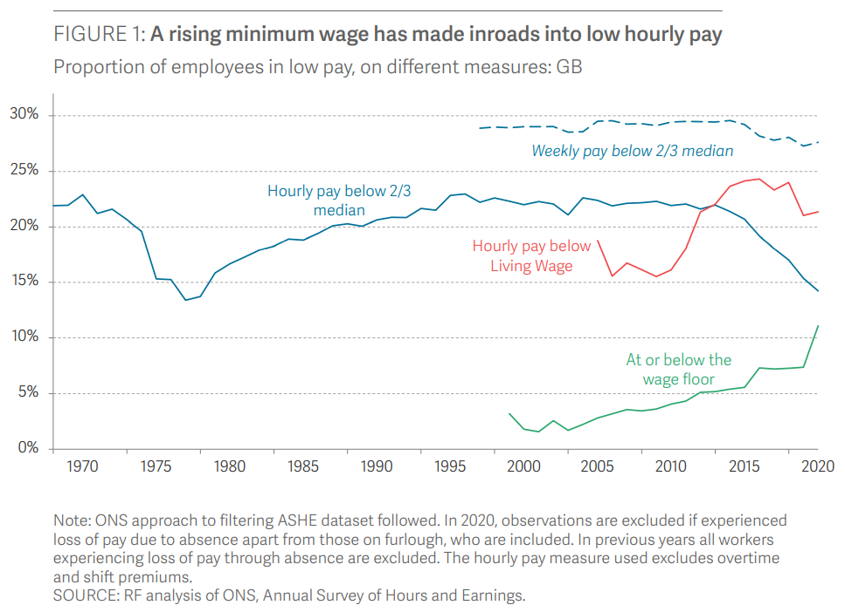
Supply of labour and skills
The backdrop to the Covid-19 pandemic was one of falling low pay. When using the standard definition of hourly pay – that is, pay that is below two thirds of the median – the proportion of workers in low pay has been falling consistently since 2015, coinciding with the introduction of the ‘National Living Wage’ (a higher minimum wage rate for those aged 25 and above – since lowered to age 23 and above) in 2016 and the period following. This is shown in the solid blue line in Figure 1. Between 2015 and 2020, the proportion of workers in low hourly pay fell by 7 percentage points, from 21 per cent to 14 per cent, while the number of workers in low hourly pay fell by 1.6 million, from 5.5 million in 2015 to 3.9 million in 2020. The fact that low pay continued to fall in 2020 (when many workers on furlough, especially low paid workers, experienced a pay reduction) is on one level encouraging, but it may partly reflect a compositional effect given low paid workers were more likely to lose work during the crisis.
Source: Resolution Foundation, June 2021

Slide 22
Remote working
In June of 2021, there were 4,440 unique job postings for remote positions at companies based in Berkshire, around 296% more than the figure of 1,119 for the same period one year previous.
Compare this with the South East, in June 2021 there were 26,050 unique remote job postings for remote positions; rising from 7,064 in June of the previous year – an increase of over 268%
A rise can also be seen at national level, with a recorded 163,117 unique remote job postings in England in June of 2021, rising from 49,579 in June 2020 – an increase of over 229%.
From these figures it’s apparent that the COVID-19 pandemic has, somewhat unsurprisingly, prompted a massive boost in job postings for explicitly remote roles. Berkshire has seen a larger boost in vacancies which are remote-based than both England and the South East.
Source: EMSI, June 2021

Slide 23
Local Profiles

Slide 24
Bracknell Forest

Slide 25
Impact of COVID-19 up to 12th July 2021
COVID-19 cases (to 12th July 2021) – Source: Public Health Berkshire COVID-19 Dashboard, July 2021
8,198 total cases
71 new cases daily
Claimant unemployment (to May 2021)
3,145 claimants (4% of the working age population) in Bracknell Forest UA
Notable business news
Home Bargains has been given the go-ahead to open a store in The Peel Centre, Bracknell. A planning application was lodged to Bracknell Forest Council for the popular retailer to move into the vacant store Next used to occupy at The Peel Centre. The applicants have been given the green-light to convert part of Unit 4a into space exclusively for the sale of food. Documents attached to the application indicate Home Bargains want to use 30 per cent of the floor space at the 1,862 square metre site for this purpose.
Source: Bracknell News, June 2021

Slide 26
Industries hit hardest by COVID shutdown
As illustrated by the above graph, Bracknell Forest has suffered very similarly to Great Britain in terms of the percentage of jobs within industries which have been hit hardest by COVID shutdowns. Thames Valley Berkshire area has seen an additional 0.77% of jobs of jobs affected worst by the COVID shutdowns when compared to Bracknell Forest.
Source: EMSI, March 2021 (definition for industries hit hardest provided on slide 54)

Slide 27
Industry risks and opportunities (2020-2021)
Critical industries
Food and drink retail: 3,234 employees (1% below the national average)
Energy/utilities: 257 employees (65% below the national average)
Health and social care: 6,193 employees (25% below the national average)
Freight/logistics: 515 employees (70% below the national average)
Insurance: 186 employees (69% below the national average)
Banking and financial services: 1,291 employees (13% below the national average)
Sectors most impacted
Hospitality and tourism: 3,743 employees (26% below the national average)
Arts, entertainment and recreation: 1,148 (24% below the national average)
Admin and support: 2,694 (21% below the national average)
Aviation: 0 employees
Non-food retail and wholesale: 8,508 (75% above the national average)
Manufacturing: 1,549 (69% below the national average)
Construction: 1,771 (40% below the national average)
Source: EMSI, January 2021

Slide 28
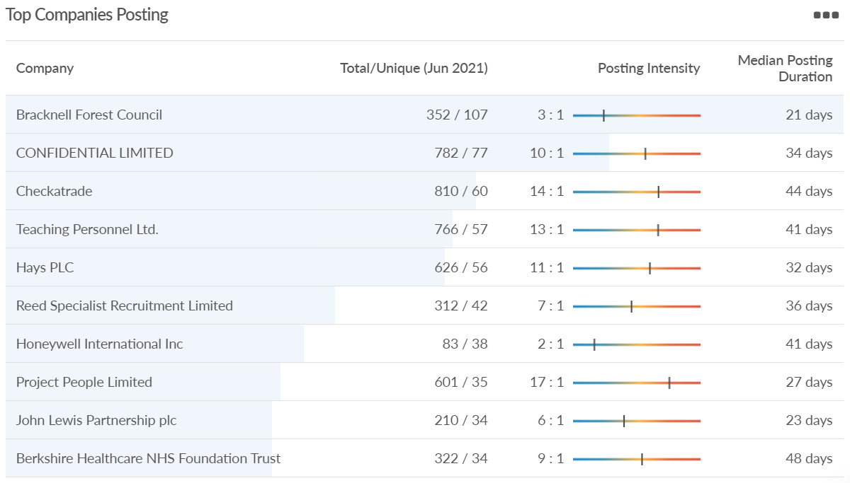
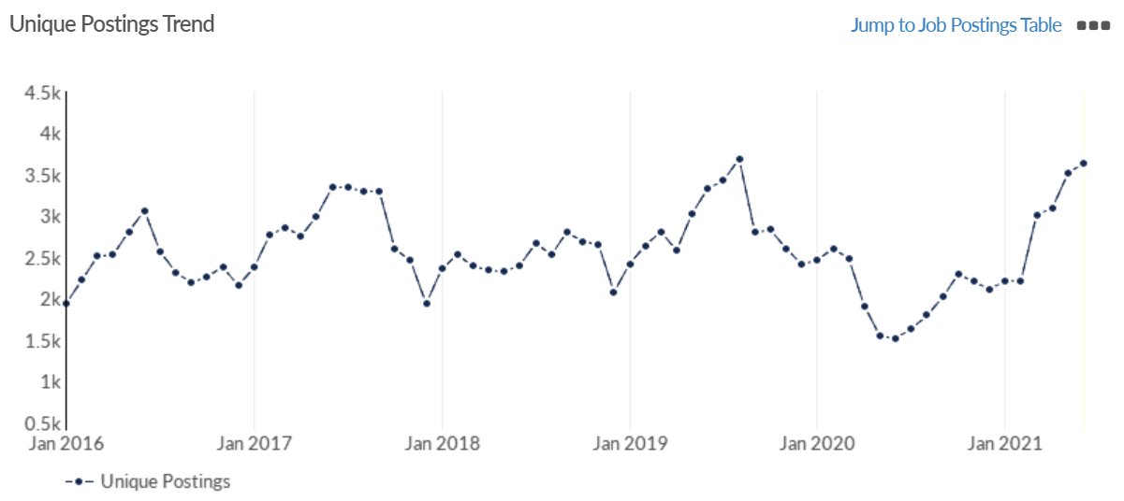
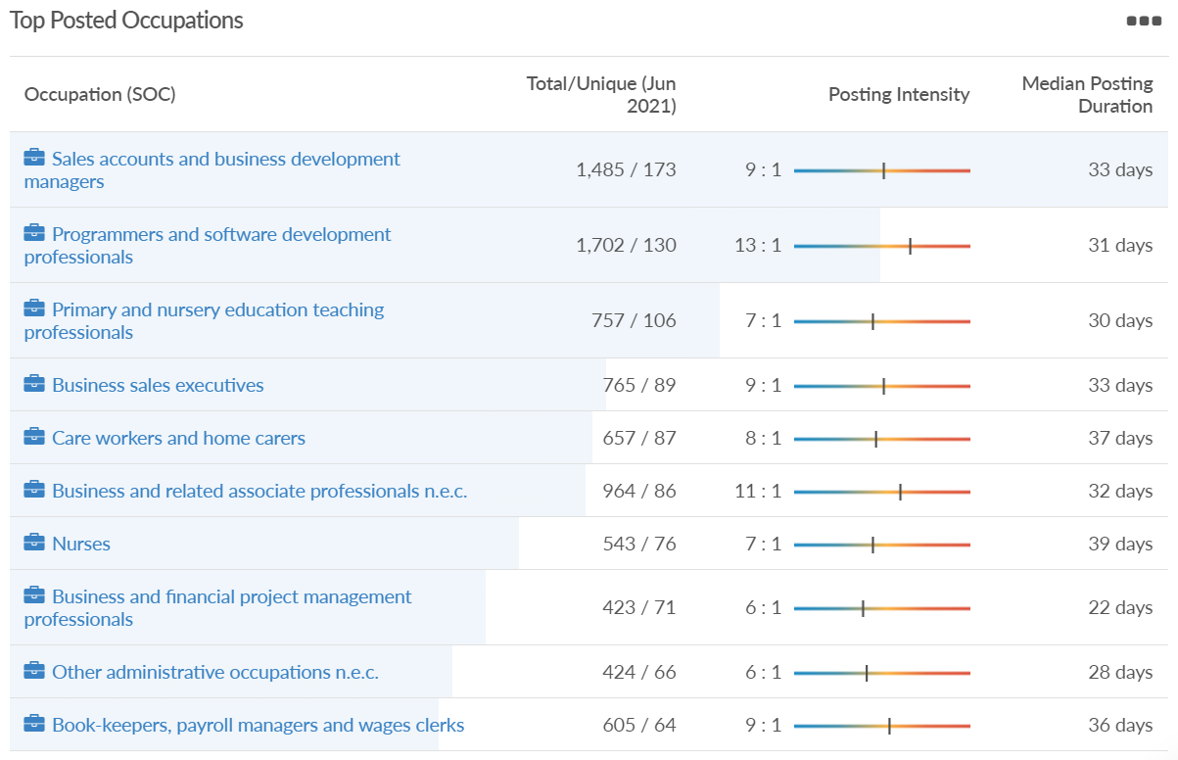
Job posting analytics (EMSI, June 2021)
Unique job postings: 3,639
Total job postings: 30,391
Job posting intensity: 8:1
Unique job postings (June 2020): 1,520

Slide 29
Slough

Slide 30
Impact of COVID-19 up to 12th July 2021
COVID-19 cases (to 12th July 2021) – Source: Public Health Berkshire COVID-19 Dashboard, 12th July 2021
16,666 total cases
42 new cases daily
Claimant unemployment (to May 2021)
7,965 claimants (8.4% of the working age population) in Slough UA
Notable business news
Discount supermarket chain Lidl has announced it is scouting for new sites across Berkshire - with a potential 14 new stores set to open in the county. Lidl is planning a huge national expansion - with a potential 200 new stores in the next two years, bringing the total number of sites to 1,000 across the country. There is already a store in Slough, but the company is looking for locations in three areas around the town.

Slide 31
Industries hit hardest by COVID shutdown
When compared to both Thames Valley Berkshire and Great Britain, Slough has seen a significantly lower percentage of jobs affected by COVID shutdowns – perhaps somewhat surprising given the LA’s proximity to Heathrow and the almost complete shutdown of the aviation sector.
Source: EMSI, March 2021 (definition for industries hit hardest provided on slide 54)

Slide 32
Industry risks and opportunities (2020-2021)
Critical industries
Food and drink retail: 6,656 employees (47% above the national average)
Energy/utilities: 2,820 employees (174% above the national average)
Health and social care: 8,201 employees (28% below the national average)
Freight/logistics: 4,640 employees (93% above the national average)
Insurance: 121 employees (86% below the national average)
Banking and financial services: 731 employees (65% below the national average)
Sectors most impacted
Hospitality and tourism: 3,780 employees (46% below the national average)
Arts, entertainment and recreation: 442 (79% below the national average)
Admin and support: 9,765 (107% above the national average)
Aviation: 262 employees (16% above the national average)
Non-food retail and wholesale: 6,719 (0% above the national average)
Manufacturing: 5,071 (28% below the national average)
Construction: 2,620 (36% below the national average)
Source: EMSI, January 2021

Slide 33
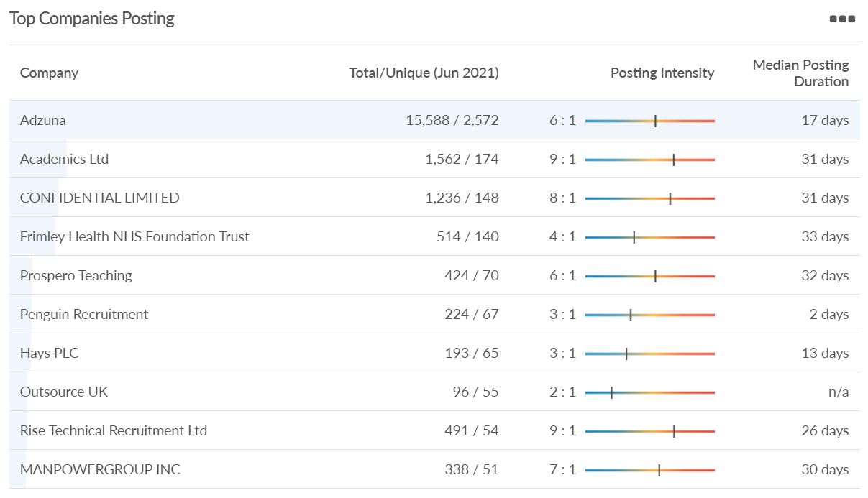
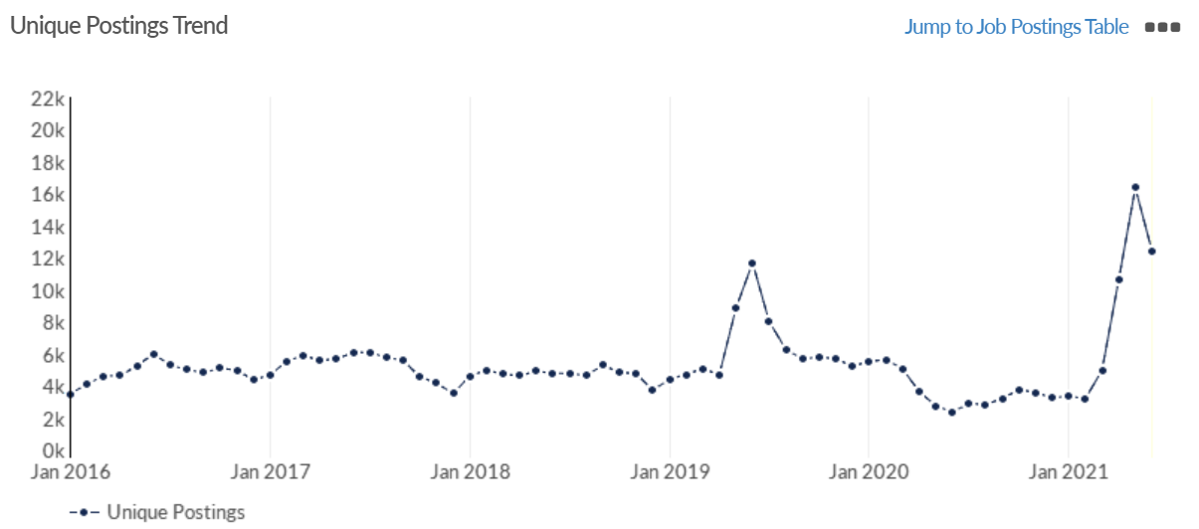
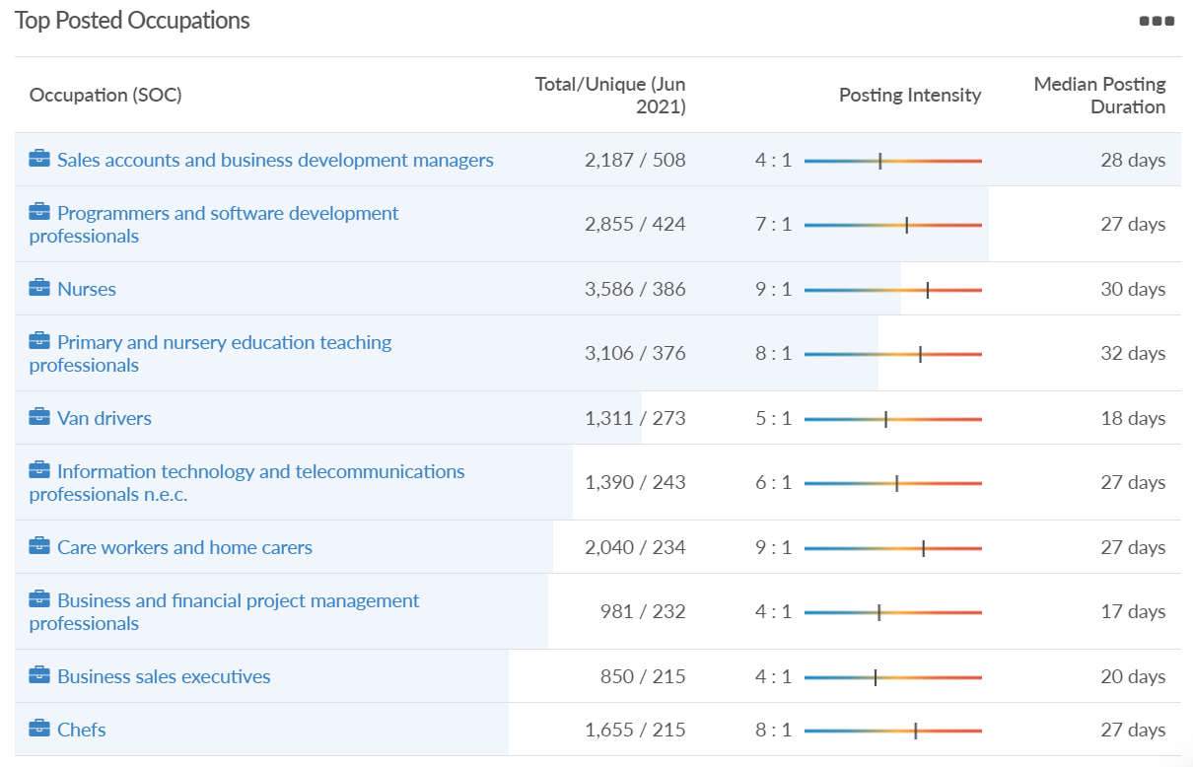
Job posting analytics (EMSI, June 2021)
Unique job postings: 12,435
Total job postings: 66,917
Job posting intensity: 5:1
Unique job postings (June 2020): 2,362

Slide 34
Reading

Slide 35
Impact of COVID-19 up to 12th July 2021
COVID-19 cases (to 12th July 2021) – Source: Public Health Berkshire COVID-19 Dashboard, 12th July 2021
12,869 total cases
90 new case daily
Claimant unemployment (to May 2021)
6,845 claimants (6.4% of the working age population) in Reading UA
Notable business news
Reading Flooring Superstore becomes the 10th store opened by the UK’s fastest-growing flooring retailer in less than a month – the store opened its doors to shoppers at Reading Gateway in May. The retailer has invested £200,000 and created four new jobs with the opening of the 4,475 sq ft outlet on Imperial Way. This was the 10th store launched by Flooring Superstore since 12 April, with stores having also opened in Newcastle, Huddersfield, Doncaster, Hull, Basingstoke, Orpington, Norwich, Lincoln, and Carlisle.
Source: Business Magazine, June 2021

Slide 36
Industries hit hardest by COVID shutdown
Reading has been marginally less affected by the COVID shutdowns as Great Britain has on average, with 15.16% of jobs within industries which have been most severely impacted by the shutdowns. The Local Authority is 1.26% better off than the average of the Thames Valley Berkshire area.
Source: EMSI, March 2021 (definition for industries hit hardest provided on slide 54)

Slide 37
Industry risks and opportunities (2020-2021)
Critical industries
Food and drink retail: 6,192 employees (11% above the national average)
Energy/utilities: 3,350 employees (163% above the national average)
Health and social care: 13,464 employees (5% below the national average)
Freight/logistics: 1,513 employees (49% below the national average)
Insurance: 2,076 employees (100% above the national average)
Banking and financial services: 1,688 employees (34% below the national average)
Sectors most impacted
Hospitality and tourism: 6,567 employees (25% below the national average)
Arts, entertainment and recreation: 1,811 (31% below the national average)
Admin and support: 9,212 (58% above the national average)
Aviation: <10 employees
Non-food retail and wholesale: 8,626 (18% above the national average)
Manufacturing: 2,000 (77% below the national average)
Construction: 2,273 (55% below the national average)
Source: EMSI, January 2021

Slide 38
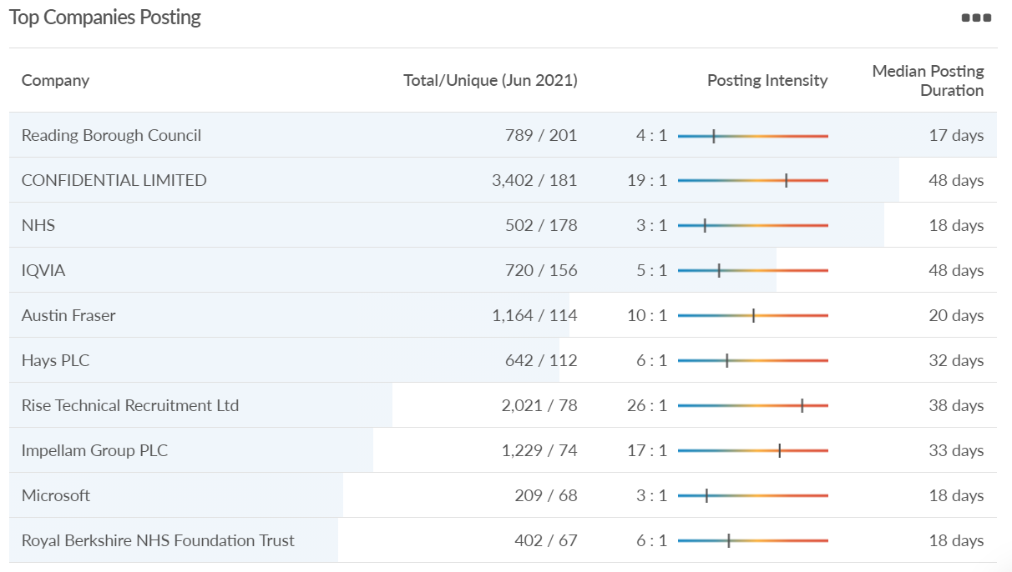
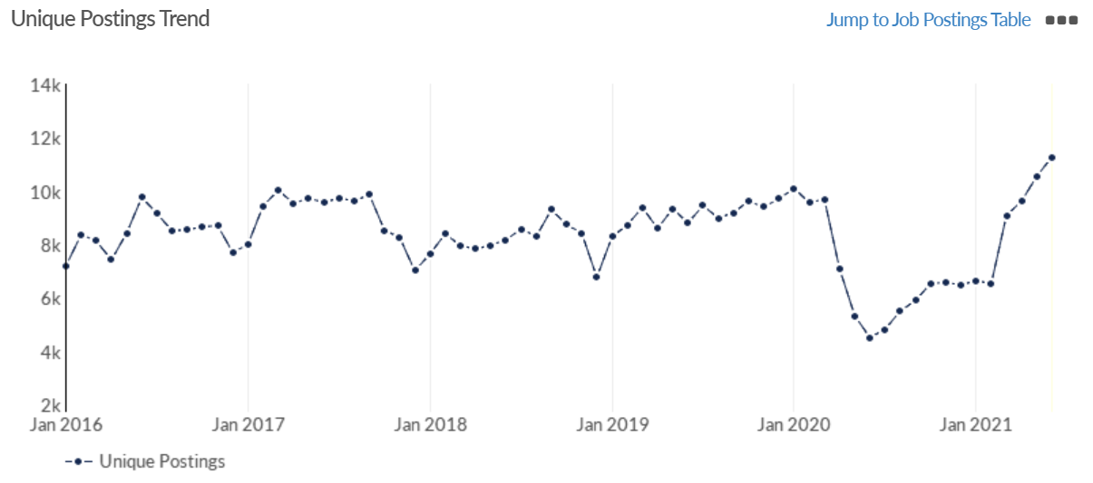
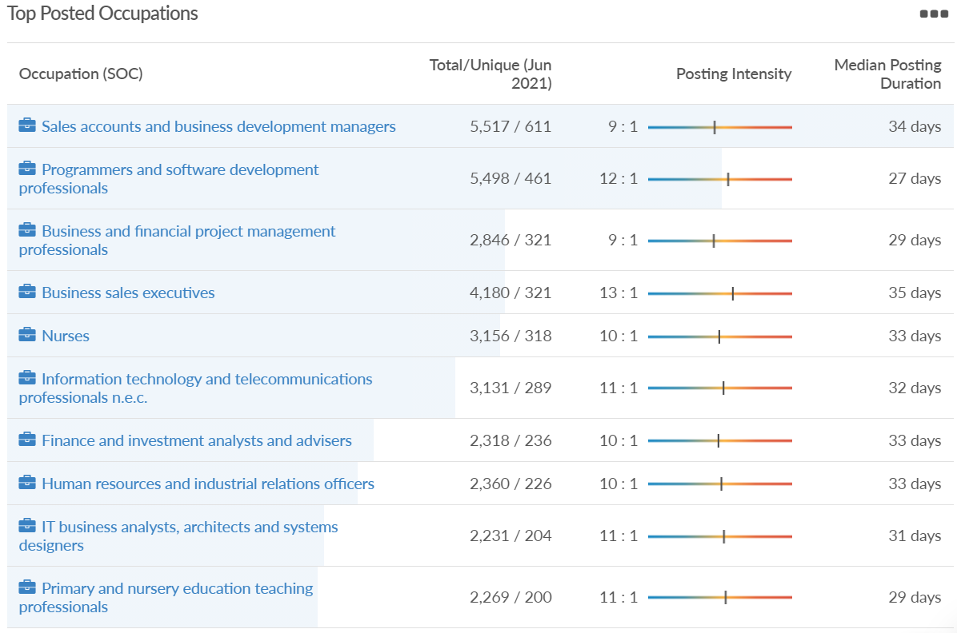
Job posting analytics (EMSI, June 2021)
Unique job postings: 11,277
Total job postings: 113,857
Job posting intensity: 11:1
Unique job postings (June 2020): 4,510

Slide 39
Wokingham

Slide 40
Impact of COVID-19 up to 12th July 2021
COVID-19 cases (to 12th July 2021) – Source: Public Health Berkshire COVID-19 Dashboard, 12th July 2021
9,594 total cases
61 new cases daily
Claimant unemployment (to May 2021)
3,135 claimants (3% of the working age population) in Wokingham UA
Notable business news
Winnersh Triangle’s new flexi-working suite, Arena Business Centres, has been opened by Wokingham borough’s mayor. Cllr Keith Baker launched the “state of the art” business centre on Friday, June 11, which brings a new working environment to the area. “I’m extremely pleased to be invited to this brand-new building owned by Arena Business Centres,” he said. “It’s an amazing facility that’s really flexible and can cater to almost anyone’s requirements whether they are a small SME or a large corporate.” The firm moved to Winnersh Triangle as part of an £8 million project, and includes workspaces for groups of two people up to 500. It said this will help businesses relocate, upsize and downsize with ease.
Source: Wokingham Today, June 2021

Slide 41
Industries hit hardest by COVID shutdown
Wokingham is in a similar position to Slough in that is has been significantly less affected by the COVID shutdowns than both the Thames Valley Berkshire area and Great Britain as a whole. This is likely due to the high levels of employment from the Tech sector (Microsoft etc. based at TVP) as this industry is able to work well from home.
Source: EMSI, March 2021 (definition for industries hit hardest provided on slide 54)

Slide 42
Industry risks and opportunities (2020-2021)
Critical industries
Food and drink retail: 3,883 employees (17% below the national average)
Energy/utilities: 1,434 employees (35% above the national average)
Health and social care: 7,283 employees (38% below the national average)
Freight/logistics: 886 employees (64% below the national average)
Insurance: 453 employees (48% below the national average)
Banking and financial services: 423 employees (80% below the national average)
Sectors most impacted
Hospitality and tourism: 5,410 employees (25% below the national average)
Arts, entertainment and recreation: 1,831 (16% below the national average)
Admin and support: 6,432 (33% above the national average)
Aviation: 0 employees
Non-food retail and wholesale: 6,494 (6% below the national average)
Manufacturing: 3,731 (48% below the national average)
Construction: 3,115 (26% below the national average)
Source: EMSI, January 2021

Slide 43
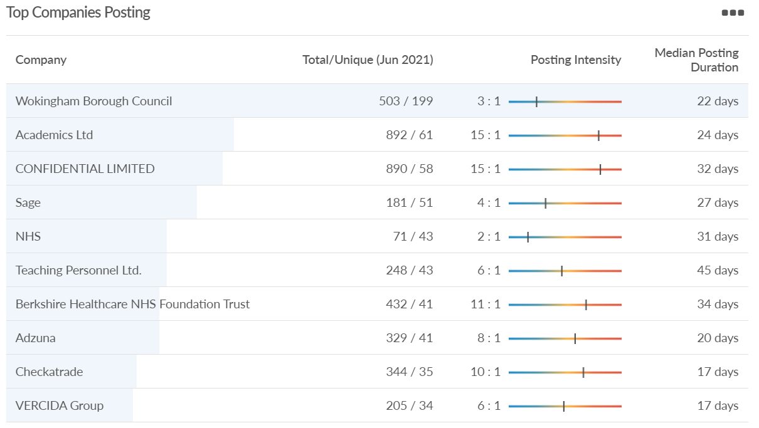
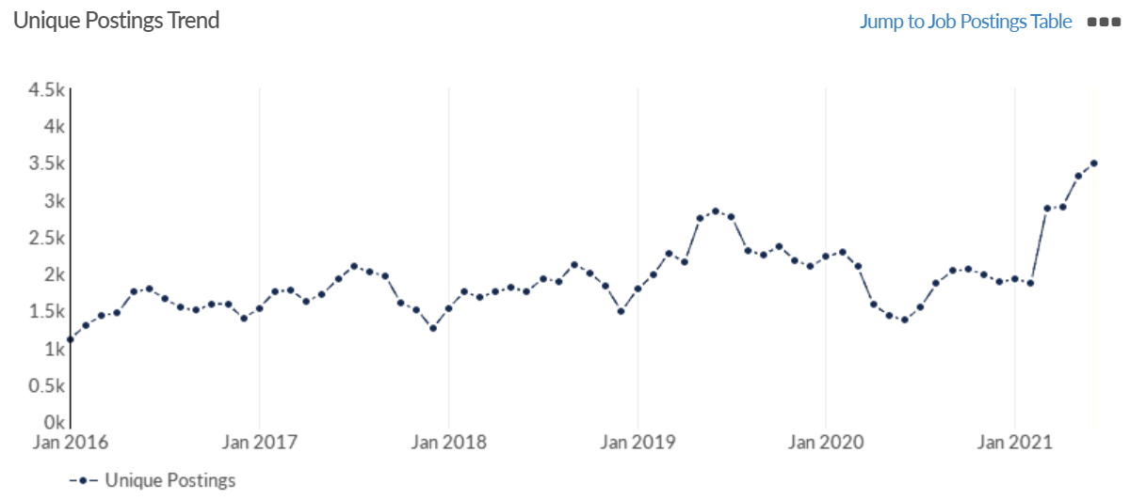
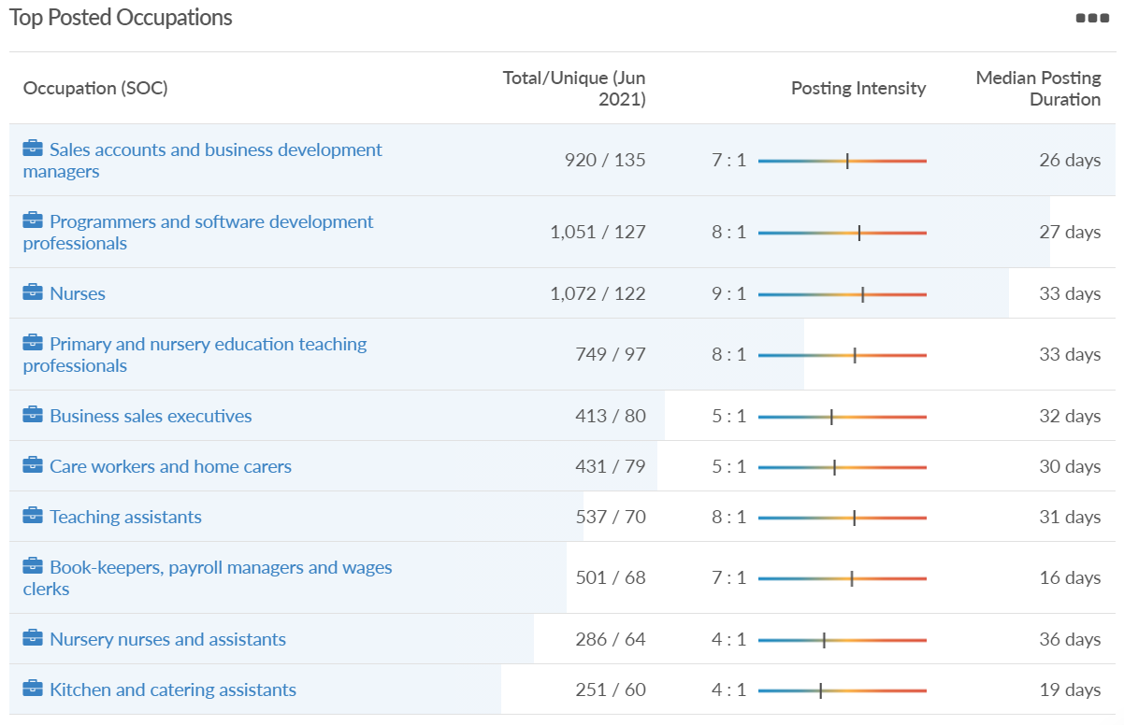
Job posting analytics (EMSI, June 2021)
Unique job postings: 3,489
Total job postings: 21,768
Job posting intensity: 6:1
Unique job postings (June 2020): 1,365

Slide 44
Windsor and Maidenhead

Slide 45
Impact of COVID-19 up to 12th July 2021
COVID-19 cases (to 12th July 2021) – Source: Public Health Berkshire COVID-19 Dashboard, 12th July 2021
9,497 total cases
52 new cases daily
Claimant unemployment (to May 2021)
3,775 claimants (4.1% of the working age population) in Windsor and Maidenhead UA
Notable business news
Talented cooks across Berkshire are being given the chance to show off their skills a build a reputation for their dishes without even leaving their homes. Maidenhead business partners Dinesh Patil and Shabbir Mookhtiar set up Cook My Grub to give people the opportunity to move away from their local takeaway and experience home-cooked meals from a wide range of cultures. The dads met at the school gates, while waiting to pick up their children and became friends, they launched Cook My Grub with an app and website last year just before the pandemic hit, and it has quickly grown.
Source: Berkshire Live, June 2021

Slide 46
Industries hit hardest by COVID shutdown
Windsor and Maidenhead appears to be the most severely affected of all the Local Authorities which make up Berkshire in terms of percentage of jobs hit hardest by the COVID shutdowns. This is likely due in part to the enormous hit the leisure/tourism sector has taken and how key of an employer Legoland Windsor to the region.
Source: EMSI, March 2021 (definition for industries hit hardest provided on slide 54)

Slide 47
Industry risks and opportunities (2020-2021)
Critical industries
Food and drink retail: 3,733 employees (17% below the national average)
Energy/utilities: 882 employees (13% below the national average)
Health and social care: 8017 employees (29% below the national average)
Freight/logistics: 748 employees (68% below the national average)
Insurance: 434 employees (48% below the national average)
Banking and financial services: 1,252 employees (39% below the national average)
Sectors most impacted
Hospitality and tourism: 9,437 employees (35% above the national average)
Arts, entertainment and recreation: 4,516 (117% above the national average)
Admin and support: 4,207 (10% below the national average)
Aviation: 11 employees (95% below the national average)
Non-food retail and wholesale: 7,834 (18% above the national average)
Manufacturing: 2,523 (64% below the national average)
Construction: 6,201 (54% above the national average)
Source: EMSI, January 2021

Slide 48
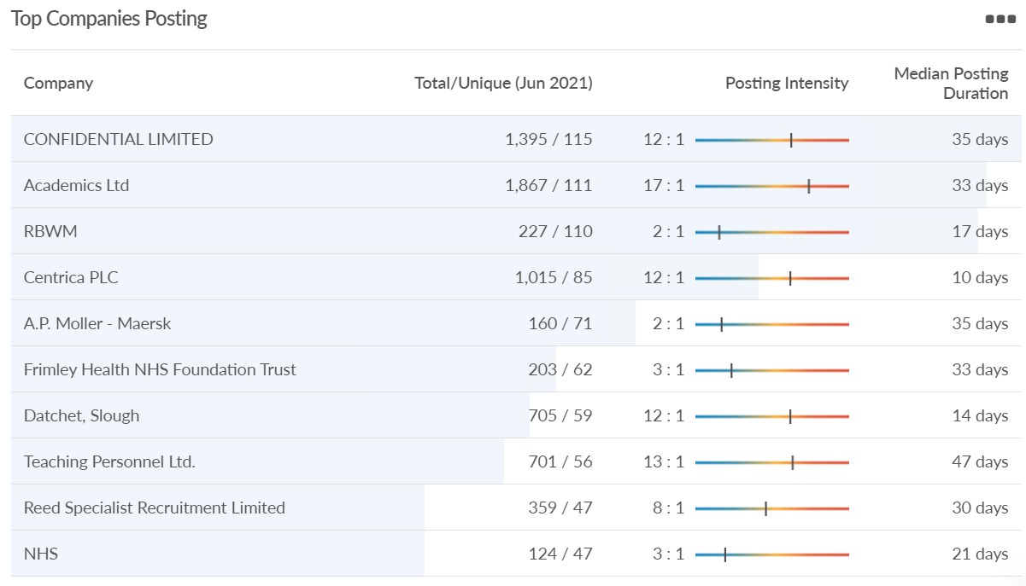
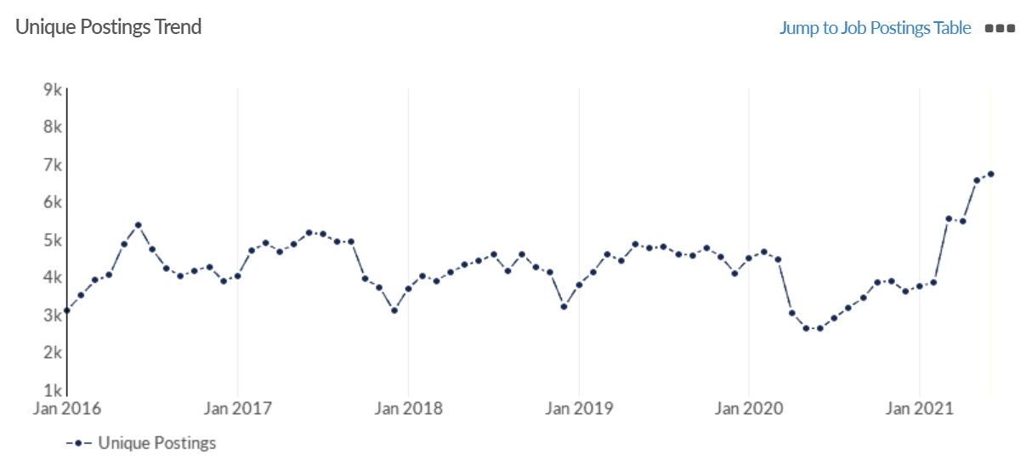
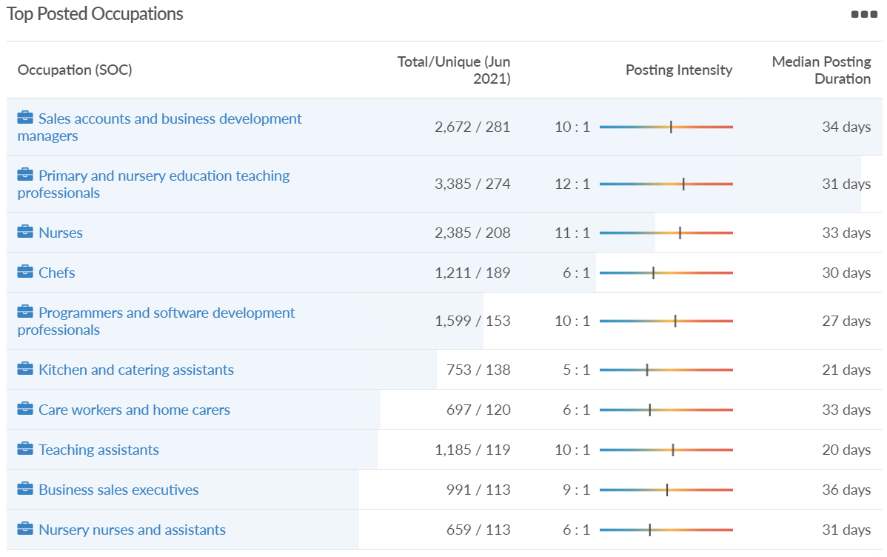
Job posting analytics (EMSI, June 2021)
Unique job postings: 6,739
Total job postings: 57,732
Job posting intensity: 9:1
Unique job postings (June 2020): 2,621

Slide 49
West Berkshire

Slide 50
Impact of COVID-19 up to 12th July 2021
COVID-19 cases (to 12th July 2021) – Source: Public Health Berkshire COVID-19 Dashboard, 12th July 2021
7,300 total cases
47 new case daily
Claimant unemployment (to May 2021)
3,545 claimants (3.7% of the working age population) in West Berkshire UA
Notable business news
A former London Stock Exchange IT expert has turned his passion for cakes into a business - having left the capital to set up an egg-free cake shop in Berkshire. Ali Kazmi, who until September last year (2020) was an IT operations manager in London, decided he wanted a change of direction and joined the egg-free Cake Box franchise, opening his first shop in Newbury town centre in April.
Source: Berkshire Live, June 2021

Slide 51
Industries hit hardest by COVID shutdown
While West Berkshire hasn’t been as fortunate as Slough in terms of how great of a percentage of jobs have been directly affected by the COVID shutdown, it has fared significantly better than the Thames Valley Berkshire area and better than Great Britain.
Source: EMSI, March 2021 (definition for industries hit hardest provided on slide 54)

Slide 52
Industry risks and opportunities (2020-2021)
Critical industries
Food and drink retail: 4,289 employees (17% below the national average)
Energy/utilities: 1,343 employees (14% above the national average)
Health and social care: 6,773 employees (48% below the national average)
Freight/logistics: 1,574 employees (43% below the national average)
Insurance: 262 employees (73% below the national average)
Banking and financial services: 692 employees (71% below the national average)
Sectors most impacted
Hospitality and tourism: 6,617 employees (18% below the national average)
Arts, entertainment and recreation: 2,674 (10% above the national average)
Admin and support: 4,803 (11% below the national average)
Aviation: <10 employees
Non-food retail and wholesale: 8,432 (9% above the national average)
Manufacturing: 11,330 (41% above the national average)
Construction: 4,813 (3% above the national average)
Source: EMSI, January 2021

Slide 53
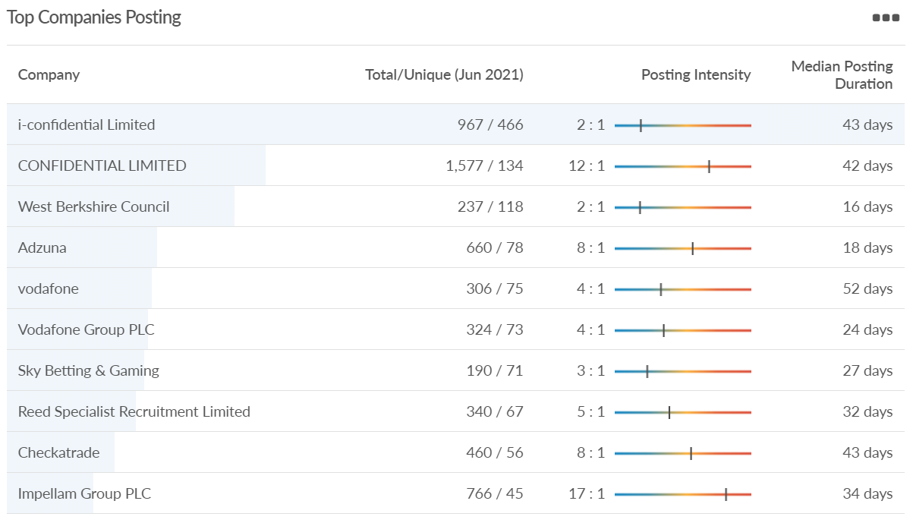
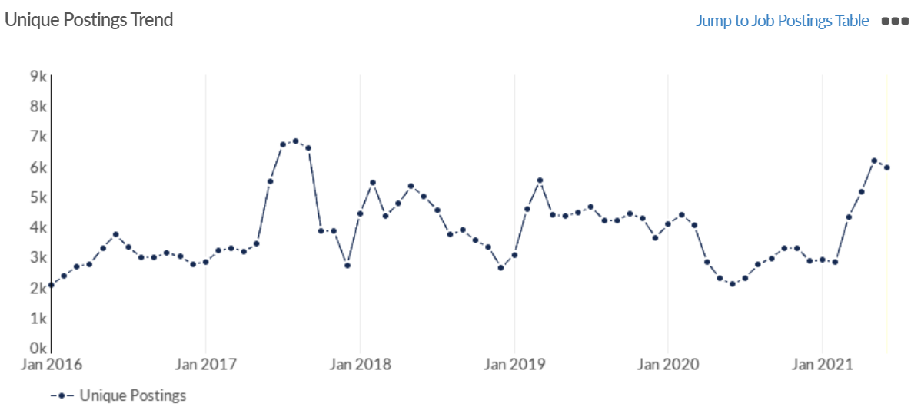
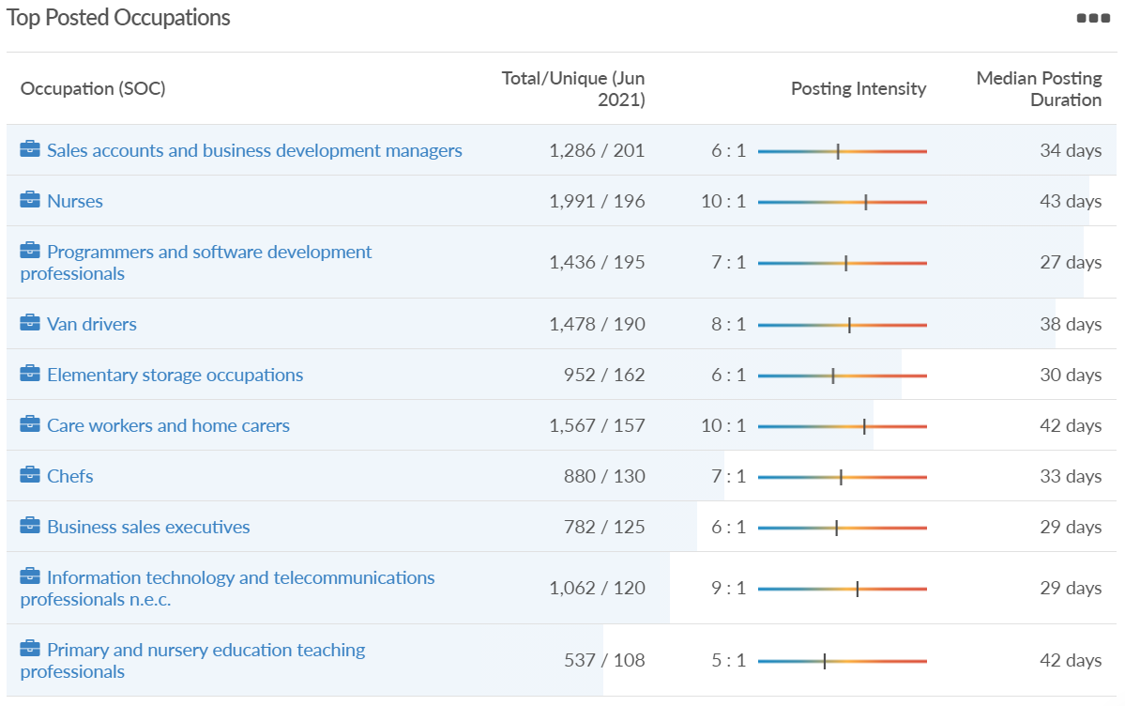
Job posting analytics (EMSI, June 2021)
Unique job postings: 5,964
Total job postings: 41,109
Job posting intensity: 7:1
Unique job postings (June 2020): 2,088

Slide 54
Definitions
Source: Institute for Fiscal Studies, April 2020

