Slide 1
Thames Valley Berkshire Monthly Economic Briefing
February 2021

Slide 2
Key contents of this month’s briefing
Updated global and UK economic forecasts
Commentary on the UK Budget announced on 3 March 2021
Latest furlough, SEISS and claimant count figures by Local Authority
Latest ‘notable business news’ by Local Authority
Latest figures for industries hit hardest by the COVID-19 shutdowns by Local Authority
Latest job posting analytics by Local Authority

Slide 3
Global and National Economy
February 2021

Slide 4
Global Economy
As countries gradually emerge from their lockdowns, we expect global GDP to recover by 5.0% in 2021, following a 3.9% contraction in 2020.
Prospects for global trade in 2021 are good, following a revival of trade growth in the second half of last year. Global trade growth is expected to rebound by 7-8% in 2021, after a contraction of similar size in 2020.
After economic downturns in 2020, advanced markets as a group see growth rebounding by 3.9% in 2021, after a 5.0% decline in 2020. The pace of recovery deviates, but most advanced markets do not completely recover in 2021 from the GDP contraction they experienced last year.
In the Eurozone, economies continue to be in relatively strict lockdowns. A partial recovery of 4.2% is likely to occur in 2021 and only in 2022 is activity expected to return to pre-pandemic levels. National governments are expected to continue fiscal stimulus well into 2021.
The virus poses serious downside risks to the US economy in 2021, but economic growth is forecast to rebound as the rollout of vaccination allows lockdown measures to be gradually reversed. Moreover, the new government reduces policy uncertainty, and a new major stimulus plan for the economy is in the making.
In Japan, infections were brought under control in the first half of 2020. As a result, the economy is off to a good start in 2021, though it will not fully recover from the recession of last year. If held, the Tokyo Olympics will provide a temporary boost to GDP in 2021.
Many emerging market economies (EMEs) are still at a critical stage in the health crisis, though there are large differences between countries and regions. Asia is head of the curve in controlling the number of infections. Emerging markets as a group are forecast to grow by 6.3% in 2021, following a 1.9% contraction in 2020.
Source: Atradius, February 2021
Source: ABN AMRO, February 2021

Slide 5
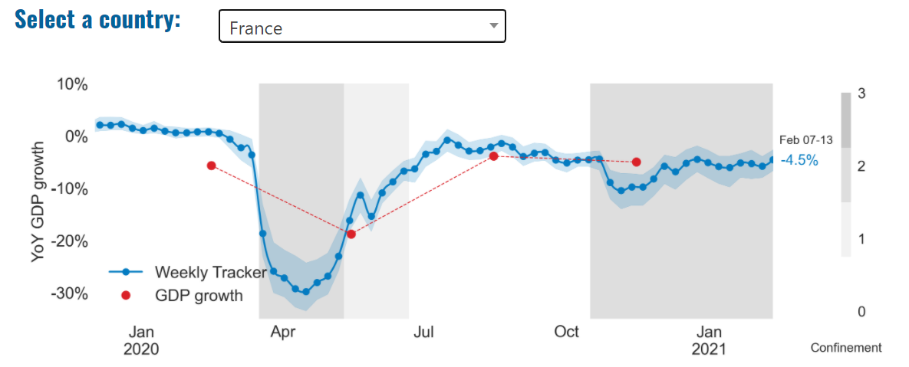
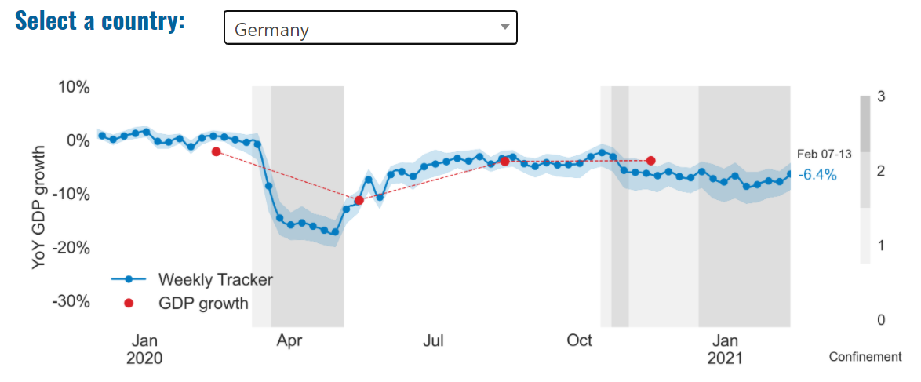
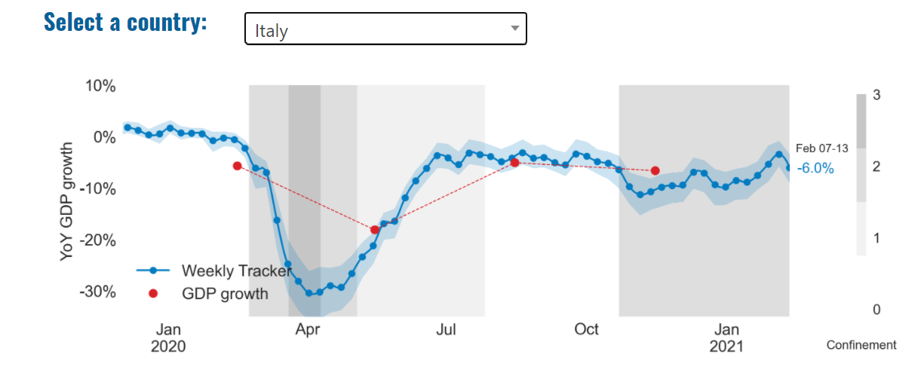
Global Economy – OECD GDP Tracker

Slide 6
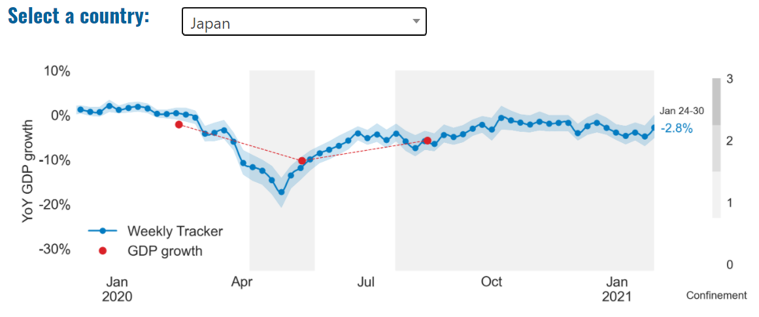
Global Economy – OECD GDP Tracker Continued
China
China is not included within the OECD GDP tracker and so the graph on the left has been compiled using statistics from the IMF and National Bureau of Statistics of China. The 2021 figure is a preliminary figure published by the National Bureau of Statistics of China in January 2021.
Note: The blue confidence band shows 95% confidence intervals. The darkness of the grey background reflects stay-at-home confinement requirement based on the Oxford Blavatnik database (0 - no measures, 1 - recommend not leaving house, 2 - require not leaving house with exceptions, 3 - require not leaving house with minimal exceptions).
Source: OECD, February 2021

Slide 7
UK Economy – OBR Economic and Fiscal Outlook
On 3 March, the Office for Budget Responsibility (OBR) published its Economic and Fiscal Outlook. Key observations made by the OBR include:
Around the globe, more than 100 million people have had Covid-19 and around 2.5 million have died from it
Global GDP fell by 3½ per cent in 2020 as much of the world went into lockdown
As of March 2021, more than 200 million people worldwide have received their first dose of one of the vaccines
Around 1 in 5 people in the UK have so far contracted Covid-19, 1 in 150 have been hospitalised, and 1 in 550 have died. This is the fourth highest mortality rate in the world
UK GDP fell 9.9 per cent in 2020, the largest decline in the G7. Output partially recovered in the second half of last year – and somewhat more strongly than previously forecast – but the OBR expects output to fall again in the first quarter of 2021
In the UK, 20 million people have received a first vaccine dose – more than a third of all adults and the fourth highest vaccination rate worldwide
GDP is expected to grow by 4 per cent in 2021 and to regain its pre-pandemic level in the second quarter of 2022, six months earlier than the OBR forecast in November
Unemployment is expected to rise by a further 500,000 to a peak of 6.5 per cent at the end of 2021, but the peak is around 340,000 less than the 7.5 per cent assumed in the OBR’s November forecast, thanks partly to the latest extension of the furlough scheme
The pandemic is expected to lower the supply capacity of the economy in the medium term by around 3 per cent relative to previous expectations
Source: OBR, March 2021

Slide 8
UK Economy – OBR Economic and Fiscal Outlook
Key observations made by the OBR (continued) include:
In Budget 2021, the Chancellor has extended the virus-related rescue support to households, businesses and public services by a further £44.3 billion, taking its total cost to £344 billion
He has boosted the recovery, most notably through a temporary tax break costing more than £12 billion a year that encourages businesses to bring forward investment spending from the future into this year and next
As the economy normalises, the Chancellor has started to repair the damage to the public finances in the final three years of the forecast by:
Raising the headline corporation tax rate
Freezing personal tax allowances and thresholds, and
Taking around £4 billion a year more off annual departmental spending plans, raising a total of £31.8 billion in 2025-26
Source: OBR, March 2021

Slide 9
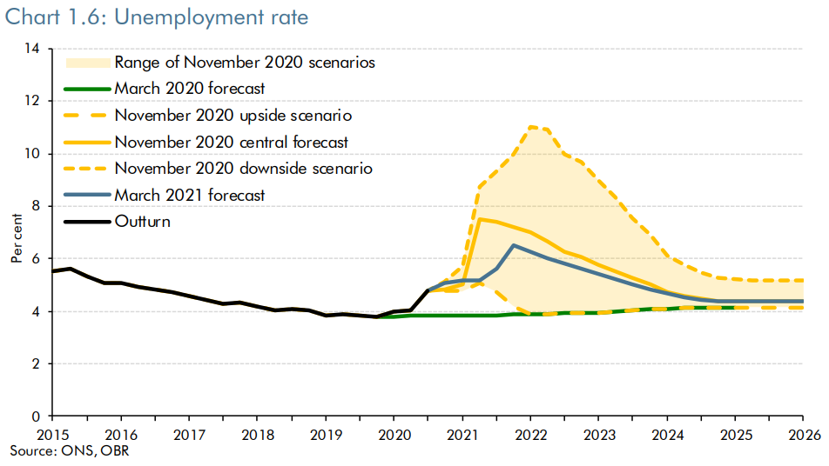
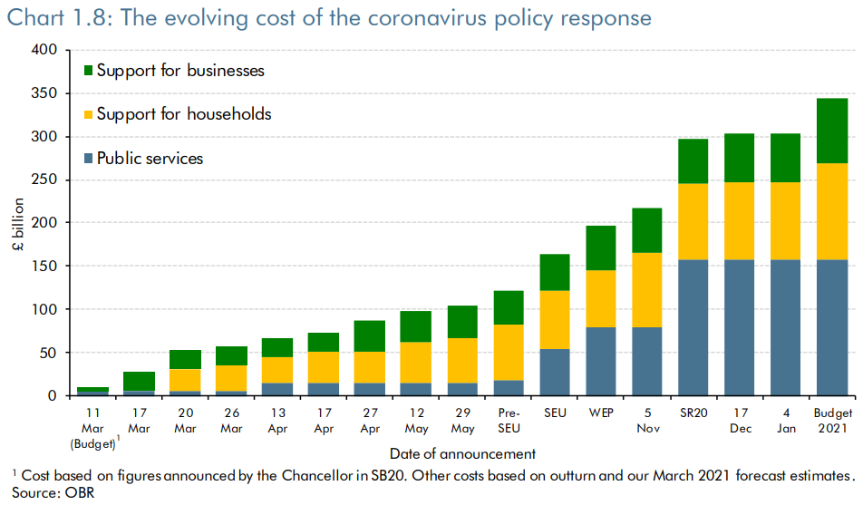
UK Economy – OBR Economic and Fiscal Outlook (Key Charts)
Highlighted on this slide are some of what we deem to be the key charts from the OBR’s Economic and Fiscal Outlook for March 2021. These charts provide UK level data on real GDP, unemployment rate and the evolving cost of the coronavirus policy response.
Source: OBR, March 2021

Slide 10
Budget 2021 – Key Announcements
Extension of the furlough scheme until September, albeit with an employer contribution from July onwards
There will be a fifth Self Employed Income Support Scheme (SEISS) grant covering May to September.
Extension of the temporary £20 per week increase to the Universal Credit standard allowance for a further six months.
Employers who hire a new apprentice between 1 April 2021 and 30 September 2021 will receive £3,000 per new hire, compared with £1,500 per new apprentice hire (or £2,000 for those aged 24 and under) under the previous scheme
The government will provide ‘Restart Grants’ in England of up to £6,000 per premises for non-essential retail businesses and up to £18,000 per premises for hospitality, accommodation, leisure, personal care and gym businesses
The government is renewing the Airports and Ground Operations Support Scheme for a further six months from the start of 2021-22. This will provide support for eligible businesses in England up to the equivalent of half of their business rates liabilities during 2021-22
The government will publish a tax consultation, ‘Tax policies and consultations (Spring 2021)’ on 23 March 2021
Source: UK Government, March 2021

Slide 11
Budget 2021 – Key Announcements
The income tax personal allowance will rise with CPI as planned to £12,570 from April 2021 and will remain at this level until April 2026
The higher rate threshold will rise as planned to £50,270 from April 2021 and will remain at this level until April 2026
The rate of corporation tax will increase from April 2023 to 25% on profits over £250,000
From 1 April 2021 until 31 March 2023, companies investing in qualifying new plant and machinery will benefit from a 130% first-year capital allowance. This upfront super-deduction will allow companies to cut their tax bill by up to 25p for every £1 they invest
East Midlands Airport, Felixstowe & Harwich, Humber, Liverpool City Region, Plymouth and South Devon, Solent, Teesside and Thames have been successful in the Freeports bidding process for England. These Freeports will begin operations from late 2021
Help to Grow – management. The government will offer a new UK-wide management programme to upskill 30,000 SMEs in the UK over three years. The programme will combine a national curriculum with practical case studies and mentoring
Help to Grow – digital. The government will launch a new UK-wide scheme to help 100,000 SMEs save time and money by adopting productivity-enhancing software. This will combine a voucher covering up to half of the costs of approved software up to a maximum of £5,000, and free advice, delivered through an online platform
Source: UK Government, March 2021

Slide 12
UK Economy – Other Forecasts
Our projection of annual UK GDP growth for 2021 is between 3.4% and 4.6%. Under the ‘quick recovery’ scenario, we expect economic output to remain 3.1% below pre-pandemic levels by the end of the year. We expect the economy to contract by 2.6% in January 2021, as predicted by our nowcasting model, before gradually returning to growth of 0.4% and 1.1% in February and March 2021, respectively.
However, there is still significant uncertainty over the pace and the path of the recovery in 2021, including the speed of the vaccine rollout and its effectiveness in limiting the spread of the virus, especially with regards to new variants. Additional key risks include the duration of the current national lockdown, the extent to which businesses adapt to new trading arrangements with the EU, the outcome of the US-UK trade negotiations, and the degree of economic scarring. Source: PwC, Feb 2021
In our baseline forecast for UK GDP, we expect a contraction in the first quarter of 2021 owing to the impact on activity of restrictions needed to contain the new COVID-19 variant. We expect the downturn in GDP to be smaller than in the first half of 2020, given increased business preparedness and continued fiscal and monetary support. In the second quarter we expect the rollout of the vaccine and warmer weather to allow for a modest easing of restrictions, followed by a strong bounce in the third quarter as vaccine coverage exceeds 50% of the population.
Source: Deloitte, Feb 2021

Slide 13
UK Economy Continued
The third national lockdown, in place since January, will leave a mark on the U.K. economy this quarter. However, after a record year of contraction, the worst in over three centuries, the U.K. looks set for a stronger year on the back of speedier rollout of vaccines (Britain is the best performer among the G20 nations). Growing consumer demand and sustained monetary and fiscal support will boost economic growth.
Brexit has ensured tariff and quota-free trade between the U.K. and the European Union (EU), but the new setup is causing notable disruptions at the borders in the form of bureaucratic and regulatory barriers. As a result, EU-U.K. trade flow has slowed, reflected in the significant drop in cargo shipments from the bloc to the U.K. The future of the economically vital services sector, particularly financial services, remains uncertain as the agreement did not address this sector and talks continue between the two sides.
Source: Northern Trust, February 2021

Slide 14
Coronavirus and Recession: Implications for Thames Valley Berkshire

Slide 15
Furloughing (January 2021)
9,400 jobs (15% of total eligible employments) furloughed in Bracknell Forest UA
12,900 jobs (17% of total eligible employments) furloughed in Slough UA
12,800 jobs (14% of total eligible employments) furloughed in Reading UA
10,900 jobs (13% of total jobs) furloughed in Wokingham UA
11,200 jobs (16% of total jobs) furloughed in Windsor and Maidenhead
10,600 jobs (14% of total jobs) furloughed in West Berkshire
Source: HMRC, February 2021
Berkshire has a lower-than-average number of furloughed workers, compared to the rest of the UK, because of its relative strength in sectors of industry that can be continued by workers from home.

Slide 16
SEISS (January 2021)
Total value of claims made for Bracknell Forest UA – SEISS 3: £14,200,000
Total value of claims made for Slough UA – SEISS 3: £18,200,000
Total value of claims made for Reading UA – SEISS 3: £14,700,000
Total value of claims made for Wokingham – SEISS 3: £15,300,000
Total value of claims made for Windsor and Maidenhead – SEISS 3: £13,900,000
Total value of claims made in West Berkshire – SEISS 3: £15,400,000
Source: HMRC, February 2021

Slide 17
Claimant Count (January 2021)
Total of 29,565 claimants (5.1% of the working age population) in Thames Valley Berkshire
3,375 claimants (4.3% of the working age population) in Bracknell Forest UA
7,930 claimants (8.4% of the working age population) in Slough UA
6,865 claimants (6.4% of the working age population) in Reading UA
3,485 claimants (3.3% of the working age population) in Wokingham UA
4,185 claimants (4.5% of the working age population) in Windsor and Maidenhead UA
3,720 claimants (3.9% of the working age population) in West Berkshire UA
Across Thames Valley Berkshire, claimant unemployment has almost tripled in the last year, rising from 10,575 in January 2020 to 29,565 in January 2021. Slough had 8.4% of its working age population claimant unemployed in January 2021, up from 2.8% in January 2020.
Source: ONS, January 2021

Slide 18
Strategic Issues: Aviation
Heathrow Airport:
Heathrow has plunged to a £2 billion annual loss after the “toughest” year in the airport’s 75-year history as the pandemic saw passenger numbers crash by 73%. The number of people passing through the west London airport tumbled from 80.9 million in 2019 to 22.1 million last year – a level not seen since the 1970s – and more than half of those travelled before the Covid-19 crisis struck. The group’s mammoth loss last year compares with profits of £546 million in 2019. This came despite the group’s move to slash costs by nearly £400 million, reduce spending by £700 million and raise £2.5 billion to help see it through the crisis. Its cost-cutting action saw it slash its management team by about a third and around a quarter of frontline staff take voluntary redundancy.
In September 2020, the MP for Maidenhead and former Prime Minister, Theresa May, raised the plight of the aviation sector, and its effects on the economy on the floor of the House of Commons. Mrs. May said: “Passenger numbers at Heathrow have fallen by 82% and cargo is down 35%. It is reckoned that for every 1,000 passengers, one job is created. The fewer passengers, the fewer jobs. Cargo is also important, particularly for the UK as we are looking to improve our trading relationships around the world, and a lot of cargo is carried on passenger flights.”
Sources: ITV, February 2021; Hansard, September 2020
Aviation:
Brian Strutton, the general secretary of Balpa, wrote: “Government policy has effectively shut down UK aviation. We understand the reasoning behind those decisions, but the effects have already been disastrous. Covid has seen permanent closure of Flybe and Norwegian Air UK. Thousands of pilots in airlines across the country have lost their careers or are furloughed, along with tens of thousands of other front-line staff members. These are the same people who, in the face of this terrible virus, repatriated British citizens and ensured important cargo made it to the UK to protect the NHS and save lives. Now their careers and livelihoods have been permanently damaged.”
Dale Keller, chief executive of BAR UK said “As we check-in for the long-haul journey out of this pandemic it is essential that we put to best use the learnings of science, experience and hindsight that was lacking as Governments worldwide applied inconsistent and poorly aligned measures on international travel. The best minds in the industry and Government must come together to develop and implement a well thought out and workable plan that is needed to restore the UK’s international connectivity. The airline industry has tremendous expertise available to the Government on effective scenario planning and our thought leadership on a pathway to safely reopening international travel poses the practical questions and ideas that need to be worked through.”
Sources: The Independent, February 2021; BAR UK, February 2021

Slide 19
Demand and Supply Conditions: Businesses, Hiring, Restructuring, Investment, Labour and Skills Supply

Slide 20
Household/Consumer Demand
Slough is top of the spend index according to the Centre for Cities High Streets Recovery Tracker, whilst Reading is third from bottom.
Source: Centre for Cities, February 2021
In January 2021, retail sales volumes decreased by 8.2% when compared with December 2020 as tighter nationwide coronavirus (COVID-19) restrictions affected sales.
Retail sales volumes were 5.5% lower than before the pandemic in February 2020 indicating that the impact of restrictions on the retail sector was not as large as that seen in April 2020 during the first full month of retail restrictions when sales fell by 22.2% when compared with levels before the pandemic.
All sectors saw a monthly decline in volume sales in January 2021 except for non-store retailers and food stores, who reported growth of 3.7% and 1.4% respectively when compared with December 2020.
In the three months to January 2021, retail sales volume fell by 4.9% when compared with the previous three months, with strong declines in both clothing stores and automotive fuel.
The proportion spent online soared to 35.2% in January 2021, the highest on record; this compares with 29.6% in December 2020 and 19.5% reported in January 2020.
All store types reported an increase in their proportion of online spending in January 2021 when compared with December 2020; with food stores reaching an historic high of 12.2% of sales conducted online.
Source: ONS, February 2021

Slide 21
Industries at Risk
MANUFACTURING
28,000 people work in manufacturing in Berkshire – with 11,000 in West Berkshire alone and 2,487,000 across the whole of Great Britain (ONS, 2020)
Half of all UK manufacturing firms have made redundancies. A further 20% plan to make more redundancies in the next six months (Make UK, October 2020)
37% of manufacturers think it will take more than a year to return to normal trading conditions (Make UK, October 2020)
HOSPITALITY & TOURISM
The hospitality and tourism sector in Berkshire employed 35,842 people in 2020 – an increase of 0.8% on the previous year (EMSI, 2021)
In June, ‘Pathways to Recovery’, a report by the All Party Parliamentary Group on Hospitality and Tourism, found that just 11% of hospitality businesses had been able to operate normally during the first lockdown and international tourist arrivals were likely to be down 59% for the year.
Kate Nicholls, CEO of UK Hospitality, told the BBC (December 2020) that 30,000 hospitality businesses – most of them SMEs and one-third of the total – could be lost by the end of 2020.
According to Sky News in December, at least 38,653 hospitality jobs had been lost during the pandemic.
CONSTRUCTION
21,000 people work in construction in Berkshire – with only 1,500 of these working in Bracknell Forest and 2,164,000 across the whole of Great Britain (ONS, 2020)
The level of construction output in August 2020 was 10.8% below the February 2020 level (ONS, 2020)
Construction output grew by 18.5% in the three months to August 2020 compared with the previous three-month period, but this followed 10 consecutive periods of decline (ONS, 2020)
NON-FOOD RETAIL & WHOLESALE
More than 45,000 people work in non-motor vehicle retail in Berkshire – with 12,500 of them working in Reading (EMSI, 2021). The offline retail sector has struggled during the pandemic. At least 39,000 jobs had been lost in retail as of 3 December. Redundancy announcements include 7,000 at Marks and Spencer (August), 4,000 at Debenhams (August) and 4,000 at Boots (July) - Sky News, 2020.
The pre-pandemic trend of on-line shopping has strengthened in 2020; a record total of 31.4% of shopping was done on line in November 2020 (ONS, 2020), a trend that will have profound implications for the high street.
In November, retail sales volume decreased by 3.8% (vs October figures) as a result of COVID-19. Despite this, overall sales remain above their pre-pandemic levels (ONS, 2020).
ARTS, ENTERTAINMENT & RECREATION
12,000 people work in arts, entertainment and recreation in Berkshire. 4,500 of them – more than one third – work in Windsor and Maidenhead and 925,000 across the whole of Great Britain (ONS, 2020)
Between 19 Nov and 1 Dec, 24 per cent of arts, entertainment and recreation venues had temporarily closed or paused trading. (ONS, 2020)
52% of eligible employments in arts, entertainment and recreation were on furlough on 31 July 2020 – a figure that had fallen to 24% as at 31 October. (HMRC, 2020)
AVIATION
Aviation has an estimated value of £28 billion to the UK economy, employing 230,000 workers at over 40 commercial airports. (House of Commons Transport Committee, June 2020)
76,000 people work in over 400 business across Heathrow Airport. Many of these people live in Slough, in Berkshire. (Heathrow local recovery plan, 2020)
There were 5,800 passenger flights in April 2020 compared to 201,000 a year earlier: a reduction of 97%. The impact is several times more severe than the aftermath of the global financial crisis in 2008, when passenger flights reduced by around 67,000 to 134,000 per month. (House of Commons Transport Committee, June 2020)
The UK aviation industry has been hit harder than any European country by the pandemic with IATA calculating that the “coronavirus crisis will cost 780,000 British jobs and cost £46bn in lost GDP.” (International Air Transport Association, 2020).
ADMINISTRATION & SUPPORT
More than 51,000 people in Berkshire work in admin and support services – including 10,000 in Wokingham and 10,000 in West Berkshire and 2,752,000 across the whole of Great Britain (ONS, 2020)
More than 600,000 admin and support workers – 27% of the total – were furloughed as at 31 October (HMRC, 2020)

Slide 22
Industries more likely to be resilient/grow – IT and Healthcare
Based on the analysis of their database of 440+ UK industries, IBISWorld has produced a list of the Fastest Growing Industries in the UK and predicted their Revenue Growth (%) for 2021:
1. Safety Equipment & Supplies Wholesaling in the UK - 78.0%
2. CRM System Providers in the UK - 49.1%
3. Online Food Ordering & Delivery Platforms in the UK - 45.1%
4. Online Alcohol Retailing in the UK - 42.0%
5. Language Learning Software Developers in the UK - 39.5%
6. Online Greetings Card Retailers in the UK - 36.5%
7. Precious Metals Production in the UK - 35.9%
8. Online Vitamin & Supplement Retailing in the UK - 29.8%
9. E-Commerce & Online Auctions in the UK - 29.5%
10. Respiratory Protection Equipment Manufacturing in the UK - 28.4%
Source: IBISWorld, December 2020
From this analysis, it is apparent that (as alluded to in the previous monthly report) IT, and e-commerce by extension, as well as healthcare related industries and those which have so far demonstrated the greatest resilience in the face of the COVID-19 pandemic and are predicted to see the highest growth throughout 2021.

Slide 23
Supply of labour and skills
The January lockdown has not had as significant a labour market impact as the first lockdown did in spring 2020. The main effect has been increased use of the JRS, with the number of workers on furlough rising from 4 million in December to 4.5 million in January, with all of this increase coming from a rise in the number of workers on full furlough (i.e. not working any hours).
The crisis continues to be highly sector-specific in its impacts, with workers in hospitality, leisure, and non-supermarket retail much more likely than workers in other parts of the economy to have found themselves out of work, on furlough, or earning less than they were before the crisis, including over seven-in-ten hospitality workers and more than half of those in non-food retail. These sectoral differences are in turn driving the greater impacts experienced by the youngest (and older) workers, and those in low paid jobs – 18-24-year-olds are twice as likely to have faced an impact as those in middle age, for example.
The difference in the economic impact on men and women has been an important question during this crisis. The latest data shows that the impact on male employment has been greater (down 1.9 per cent since the start of the crisis, compared to a 1.1 per cent fall in female employment), although women have been marginally more likely than men to have been furloughed. Of course, the headline effects do not tell the whole story, and women have borne the brunt of the crisis in other ways – other studies have shown, for example, that the crisis has worsened within-household inequalities in the apportionment of childcare and housework.
Source: Resolution Foundation, February 2021

Slide 24
Remote working
In February of 2021, there were 2,576 unique job postings for remote positions at companies based in Berkshire, almost 200% more than the figure of 862 for the same period one year previous.
Compare this with the South East, in February 2021 there were 16,635 unique remote job postings for remote positions; rising from 4,848 in February of the previous year – a 243% increase.
A similar rise can be seen at national level, with a recorded 107,757 unique remote job postings in England in February of 2021, rising from 33,671 in February 2020 – an increase of 220%.
From these figures it’s apparent that the COVID-19 pandemic has, somewhat unsurprisingly, prompted a massive boost in job postings for explicitly remote roles. Berkshire has seen a smaller boost in vacancies which are remote-based than both England and the South East, but still one which is hugely significant.
Source: EMSI, February 2021

Slide 25
Local Profiles

Slide 26
Bracknell Forest

Slide 27
Impact of COVID-19 up to 21st February 2021
COVID-19 cases (to 21st February 2021) – Source: Public Health Berkshire COVID-19 Dashboard, February 2021
6,752 total cases
20 new cases daily
Claimant unemployment (to January 2021)
3,375 claimants (4.3% of the working age population) in Bracknell Forest UA
Notable business news
The Lexicon has announced that Sports Direct will be opening a store in Princess Square later this year. Moving into the old Sainsbury’s unit, the new store will also include GAME and Evans Cycles. Rob Morris, general manager at The Lexicon said: “We are so pleased to be able to welcome the ever-popular Sports Direct store to Princess Square. It will be the first time that Evans Cycles has opened in the town, which we know will be a popular addition for the many local cycling enthusiasts.”
Source: Bracknell Forest Council, February 2021

Slide 28
Industries hit hardest by COVID shutdown
As illustrated by the above graph, Bracknell Forest has suffered very similarly to Great Britain in terms of the percentage of jobs within industries which have been hit hardest by COVID shutdowns. Thames Valley Berkshire area has seen an additional 0.77% of jobs of jobs affected worst by the COVID shutdowns when compared to Bracknell Forest.
Source: EMSI, February 2021 (definition for industries hit hardest provided on slide 56)

Slide 29
Industry risks and opportunities (2020-2021)
Critical industries
Food and drink retail: 3,234 employees (1% below the national average)
Energy/utilities: 257 employees (65% below the national average)
Health and social care: 6,193 employees (25% below the national average)
Freight/logistics: 515 employees (70% below the national average)
Insurance: 186 employees (69% below the national average)
Banking and financial services: 1,291 employees (13% below the national average)
Sectors most impacted
Hospitality and tourism: 3,743 employees (26% below the national average)
Arts, entertainment and recreation: 1,148 (24% below the national average)
Admin and support: 2,694 (21% below the national average)
Aviation: 0 employees
Non-food retail and wholesale: 8,508 (75% above the national average)
Manufacturing: 1,549 (69% below the national average)
Construction: 1,771 (40% below the national average)
Source: EMSI, January 2021

Slide 30
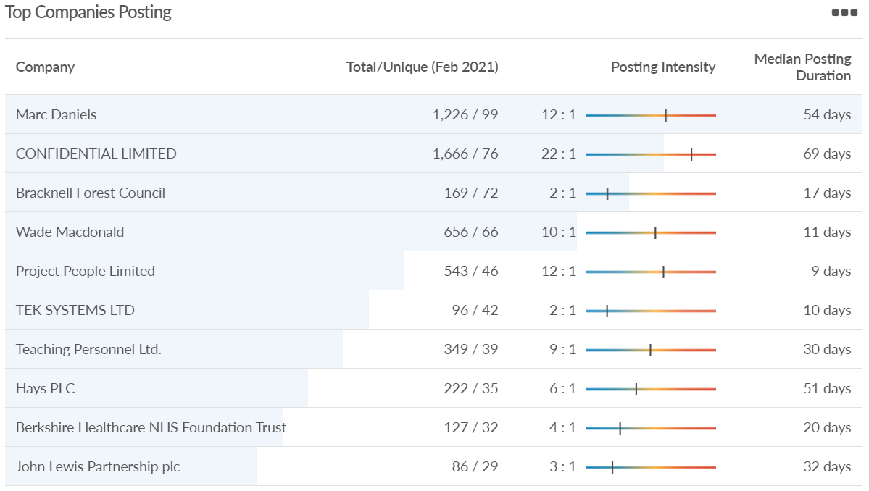
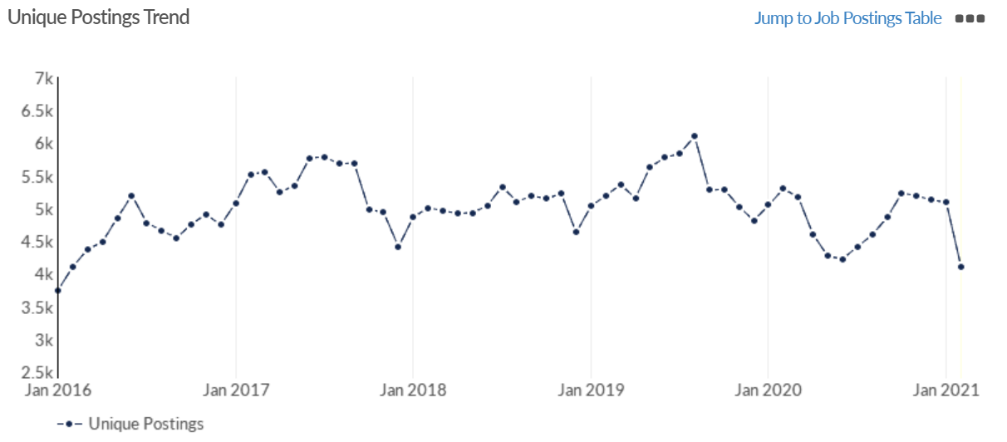
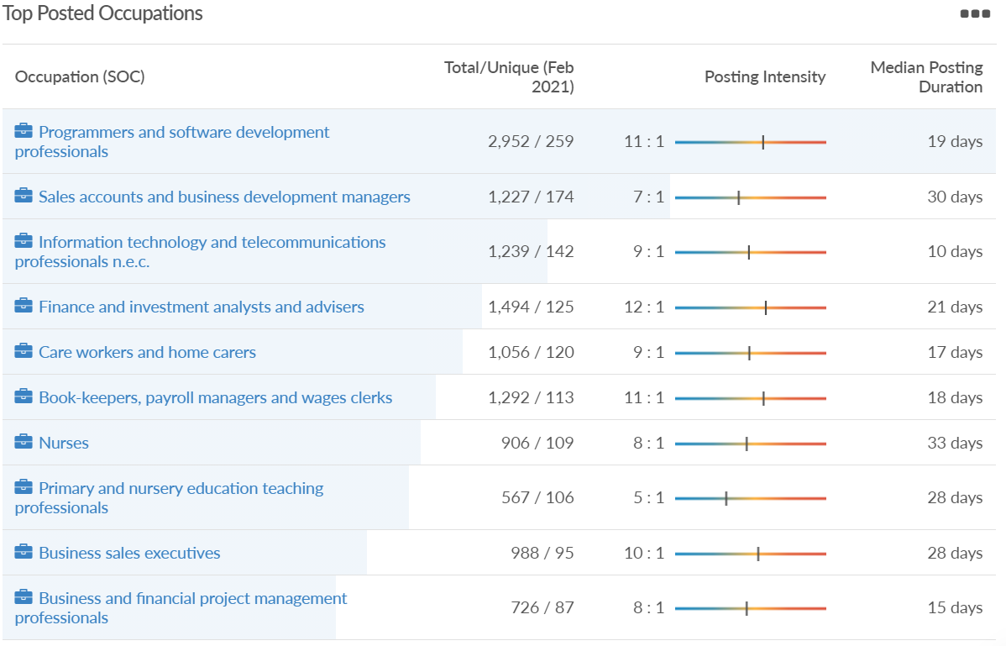
Job posting analytics (EMSI, February 2021)
Unique job postings: 4,101
Total job postings: 36,747
Job posting intensity: 9:1
Unique job postings (Feb 2020): 5,297

Slide 31
Slough

Slide 32
Impact of COVID-19 up to 21st February 2021
COVID-19 cases (to 21st February 2021) – Source: Public Health Berkshire COVID-19 Dashboard, February 2021
14,407 total cases
48 new cases daily
Claimant unemployment (to January 2021)
7,930 claimants (8.4% of the working age population) in Slough UA
Notable business news
The first double-decker hotel in Slough opened its doors in February, three months ahead of schedule, becoming the first time Marriott International has combined two hotel brands under one roof in the UK. Developed and owned by Slough Borough Council, both hotels are operated by specialist hotel management company Cycas Hospitality. The company was responsible for the first dual-branded Marriott property in Europe in 2018, launched under the Moxy and Residence Inn brands in Amsterdam. The development was built via Slough Urban Renewal, a joint venture between the council and Morgan Sindall Investments. The 244-room hotel complex forms part of a major development transforming the town’s former library site, which also include 64 new apartments and 4,000 square foot of restaurant and retail space.
Source: Breaking Travel News, February 2021

Slide 33
Industries hit hardest by COVID shutdown
When compared to both Thames Valley Berkshire and Great Britain, Slough has seen a significantly lower percentage of jobs affected by COVID shutdowns – perhaps somewhat surprising given the LA’s proximity to Heathrow and the almost complete shutdown of the aviation sector.
Source: EMSI, February 2021 (definition for industries hit hardest provided on slide 56)

Slide 34
Industry risks and opportunities (2020-2021)
Critical industries
Food and drink retail: 6,656 employees (47% above the national average)
Energy/utilities: 2,820 employees (174% above the national average)
Health and social care: 8,201 employees (28% below the national average)
Freight/logistics: 4,640 employees (93% above the national average)
Insurance: 121 employees (86% below the national average)
Banking and financial services: 731 employees (65% below the national average)
Sectors most impacted
Hospitality and tourism: 3,780 employees (46% below the national average)
Arts, entertainment and recreation: 442 (79% below the national average)
Admin and support: 9,765 (107% above the national average)
Aviation: 262 employees (16% above the national average)
Non-food retail and wholesale: 6,719 (0% above the national average)
Manufacturing: 5,071 (28% below the national average)
Construction: 2,620 (36% below the national average)
Source: EMSI, January 2021

Slide 35
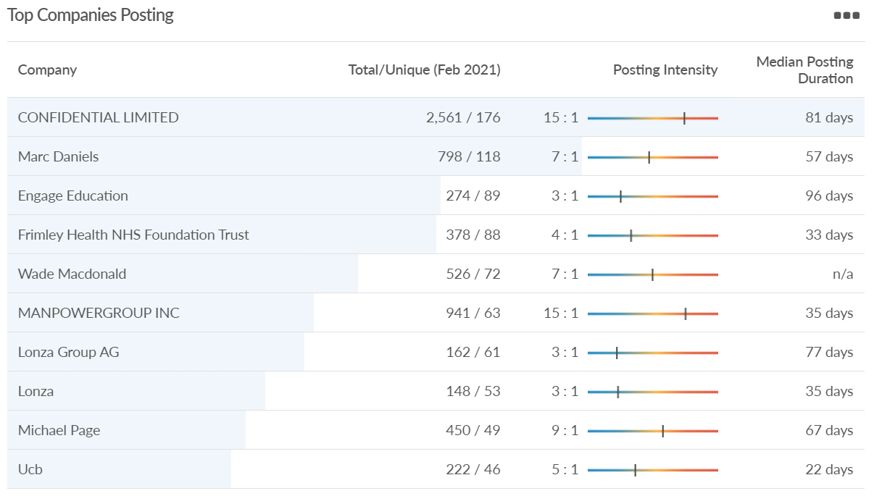
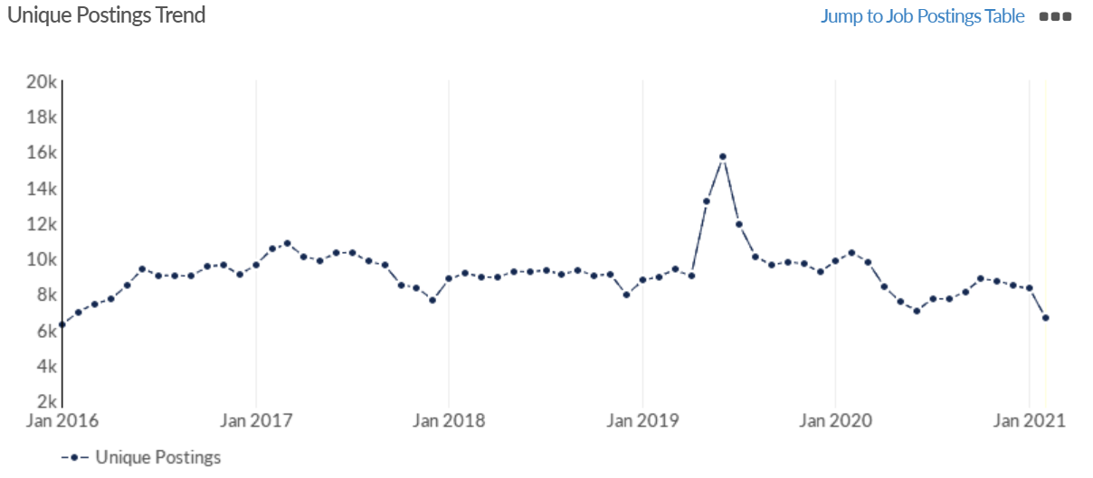
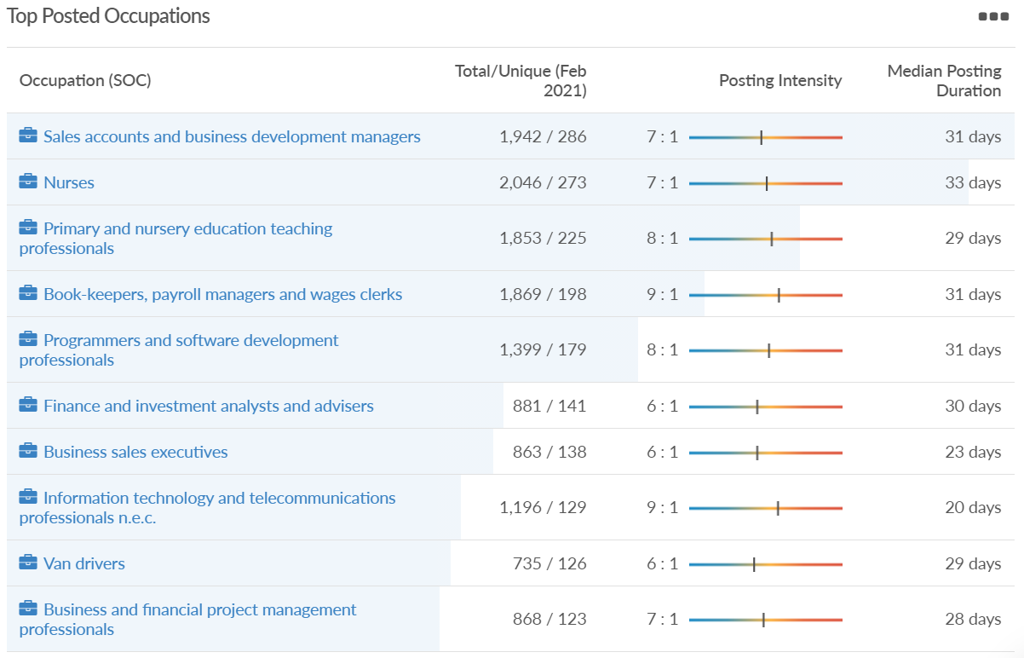
Job posting analytics (EMSI, February 2021)
Unique job postings: 6,634
Total job postings: 48,800
Job posting intensity: 7:1
Unique job postings (Feb 2020): 10,331

Slide 36
Reading

Slide 37
Impact of COVID-19 up to 21st February 2021
COVID-19 cases (to 21st February 2021) – Source: Public Health Berkshire COVID-19 Dashboard, February 2021
10,386 total cases
23 new cases daily
Claimant unemployment (to January 2021)
6,865 claimants (6.4% of the working age population) in Reading UA
Notable business news
A new Thai restaurant at Broad Street Mall is coming to Reading. ThaiGrr! will take up unit 1D at the shopping center on Queens Walk, after the application for new signs at the empty unit was approved on Thursday (January 28). Eat in, takeout, and delivery will be available, depending on Covid-19 restrictions, when the restaurant opens. Currently, only takeaway and delivery is allowed, with England in lockdown. A new bowling alley, mini-golf and darts venue and a cinema are also planned at other empty Broad Street Mall units on Queens Walk.
Source: The Reading Chronicle, February 2021
The UK's first Wendy's restaurant in more than 20 years is on course to open later this year as the company announces more branches will open soon. The restaurant on the corner of Friar Street and Station Road in Reading town centre, will be the company's first in the UK in 21 years. The company has now added its branding to the former home of Nationwide. No official date has been released yet, but the company says it will open in "first half of the year".
Source: Berkshire Live, February 2021

Slide 38
Industries hit hardest by COVID shutdown
Reading has been marginally less affected by the COVID shutdowns as Great Britain has on average, with 15.16% of jobs within industries which have been most severely impacted by the shutdowns. The Local Authority is 1.26% better off than the average of the Thames Valley Berkshire area.
Source: EMSI, Febraury 2021 (definition for industries hit hardest provided on slide 56)

Slide 39
Industry risks and opportunities (2020-2021)
Critical industries
Food and drink retail: 6,192 employees (11% above the national average)
Energy/utilities: 3,350 employees (163% above the national average)
Health and social care: 13,464 employees (5% below the national average)
Freight/logistics: 1,513 employees (49% below the national average)
Insurance: 2,076 employees (100% above the national average)
Banking and financial services: 1,688 employees (34% below the national average)
Sectors most impacted
Hospitality and tourism: 6,567 employees (25% below the national average)
Arts, entertainment and recreation: 1,811 (31% below the national average)
Admin and support: 9,212 (58% above the national average)
Aviation: <10 employees
Non-food retail and wholesale: 8,626 (18% above the national average)
Manufacturing: 2,000 (77% below the national average)
Construction: 2,273 (55% below the national average)
Source: EMSI, January 2021

Slide 40
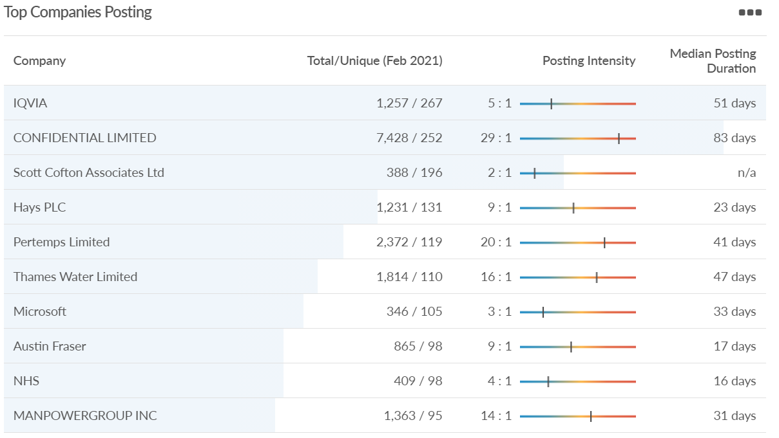
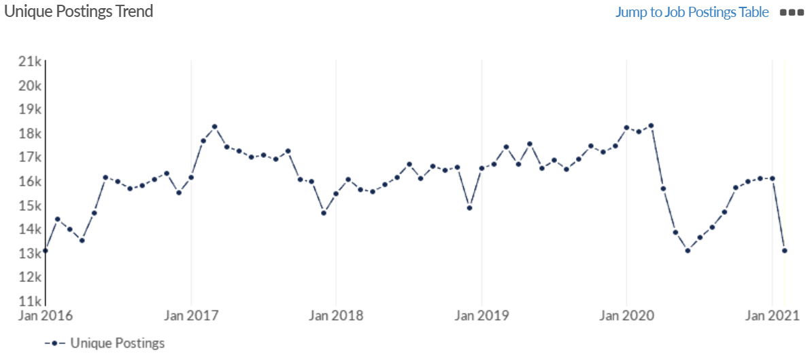
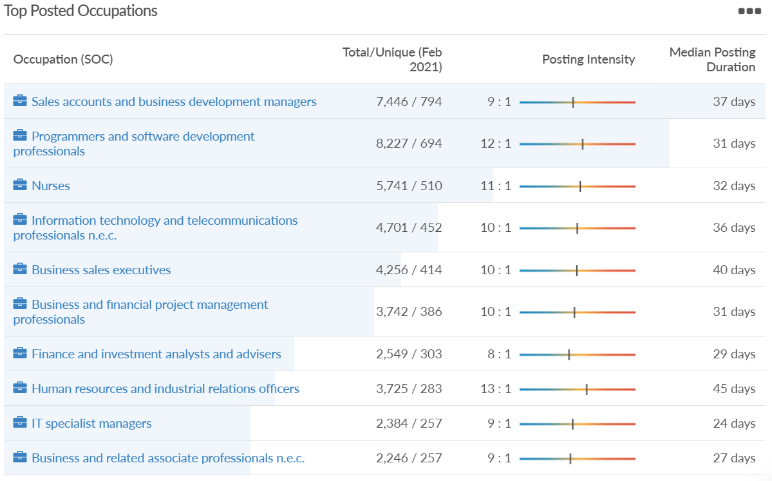
Job posting analytics (EMSI, February 2021)
Unique job postings: 13,056
Total job postings: 136,335
Job posting intensity: 10:1
Unique job postings (Feb 2020): 18,020

Slide 41
Wokingham

Slide 42
Impact of COVID-19 up to 21st February 2021
COVID-19 cases (to 21st February 2021) – Source: Public Health Berkshire COVID-19 Dashboard, February 2021
7,757 total cases
12 new cases daily
Claimant unemployment (to January 2021)
3,485 claimants (3.3% of the working age population) in Wokingham UA
Notable business news
Three local businesses have signed up to open units as part of the town center regeneration project. Peacock House Interiors and the Vale Clinic will soon be opening their doors in Elms Field, and new bistro Hamlet will welcome customers in Peach Place. The owners of the new bistro have a background in fine dining and want to bring the best of British food and produce to local residents, while Peacock House Interiors is set to open a furniture and home goods store. The Vale Clinic, which also has a branch in Earley, will offer a range of podiatry services. It has already opened its doors on the corner of Elms Walk and Denmark Street.
Source: Wokingham Today, February 2021

Slide 43
Industries hit hardest by COVID shutdown
Wokingham is in a similar position to Slough in that is has been significantly less affected by the COVID shutdowns than both the Thames Valley Berkshire area and Great Britain as a whole. This is likely due to the high levels of employment from the Tech sector (Microsoft etc. based at TVP) as this industry is able to work well from home.
Source: EMSI, February 2021 (definition for industries hit hardest provided on slide 56)

Slide 44
Industry risks and opportunities (2020-2021)
Critical industries
Food and drink retail: 3,883 employees (17% below the national average)
Energy/utilities: 1,434 employees (35% above the national average)
Health and social care: 7,283 employees (38% below the national average)
Freight/logistics: 886 employees (64% below the national average)
Insurance: 453 employees (48% below the national average)
Banking and financial services: 423 employees (80% below the national average)
Sectors most impacted
Hospitality and tourism: 5,410 employees (25% below the national average)
Arts, entertainment and recreation: 1,831 (16% below the national average)
Admin and support: 6,432 (33% above the national average)
Aviation: 0 employees
Non-food retail and wholesale: 6,494 (6% below the national average)
Manufacturing: 3,731 (48% below the national average)
Construction: 3,115 (26% below the national average)
Source: EMSI, January 2021

Slide 45
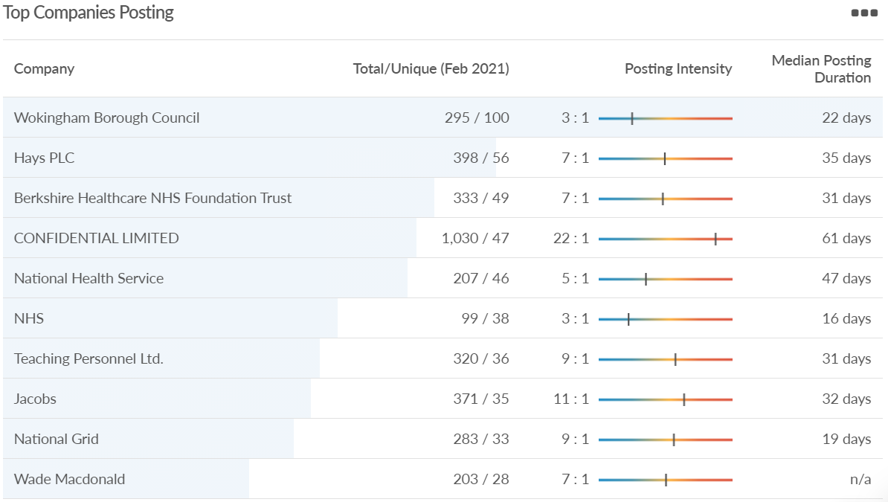
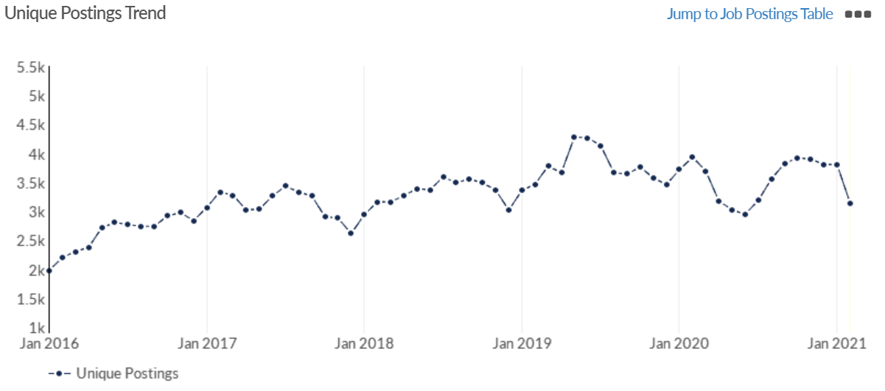
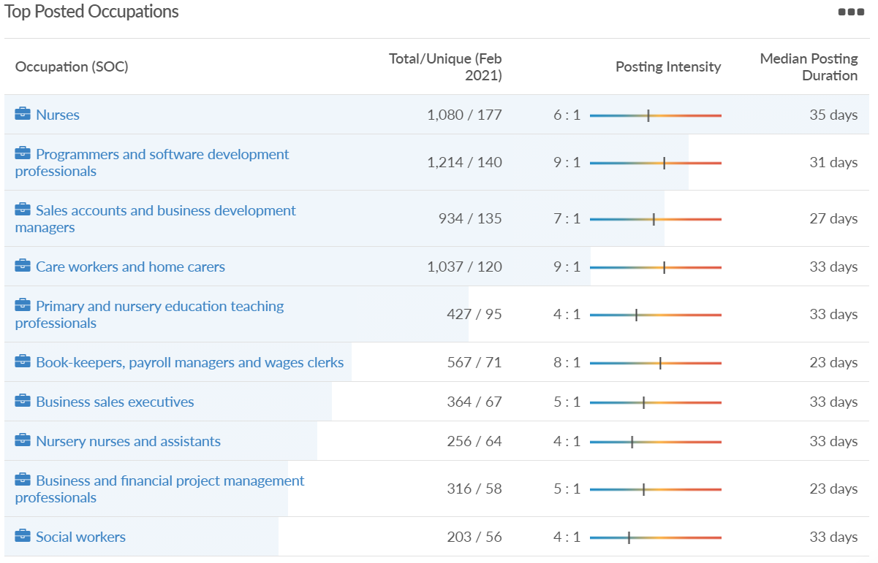
Job posting analytics (EMSI, February 2021)
Unique job postings: 3,139
Total job postings: 22,513
Job posting intensity: 7:1
Unique job postings (Feb 2020): 3,934

Slide 46
Windsor and Maidenhead

Slide 47
Impact of COVID-19 up to 21st February 2021
COVID-19 cases (to 21st February 2021) – Source: Public Health Berkshire COVID-19 Dashboard, February 2021
7,934 total cases
23 new cases daily
Claimant unemployment (to January 2021)
4,185 claimants (4.5% of the working age population) in Windsor and Maidenhead UA
Notable business news
Windsor was ranked 44th in a list of the best shopping hotspots in Britain by Harper Dennis Hobbs, who made the rankings according to multiple factors, including vacancy rates and the suitability of the shops. The Berkshire town has been upgraded from 53rd, climbing nine places. Other towns rocketed up the charts, including nearby Henley-on-Thames, which had gone from 28th to an impressive second place ranking. Beaconsfield came in first place, with all three of the top rankings going to places in the South East.
Source: Berkshire Live, February 2021

Slide 48
Industries hit hardest by COVID shutdown
Windsor and Maidenhead appears to be the most severely affected of all the Local Authorities which make up Berkshire in terms of percentage of jobs hit hardest by the COVID shutdowns. This is likely due in part to the enormous hit the leisure/tourism sector has taken and how key of an employer Legoland Windsor to the region.
Source: EMSI, February 2021 (definition for industries hit hardest provided on slide 56)

Slide 49
Industry risks and opportunities (2020-2021)
Critical industries
Food and drink retail: 3,733 employees (17% below the national average)
Energy/utilities: 882 employees (13% below the national average)
Health and social care: 8017 employees (29% below the national average)
Freight/logistics: 748 employees (68% below the national average)
Insurance: 434 employees (48% below the national average)
Banking and financial services: 1,252 employees (39% below the national average)
Sectors most impacted
Hospitality and tourism: 9,437 employees (35% above the national average)
Arts, entertainment and recreation: 4,516 (117% above the national average)
Admin and support: 4,207 (10% below the national average)
Aviation: 11 employees (95% below the national average)
Non-food retail and wholesale: 7,834 (18% above the national average)
Manufacturing: 2,523 (64% below the national average)
Construction: 6,201 (54% above the national average)
Source: EMSI, January 2021

Slide 50
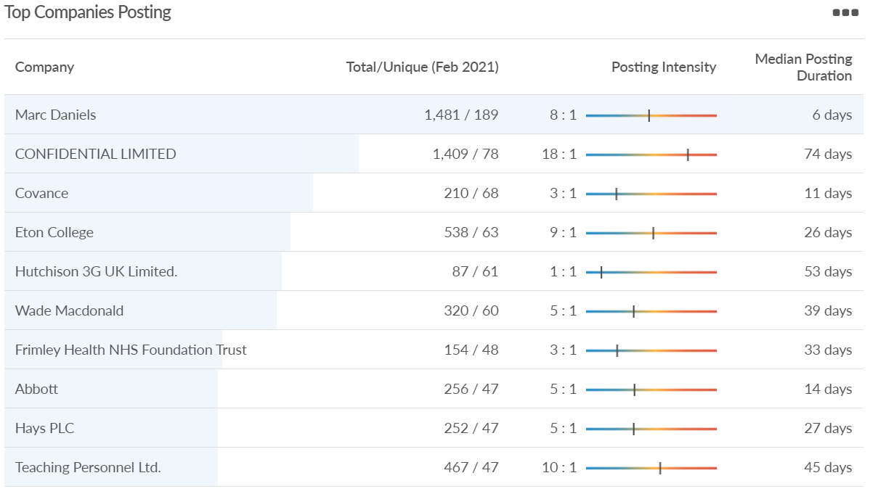
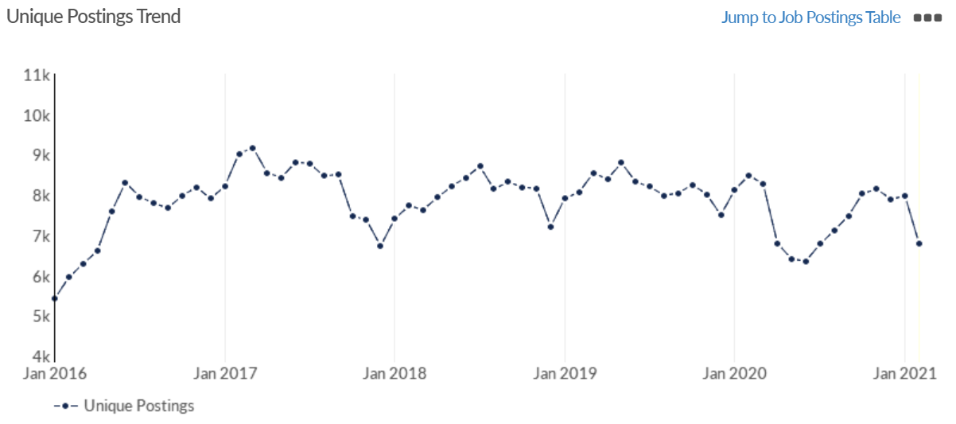
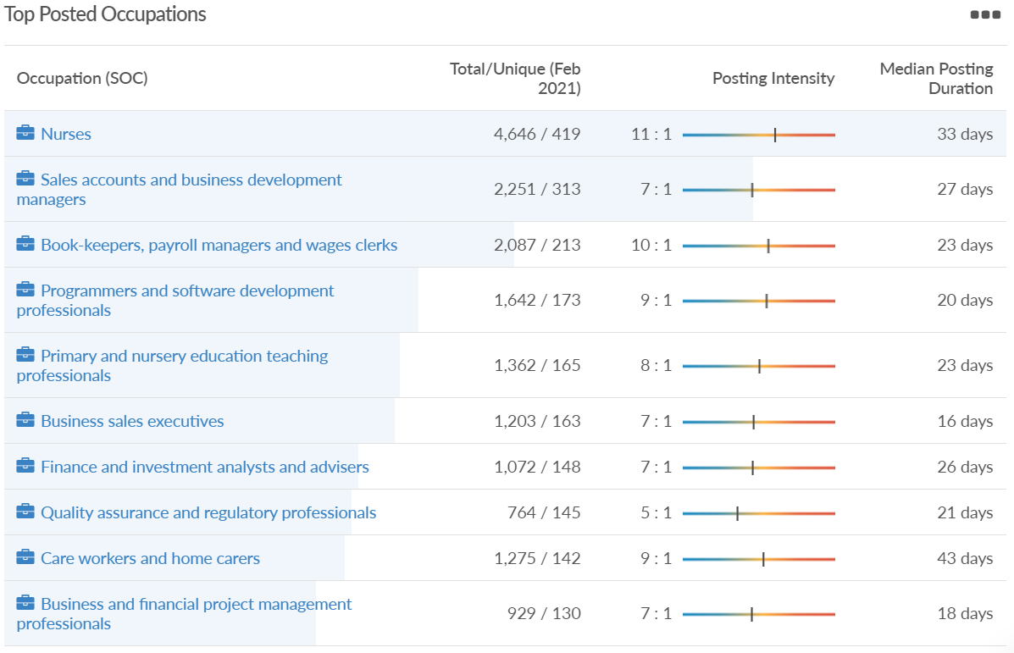
Job posting analytics (EMSI, February 2021)
Unique job postings: 6,780
Total job postings: 55,481
Job posting intensity: 8:1
Unique job postings (Feb 2020): 8,490

Slide 51
West Berkshire

Slide 52
Impact of COVID-19 up to 21st February 2021
COVID-19 cases (to 21st February 2021) – Source: Public Health Berkshire COVID-19 Dashboard, February 2021
6,000 total cases
21 new cases daily
Claimant unemployment (to January 2021)
3,720 claimants (3.9% of the working age population) in West Berkshire UA
Notable business news
New West Berkshire business: Former Kennet School pals set up DR Flame. Richard Baldwin and his business partner Dylan Collins had a bit of a ‘Eureka!’ moment when they decided to start up a new company, DR Flame, offering colour flame pellets. The colours currently on offer are blue and green, but Mr Baldwin says they are looking at finding ways to add more colours into the mix. Unfortunately, this was all just before the coronavirus pandemic hit. “When the first lockdown came, we had some difficulty in getting supplies, but we’ve soldiered on and I think we are the only people – possibly in the world – who make these pellets.” said Mr Baldwin. Source: Newbury Today, February 2021

Slide 53
Industries hit hardest by COVID shutdown
While West Berkshire hasn’t been as fortunate as Slough in terms of how great of a percentage of jobs have been directly affected by the COVID shutdown, it has fared significantly better than the Thames Valley Berkshire area and better than Great Britain.
Source: EMSI, February 2021 (definition for industries hit hardest provided on slide 56)

Slide 54
Industry risks and opportunities (2020-2021)
Critical industries
Food and drink retail: 4,289 employees (17% below the national average)
Energy/utilities: 1,343 employees (14% above the national average)
Health and social care: 6,773 employees (48% below the national average)
Freight/logistics: 1,574 employees (43% below the national average)
Insurance: 262 employees (73% below the national average)
Banking and financial services: 692 employees (71% below the national average)
Sectors most impacted
Hospitality and tourism: 6,617 employees (18% below the national average)
Arts, entertainment and recreation: 2,674 (10% above the national average)
Admin and support: 4,803 (11% below the national average)
Aviation: <10 employees
Non-food retail and wholesale: 8,432 (9% above the national average)
Manufacturing: 11,330 (41% above the national average)
Construction: 4,813 (3% above the national average)
Source: EMSI, January 2021

Slide 55
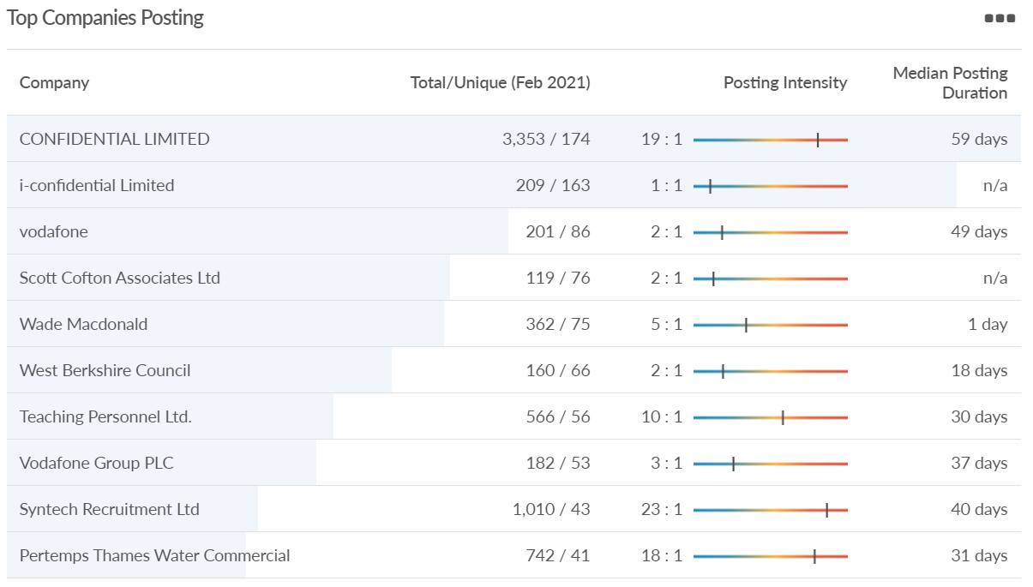
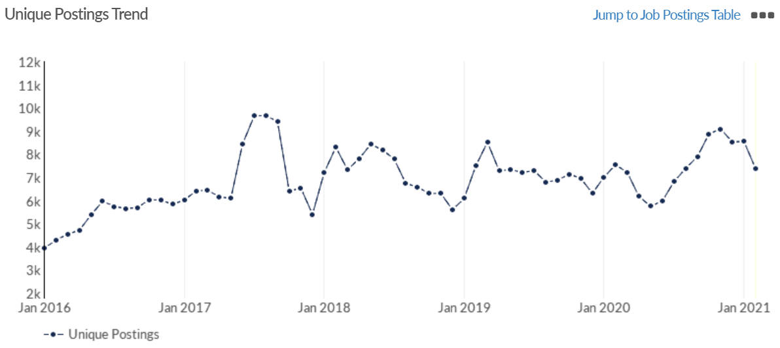
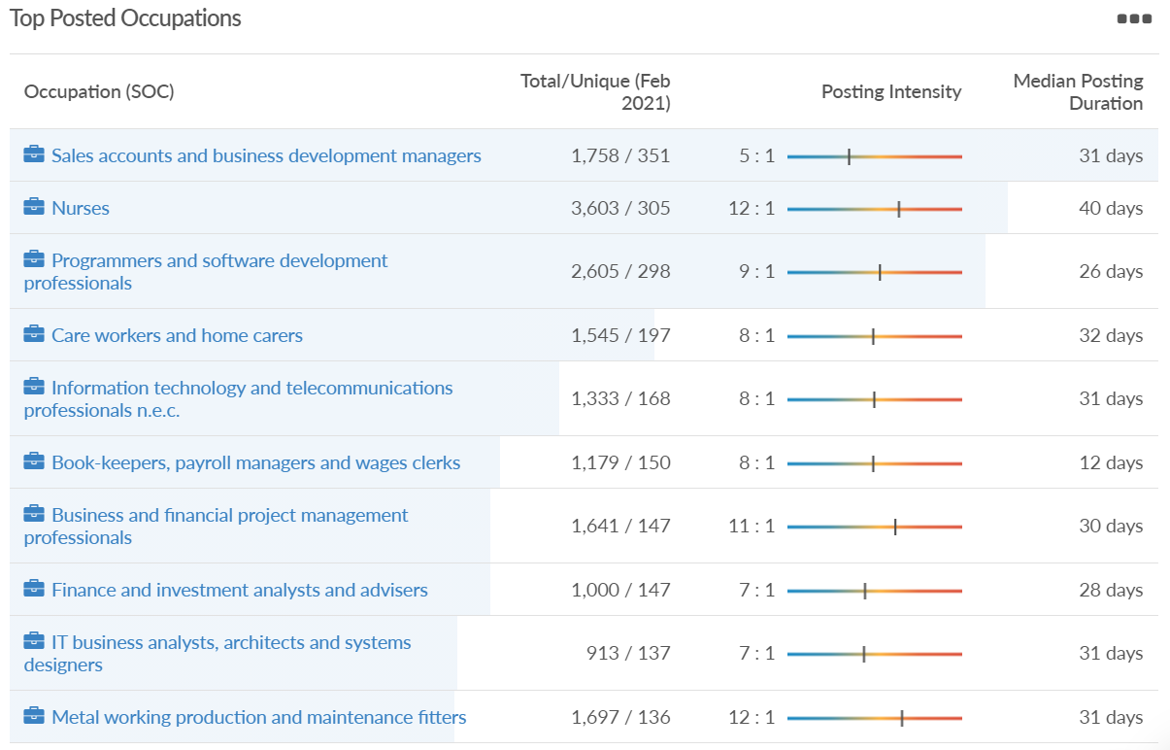
Job posting analytics (EMSI, February 2021)
Unique job postings: 7,379
Total job postings: 59,051
Job posting intensity: 8:1
Unique job postings (Feb 2020): 7,551

Slide 56
Definitions
Source: Institute for Fiscal Studies, April 2020

