Slide 1
Thames Valley Berkshire Monthly Economic Briefing
September 2021

Slide 2
Key contents of this month’s briefing
Updated global and UK economic forecasts
Latest furlough, SEISS and claimant count figures by Local Authority
Latest remote working figures for Thames Valley Berkshire
Latest ‘notable business news’ by Local Authority
Latest job posting analytics by Local Authority

Slide 3
Global and National Economy
September 2021

Slide 4
Global Economy
The global economic recovery remains strong, helped by government and central bank support and by progress in vaccination. But although global GDP has now risen above its pre-pandemic level, the recovery remains uneven with countries emerging from the crisis facing different challenges.
Large differences in vaccination rates between countries are adding to the unevenness of the recovery. Renewed outbreaks of the virus are forcing some countries to restrict activities, resulting in bottlenecks and pressures on supply chains.
A rapid increase in demand as economies reopen has pushed up prices in key commodities such as oil and metals. Food prices are also rising boosting prices especially in emerging markets. Tensions along supply chains caused by the pandemic have added to cost pressures. At the same time, shipping costs have increased sharply.
Nevertheless, the outlook for inflation varies markedly. It has risen sharply in the US and some emerging market economies but remains relatively low in many other advanced economies, particularly in Europe.
These inflationary pressures should eventually fade. Once bottlenecks are resolved, price increases in durable goods, such as cars, are likely to ease quickly as supply from the manufacturing sector rapidly picks up. Consumer price inflation in G20 countries is projected to peak towards the end of 2021 and slow throughout 2022. Although sizeable pay increases are happening in some sectors that are reopening such as transportation, leisure and hospitality, overall wage pressure remains moderate. Source: OECD, September 2021

Slide 5
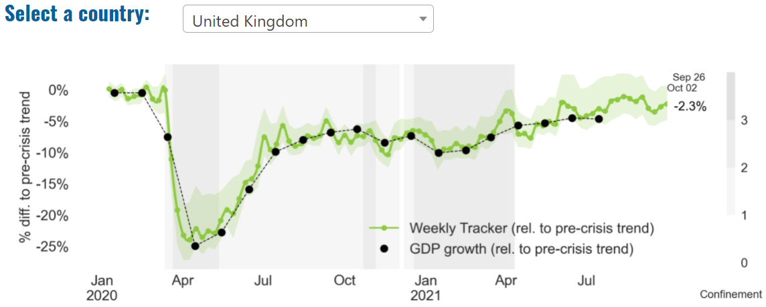
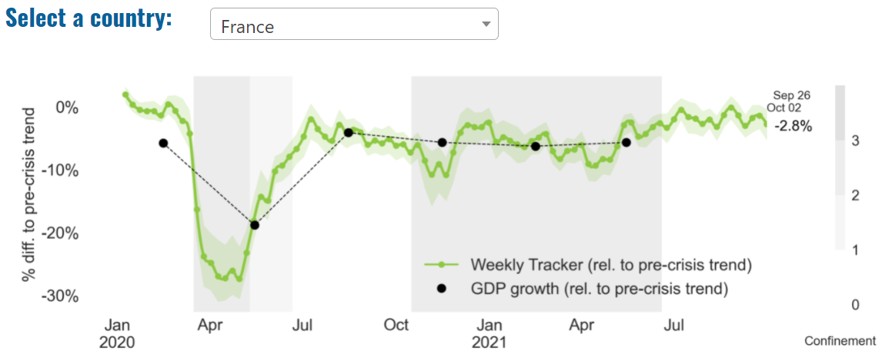
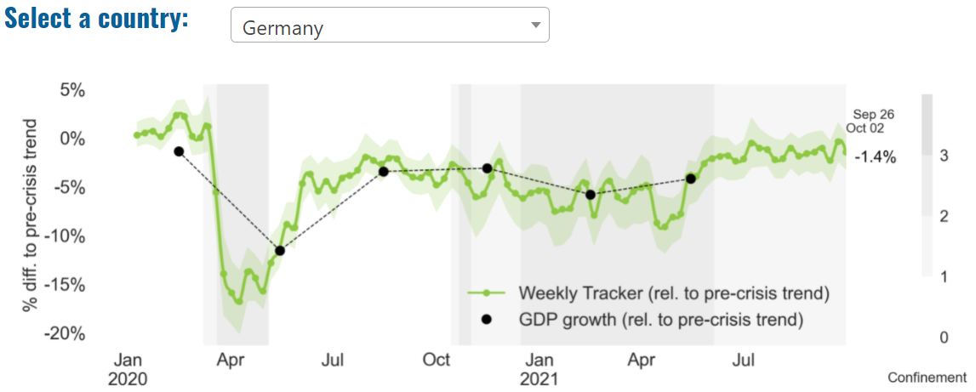
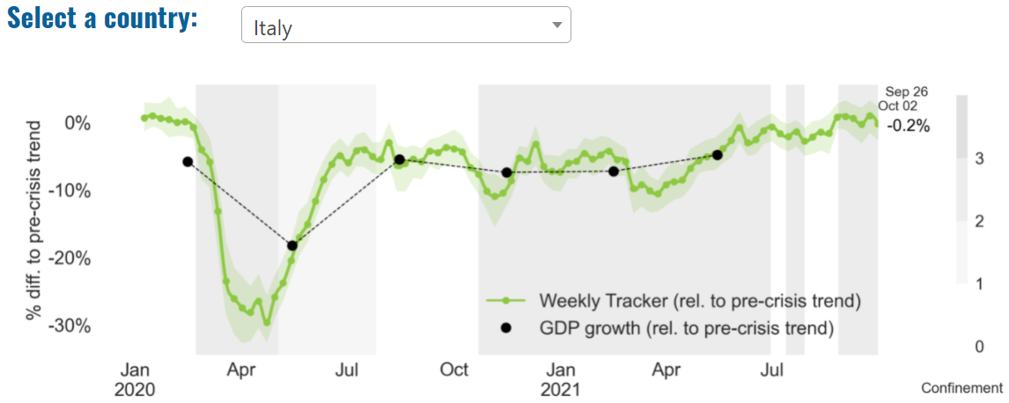
Global Economy – OECD GDP Tracker

Slide 6
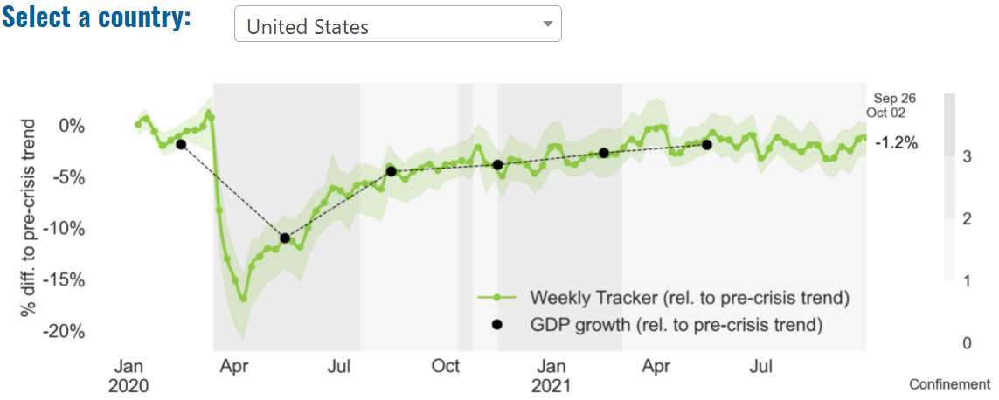
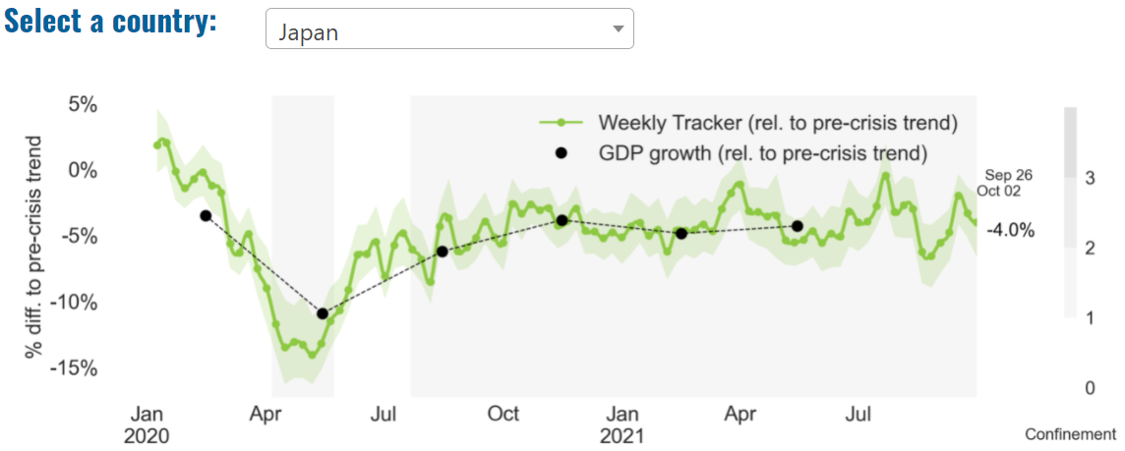
Global Economy – OECD GDP Tracker Continued
China
China is not included within the OECD GDP tracker and so the graph on the left has been compiled using statistics from the IMF and National Bureau of Statistics of China. The 2021 figure is a preliminary figure published by the National Bureau of Statistics of China in January 2021.
Note: The green confidence band shows 95% confidence intervals. The Weekly Tracker is an estimate of weekly GDP relative to the pre-crisis trend, which is proxied by the November 2019 OECD Economic Outlook forecasts. The darkness of the grey background reflects stay-at-home confinement requirement based on the Oxford Blavatnik database (0 - no measures, 1 - recommend not leaving house, 2 - require not leaving house with exceptions, 3 - require not leaving house with minimal exceptions). Source: OECD, September 2021

Slide 7
UK Economy
The UK economy expanded in August after shrinking slightly in July, but growth narrowly undershot expectations and analysts said supply shortages would make the coming months difficult.
UK gross domestic product grew 0.4% in August after a revised 0.1% fall in July, the Office for National Statistics said Wednesday. August’s reading was below expectations of 0.5% growth.
Output in the all-important services sector grew 0.3%, leaving it just 0.6% smaller than in February 2020.
The August expansion left overall UK GDP 0.8% below where it was in February last year, the ONS said. That’s a much smaller gap than in July, after previous months’ growth figures were revised upwards.
“The economy picked up in August as bars, restaurants and festivals benefited from the first full month without COVID-19 restrictions in England,” Darren Morgan, director for economic statistics at the ONS, said.
Sources: Business Insider, September 2021; Deloitte, September 2021

Slide 8
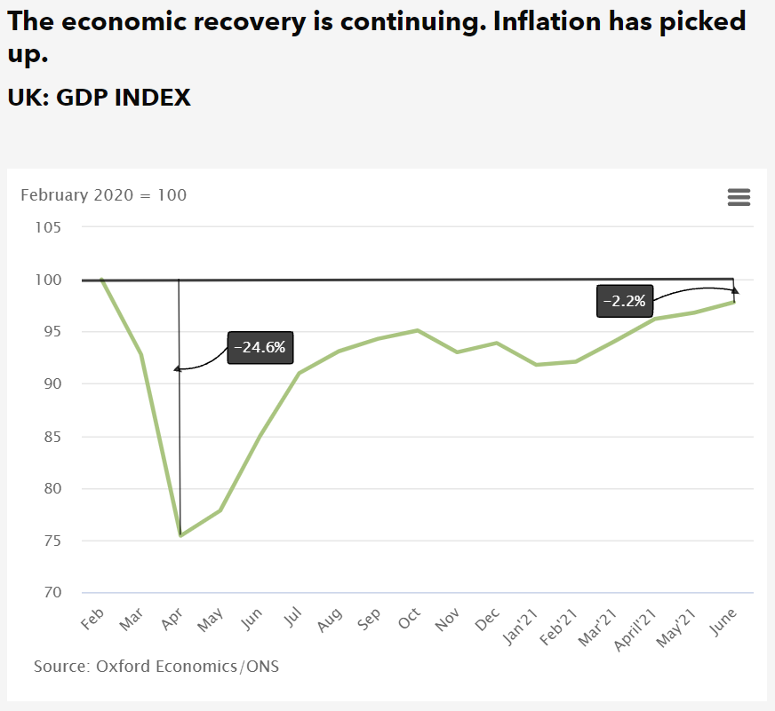
UK Economy 2
Confidence is again at a record level, boosted by strong sales expectations, especially for domestic markets.
Customer demand is less of an issue but other challenges still exist and are increasing in prominence: skills availability, staff turnover, regulatory restrictions and (especially for Manufacturers and those that export) transport problems.
Companies also expect costs and prices to rise as the economy expands. However, they are not anticipating either input costs or selling prices to rise more rapidly than in the pre-pandemic period.
Businesses also plan to raise investment in capital equipment and Research & Development, reflecting the strength of demand, less widespread problems of spare capacity, and higher expected profits. Retailers and Wholesalers are in the forefront, as they shift increasingly online.
The optimism is shared across sectors, after a year in which some saw a rise in sales but others experienced significant declines. Transport & Storage companies expect a particularly strong improvement in their sales.
Variations across regions and types of businesses are not particularly marked, although companies that Source: ICAEW, September 2021

Slide 9
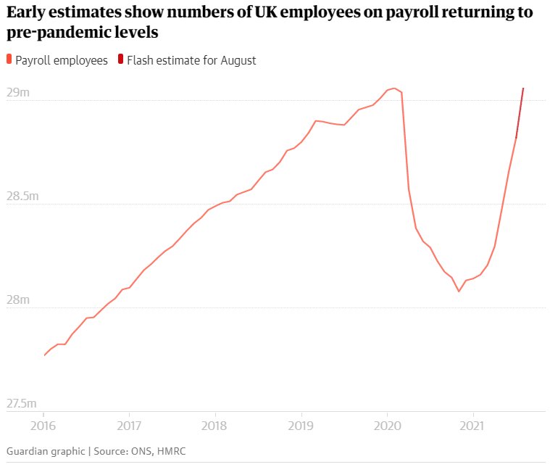
UK Economy 3
Employers are scrambling to hire staff amid widespread labour shortages after lockdown helped to return the number of workers on company payrolls to pre-pandemic levels in August, official figures show.
The Office for National Statistics said the number of payroll employees increased by 241,000 to 29.1 million in August, lifting employment in all regions of the UK to pre-Covid levels except in London, Scotland and south-east England.
It came as the number of job vacancies soared to more than 1m in August for the first time since official records began in 2001, rising by 35% in the space of three months across all sectors of the British economy. Source: The Guardian, September 2021

Slide 10
Conservative Party Conference – Rishi Sunak
On 4 October, the Chancellor, Rishi Sunak addressed the Conservative Party Conference. Key points from his speech included:
”It’s not the state’s money. It’s your money.” This was a nod to Margaret Thatcher, whose philosophy is encapsulated by this phrase.
“I believe that the only sustainable route out of poverty comes from having a good job.” This was an attempt to position the Conservatives as the party of work.
“The unemployment rate is at less than 5% and falling. That’s lower than France, America, Canada, Italy, and Spain. And we now have one of the fastest recoveries of any major economy in the world.” Sunak argued that the Conservatives are securing the economic recovery
“…today, I am announcing that we will create 2,000 elite AI scholarships for disadvantaged young people and double the number of Turing AI World-Leading Research Fellows, helping to ensure that the most exciting industries and opportunities are open to all parts of our society.” In an otherwise policy-lite speech, Sunak’s major announcement was on Artificial Intelligence.

Slide 11
Labour Party Conference – Rachel Reeves
On 27 September, the Shadow Chancellor, Rachel Reeves, addressed the Labour Party Conference.
Reeves spoke of the “everyday economy”, made up of carers, train and bus drivers, nurses, teachers.
She criticised the end of the £20 uplift in Universal Credit and described Rishi Sunak as “missing in action”.
In policy terms, Reeves pledged to end the charitable status of private schools, making them eligible for business rates and VAT, and said the £1.7bn raised would be spent on state schools.
Reeves also called on the government to freeze business rates next year and said Labour would scrap them, replacing them with a system which will incentivise investment.

Slide 12
Coronavirus and Recession: Implications for Thames Valley Berkshire

Slide 13
Furloughing (Latest data - August 2021)
21,800 jobs furloughed across Thames Valley Berkshire
2,800 jobs (5% of total eligible employments) furloughed in Bracknell Forest UA
5,500 (8% of total eligible employments) furloughed in Slough UA
3,300 jobs (4% of total eligible employments) furloughed in Reading UA
3,500 jobs (4% of total jobs) furloughed in Wokingham UA
4,000 jobs (6% of total jobs) furloughed in Windsor and Maidenhead
2,700 jobs (4% of total jobs) furloughed in West Berkshire
Source: HMRC, August 2021
Berkshire has a lower-than-average number of furloughed workers, compared to the rest of the UK, because of its relative strength in sectors of industry that can be continued by workers from home.

Slide 14
SEISS (Latest data - August 2021)
Total value of claims made across Thames Valley Berkshire: £398,300,000
Total value of claims made for Bracknell Forest UA – All SEISS: £61,800,000
Total value of claims made for Slough UA – All SEISS: £78,600,000
Total value of claims made for Reading UA – All SEISS: £63,700,000
Total value of claims made for Wokingham – All SEISS: £66,400,000
Total value of claims made for Windsor and Maidenhead – All SEISS: £60,700,000
Total value of claims made in West Berkshire – All SEISS: £67,100,000
Source: HMRC, August 2021

Slide 15
Claimant Count (Latest data - September 2021)
Total of 22,625 claimants (3.9% of the working age population) in Thames Valley Berkshire
2,415 claimants (3% of the working age population) in Bracknell Forest UA
6,310 claimants (6.7% of the working age population) in Slough UA
5,660 claimants (5.3% of the working age population) in Reading UA
2,470 claimants (2.3% of the working age population) in Wokingham UA
2,870 claimants (3.1% of the working age population) in Windsor and Maidenhead UA
2,905 claimants (3% of the working age population) in West Berkshire UA
Across Thames Valley Berkshire, claimant unemployment has fallen significantly from 30,290 in September 2020 to 22,625 in September 2021. Slough had 6.7% of its working age population claim unemployment in September 2021, down slightly from 8.4% in September 2020.
Source: ONS, September 2021

Slide 16
Strategic Issues: Heathrow
Heathrow Airport
Britain's biggest airport Heathrow said on 13 September that passenger numbers were still 71% lower in August compared to the same month before the COVID-19 pandemic, as it demanded that the government change its travel rules to help the sector recover.
Heathrow blamed the complicated, changing and expensive rules for those arriving in the United Kingdom for Britain's much slower travel recovery versus competitors, pushing it down to 10th busiest European airport, from its top spot in 2019.
Expectations are growing that there will be a simplification of those travel rules, after Health Minister Sajid Javid that he wanted to "get rid of" expensive PCR tests for travellers as soon as possible.
British Prime Minister Boris Johnson will shortly set out his plans to manage the COVID-19 pandemic in the winter months.
Heathrow said in its statement that it would favour a two-tier system with destination countries rated either low risk or high risk, with the latter still requiring hotel quarantine. Source: Reuters, September 2021

Slide 17
Strategic Issues: Aviation
Aviation:
Aviation leaders have welcomed the UK’s government’s easing of travel restrictions as a “step forward” although they said more needs to be done to ease international travel. Under the changes, from October 4 a red list of countries will remain in place with anywhere not on the red list automatically considered as being green and safe to travel to.
A total of eight countries are going to be removed from the red list from 4 am September 22. These are Turkey, the Maldives, Egypt, Sri Lanka, Pakistan, Oman, Bangladesh and Kenya. Also from October 4, pre-departure tests will no longer be required for fully-vaccinated (double jabbed) travelers arriving into England from non-red list countries. From “later in October”, the day 2 test for international arrivals can be conducted with a lateral flow test – ending the requirement for expensive PCR tests.
The rules currently will apply only in England, though on Friday the Welsh government confirmed it would remove the same eight countries from its red list. The Scottish and Northern Irish governments have so far not made any changes to their restrictions. “Fully vaccinated passengers now have a larger choice of destinations and can book with more confidence in the months before Christmas and beyond – free from the need to arrange pre-departure tests before coming back into the UK. Source: Euro Weekly News, September 2021

Slide 18
Demand and Supply Conditions: Businesses, Hiring, Restructuring, Investment, Labour and Skills Supply

Slide 19
Household/Consumer Demand
Slough had an overall recovery index score of 62 at the end of August, putting them in a weaker position in terms of recovery (closer to pre-lockdown levels) than Reading which had a recovery index score of 95.
Source: Centre for Cities, August 2021 (latest release)
Retail sales volumes fell by 0.9% in August 2021, following a 2.8% fall in July; however, volumes were up by 0.3% in the three months to August compared with the previous three months, and in August 2021 were 4.6% higher than their pre-coronavirus (COVID-19) pandemic February 2020 levels.
Food store sales volumes fell by 1.2% in August 2021, with some evidence to suggest that the further easing of hospitality restrictions had an impact on sales; people increased their social spending such as eating and drinking at restaurants and bars.
Non-food stores reported a fall of 1.0% in sales volumes in August 2021, driven by falls in department stores (negative 3.7%) and other stores, such as sports equipment and computer stores (negative 1.2%).
Automotive fuel sales volumes rose by 1.5% in August 2021 as people continued to increase their amount of travel; however, they remained 1.2% below their pre-pandemic February 2020 levels.
The proportion of retail sales online rose to 27.7% in August 2021 from 27.1% in July, substantially higher than the 19.7% in February 2020 before the pandemic. Source: ONS, September 2021 (latest release)

Slide 20
Industries at Risk
MANUFACTURING
28,000 people work in manufacturing in Berkshire – with 11,000 in West Berkshire alone and 2,487,000 across the whole of Great Britain (ONS, 2020)
Half of all UK manufacturing firms have made redundancies. A further 20% plan to make more redundancies in the next six months (Make UK, October 2020)
37% of manufacturers think it will take more than a year to return to normal trading conditions (Make UK, October 2020)
HOSPITALITY & TOURISM
The hospitality and tourism sector in Berkshire employed 35,842 people in 2020 – an increase of 0.8% on the previous year (EMSI, 2021)
In June, ‘Pathways to Recovery’, a report by the All Party Parliamentary Group on Hospitality and Tourism, found that just 11% of hospitality businesses had been able to operate normally during the first lockdown and international tourist arrivals were likely to be down 59% for the year.
Kate Nicholls, CEO of UK Hospitality, told the BBC (December 2020) that 30,000 hospitality businesses – most of them SMEs and one-third of the total – could be lost by the end of 2020.
According to Sky News in December, at least 38,653 hospitality jobs had been lost during the pandemic.
CONSTRUCTION
21,000 people work in construction in Berkshire – with only 1,500 of these working in Bracknell Forest and 2,164,000 across the whole of Great Britain (ONS, 2020)
The level of construction output in August 2020 was 10.8% below the February 2020 level (ONS, 2020)
Construction output grew by 18.5% in the three months to August 2020 compared with the previous three-month period, but this followed 10 consecutive periods of decline (ONS, 2020)
NON-FOOD RETAIL & WHOLESALE
More than 45,000 people work in non-motor vehicle retail in Berkshire – with 12,500 of them working in Reading (EMSI, 2021). The offline retail sector has struggled during the pandemic. At least 39,000 jobs had been lost in retail as of 3 December. Redundancy announcements include 7,000 at Marks and Spencer (August), 4,000 at Debenhams (August) and 4,000 at Boots (July) - Sky News, 2020.
The pre-pandemic trend of on-line shopping has strengthened in 2020; a record total of 31.4% of shopping was done on line in November 2020 (ONS, 2020), a trend that will have profound implications for the high street.
In November, retail sales volume decreased by 3.8% (vs October figures) as a result of COVID-19. Despite this, overall sales remain above their pre-pandemic levels (ONS, 2020).
ARTS, ENTERTAINMENT & RECREATION
12,000 people work in arts, entertainment and recreation in Berkshire. 4,500 of them – more than one third – work in Windsor and Maidenhead and 925,000 across the whole of Great Britain (ONS, 2020)
Between 19 Nov and 1 Dec, 24 per cent of arts, entertainment and recreation venues had temporarily closed or paused trading. (ONS, 2020)
52% of eligible employments in arts, entertainment and recreation were on furlough on 31 July 2020 – a figure that had fallen to 24% as at 31 October. (HMRC, 2020)
AVIATION
Aviation has an estimated value of £28 billion to the UK economy, employing 230,000 workers at over 40 commercial airports. (House of Commons Transport Committee, June 2020)
76,000 people work in over 400 business across Heathrow Airport. Many of these people live in Slough, in Berkshire. (Heathrow local recovery plan, 2020)
There were 5,800 passenger flights in April 2020 compared to 201,000 a year earlier: a reduction of 97%. The impact is several times more severe than the aftermath of the global financial crisis in 2008, when passenger flights reduced by around 67,000 to 134,000 per month. (House of Commons Transport Committee, June 2020)
The UK aviation industry has been hit harder than any European country by the pandemic with IATA calculating that the “coronavirus crisis will cost 780,000 British jobs and cost £46bn in lost GDP.” (International Air Transport Association, 2020).
ADMINISTRATION & SUPPORT
More than 51,000 people in Berkshire work in admin and support services – including 10,000 in Wokingham and 10,000 in West Berkshire and 2,752,000 across the whole of Great Britain (ONS, 2020)
More than 600,000 admin and support workers – 27% of the total – were furloughed as at 31 October (HMRC, 2020)

Slide 21
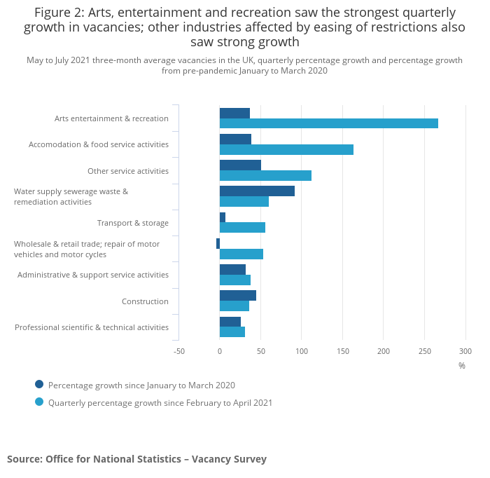
Industries showing strong growth in advertised vacancies as a result of easing of COVID-19 restrictions
Quarterly growth was seen across all industries. The fastest rate of growth was seen in arts, entertainment and recreation, which grew by 267.1% (23,000).
The largest increase in levels was seen in accommodation and food service activities, which grew by 73,000 (163.7%).
Both industries are likely to have seen demand for labour increase, as coronavirus restrictions eased through the spring into the summer. In 10 of the 18 industries, the number of vacancies equalled or reached record-high levels in May to July 2021.
Source: ONS, August 2021.

Slide 22
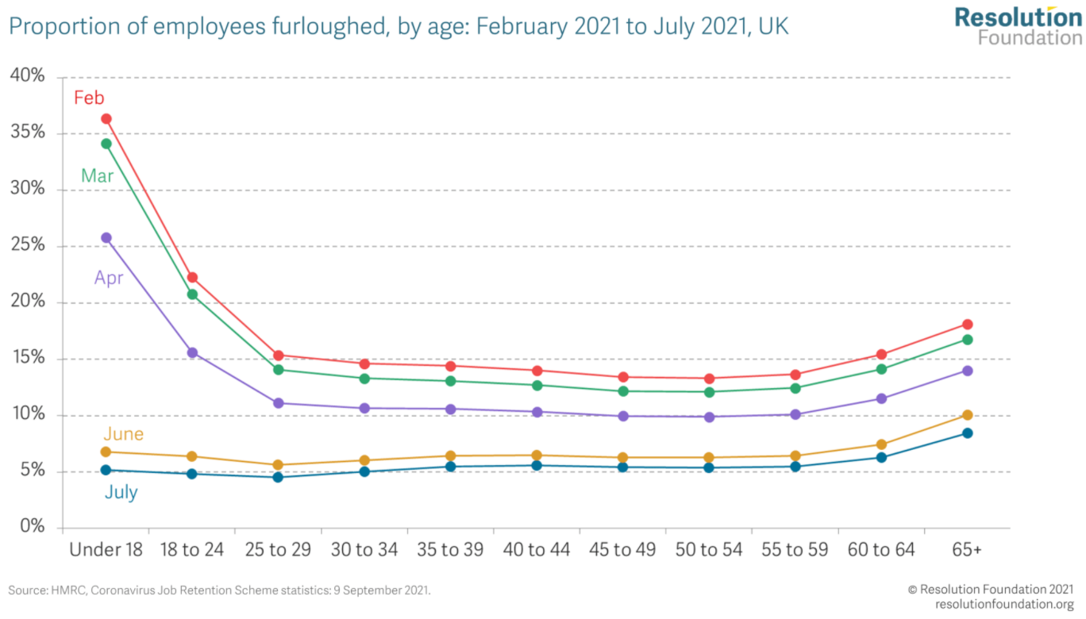
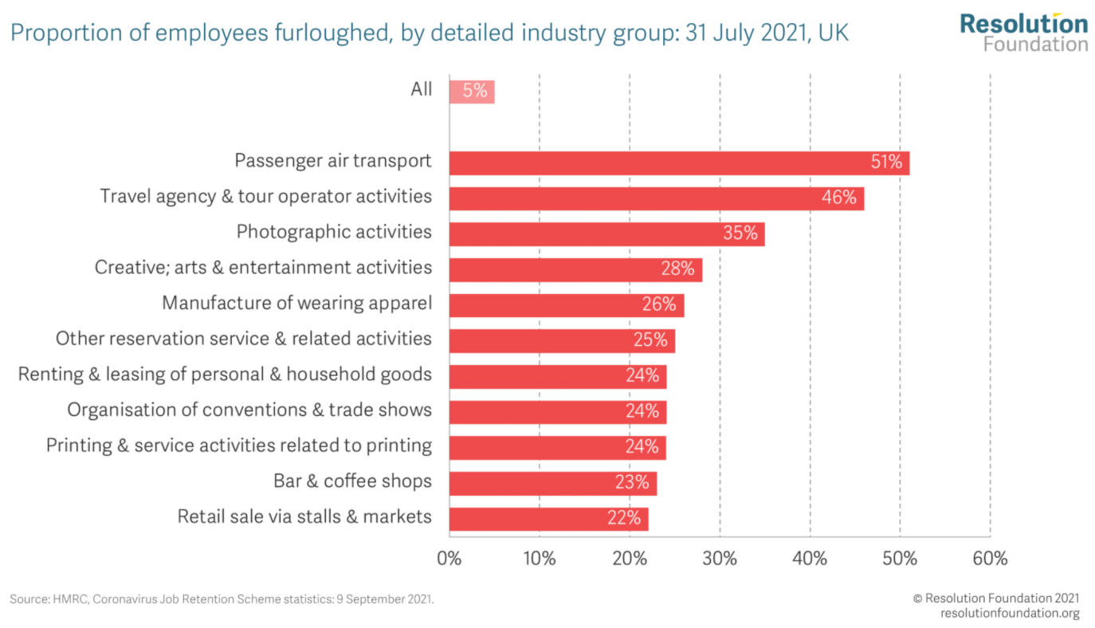
Supply of labour and skills
This tilt towards older workers as the JRS comes to an end is a cause for concern, given the evidence on the challenges that older workers face when entering unemployment. Previous Resolution Foundation research has shown that older workers take longer to return to work after losing a job, and suffer a larger pay penalty when returning to work. If a higher share of older workers decide to take early retirement, this could be a lasting and damaging labour market supply shock from this crisis.
It is important to be cognisant too of the length of time that some people will have spent on furlough during this crisis. Some of those still fully-furloughed may have been in this position for a very long time. Earlier this year, we found that over 60 per cent of those fully-furloughed in May had been so for seven or more months, and half of those fully-furloughed then had been so for 10 or more months. Given the damaging effects that long periods out of work can have on subsequent job prospects and future earnings, we need to take seriously the fact that some of those who will move from full furlough to unemployment in October will not have worked for many months.
Source: Resolution Foundation, September 2021

Slide 23
Remote working
In September of 2021, there were 3,250 unique job postings for remote positions at companies based in Berkshire, around 180% more than the figure of 1,157 for the same period one year previous.
Compare this with the South East, in September 2021 there were 21,878 unique remote job postings for remote positions; rising from 7,167 in September of the previous year – an increase of over 205%
A rise can also be seen at national level, with a recorded 137,967 unique remote job postings in England in September of 2021, rising from 47,178 in August 2020 – an increase of over 192%.
From these figures it’s apparent that the COVID-19 pandemic has, somewhat unsurprisingly, prompted a massive boost in job postings for explicitly remote roles. Berkshire has seen a slightly smaller boost in vacancies which are remote-based than both England and the South East.
Source: EMSI, September 2021

Slide 24
Local Profiles

Slide 25
Bracknell Forest

Slide 26
Impact of COVID-19 up to 11th October 2021
COVID-19 cases (to 11th October 2021) – Source: Public Health Berkshire COVID-19 Dashboard, 11th October 2021
13,111 total cases
65 new cases daily
Claimant unemployment (to September 2021)
2,415 claimants (3% of the working age population) in Bracknell Forest UA
Notable business news:
The Department for Work & Pensions (DWP) has taken the entire ground floor of refurbished Phoenix House in Bracknell, the biggest office letting in the town this year. The DWP is running a campaign to acquire vacant office space across the country to house more than 80 temporary job centres for retraining people after Covid. Vail Williams, acting for the building’s owners MCR Property Group alongside Fryer Commercial, brokered a five-year deal for the 9,267 sq ft letting.
Source: UK Property Forums, September 2021

Slide 27
Industries hit hardest by COVID shutdown
As illustrated by the above graph, Bracknell Forest has suffered very similarly to Great Britain in terms of the percentage of jobs within industries which have been hit hardest by COVID shutdowns. Thames Valley Berkshire area has seen an additional 0.77% of jobs of jobs affected worst by the COVID shutdowns when compared to Bracknell Forest.
Source: EMSI, March 2021 (definition for industries hit hardest provided on slide 55)

Slide 28
Industry risks and opportunities (2020-2021)
Critical industries
Food and drink retail: 3,234 employees (1% below the national average)
Energy/utilities: 257 employees (65% below the national average)
Health and social care: 6,193 employees (25% below the national average)
Freight/logistics: 515 employees (70% below the national average)
Insurance: 186 employees (69% below the national average)
Banking and financial services: 1,291 employees (13% below the national average)
Sectors most impacted
Hospitality and tourism: 3,743 employees (26% below the national average)
Arts, entertainment and recreation: 1,148 (24% below the national average)
Admin and support: 2,694 (21% below the national average)
Aviation: 0 employees
Non-food retail and wholesale: 8,508 (75% above the national average)
Manufacturing: 1,549 (69% below the national average)
Construction: 1,771 (40% below the national average)
Source: EMSI, January 2021

Slide 29
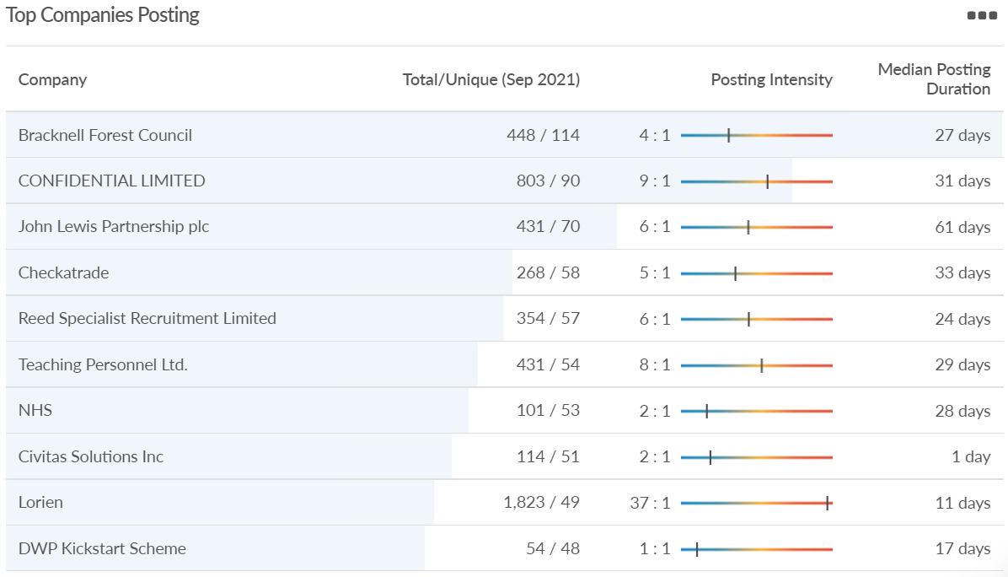
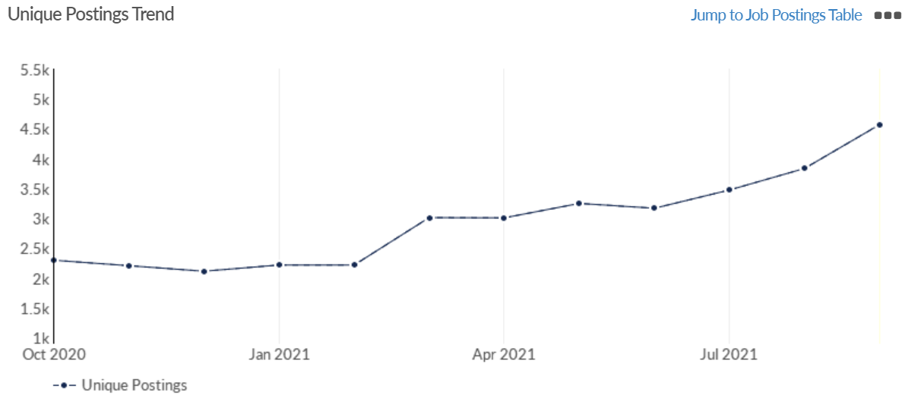
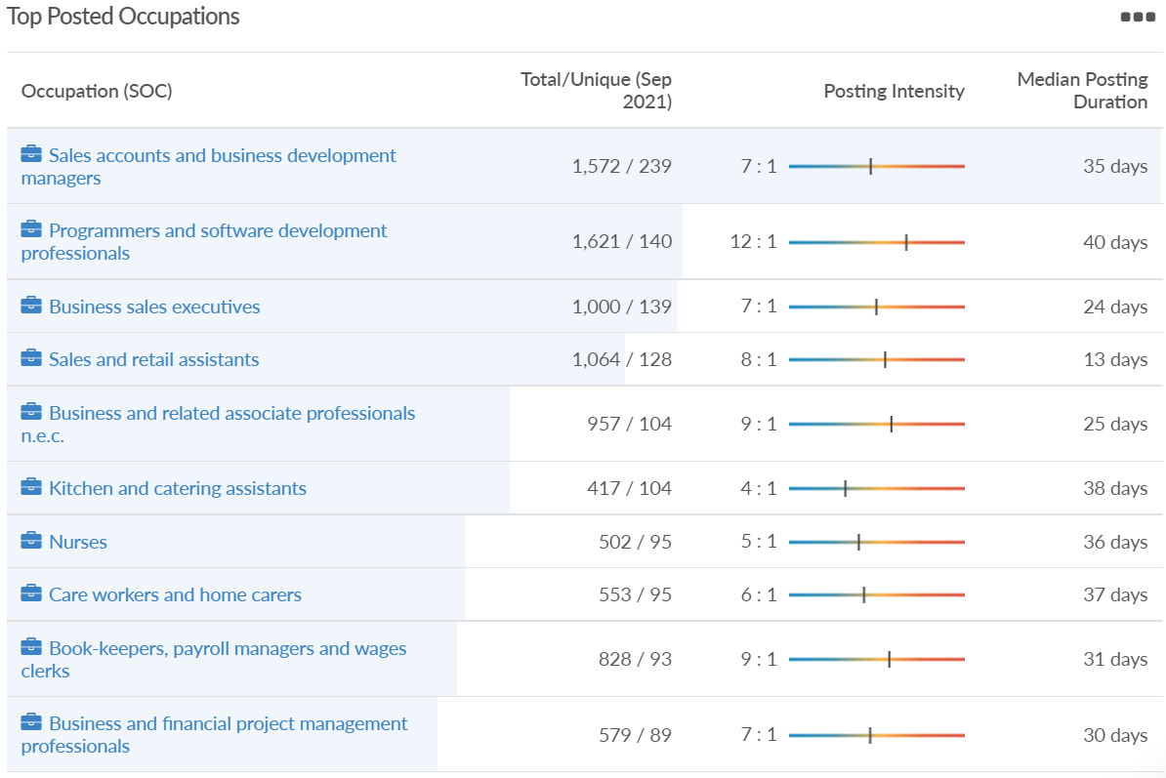
Job posting analytics (EMSI, September 2021)
Unique job postings: 4,571
Total job postings: 33,103
Job posting intensity: 7:1
Unique job postings (September 2020): 2,017

Slide 30
Slough

Slide 31
Impact of COVID-19 up to 11th October 2021
COVID-19 cases (to 11th October 2021) – Source: Public Health Berkshire COVID-19 Dashboard, 11th October 2021
22,288 total cases
116 new cases daily
Claimant unemployment (to September 2021)
6,310 claimants (6.7% of the working age population) in Slough UA
Notable business news:
Fresh details have emerged of when work could start on transforming a Berkshire shopping centre. The major development, set to take 14 years to complete, would see the demolition of Slough's Queensmere shopping centre to make way for homes and offices. A planning application has not yet been submitted by the developers, British Land. But it is understood an outline planning application will be submitted by the autumn, which could include 1,600 homes and up to 50,000sqm of office space if there is future demand. This means the plans are subject to change and a fully detailed proposal will require another approval.
Source: Berkshire Live, September, 2021

Slide 32
Industries hit hardest by COVID shutdown
When compared to both Thames Valley Berkshire and Great Britain, Slough has seen a significantly lower percentage of jobs affected by COVID shutdowns – perhaps somewhat surprising given the LA’s proximity to Heathrow and the almost complete shutdown of the aviation sector.
Source: EMSI, March 2021 (definition for industries hit hardest provided on slide 55)

Slide 33
Industry risks and opportunities (2020-2021)
Critical industries
Food and drink retail: 6,656 employees (47% above the national average)
Energy/utilities: 2,820 employees (174% above the national average)
Health and social care: 8,201 employees (28% below the national average)
Freight/logistics: 4,640 employees (93% above the national average)
Insurance: 121 employees (86% below the national average)
Banking and financial services: 731 employees (65% below the national average)
Sectors most impacted
Hospitality and tourism: 3,780 employees (46% below the national average)
Arts, entertainment and recreation: 442 (79% below the national average)
Admin and support: 9,765 (107% above the national average)
Aviation: 262 employees (16% above the national average)
Non-food retail and wholesale: 6,719 (0% above the national average)
Manufacturing: 5,071 (28% below the national average)
Construction: 2,620 (36% below the national average)
Source: EMSI, January 2021

Slide 34
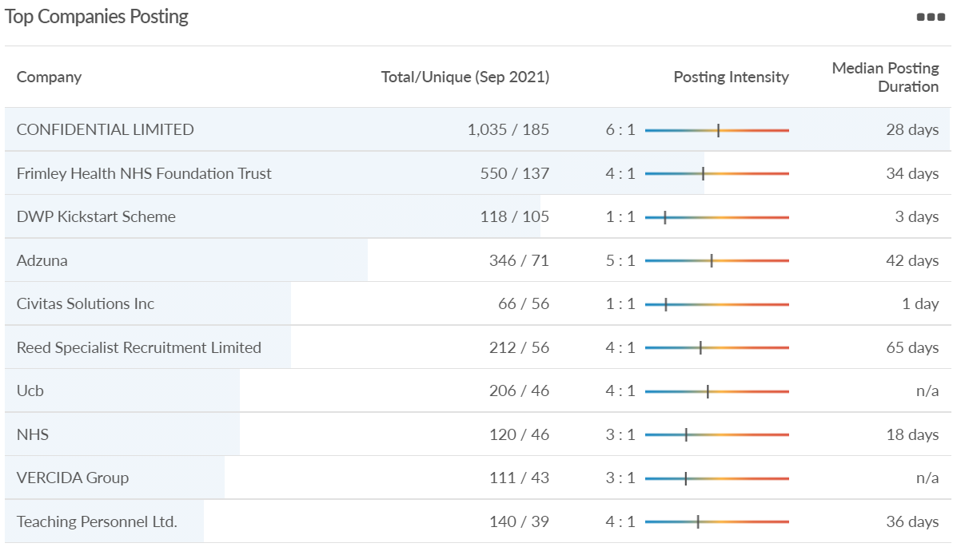
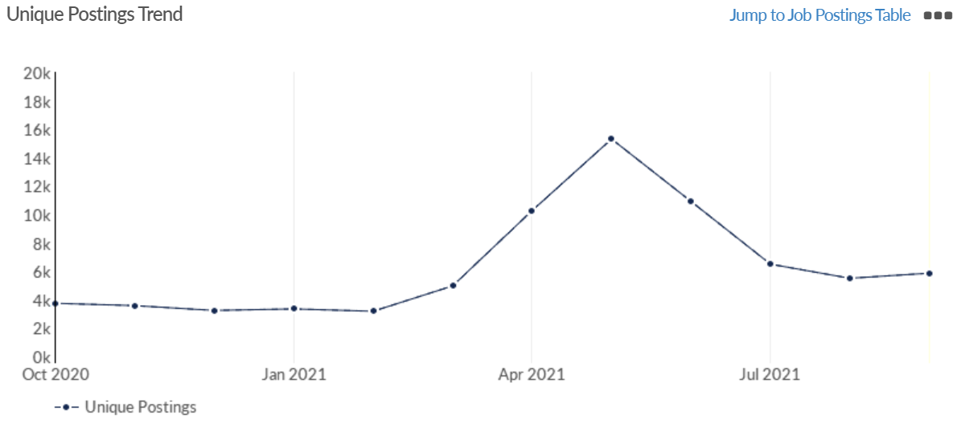
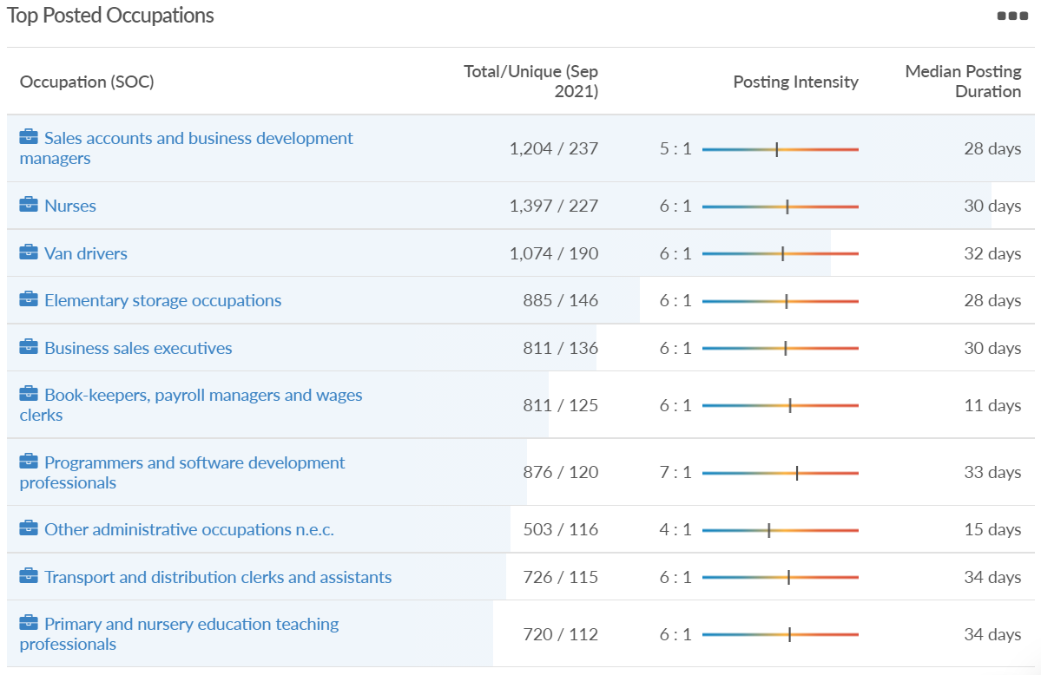
Job posting analytics (EMSI, September 2021)
Unique job postings: 5,872
Total job postings: 31,794
Job posting intensity: 5:1
Unique job postings (September 2020): 3,190

Slide 35
Reading

Slide 36
Impact of COVID-19 up to 11th October 2021
COVID-19 cases (to 11th October 2021) – Source: Public Health Berkshire COVID-19 Dashboard, 11th October 2021
19,695 total cases
98 new case daily
Claimant unemployment (to September 2021)
5,660 claimants (5.3% of the working age population) in Reading UA
Notable business news:
Reading-based Isotropic Systems has secured more than $37 million in additional Series B funding to facilitate the development of its unique multi-link antenna through to product launch in 2022. This latest funding round takes the total capital secured from investor and customer support to more than $100 million. The funding round secures strong support from existing investors including AEI HorizonX, Promus Ventures through its Luxembourg based space investment fund Orbital Ventures, SES and the government.
Source: Business Innovation Magazine, September 2021

Slide 37
Industries hit hardest by COVID shutdown
Reading has been marginally less affected by the COVID shutdowns as Great Britain has on average, with 15.16% of jobs within industries which have been most severely impacted by the shutdowns. The Local Authority is 1.26% better off than the average of the Thames Valley Berkshire area.
Source: EMSI, March 2021 (definition for industries hit hardest provided on slide 55)

Slide 38
Industry risks and opportunities (2020-2021)
Critical industries
Food and drink retail: 6,192 employees (11% above the national average)
Energy/utilities: 3,350 employees (163% above the national average)
Health and social care: 13,464 employees (5% below the national average)
Freight/logistics: 1,513 employees (49% below the national average)
Insurance: 2,076 employees (100% above the national average)
Banking and financial services: 1,688 employees (34% below the national average)
Sectors most impacted
Hospitality and tourism: 6,567 employees (25% below the national average)
Arts, entertainment and recreation: 1,811 (31% below the national average)
Admin and support: 9,212 (58% above the national average)
Aviation: <10 employees
Non-food retail and wholesale: 8,626 (18% above the national average)
Manufacturing: 2,000 (77% below the national average)
Construction: 2,273 (55% below the national average)
Source: EMSI, January 2021

Slide 39
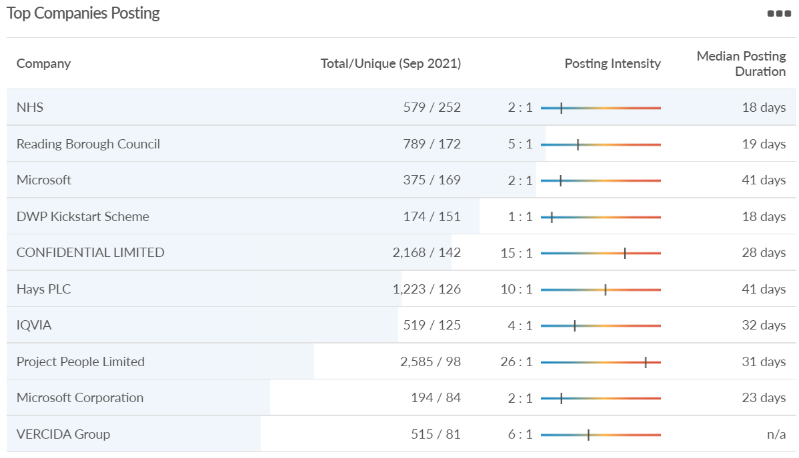
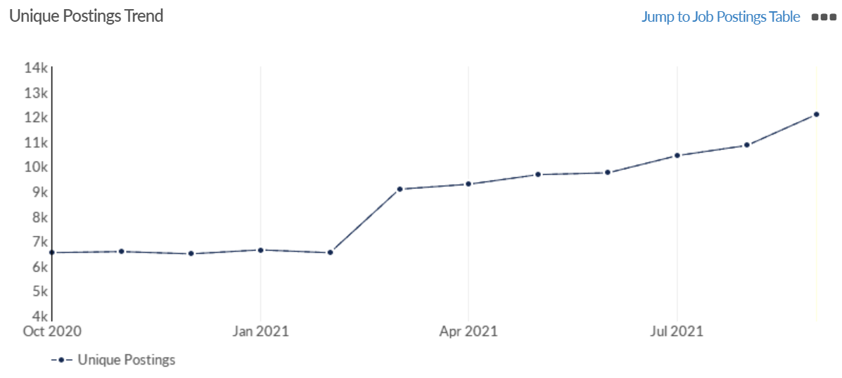
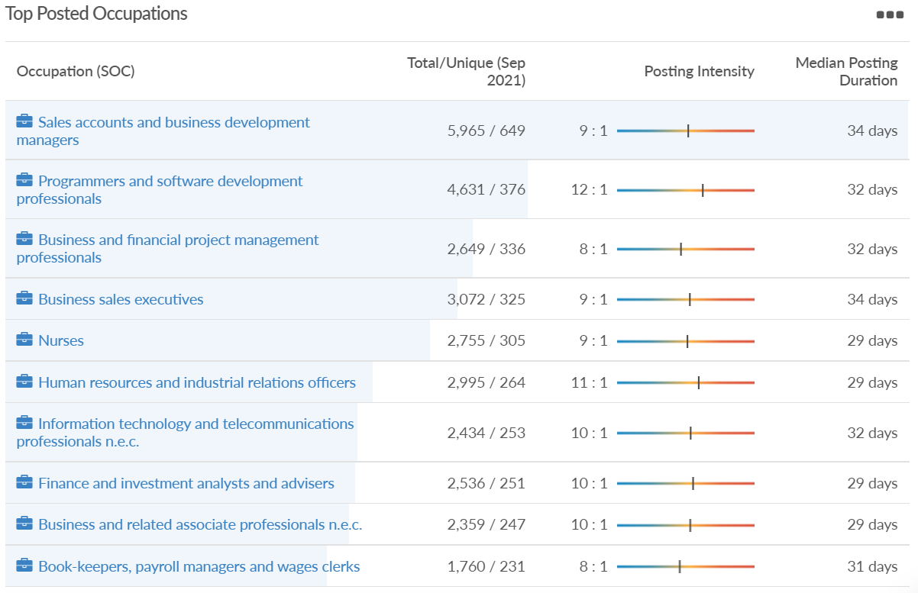
Job posting analytics (EMSI, September 2021)
Unique job postings: 12,088
Total job postings: 104,962
Job posting intensity: 9:1
Unique job postings (September 2020): 5,900

Slide 40
Wokingham

Slide 41
Impact of COVID-19 up to 11th October 2021
COVID-19 cases (to 11th October 2021) – Source: Public Health Berkshire COVID-19 Dashboard, 11th October 2021
16,667 total cases
182 new cases daily
Claimant unemployment (to September 2021)
2,470 claimants (2.3% of the working age population) in Wokingham UA
Notable business news:
Wokingham BC has approved plans for a major new solar farm at Barkham. The development, for a temporary period of 25 years, will involve 67,340 photovoltaic panels, a substation building, fencing and underground cabling to the Electricity Distribution Centre. The plans, drawn up by WSP, also include 10,947 trees planted on 2.9 hectares of the land.
Source: UK Property Forums, September 2021

Slide 42
Industries hit hardest by COVID shutdown
Wokingham is in a similar position to Slough in that is has been significantly less affected by the COVID shutdowns than both the Thames Valley Berkshire area and Great Britain as a whole. This is likely due to the high levels of employment from the Tech sector (Microsoft etc. based at TVP) as this industry is able to work well from home.
Source: EMSI, March 2021 (definition for industries hit hardest provided on slide 55)

Slide 43
Industry risks and opportunities (2020-2021)
Critical industries
Food and drink retail: 3,883 employees (17% below the national average)
Energy/utilities: 1,434 employees (35% above the national average)
Health and social care: 7,283 employees (38% below the national average)
Freight/logistics: 886 employees (64% below the national average)
Insurance: 453 employees (48% below the national average)
Banking and financial services: 423 employees (80% below the national average)
Sectors most impacted
Hospitality and tourism: 5,410 employees (25% below the national average)
Arts, entertainment and recreation: 1,831 (16% below the national average)
Admin and support: 6,432 (33% above the national average)
Aviation: 0 employees
Non-food retail and wholesale: 6,494 (6% below the national average)
Manufacturing: 3,731 (48% below the national average)
Construction: 3,115 (26% below the national average)
Source: EMSI, January 2021

Slide 44
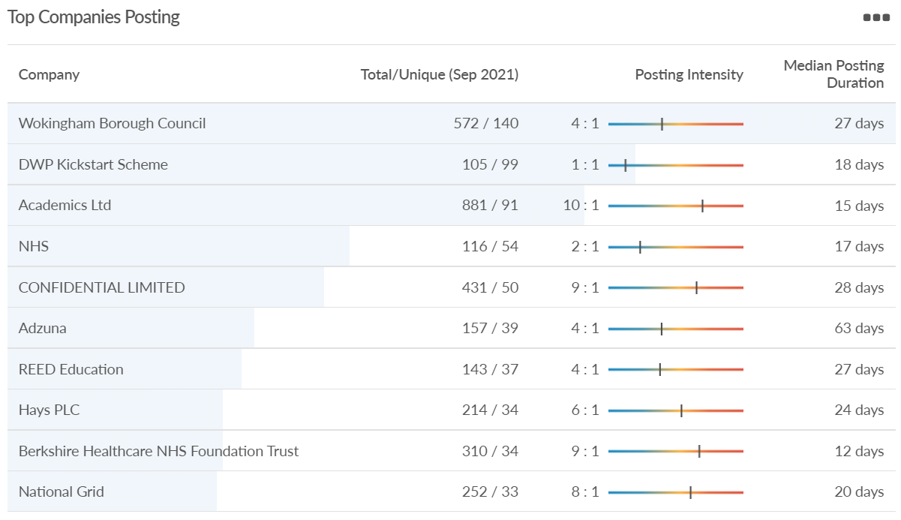
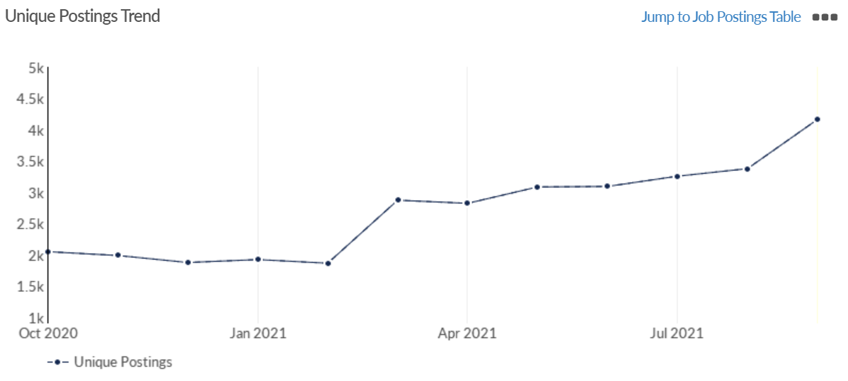
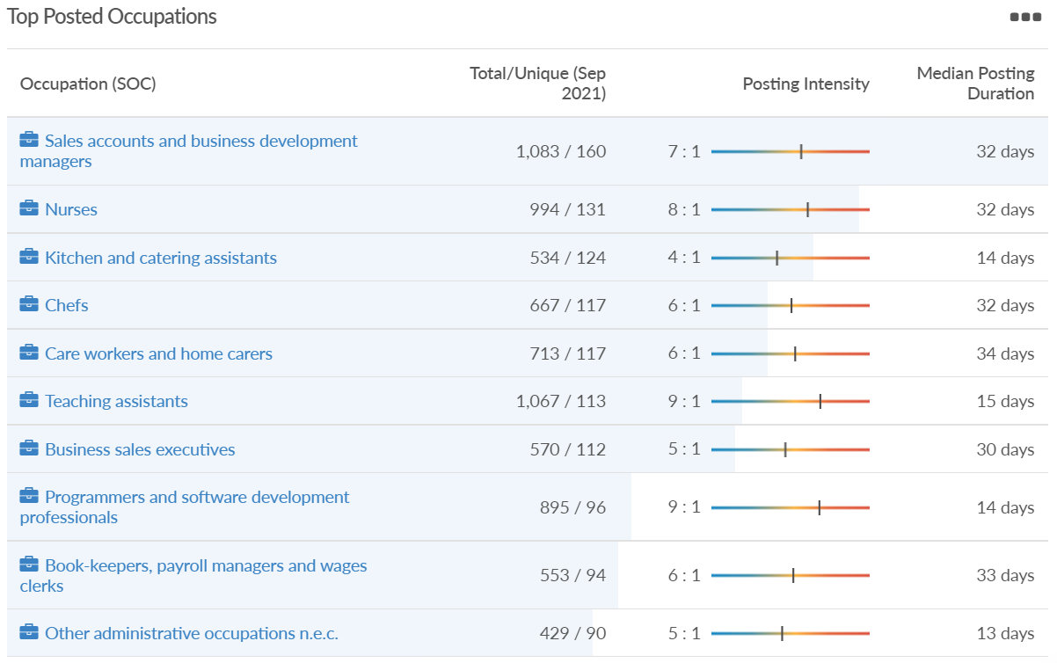
Job posting analytics (EMSI, September 2021)
Unique job postings: 4,166
Total job postings: 23,223
Job posting intensity: 6:1
Unique job postings (September 2020): 2,033

Slide 45
Windsor and Maidenhead

Slide 46
Impact of COVID-19 up to 11th October 2021
COVID-19 cases (to 11th October 2021) – Source: Public Health Berkshire COVID-19 Dashboard, 11th October 2021
16,108 total cases
123 new cases daily
Claimant unemployment (to September 2021)
2,870 claimants (3.1% of the working age population) in Windsor and Maidenhead UA
Notable business news:
Maidenhead-based Made for Drink has secured a £300,000 loan from the Thames Valley Berkshire (TVB) Funding Escalator to develop its product range and create jobs.
Source: Insider Media, September 2021

Slide 47
Industries hit hardest by COVID shutdown
Windsor and Maidenhead appears to be the most severely affected of all the Local Authorities which make up Berkshire in terms of percentage of jobs hit hardest by the COVID shutdowns. This is likely due in part to the enormous hit the leisure/tourism sector has taken and how key of an employer Legoland Windsor to the region.
Source: EMSI, March 2021 (definition for industries hit hardest provided on slide 55)

Slide 48
Industry risks and opportunities (2020-2021)
Critical industries
Food and drink retail: 3,733 employees (17% below the national average)
Energy/utilities: 882 employees (13% below the national average)
Health and social care: 8017 employees (29% below the national average)
Freight/logistics: 748 employees (68% below the national average)
Insurance: 434 employees (48% below the national average)
Banking and financial services: 1,252 employees (39% below the national average)
Sectors most impacted
Hospitality and tourism: 9,437 employees (35% above the national average)
Arts, entertainment and recreation: 4,516 (117% above the national average)
Admin and support: 4,207 (10% below the national average)
Aviation: 11 employees (95% below the national average)
Non-food retail and wholesale: 7,834 (18% above the national average)
Manufacturing: 2,523 (64% below the national average)
Construction: 6,201 (54% above the national average)
Source: EMSI, January 2021

Slide 49
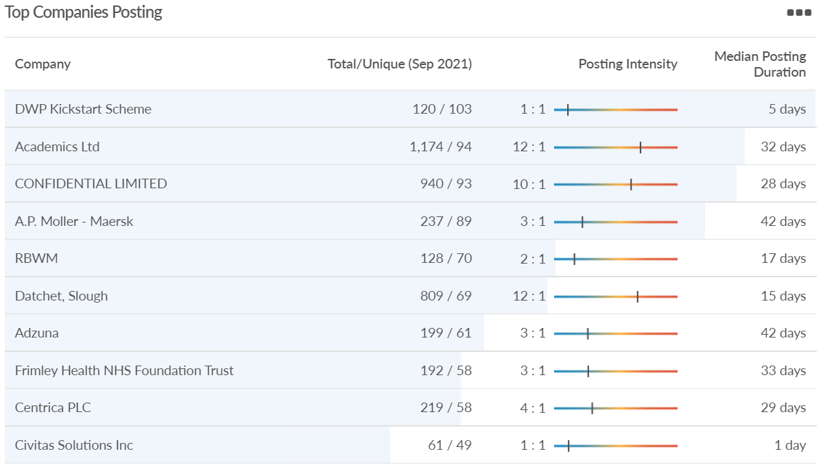
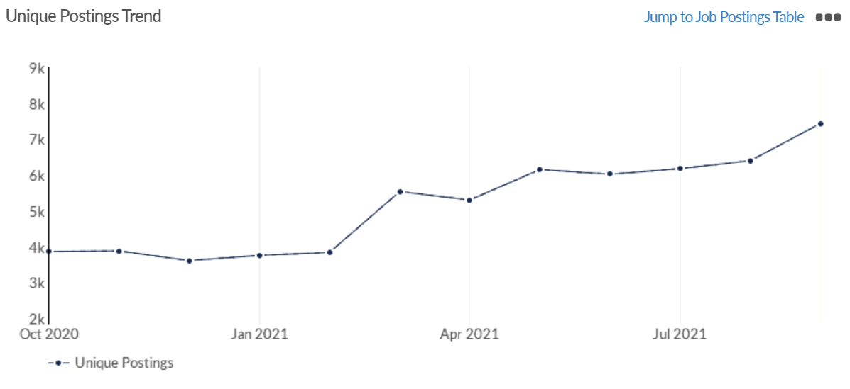
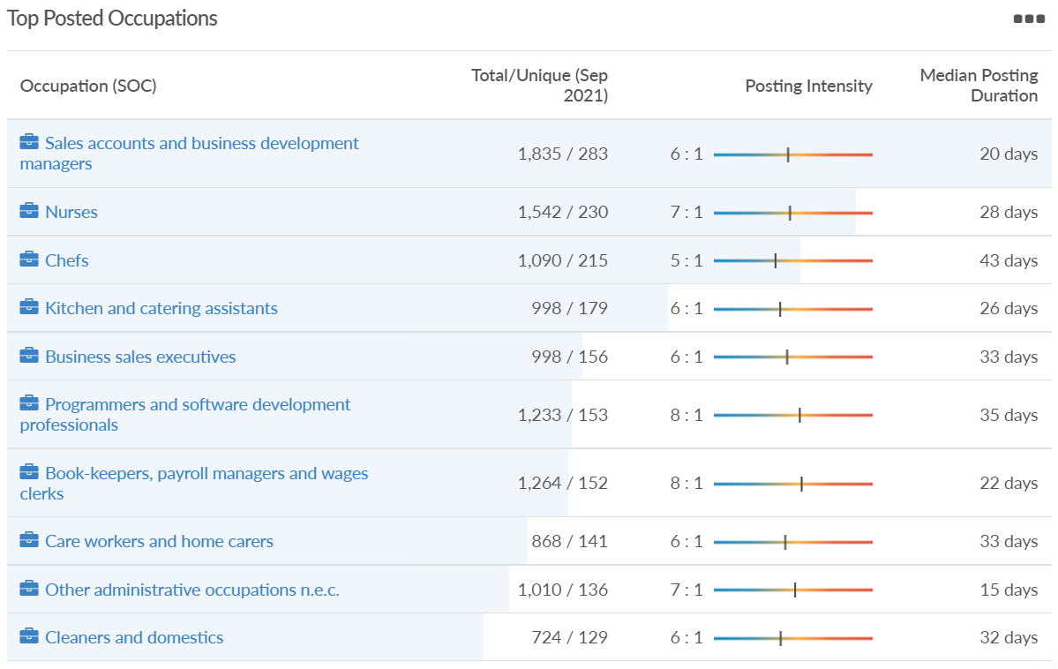
Job posting analytics (EMSI, September 2021)
Unique job postings: 7,442
Total job postings: 52,974
Job posting intensity: 7:1
Unique job postings (September 2020): 3,431

Slide 50
West Berkshire

Slide 51
Impact of COVID-19 up to 11th October 2021
COVID-19 cases (to 11th October 2021) – Source: Public Health Berkshire COVID-19 Dashboard, 11th October 2021
13,082 total cases
94 new case daily
Claimant unemployment (to September 2021)
2,905 claimants (3% of the working age population) in West Berkshire UA
Notable business news:
Pharmaceutical thermal protection specialist Tower Cold Chain is opening a new global headquarters that will be located close to its existing premises in Theale. The 26,000 sq. ft building will greatly expand Tower’s container conditioning and storage capacities, as well as enhancing its design, laboratory and testing capabilities in the development of robust, reliable and reusable temperature-controlled pharmaceutical supply chain solutions.
Source: Business Magazine, September 2021

Slide 52
Industries hit hardest by COVID shutdown
While West Berkshire hasn’t been as fortunate as Slough in terms of how great of a percentage of jobs have been directly affected by the COVID shutdown, it has fared significantly better than the Thames Valley Berkshire area and better than Great Britain.
Source: EMSI, March 2021 (definition for industries hit hardest provided on slide 55)

Slide 53
Industry risks and opportunities (2020-2021)
Critical industries
Food and drink retail: 4,289 employees (17% below the national average)
Energy/utilities: 1,343 employees (14% above the national average)
Health and social care: 6,773 employees (48% below the national average)
Freight/logistics: 1,574 employees (43% below the national average)
Insurance: 262 employees (73% below the national average)
Banking and financial services: 692 employees (71% below the national average)
Sectors most impacted
Hospitality and tourism: 6,617 employees (18% below the national average)
Arts, entertainment and recreation: 2,674 (10% above the national average)
Admin and support: 4,803 (11% below the national average)
Aviation: <10 employees
Non-food retail and wholesale: 8,432 (9% above the national average)
Manufacturing: 11,330 (41% above the national average)
Construction: 4,813 (3% above the national average)
Source: EMSI, January 2021

Slide 54
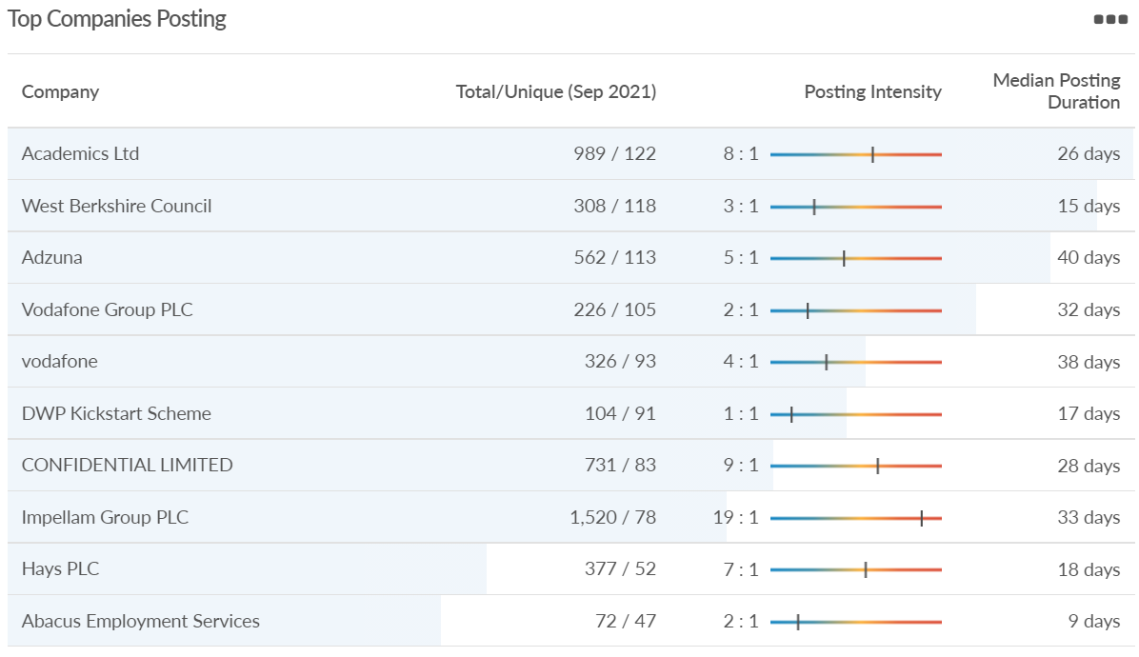
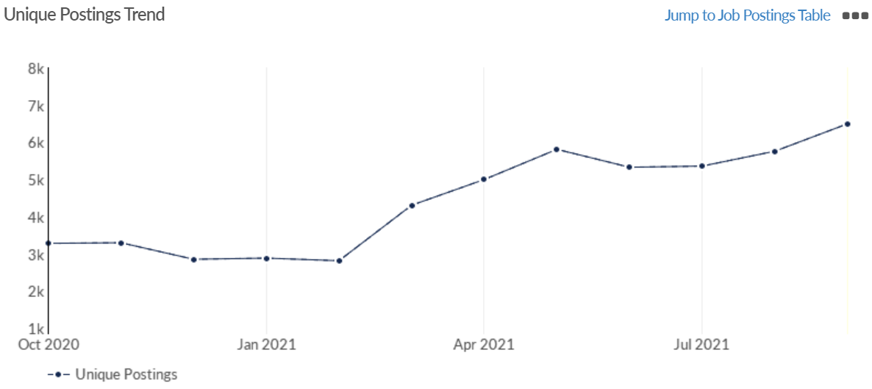
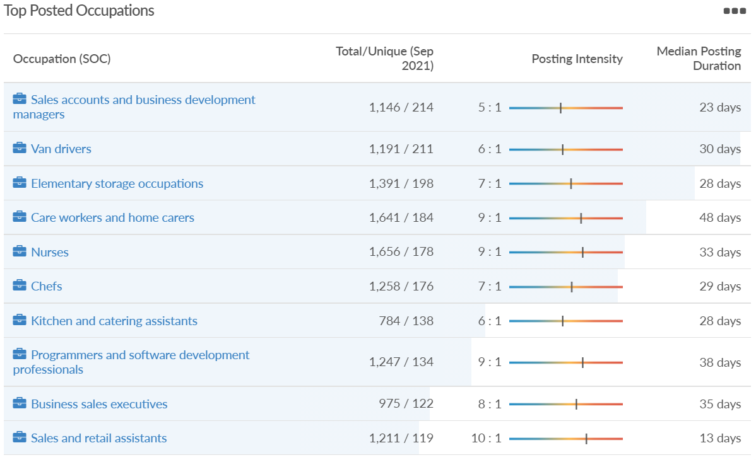
Job posting analytics (EMSI, September 2021)
Unique job postings: 6,495
Total job postings: 39,923
Job posting intensity: 6:1
Unique job postings (September 2020): 2,952

Slide 55
Definitions
Source: Institute for Fiscal Studies, April 2020

