Slide 1
Thames Valley Berkshire Monthly Economic Briefing
February 2022

Slide 2
2022 Refresh
Following on from stakeholder feedback as well as discussions within the LEP over the course of the last year, we have decided to make some additions to the content of our economic briefings, whilst still continuing to report on the bulk of the areas we were last year.
Each month, we aim to have a themed feature. This month we will be looking at the Levelling Up White Paper Response by the Institute of Economic Development.
These monthly economic briefings are constantly evolving documents and their content is dictated in part by data/information requests from our readers.
If there is an economic aspect not currently covered within these reports which you think would be beneficial to include/expand upon (or you have any queries), we will do our best to help. Please contact Dex in the LEP’s research team at dexterlevick@thamesvalleyberkshire.co.uk.

Slide 3
Key contents of this month’s briefing
Updated global and UK economic forecasts
Monthly Event Spotlight – Levelling Up White Paper Response by the Institute of Economic Development
Key points from the latest Labour Force Survey data
Latest claimant count figures by Local Authority
Latest remote working figures for Thames Valley Berkshire
Latest ‘notable business news’ by Local Authority
Latest job posting analytics by Local Authority

Slide 4
Global and National Economy
February 2022

Slide 5
Global Economy
Global real GDP growth is estimated to have reached 5.8% in 2021. In the baseline scenario, global real GDP is expected to increase by 4.2% in 2022 (with a range of 3.2-4.2%) and by 3.4% in 2023 (with a range of 2.2-4.6%).
The 2022 global growth forecast represents a 0.6 percentage point downgrade from forecasts in Q4 2021. The downgrade is driven by the emergence of the new highly infectious Omicron COVID-19 variant, the greater expected persistence of current supply constraints, lower than expected fiscal stimulus in the US and worsening conditions in the real estate sector in China.
The global economy remains constrained by the ongoing negative effects of the pandemic, major supply bottlenecks and high commodity and energy prices. Growing problems in China’s real estate and consumer sectors and rising geopolitical uncertainty in Europe surrounding the Russia-Ukraine conflict are also raising downside risks, in addition to the pandemic and inflation uncertainty. Source: Euromonitor International, February 2022

Slide 6
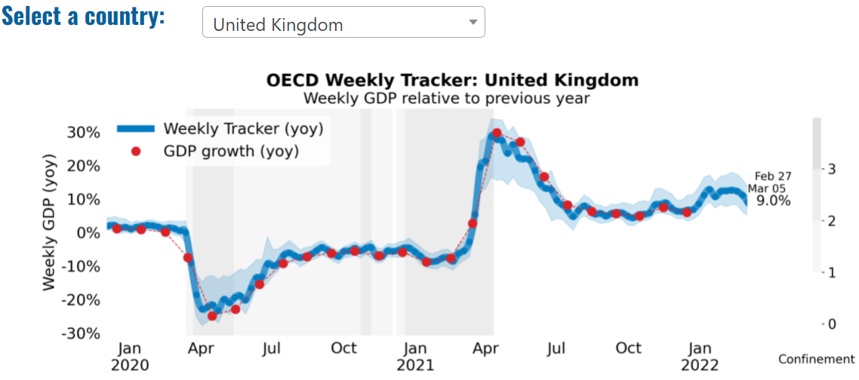
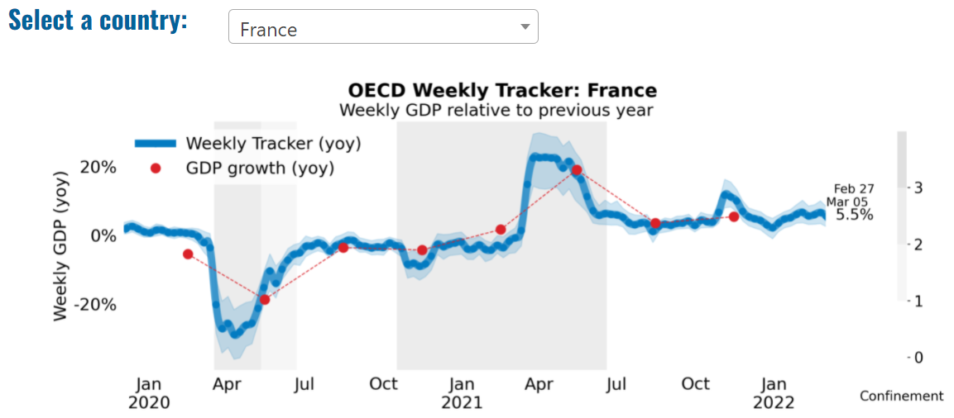
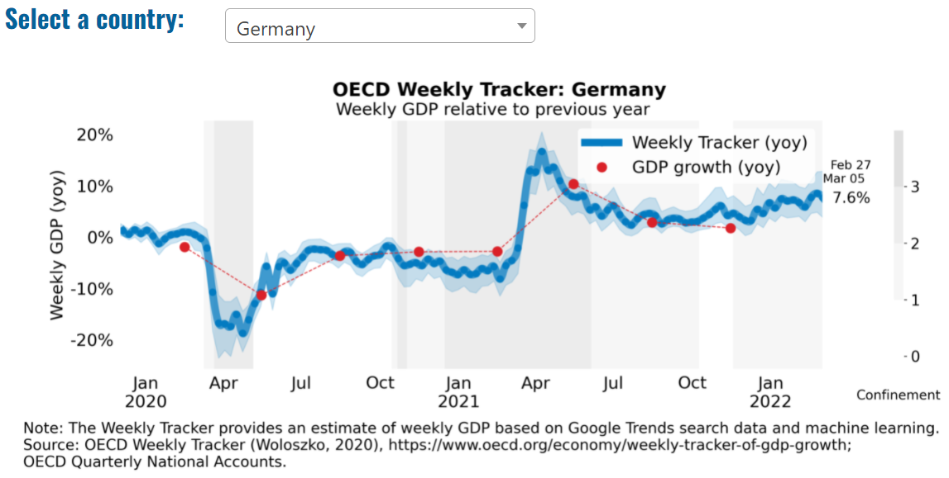
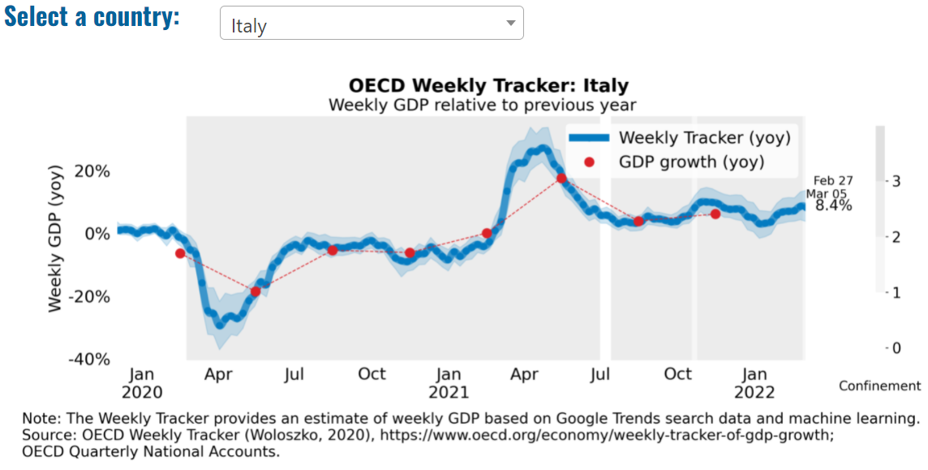
Global Economy – OECD GDP Tracker

Slide 7
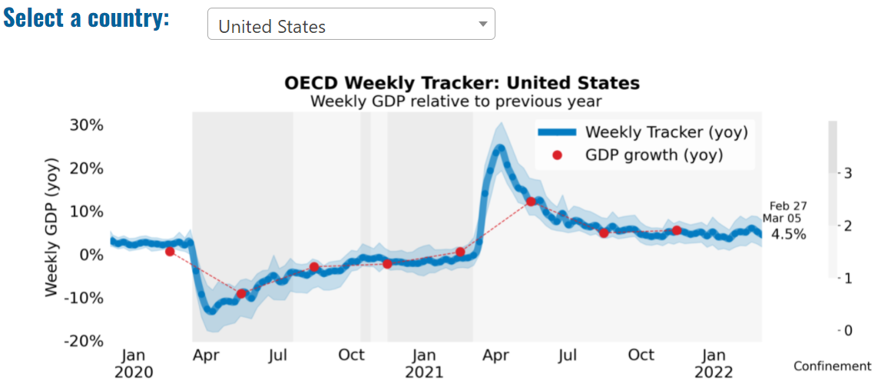
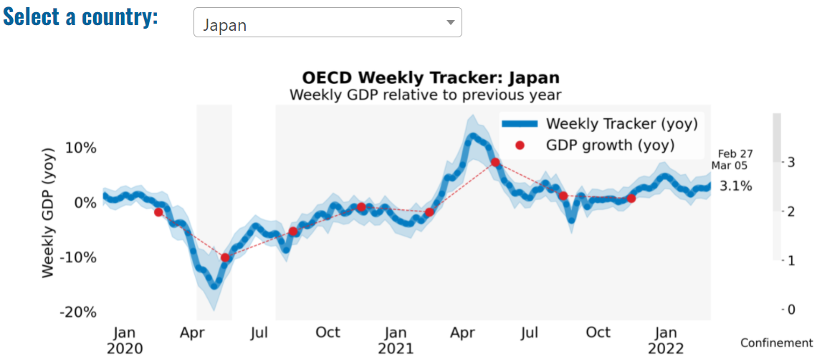
Global Economy – OECD GDP Tracker Continued
Note: The green confidence band shows 95% confidence intervals. The Weekly Tracker is an estimate of weekly GDP relative to the pre-crisis trend, which is proxied by the November 2019 OECD Economic Outlook forecasts. The darkness of the grey background reflects stay-at-home confinement requirement based on the Oxford Blavatnik database (0 - no measures, 1 - recommend not leaving house, 2 - require not leaving house with exceptions, 3 - require not leaving house with minimal exceptions).
Source: OECD, February 2022

Slide 8
UK Economy
The UK economy continues to recover. In November last year, economic activity was back to where it was before the pandemic. Since then, the spread of Omicron meant people spent less. But as the number of new cases falls, we expect spending to go up again. The number of people out of work is going down. The unemployment rate is only slightly higher than it was before the start of the pandemic. Inflation has risen above our 2% target. Prices rose by 5.4% last year.
Higher energy prices is one of the main reasons for this. Large increases in oil and gas prices have pushed up petrol prices and utility bills. Higher prices for goods that we buy from abroad have also played a big role.
We expect inflation to rise to around 7% in the spring. We expect inflation to fall back from the middle of this year. We don’t expect that energy prices will continue to rise as fast, and the shortages that are currently making it difficult for businesses to make their products should ease. We expect inflation to be close to our target in around two years’ time.
We have raised the official interest rate we set, known as Bank Rate, to 0.5% to support inflation returning to our 2% target. We may need to raise interest rates somewhat further. Our job is to ensure that inflation returns to our target in a sustainable way.
Source: Bank of England, February 2022

Slide 9
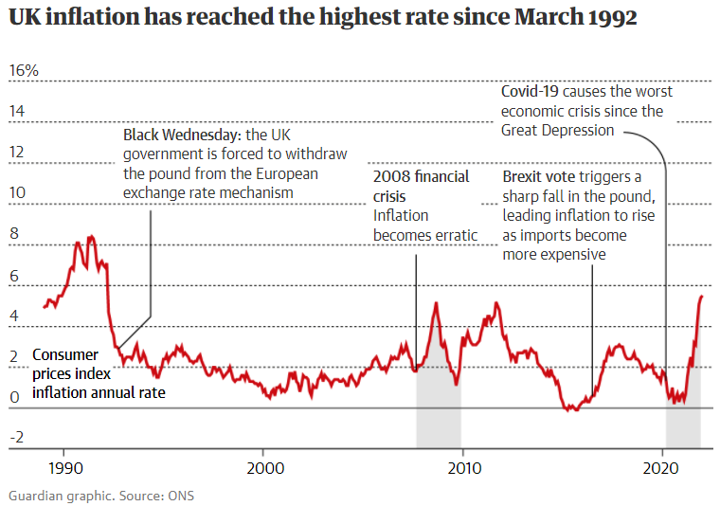
UK Economy 2
Britain’s hard-pressed households have been warned to expect a fresh squeeze on their living standards in the coming months after the annual inflation rate climbed for a 13th month to its highest point in almost 30 years.
Economists said they expected the government’s preferred measure of the yearly jump in the cost of living – the consumer prices index – to rise from 5.5% in January to almost 8% in April when household energy bills will soar by hundreds of pounds.
Source: The Guardian, January 2022

Slide 10
UK Economy 3
UK GDP growth forecast for 2022 is 3.6%, 1.3% in 2023 and 1.2% in 2024
Following Q4 2021 growth of 1.0%, quarter-on-quarter GDP growth is forecast to slow to 0.7% in Q1 2022, then to 0.2% in Q2 and 0.1% growth in Q3
Household consumption forecast is for growth of 4.4% in 2022, growth of 1.3% for 2023 and 1.2% in 2024
Business investment forecast is to grow by 3.5% in 2022 before halving to 1.6% in 2023, amid the end of the super deduction and the corporation tax rise, and slowing again to 1.5% in 2024
BCC expects export growth of 4.2% in 2022, 1.6% in 2023 and 1.6% in 2024, compared to import growth of 4.7%, 1.6% and 1.5%
BCC expects a UK unemployment rate of 4.0% in 2022 and 2023, before easing slightly to 3.9% in 2024
CPI inflation is forecast to peak at 8.0% in Q2 2022, before easing to 5.5% by the end of the year. Inflation is expected to drop back to the Bank of England’s 2% target in Q4 2024
UK official interest rates are expected to rise to Q3 2022 to 0.75%, then to 1.00% in Q4 2022, ending the forecast period at 1.50%
Source: British Chambers, February 2022

Slide 11
Monthly Event Spotlight: Levelling Up White Paper Response by the Institute of Economic Development, 28th February 2022 1/2
Mark Bretton, Chair of the LEP Network
Over the last 11 years, £20bn has been allocated to us, but this has been more than matched through private sector funds we have leveraged.
LEP leaders have shown dedication and resolution, especially over the last 11 months when going through yet another LEP review. We must be the most scrutinised and reviewed local economic development body in the country.
The affirmation of the “vital role of LEPs” in the White Paper is important; but we need to resolve the financial question.
LEPs are involved in core policy issues following the White Paper, for the first time.
The White Paper includes serious policy ideas; a striking comment from journalist and academic Will Hutton noted that the first two thirds was among best analysis of the challenges we face that he has read.
On the role of LEPs: government acknowledges a future role for us; our value is in the Levelling Up vision; it recognises our convening power. It is important to retain the key strengths of LEPs. The devil is in the detail, but the course is set for greater devolution. A key issue is to convince businesses that their efforts are having an effect and it is worth them keeping involved.
There is no single model that will fit all scenarios. The journey to devolution for many will be a long one. In some places, there will be no more appetite for Mayors or County Deals in future than there is now.
Pre-event report available here: ‘Levelling Up: Pre-White Paper Perspectives’, Institute of Economic Development

Slide 12
Monthly Event Spotlight: Levelling Up White Paper Response by the Institute of Economic Development, 28th February 2022 2/2
Greg Clark
I came into politics motivated to ensure the whole country can reach its potential. I set up LEPs and did the first City Deals. These became local growth deals, devo deals. As Business Secretary, I developed an industrial strategy. There was a reliance on local growth within this. Pillars of the industrial strategy were around science and innovation, skills, infrastructure and a competitive business environment.
Both Boris Johnson and Michael Gove are very commited to the Levelling Up agenda. A big part of their analysis of the political project that is this government is that we will never achieve our potential unless every part of the country achieves its potential.
There is some unfinished business about the White Paper: there is no significant central effort for local government reorganisation. Boris Johnson could have used some of his political capital and parliamentary majority to push unitary authorities. I became convinced that a unitary model was the most effective model.
To have survived what could have been a hacking back of the role of LEPs is very significant. There has been some momentum in the last couple of years, but Local Industrial Strategies don’t have the degree of national prominence that they should have.
There is not a great deal of extra money. Money isn’t everything, but it helps, and continued resistance to tax raising powers means there are some limits on the amount of transformation that can be achieved. The question is: How to Level Up with resources that are pretty limited.
Pre-event report available here: ‘Levelling Up: Pre-White Paper Perspectives’, Institute of Economic Development

Slide 13
Employment in the UK: Labour Force Survey – February 2022
Key points:
October to December 2021 estimates show a continuing recovery in the labour market compared with the previous three-month period (July to September 2021), with an increase in the employment rate and a decrease in the unemployment rate, however, the economic inactivity rate increased on the quarter.
The UK employment rate was estimated at 75.5%, 0.1 percentage points higher than the previous three-month period, but 1.0 percentage points lower than before the coronavirus pandemic (December 2019 to February 2020).
The UK unemployment rate was estimated at 4.1%, 0.2 percentage points lower than the previous three-month period, but 0.1 percentage points higher than before the coronavirus pandemic.
The UK economic inactivity rate was estimated at 21.2%, 0.1 percentage points higher than the previous quarter, and 1.0 percentage point higher than before the coronavirus pandemic.
Source: ONS, February 2022

Slide 14
Coronavirus and Recession: Implications for Thames Valley Berkshire

Slide 15
Claimant Count (Latest data - January 2021)
Total of 19,615 claimants (3.4% of the working age population) in Thames Valley Berkshire
2,020 claimants (2.5% of the working age population) in Bracknell Forest UA
5,690 claimants (6% of the working age population) in Slough UA
4,890 claimants (4.6% of the working age population) in Reading UA
2,030 claimants (1.9% of the working age population) in Wokingham UA
2,490 claimants (2.7% of the working age population) in Windsor and Maidenhead UA
2,490 claimants (2.6% of the working age population) in West Berkshire UA
Across Thames Valley Berkshire, claimant unemployment has fallen significantly from 29,380 in December 2020 to 19,615 in January 2022. Slough had 6% of its working age population claim unemployment in January 2022, down significantly from 8.4% in January 2021.
Source: ONS, January 2021

Slide 16
Strategic Issues: Heathrow
Heathrow Airport:
Heathrow has reported that passenger numbers fell to 19.4 million last year, the lowest since 1972. Cumultative losses during the pandemic reached £3.8 billion, despite having cut £870 million in costs, due to lower passengers and high fixed costs. The airport said it was the only European hub to see a reduction in traffic last year, blaming the UK’s tighter travel restrictions than EU countries.
Passenger numbers are currently 23 per cent behind forecast, with lower-than-expected numbers in January and February, but the airport expects a surge in outbound tourism over the summer and plans to meet its target of 45.5 million passengers. The airport said that the removal of Covid testing requirements has also increased demand among UK travelers.
To aid the recovery, the airport plans to reopen Terminal 4 by July and is working with airline partners to ramp up operations. Nonetheless, the airport says that inbound tourism and business travel remain key challenges, with 63 per cent of its markets retaining some form of travel restrictions or testing requirements.
Source: Business Traveller, February 2022

Slide 17
An important note on the EMSI figures contained on the following slides: 23, 27, 30, 33, 36, 39 and 42
There appears to have been a methodological change in how EMSI calculates job posting figures between the latest February numbers and those from the months prior. Those of you who have read previous economic briefings from Thames Valley Berkshire LEP may notice that the job posting figures contained in this month's briefing are lower across the board – in some cases quite significantly.
We are still reporting on these figures, but with the caveat outlined above and will be following up with EMSI to understand why this change seems to have taken place. With this considered, we ask that readers make their own judgement concerning how much they infer from this month’s job posting figures until we have been able to gain clarification on the situation.

Slide 18
Remote working
In February of 2022, there were 3,674 unique job postings for remote positions at companies based in Berkshire, around 28% more than the figure of 2,875 for the same period one year before.
Compare this with the South-East, in February 2022 there were 21,829 unique remote job postings for remote positions; rising from 15,950 in February of the previous year – an increase of over 37%.
A rise can also be seen at national level, with a recorded 150,979 unique remote job postings in England in February of 2022, rising from 102,012 in February 2021 – an increase of over 48%.
From these figures it’s apparent that the COVID-19 pandemic has, somewhat unsurprisingly, prompted a massive boost in job postings for explicitly remote roles. Berkshire has seen a smaller boost in vacancies which are remote-based than both the South-East and England.
Source: EMSI, February 2022

Slide 19
Local Profiles

Slide 20
Bracknell Forest

Slide 21
Impact of COVID-19 up to 9th March 2022
COVID-19 cases (to 9th March 2022) – Source: Public Health Berkshire COVID-19 Dashboard, 9th March 2022
36,437 total cases
153 new cases daily
Claimant unemployment (to January 2022)
2,020 claimants (2.5% of the working age population) in Bracknell Forest UA
Notable business news:
Bracknell Forest Business Survey 2021 results are in - LINK:
Over the next year:
around 50% of Bracknell Forest businesses expect their performance to improve with only 6% anticipating a deterioration
around 20% expect their performance to remain stable
around 50% of Bracknell Forest businesses were able to mention at least one positive impact of COVID-19 on their business
56% said they expect their operations to stay the same over the next 3 years, whereas 35% expected an increase
while 51% of businesses have the intention of being more environmentally friendly, just 12% have a specific target or aim to achieve net-zero and just 5% have set a deadline to this commitment

Slide 22
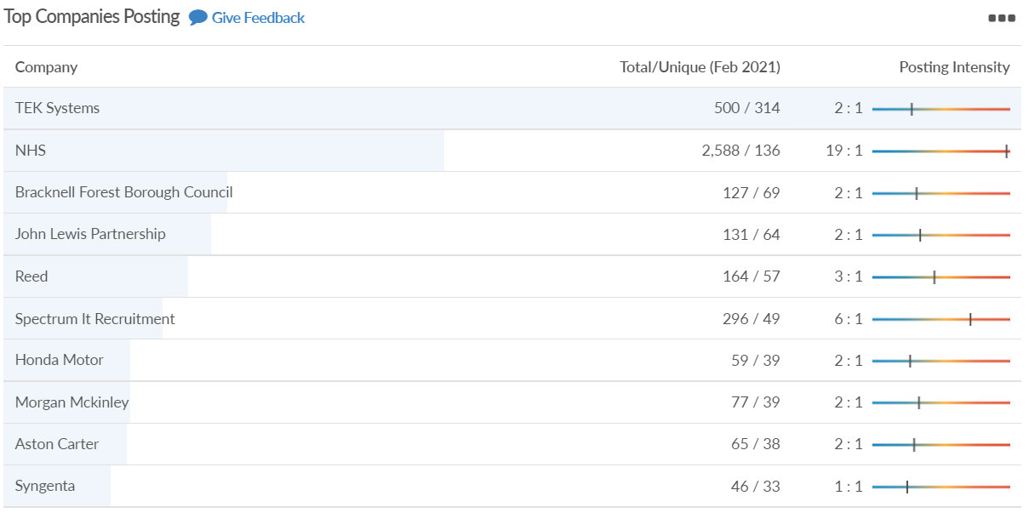
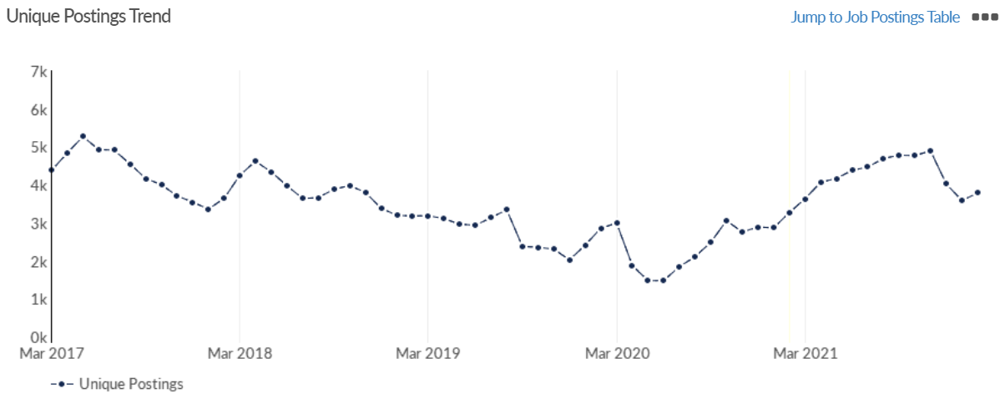
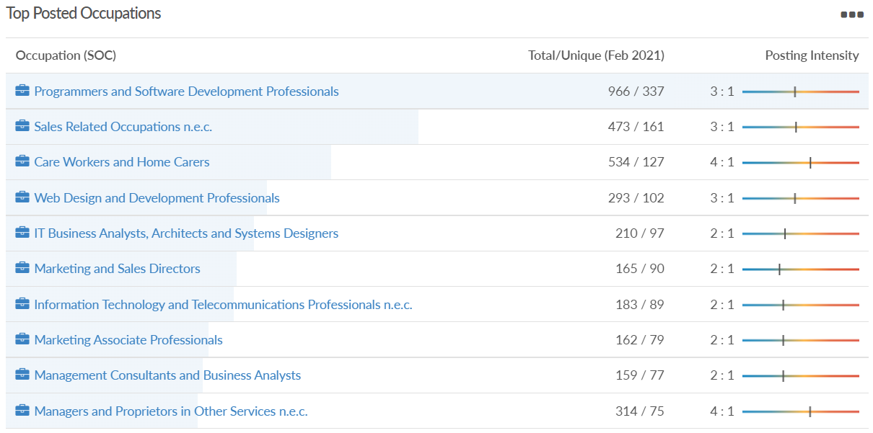
Job posting analytics (EMSI, February 2022)
Unique job postings: 3,786
Total job postings: 9,151
Job posting intensity: 2:1
Unique job postings (February 2021): 3,269

Slide 23
Slough

Slide 24
Impact of COVID-19 up to 9th March 2022
COVID-19 cases (to 9th March 2022) – Source: Public Health Berkshire COVID-19 Dashboard, 9th March 2022
48,050 total cases
102 new cases daily
Claimant unemployment (to January 2022)
5,690 claimants (6% of the working age population) in Slough UA
Notable business news:
Plans have been approved for SEGRO to develop the first multi-storey industrial development on the Slough Trading Estate. Known as SEGRO V-Park Leigh Road, the seven-storey building will provide industrial workspace for a range of businesses, including small enterprises and start-ups. The scheme represents the next phase of the evolution of the Slough Trading Estate and will be tailored to support the operation and growth of an anticipated 50 to 70 SME occupiers and providing almost 400 jobs. In line with the company's Responsible SEGRO commitment to champion low carbon growth, the building will feature the latest in sustainable features, including a green roof and solar panels to generate power.– LINK.

Slide 25
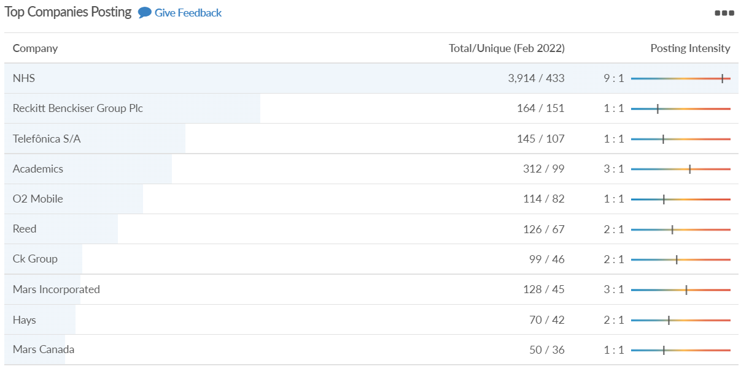
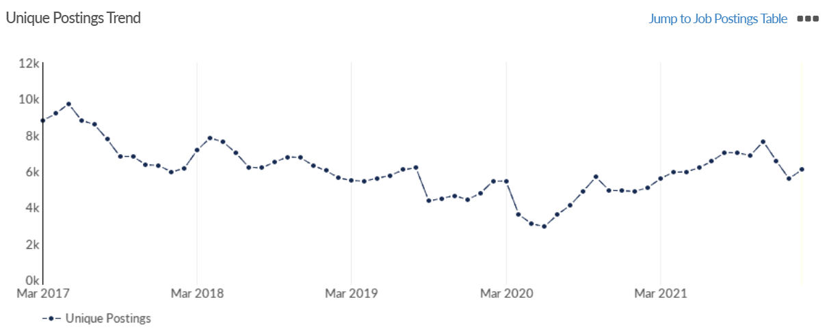
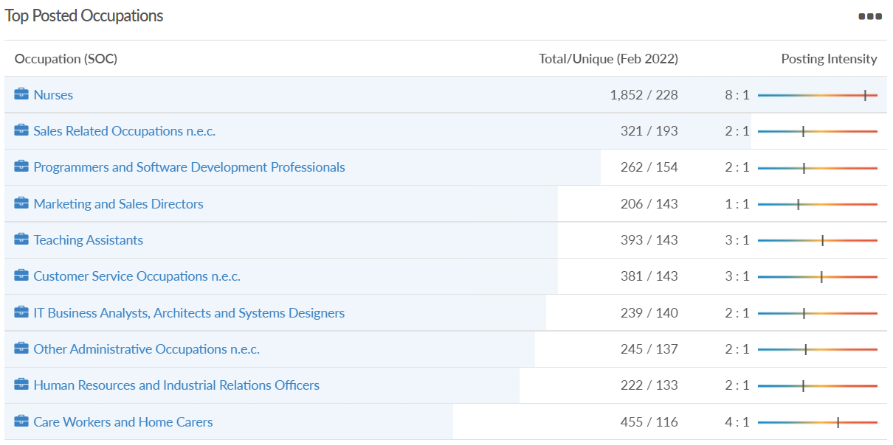
Job posting analytics (EMSI, February 2022)
Unique job postings: 6,082
Total job postings: 14,731
Job posting intensity: 2:1
Unique job postings (February 2021): 5,082

Slide 26
Reading

Slide 27
Impact of COVID-19 up to 9th March 2022
COVID-19 cases (to 9th March 2022) – Source: Public Health Berkshire COVID-19 Dashboard, 9th March 2022
50,862 total cases
157 new case daily
Claimant unemployment (to January 2022)
4,890 claimants (4.6% of the working age population) in Reading UA
Notable business news:
After many delays due to the pandemic, Green Park Station in Reading is expected to finish work soon. The construction project, headed by Reading Borough Council, began in the spring of 2019, had been delayed by the Covid-19 pandemic in 2020. The £20 million station is said to be "progressing well". So far, a pair of 150 metre platforms, a station building, an overbridge, bus interchange, parking facilities and two car parks have been erected. The new Green Park Station will be situated on the Reading to Basingstoke line and there will be a half-hourly service between the towns throughout the day – LINK.

Slide 28
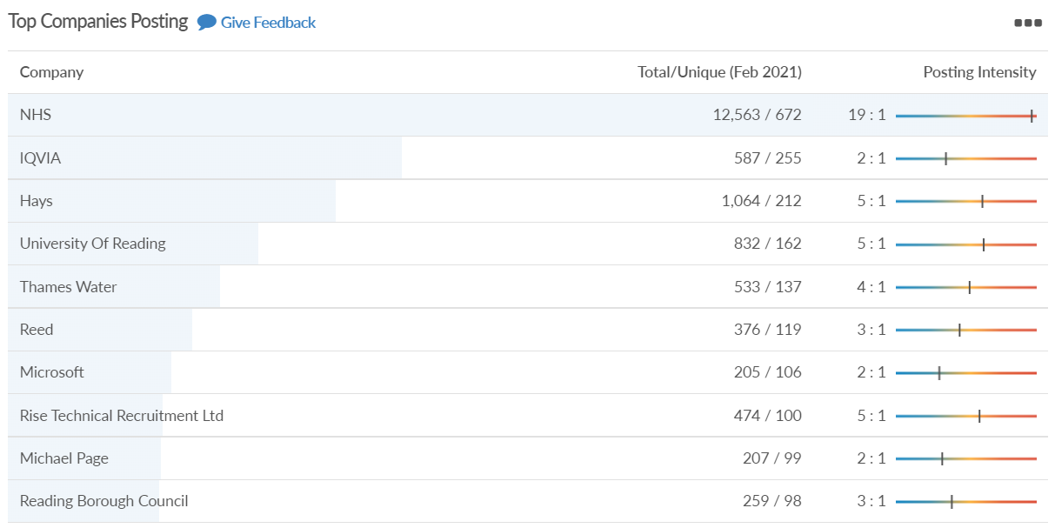
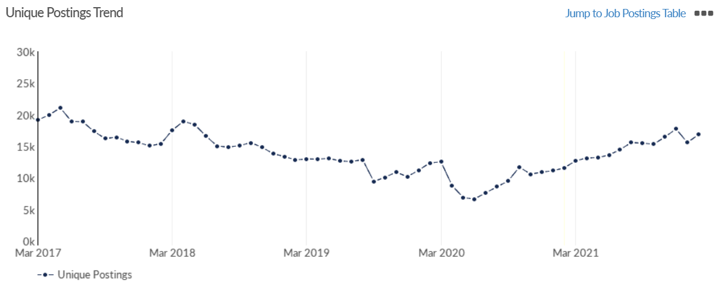
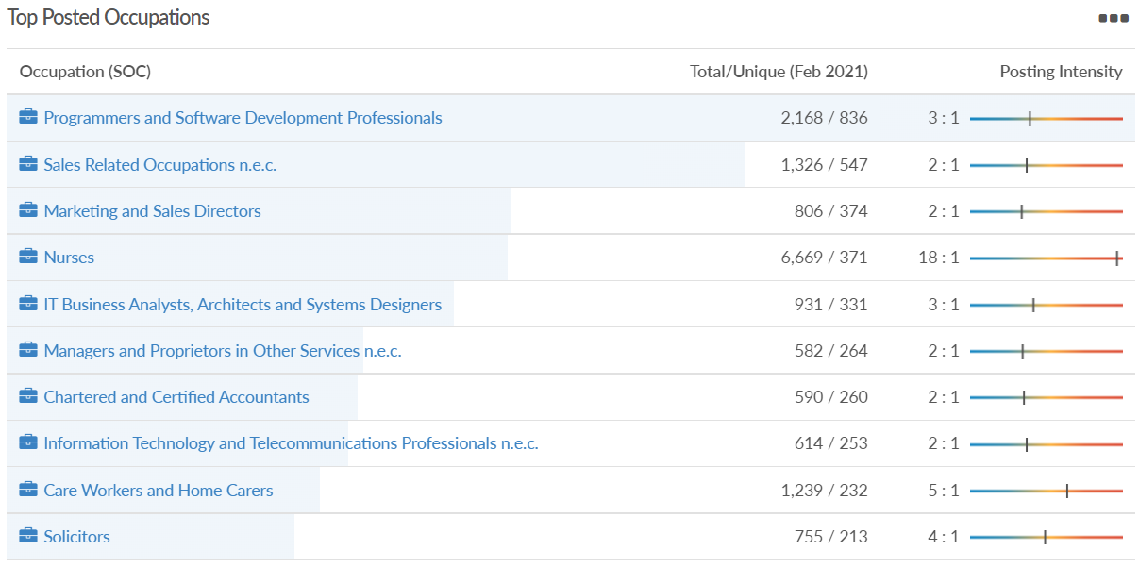
Job posting analytics (EMSI, February 2022)
Unique job postings: 16,849
Total job postings: 41,108
Job posting intensity: 2:1
Unique job postings (February 2021): 11,575

Slide 29
Wokingham

Slide 30
Impact of COVID-19 up to 9th March 2022
COVID-19 cases (to 9th March 2022) – Source: Public Health Berkshire COVID-19 Dashboard, 9th March 2022
50,498 total cases
210 new cases daily
Claimant unemployment (to January 2022)
2,030 claimants (1.9% of the working age population) in Wokingham UA
Notable business news:
Two new Midcounties Co-operative stores open in Wokingham under £1 million investment scheme. The two new shops will each create 20 new job roles for those who live in and around Wokingham. The new stores were built as part of a Midcounties Co-operative joint investment scheme that received more than £1.1 million. The Society invested more than £3.5 million in opening seven new stores in 2021 and has committed to a further £5 million and ten new store openings this year – LINK.

Slide 31
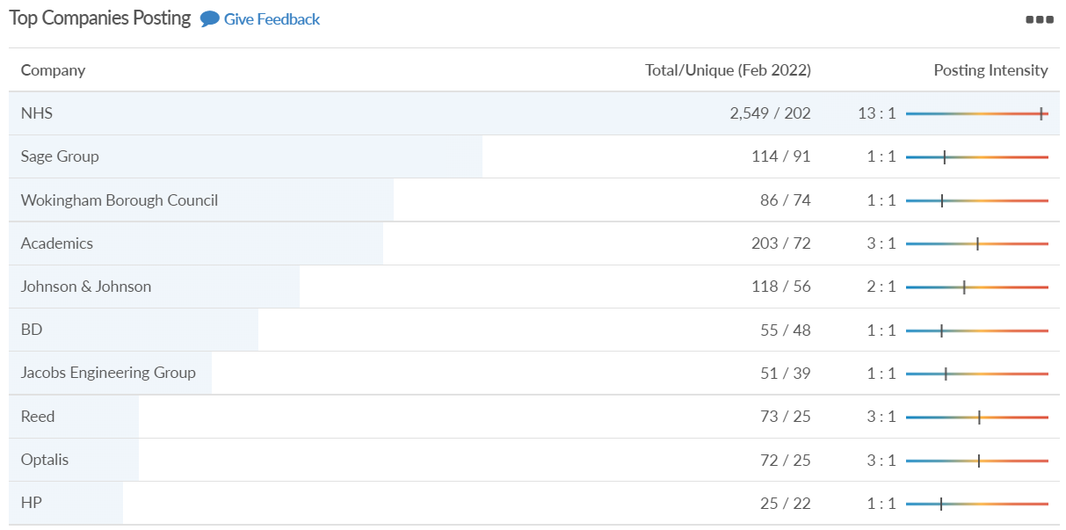
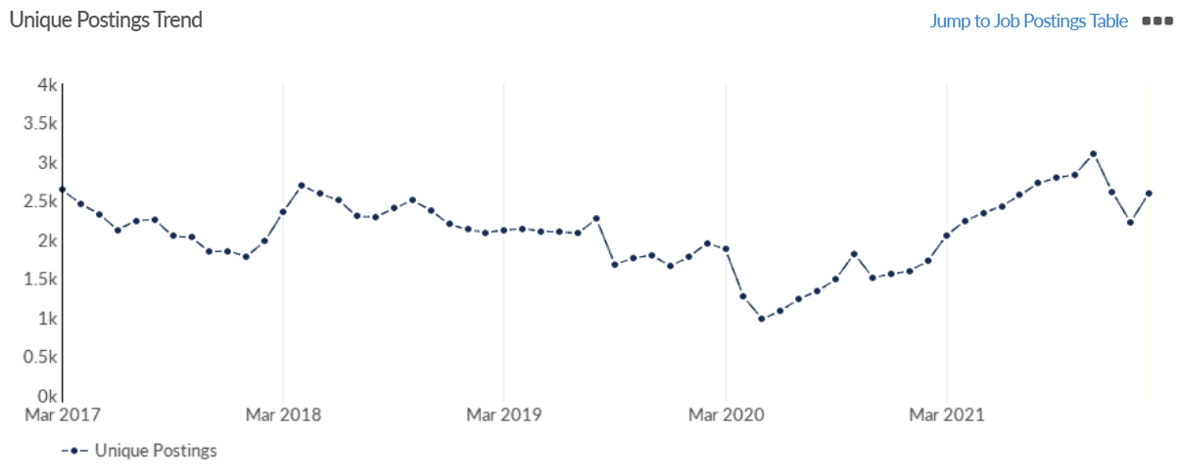
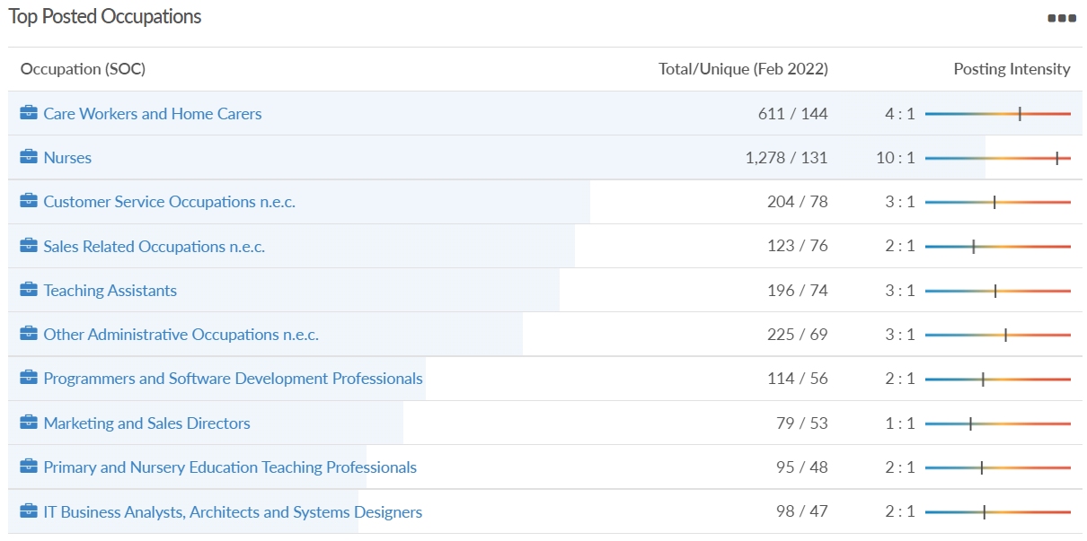
Job posting analytics (EMSI, February 2022)
Unique job postings: 2,596
Total job postings: 7,220
Job posting intensity: 3:1
Unique job postings (February 2021): 1,725

Slide 32
Windsor and Maidenhead

Slide 33
Impact of COVID-19 up to 9th March 2022
COVID-19 cases (to 9th March 2022) – Source: Public Health Berkshire COVID-19 Dashboard, 9th March 2022
44,421 total cases
156 new cases daily
Claimant unemployment (to January 2022)
2,490 claimants (2.7% of the working age population) in Windsor and Maidenhead UA
Notable business news:
Maidenhead and Windsor Council have updated their electric vehicle charging infrastructure with the introduction of more than 25 new fast charging points. The pilot project is being completed in partnership with charging infrastructure firm, Connected Kerb. The project is majority funded by the Office for Zero Emissions Vehicles (OZEV) – LINK.

Slide 34
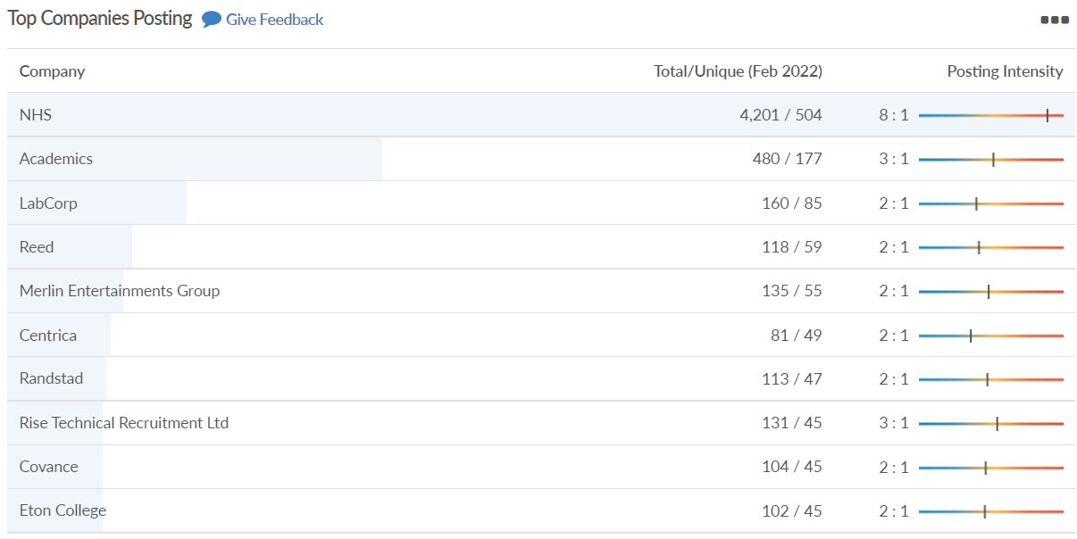
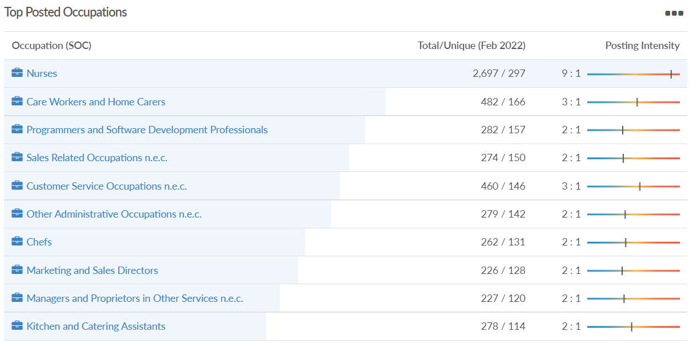
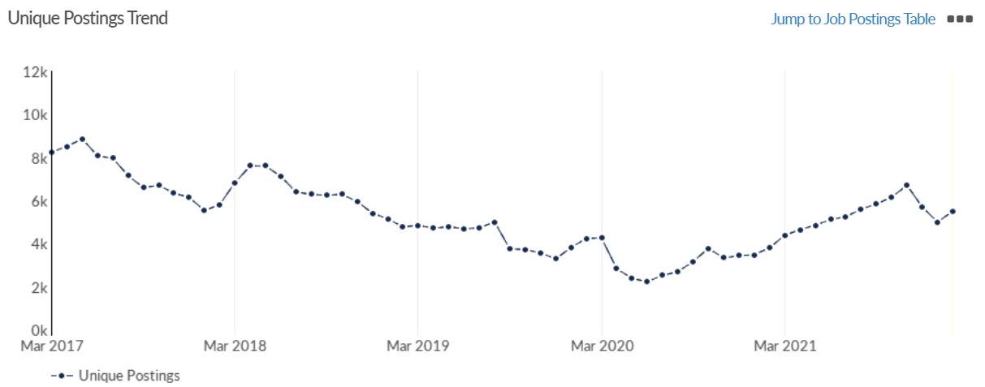
Job posting analytics (EMSI, February 2022)
Unique job postings: 5,504
Total job postings: 14,224
Job posting intensity: 3:1
Unique job postings (February 2021): 3,483

Slide 35
West Berkshire

Slide 36
Impact of COVID-19 up to 9th March 2022
COVID-19 cases (to 9th March 2022) – Source: Public Health Berkshire COVID-19 Dashboard, 9th March 2022
40,965 total cases
232 new case daily
Claimant unemployment (to January 2022)
2,490 claimants (2.6% of the working age population) in West Berkshire UA
Notable business news:
Vodafone's chief executive has confirmed the telecoms giant is in consolidation talks in its European markets. The Newbury-headquartered firm has been linked with a merger with Three, which is in the process of moving to new offices in Reading's Green Park, with consolidations with its rivals in Germany, Spain and Italy also mooted. Nick Read told the Guardian: "There has been media speculation about merger and acquisition activity in specific European markets. We feel the UK needs to consolidate to give [us] industrial scale so we can improve returns. We are active on a number of fronts and seeing good engagement from our counterparties, which confirms that we have a series of potential opportunities to shape the business with stronger assets in healthier markets and unlock value for our shareholders. We are approaching consolidation with speed and resolve” – LINK.

Slide 37
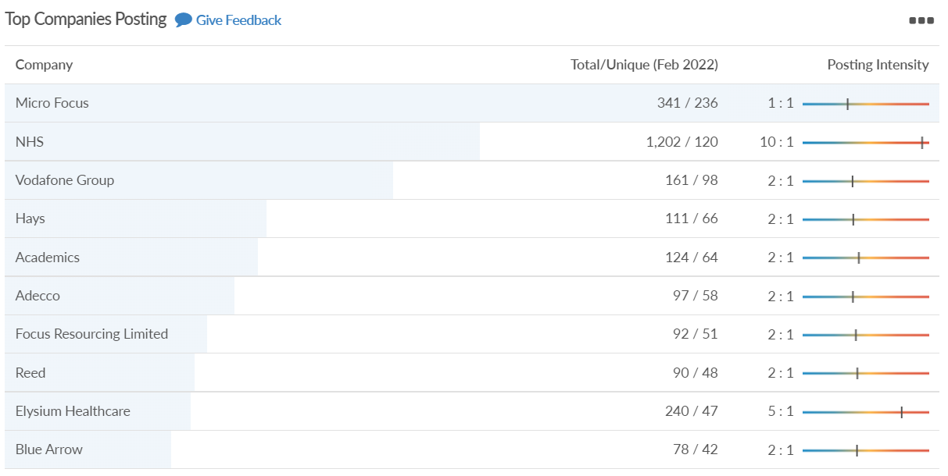
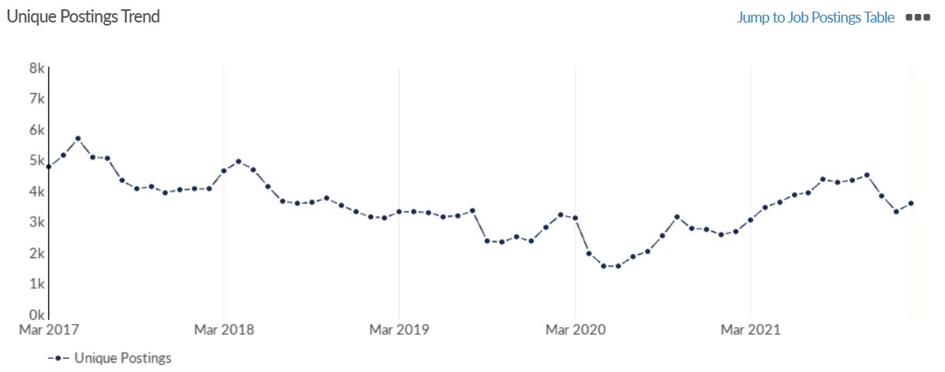
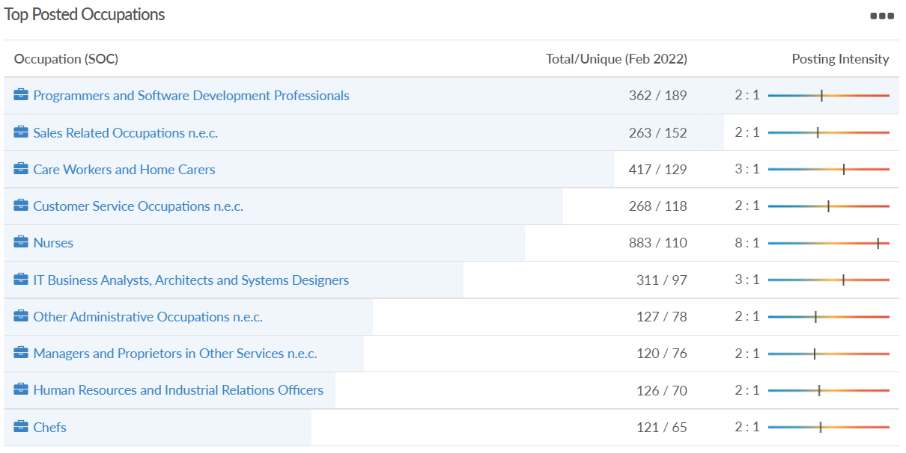
Job posting analytics (EMSI, February 2022)
Unique job postings: 3,588
Total job postings: 8,185
Job posting intensity: 2:1
Unique job postings (February 2021): 2,682

