Slide 1
Thames Valley Berkshire Monthly Economic Briefing
May 2022

Slide 2
2022 Refresh
Following on from stakeholder feedback as well as discussions within the LEP over the course of the last year, we have decided to make some additions to the content of our economic briefings, whilst still continuing to report on the bulk of the areas we were last year.
Each month, we aim to have a themed feature. This month we will be looking at the Resolution Foundations’ ‘Green Growth’ event.
These monthly economic briefings are constantly evolving documents and their content is dictated in part by data/information requests from our readers.
If there is an economic aspect not currently covered within these reports which you think would be beneficial to include/expand upon (or you have any queries), we will do our best to help. Please contact Dex in the LEP’s research team at dexterlevick@thamesvalleyberkshire.co.uk.

Slide 3
Key contents of this month’s briefing
Updated global and UK economic forecasts
Monthly Event Spotlight – Resolution Foundations’ ‘Green Growth’ event.
Key points from the latest Labour Force Survey data
Latest claimant count figures by Local Authority
Latest remote working figures for Thames Valley Berkshire
Latest ‘notable business news’ by Local Authority
Latest job posting analytics by Local Authority

Slide 4
Global and National Economy
May 2022

Slide 5
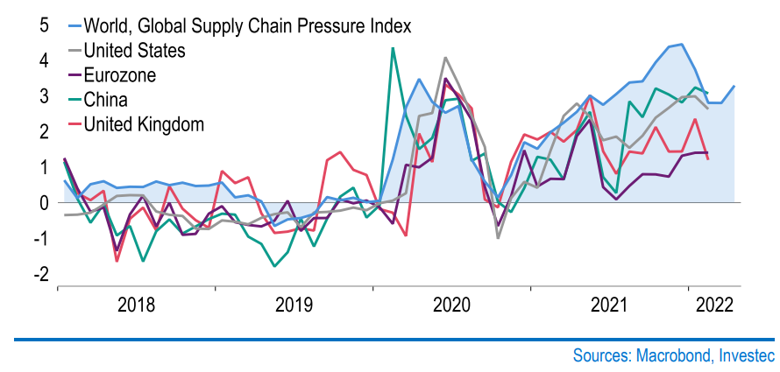
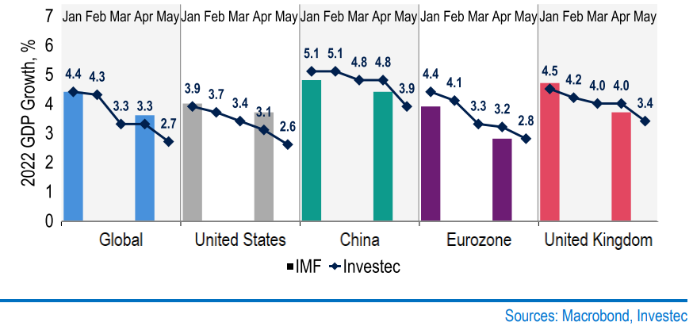
Global growth Outlook has worsened
The war in Ukraine looks set to be protracted, and Chinese economic activity is stagnant due to lockdowns. This will hamper supply chains and add to inflationary pressure, which further fuels general predictions of a global slowdown.
Increased pressure on global supply chain
Downgraded GDP growth forecasts
Due to the lockdowns in China, the manufacturing output experienced a significant decrease, which undoubtedly put a negative impact on the global supply chains.
Investec’s global growth forecast for May 2022 was reduced to 2.7%. This is due to soaring inflation and real income squeeze, which is in part a result of greatly increased energy costs.
Global Supply Chain Pressure Index (GSCPI) integrates transportation cost data and manufacturing indicators to provide a gauge of global supply chain conditions.
Source: Investec, May 2022

Slide 6
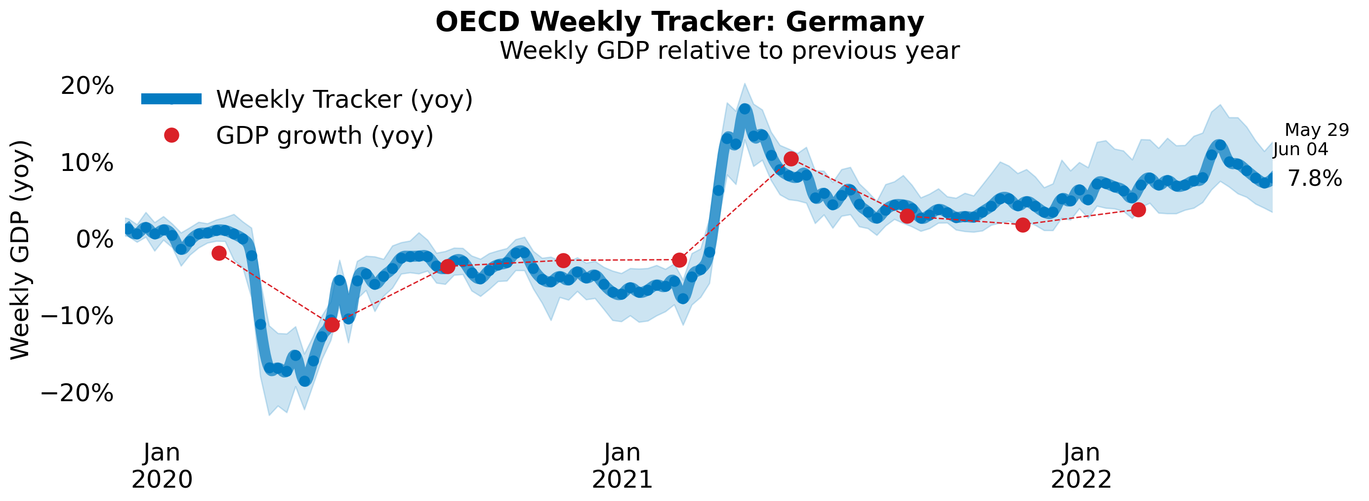
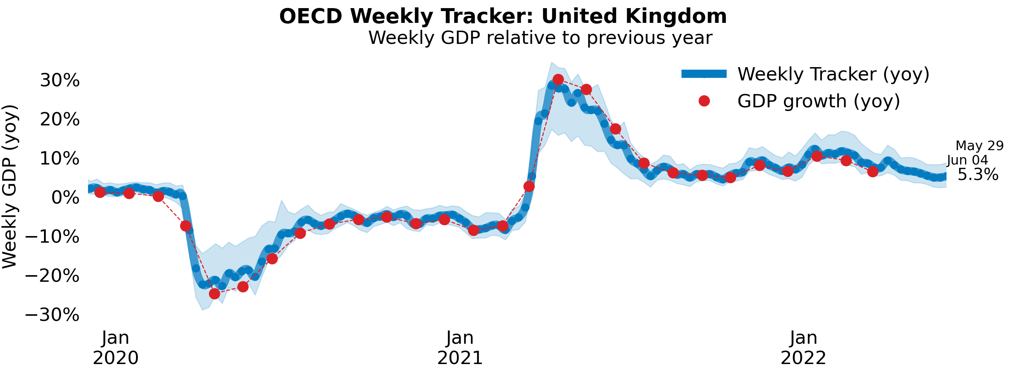
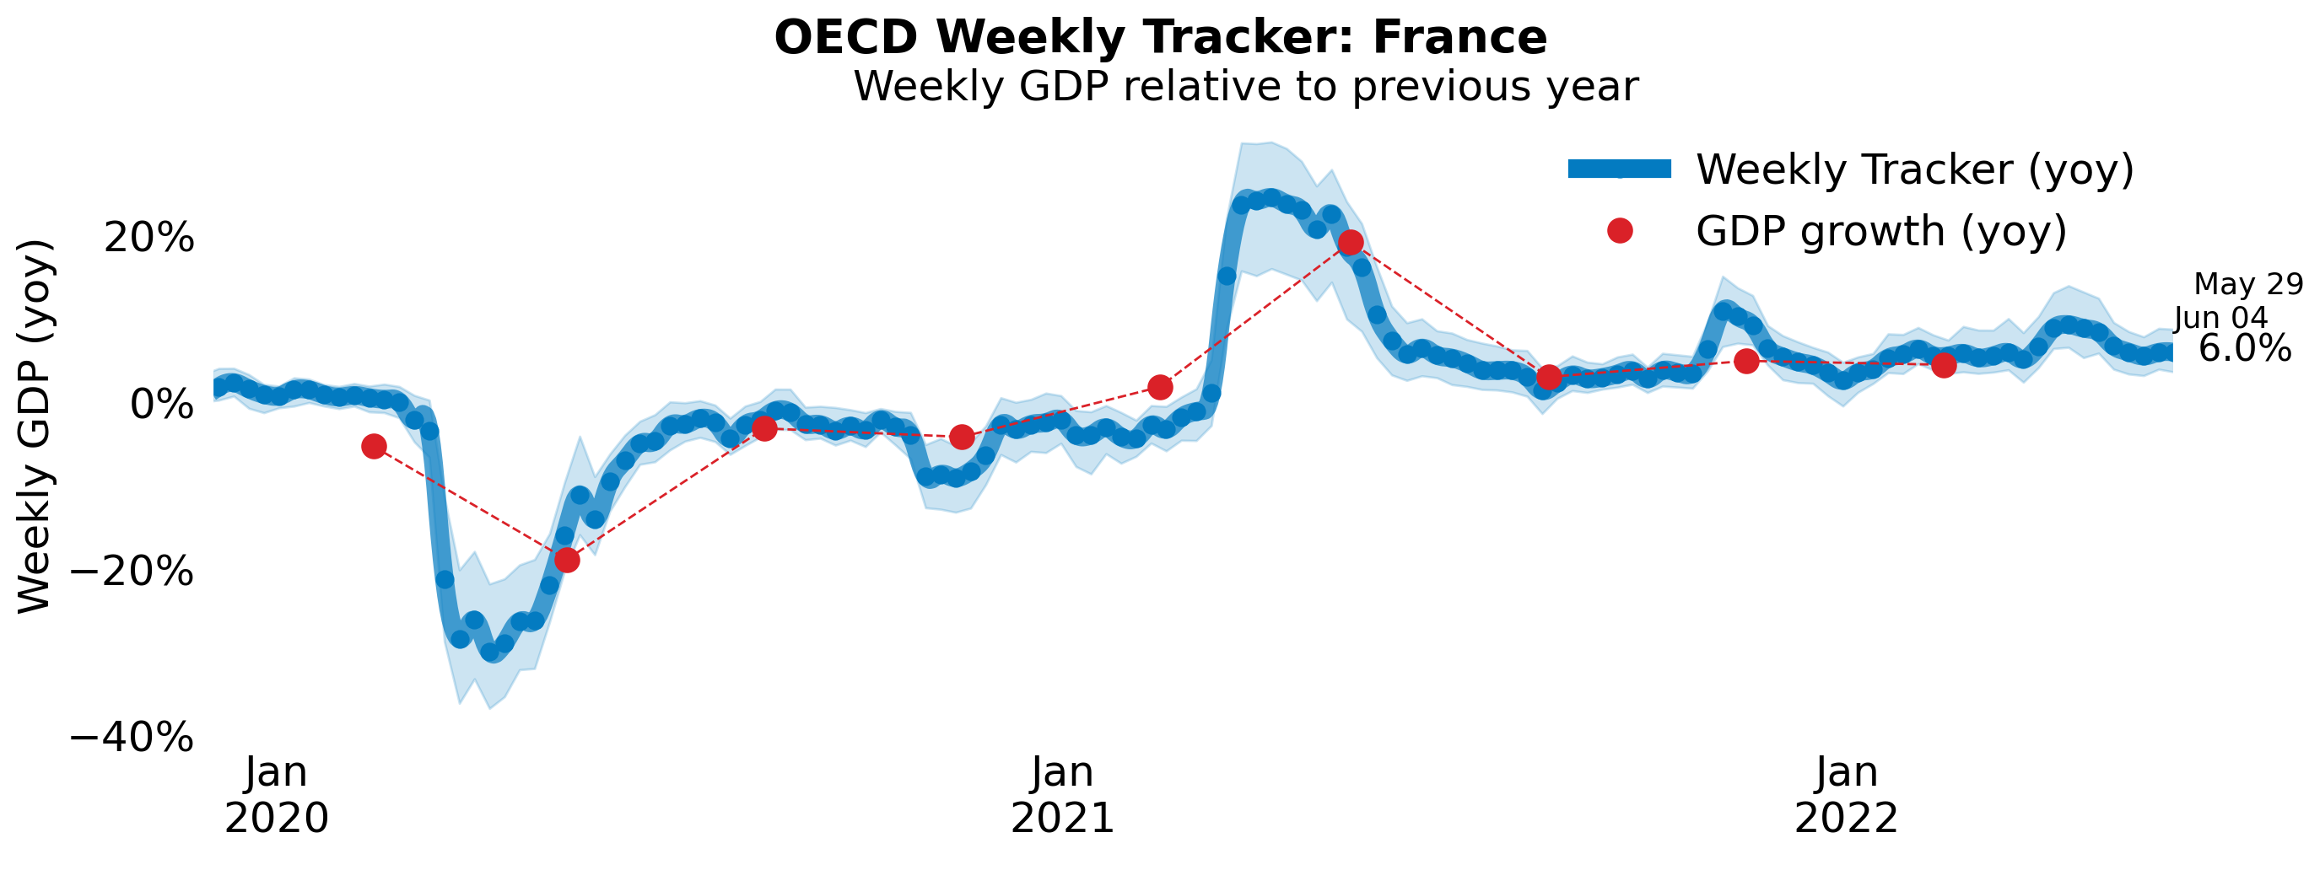
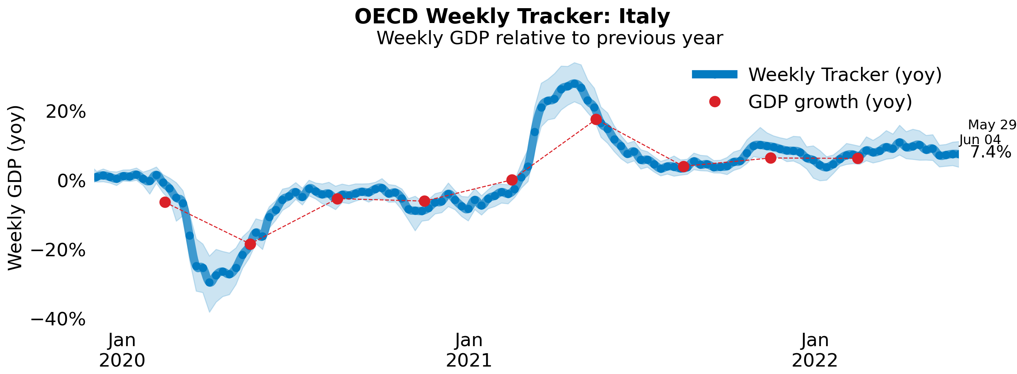
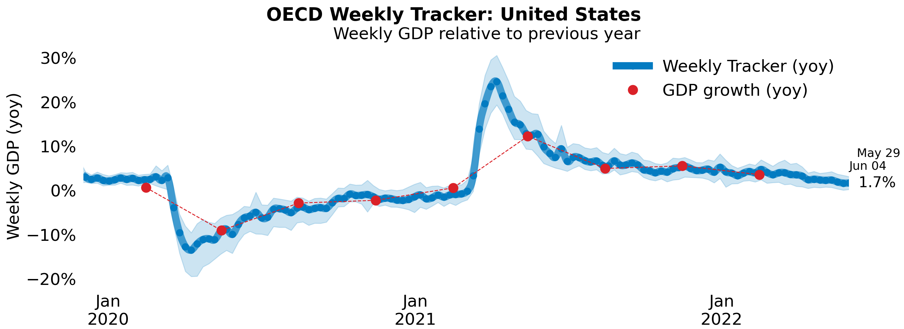
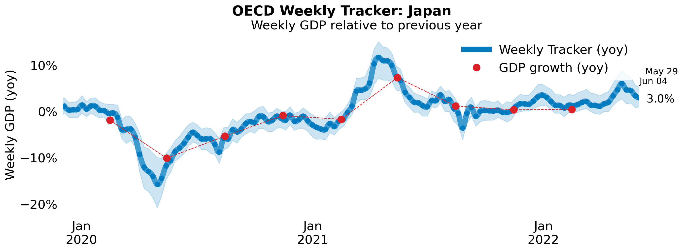
Global Economy OECD GDP Tracker
The Weekly Tracker is an estimate of weekly GDP relative to the pre-crisis trend, which is proxied by the OECD Economic Outlook forecasts.
Source: OECD, May 2022

Slide 7
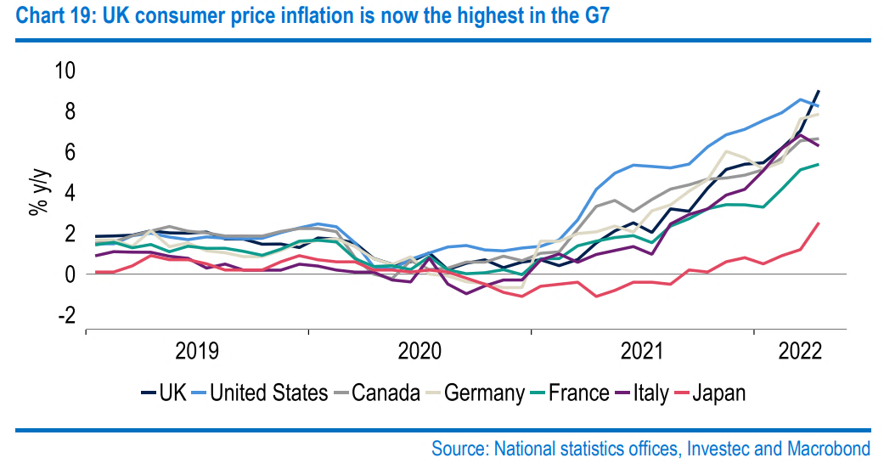
The UK economy will grow slower
Many agencies have released their predictions of GDP growth in the UK, which generally view that the economic growth rate of the UK will decrease, by varying degrees.
Investec have cut their GDP growth forecast for 2022 by 0.6%pts to 3.4% and our 2023 forecast by 0.5%pts to 1.7%.
The OECD expects the UK economy to grow by 3.6% this year, followed by zero growth next year.
The cost of living (measured by CPI) is one factor that contributes to the decreasing growth rate, which is not only its highest in four decades, but also higher than in all of its G7 peers.
Sources: Investec, May 2022 and OECD, May 2022
Notes:
data

Slide 8
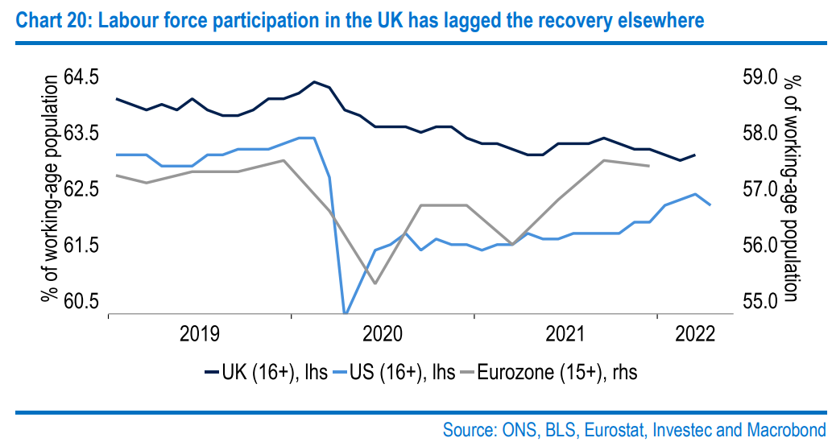
Red-hot labour market and high saving rate
Despite inflation having surged to its highest in four decades, Investec does not see a consumer-led recession as inevitable: momentum in wages and employment is strong, as are buffers from high savings.
Competitive Labour Market
The number of vacancies now surpassing the number of unemployed for the first time. This stands to support wage growth, thereby also enticing more people back into the labour force: unlike in the US and the Eurozone, the participation rate has barely risen from its pandemic trough.
Increasing Bank Rate
The Bank of England (BoE) raised UK base interest rates – the so-called "Bank Rate" – from 0.75% to 1% at the start of May in order to tackle the increasing inflation problem. Also, this policy will encourage residents to save more money and increase the overall saving rates.
Sources: Investec, May 2022 and The Bank of England, May 2022
Notes:
Data source

Slide 9
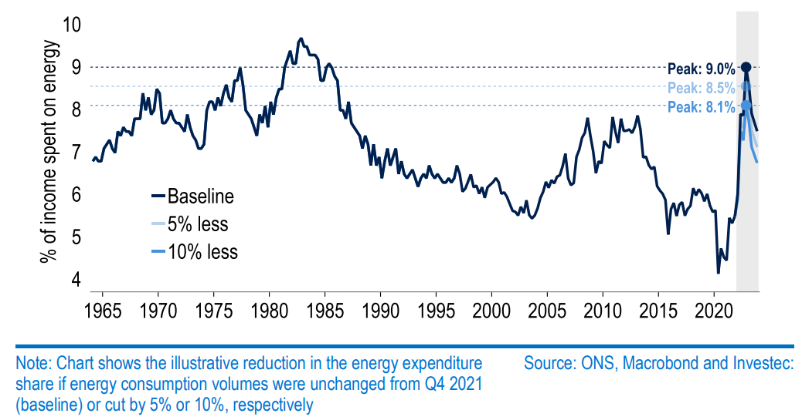
Increasing energy prices place burden on household finances
However, some weakening in growth, including in consumption, looks hard to avoid, with the spending power of those on the lowest incomes and with little or no assets squeezed the most. Even in aggregate, the share of household disposable incomes spent on energy alone stands to rise sharply.
Source: Investec, May 2022

Slide 10
Monthly Spotlight: Green Growth
Each month, Berkshire’s economic update focuses on a discussion of importance to our economy.
This month, we feature ‘Green Growth’, a discussion at the Resolution Foundation which took place on the 23rd of May and considers the UK’s existing strengths and how can they built over the coming decade, the possibility of the UK will be at the forefront of emerging clean technologies?
Chaired by David Willetts, President of the Resolution Foundation
The panellists were:
Anna Valero, Senior Policy Fellow at the Centre for Economic Performance, LSE
Dame Julia King, Chair of the Carbon Trust and Henry Royce Institute
Mike Biddle, Programme Director for the Industrial Strategy Challenge Fund, Innovate UK
The key observations from the discussion are contained in the following slides.

Slide 11
Monthly Spotlight: Green Growth
Anna Valero
Net-zero by 2050 requires accelerated emissions reductions from 2022. This requires substantially increased investment and involves change across the economy and its systems. Investments for net-zero help to drive strong, sustainable and more inclusive growth.
According to the Climate Change Committee (CCC), around 85% of decarbonisation by 2035 will involve low carbon technologies or fuels. This will generate opportunities for those who develop clean-energy related products and services to serve growing domestic and global markets. Meanwhile, a new economic strategy to embed net zero, involving appropriate incentives, regulation, government spending and participation from civil society, is required to achieve sustainable growth.
UK’s clean energy strengths
UK returns on public investments in clean tech appear to be particularly large in the UK.
Investments in clean tech, directly and indirectly, benefit less innovation-intense areas.
Less productive regions tend to see a higher intensity of clean technologies, products and services.

Slide 12
Monthly Spotlight: Green Growth
Dame Julia King
UK need OEMs and original equipment manufacturers companies that have the experience and the ability to develop and sell really capital intensive technology
Innovation in the car industry is needed. UK has few own OEMs, who do their R&D. There is a requirement to expand battery manufacturing capacity to continue to make and assemble cars for export at the same rate we do with non-EV’s.
Hydrogen is a huge global market because the UK climate change committee thinks it could be 20% of the UK energy supply by 2050. The UK is well placed geographically and geologically for working in the hydrogen space and has a good skills capital within this sphere
innovative UK companies such as Johnson Matthey
big oil companies who need to transition from oil and gas to green fuels
brilliant UK academic expertise in electric chemistry and in materials
abundant offshore wind resources

Slide 13
Monthly Spotlight: Green Growth
Mike Biddle
Heat
There are over 30 million buildings in this country that need to decarbonize, 28 and a half million of those are homes and then approaching two million non-residential buildings
Residents need to be educated as to the possibilities of how to decarbonise their properties and what options are available to them
There needs to be a focus on making net-zero things in net-zero ways
Mobility and Electrification (digital transport side)
Green transport is a key aspect of achieving green growth as mobility of people and goods is of huge importance to the economy
The right finance models are needed to enable the green growth

Slide 14
Monthly Spotlight: Green Growth
Key takeaways
The UK is not yet a clean tech superpower, but has the potential to build on its pre-existing strengths and access new opportunities.
These opportunities are also challenges to the UK
Lack of original equipment manufacturing companies
Limited innovation in car industry
How to transfer the UK current energy supply into a cleaner energy source (e.g. Hydrogen) in order to solve the energy crisis and develop a more environmentally-friendly way of growth?
In terms of Implementing policies, how to encourage residents to achieve the net-zero goal in a net-zero way is something which should also should be considered.
For example, how to use the right green financial model to help the mobility of people and goods in a green way?

Slide 15
Employment in the UK Labour Force Survey – May 2022
Key points:
January to March 2022 estimates show a decrease in the unemployment rate, while the employment and inactivity rates increased, compared with the previous three-month period (October to December 2021).
Total hours worked increased compared with the previous three-month period but are still below pre-coronavirus (COVID-19) pandemic levels.
The UK employment rate was estimated at 75.7%, 0.1 percentage points higher than the previous three-month period and 0.9 percentage points lower than before the coronavirus pandemic (December 2019 to February 2020).
The UK unemployment rate was estimated at 3.7%, 0.3 percentage points lower than the previous three-month period, and 0.2 percentage points below pre-coronavirus pandemic levels.
The UK economic inactivity rate was estimated at 21.4%, 0.1 percentage points higher than the previous three-month period, and 1.1 percentage points higher than before the coronavirus pandemic.
Source: ONS, May 2022

Slide 16
Economic and Labour Market Insight: Implications for Thames Valley Berkshire

Slide 17
Claimant Count (Latest data - April 2022)
Total of 17,920 claimants (3.1% of the working age population) in Thames Valley Berkshire
1,750 claimants (2.2% of the working age population) in Bracknell Forest UA
5,345 claimants (5.7% of the working age population) in Slough UA
4,470 claimants (4.2% of the working age population) in Reading UA
1,750 claimants (1.6% of the working age population) in Wokingham UA
2,310 claimants (2.5% of the working age population) in Windsor and Maidenhead UA
2,295 claimants (2.4% of the working age population) in West Berkshire UA
Across Thames Valley Berkshire, claimant unemployment has fallen significantly from 30,395 in April 2021 to 17,920 in April 2022. Slough had 5.7% of its working age population claim unemployment in April 2022, down significantly from 8.9% in April 2021.
Source: ONS, April 2022

Slide 18
Strategic Issues Heathrow Airport will re-open its Terminal 4
This is the first time open Terminal 4 in over two years, as part of its long-standing plan to boost airport capacity ahead of the upcoming summer season.
The move will allow Terminal 4 airlines more check in space and stand capacity as well as access to their premium facilities, and will also free up space in Terminals 2, 3, and 5 ahead of the summer peak.
Over the last two years, Heathrow have taken the opportunity to refurbish many parts of Terminal 4, including upgrading toilets, air conditioning, and hold baggage screening machines.
Though it is not always easy to balance supply and demand during this intense recovery phase. LHR are recruiting up to 1,000 new security officers and other colleagues, and supporting airlines and handlers in their recruitment programmes.
Source: International Airport Review, May 2022

Slide 19
An important note on the EMSI figures contained on the following slides: 20, 24, 27, 30, 33, 36 and 39
From February 2022, there has been a methodological change in how EMSI calculates job posting figures compared to those from prior months following a merger between EMSI and Burning Glass Technologies.
Those of you who have read previous economic briefings from Thames Valley Berkshire LEP may notice that the job posting figures contained in post-January 2022 briefings are lower across the board – in some cases quite significantly.
This change in methodology does not invalidate previous figures, but it is important to consider when reporting on job posting data longitudinally.

Slide 20
Remote working
In May of 2022, there were 4,525 unique job postings for remote positions at companies based in Berkshire, around 43% more than the figure of 3,175 for the same period one year before.
Compare this with the South-East, in May 2022 there were 20,986 unique remote job postings for remote positions; rising from 16,534 in May of the previous year – an increase of over 27%.
A rise can also be seen at national level, with a recorded 177,397 unique remote job postings in England in May of 2022, rising from 112,074 in April 2021 – an increase of over 58%.
From these figures it’s apparent that the COVID-19 pandemic has, somewhat unsurprisingly, prompted a massive boost in job postings for explicitly remote roles. Berkshire has seen a larger boost in vacancies which are remote-based than the South-East, but a smaller one than in England as whole.
Source: EMSI, May 2022

Slide 21
Local Profiles

Slide 22
Bracknell Forest

Slide 23
Unemployment figures and Notable Business News - May 2022
Claimant unemployment to April 2022 (latest)
1,750 claimants (2.2% of the working age population) in Bracknell Forest UA
Notable business news:
A salt therapy room in Bracknell recently opened its doors to customers and is the first of its kind in Berkshire. The Salt Kingdom, based at Forest Park Business Units, welcomed its first lot of visitors on March 25. The new room offers individuals the chance to relax, unwind and experience the health benefits of salt. The type of salt therapy the venue offers is halotherapy.
Note: The LEP has been previously reporting on COVID-19 case rates in these monthly economic briefings. The dashboards containing this data have been shut down as of this month and, as a result, we will no longer be doing so.

Slide 24
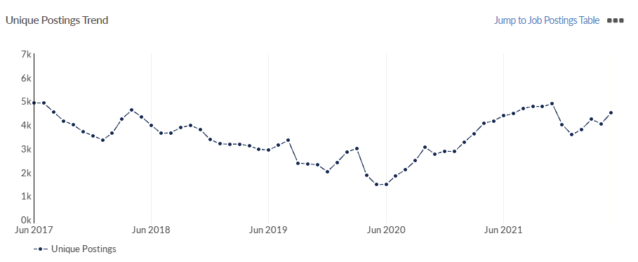
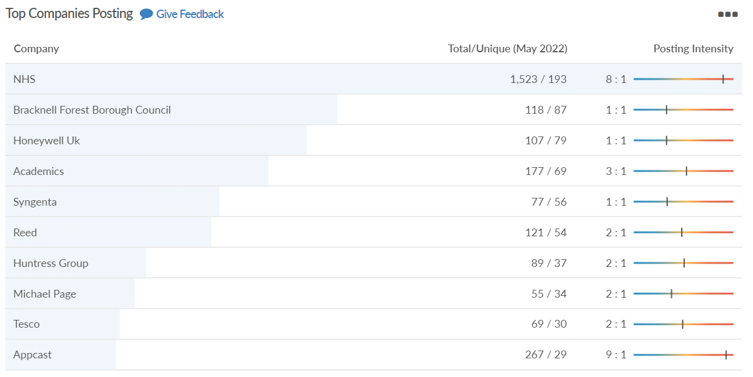
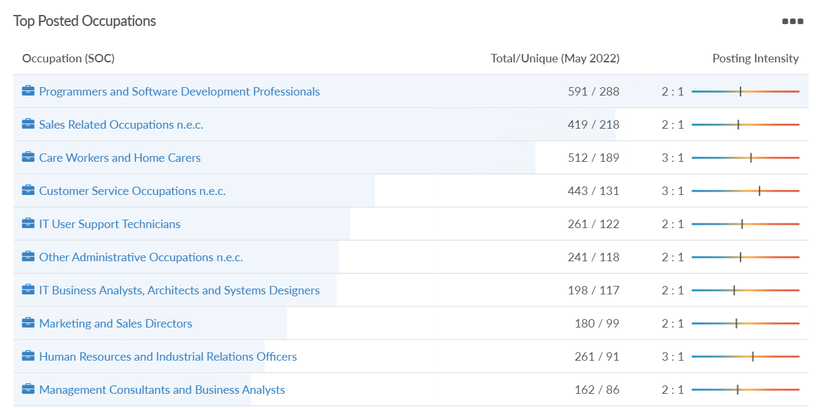
Job posting analytics (EMSI, May 2022)
Unique job postings: 4,498
Total job postings: 10,558
Job posting intensity: 2:1
Unique job postings (May 2021): 4,167

Slide 25
Slough

Slide 26
Unemployment figures and Notable Business News - May 2022
Claimant unemployment to April 2022 (latest)
5,345 claimants (5.7% of the working age population) in Slough UA
Notable business news:
Slough's civic and business leaders have laid out the town's economic strengths in a bid to bolster its reputation. A number of Slough’s major stakeholders, responsible for re-developing key areas across the borough - driving and sustaining its strong economic growth, have outlined Slough's current assets and future potential. Slough's unemployment levels are below 1% - third of the national average - and it is home to the largest concentration of global corporate headquarters outside London with tech giants Amazon, Mars UK, and O2 are all located on the Slough Trading Estate – LINK.
Note: The LEP has been previously reporting on COVID-19 case rates in these monthly economic briefings. The dashboards containing this data have been shut down as of this month and, as a result, we will no longer be doing so.

Slide 27
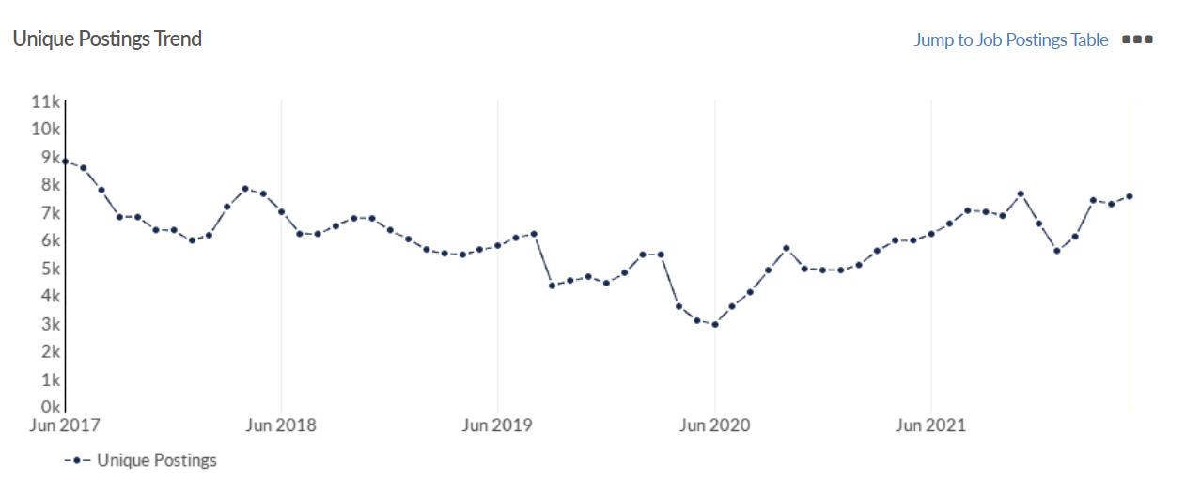
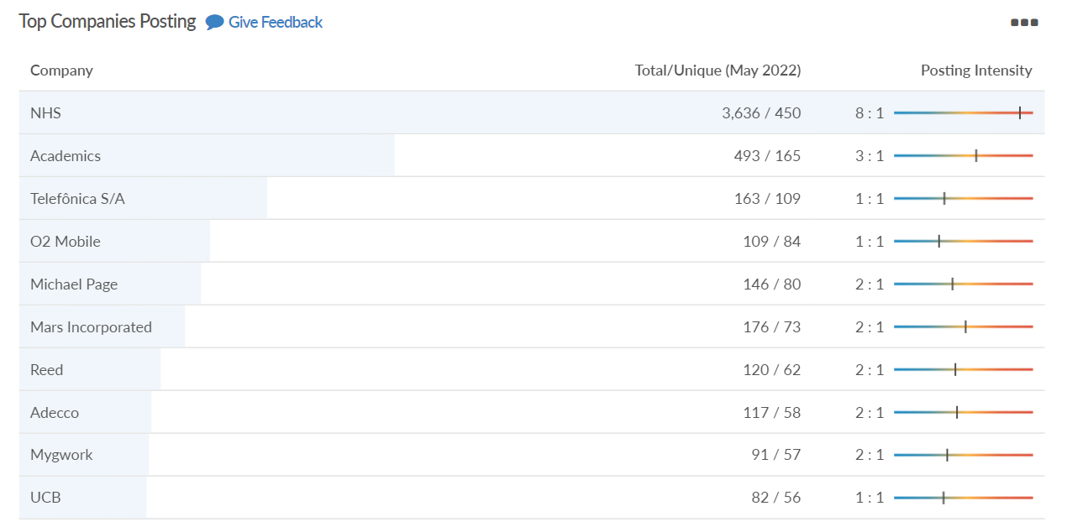
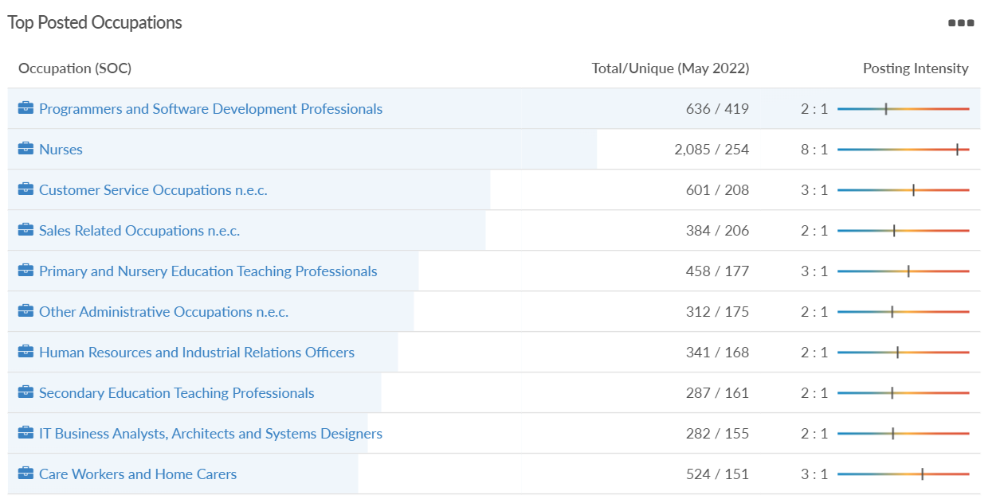
Job posting analytics (EMSI, May 2022)
Unique job postings: 7,572
Total job postings: 17,473
Job posting intensity: 2:1
Unique job postings (May 2021): 5,964

Slide 28
Reading

Slide 29
Unemployment figures and Notable Business News - May 2022
Claimant unemployment to April 2022 (latest)
4,470 claimants (4.2% of the working age population) in Reading UA
Notable business news:
Reading-based healthcare start up firm, Occuity, has been awarded £33,910 from the Berkshire Business Capital Grant Fund. The funds will support the firm's work to manufacture the first product in their line of non-invasive optical screening and monitoring devices, the PM1 Pachymeter. A pachymeter is a device which measures the thickness of the cornea. The grant is funded by Thames Valley Berkshire LEP’s Getting Building Fund and will be used to support Occuity’s purchase of equipment required to assemble test stations increase capacity and more efficient quality control in the manufacturing of the world’s first non-contacting optical pachymeter, the PM1 – LINK.
Note: The LEP has been previously reporting on COVID-19 case rates in these monthly economic briefings. The dashboards containing this data have been shut down as of this month and, as a result, we will no longer be doing so.

Slide 30
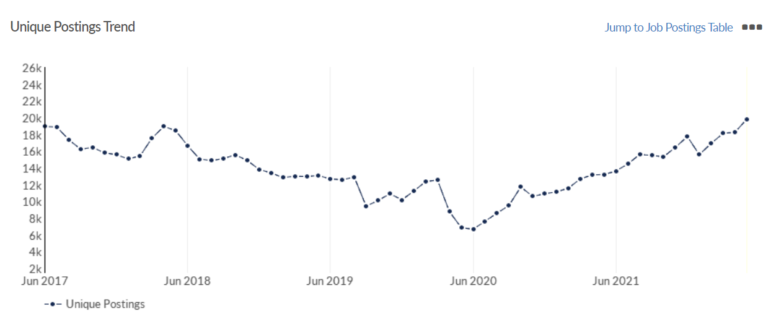
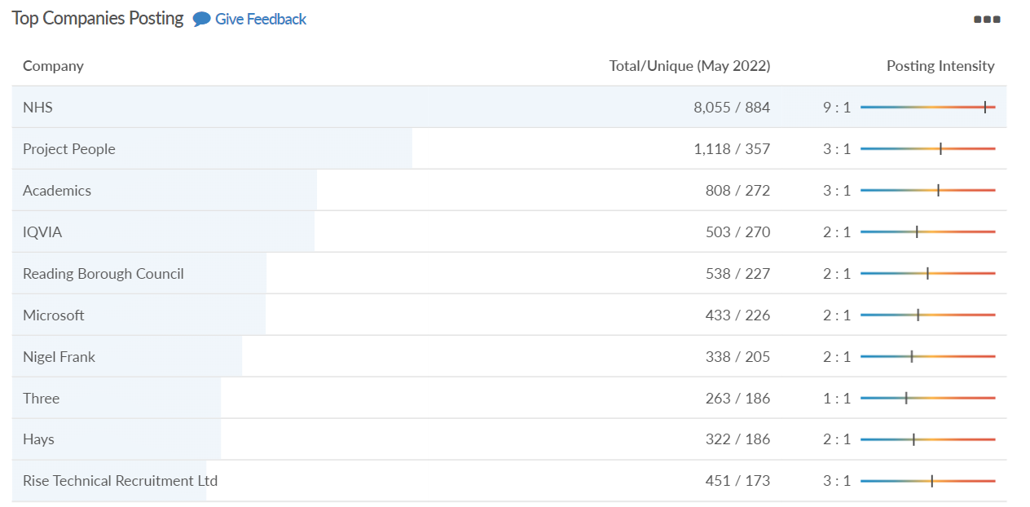
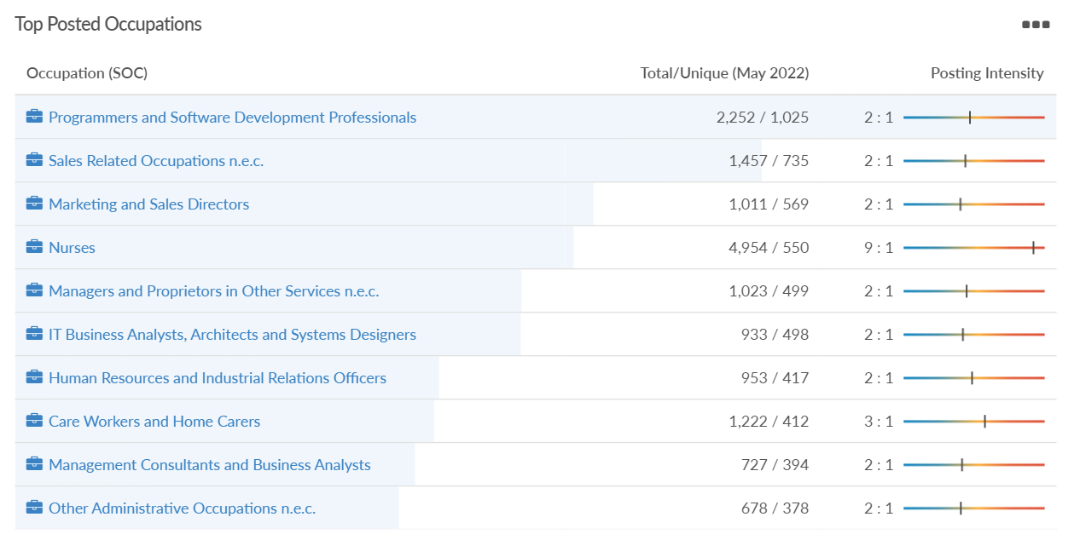
Job posting analytics (EMSI, May 2022)
Unique job postings: 19,829
Total job postings: 47,308
Job posting intensity: 2:1
Unique job postings (May 2021): 13,221

Slide 31
Wokingham

Slide 32
Unemployment figures and Notable Business News - May 2022
Claimant unemployment to April 2022 (latest)
1,750 claimants (1.6% of the working age population) in Wokingham UA
Notable business news:
Wokingham Berkshire sees the Launch of 'My Wokingham' Which Aims To Put Every Wokingham Business Online. The service aims to put every local business online and has listed over a thousand businesses so far, with each having its own dedicated page on the website. It will also publish local events and news, led by a team of community writers – LINK.
Note: The LEP has been previously reporting on COVID-19 case rates in these monthly economic briefings. The dashboards containing this data have been shut down as of this month and, as a result, we will no longer be doing so.

Slide 33
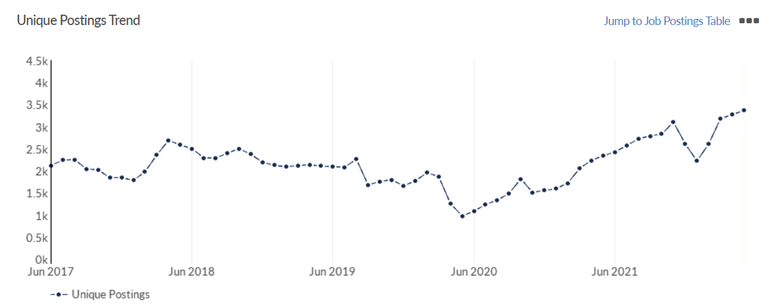
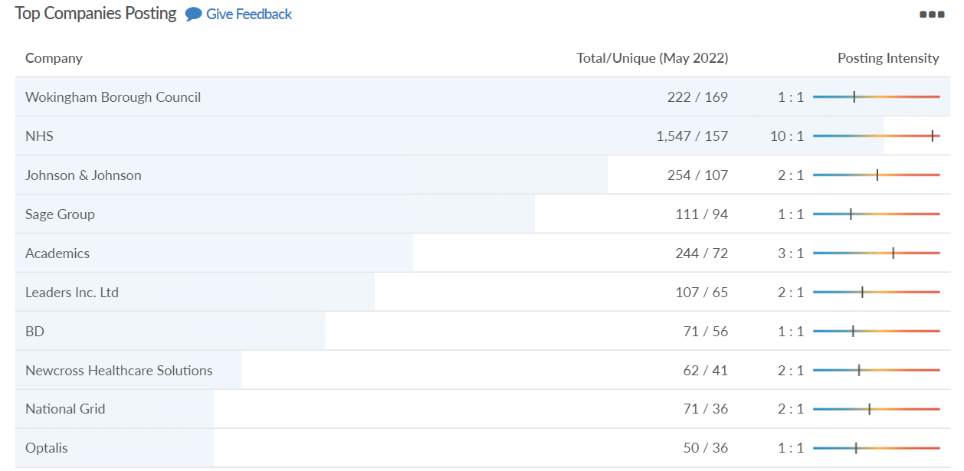
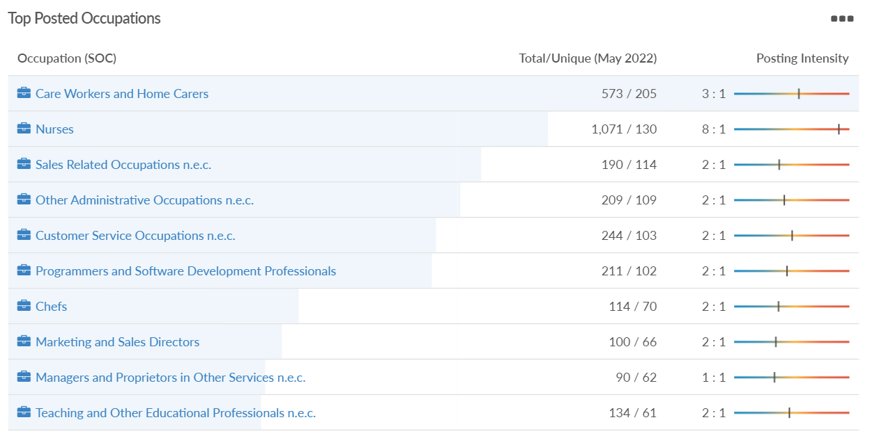
Job posting analytics (EMSI, May 2022)
Unique job postings: 3,366
Total job postings: 7,844
Job posting intensity: 2:1
Unique job postings (May 2021): 2,342

Slide 34
Windsor and Maidenhead

Slide 35
Unemployment figures and Notable Business News - May 2022
Claimant unemployment April 2022 (latest)
2,310 claimants (2.5% of the working age population) in Windsor and Maidenhead UA
Notable business news:
Maidenhead is set to welcome a new wine, tapas and e-sports bar later this summer at a new public square in the town centre. Masters will open next to the Anytime Fitness gym on Friday, July 1 at the Watermark development on the banks of Maidenhead Waterways, being built by developer Countryside. Co-owner Vithesh Sakthivel said that the new venue will be ‘versatile’ and offer a sit-down restaurant area serving grilled food, as well as a bar offering light snacks and a selection of wine. A separate room will offer a video games area for e-sports enthusiasts, with tournaments also planned outside the restaurant – LINK.
Note: The LEP has been previously reporting on COVID-19 case rates in these monthly economic briefings. The dashboards containing this data have been shut down as of this month and, as a result, we will no longer be doing so.

Slide 36
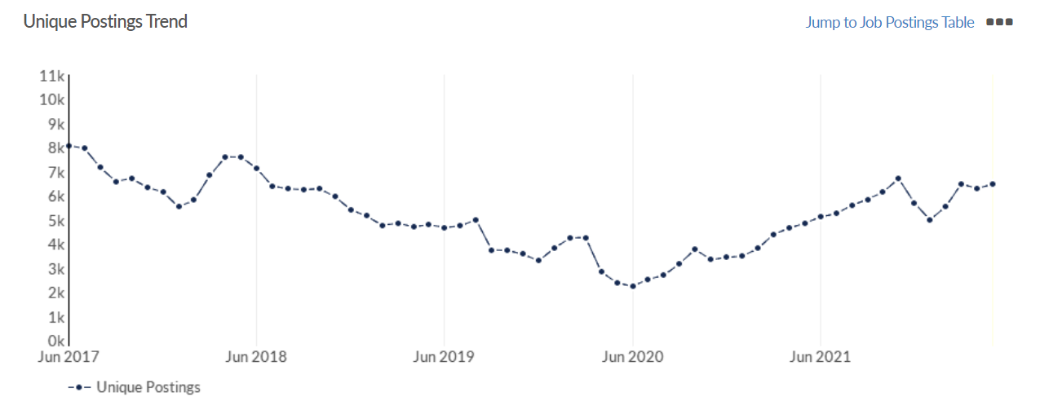
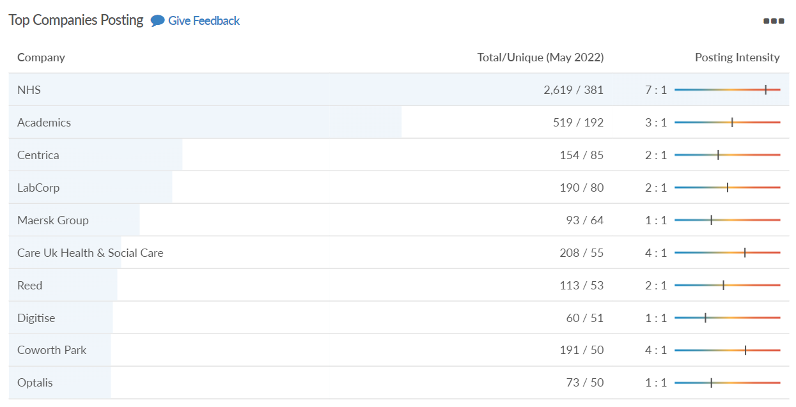
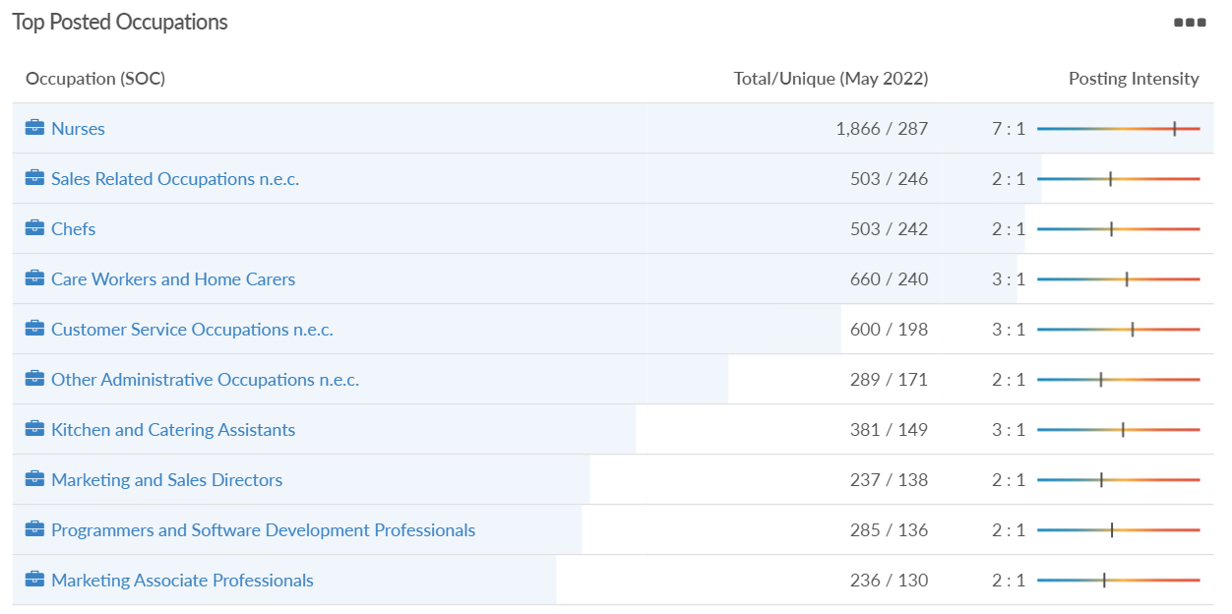
Job posting analytics (EMSI, May 2022)
Unique job postings: 6,469
Total job postings: 15,321
Job posting intensity: 2:1
Unique job postings (May 2021): 4,853

Slide 37
West Berkshire

Slide 38
Unemployment figures and Notable Business News - May 2022
Claimant unemployment to April 2022 (latest)
2,295 claimants (2.4% of the working age population) in West Berkshire UA
Notable business news:
Morrisons has beaten EG Group in a takeover battle for collapsed retailer McColl’s. Bosses said all McColl’s staff will keep their jobs as the firm’s shops transfer to the new owner, while Morrisons will take over the company’s two pension schemes. The convenience chain fell into administration on Friday, plunging the future of its 1,160 shops and 16,000 staff into doubt. It has outlets in Newbury, Thatcham, Lambourn, Mortimer Common, Kingsclere and Tadley – LINK.
Note: The LEP has been previously reporting on COVID-19 case rates in these monthly economic briefings. The dashboards containing this data have been shut down as of this month and, as a result, we will no longer be doing so.

Slide 39
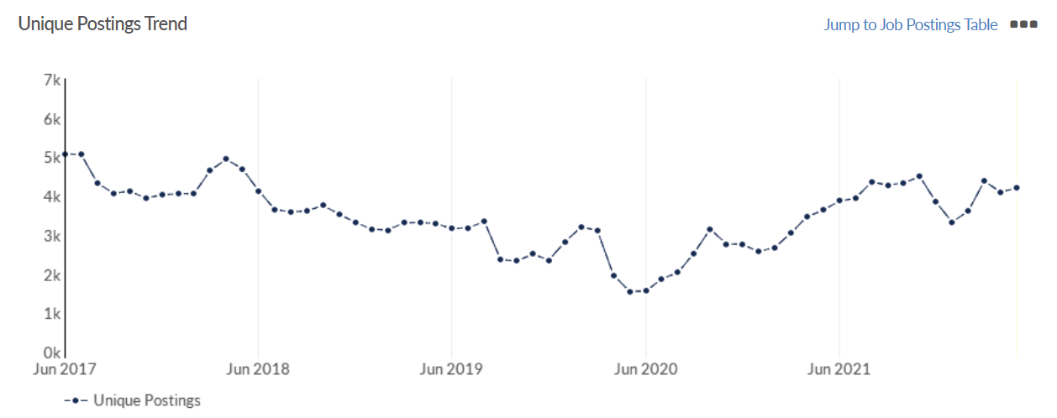
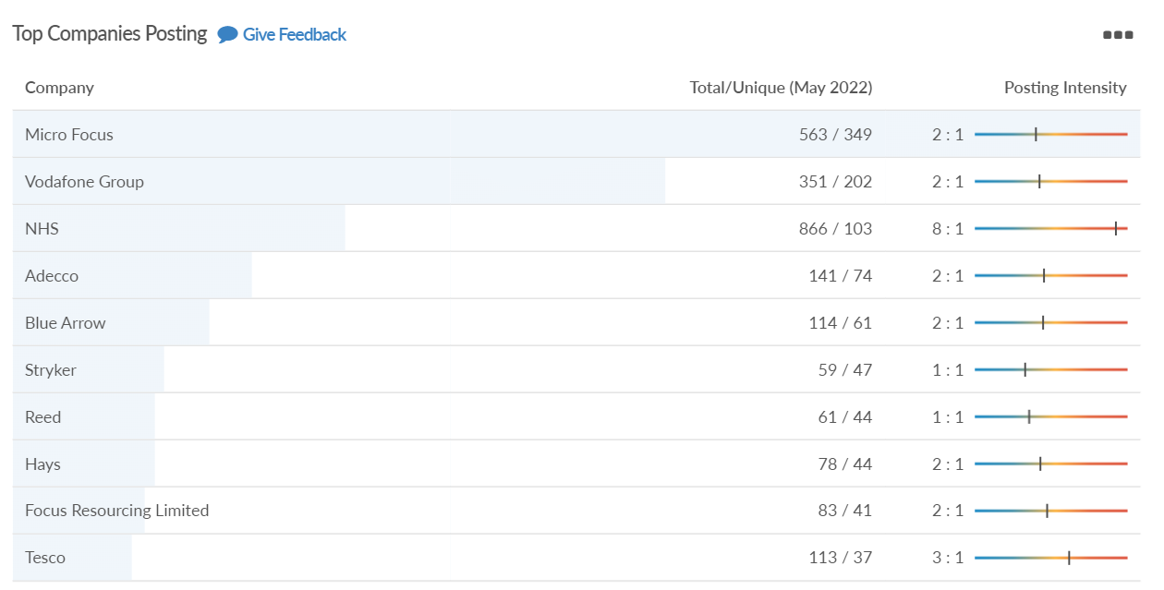
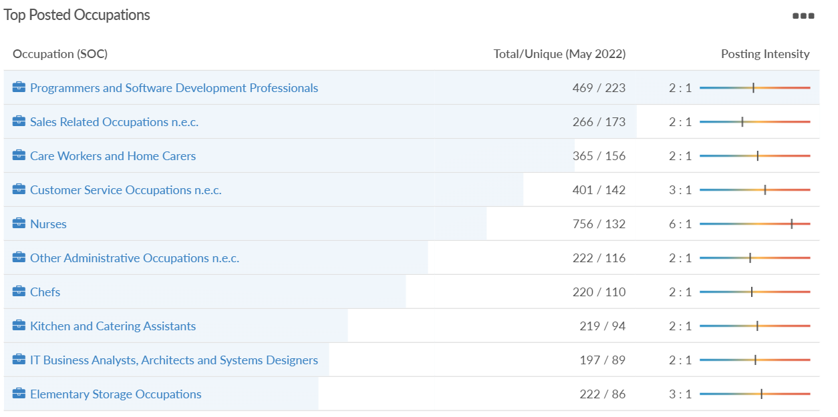
Job posting analytics (EMSI, May 2022)
Unique job postings: 4,205
Total job postings: 9,173
Job posting intensity: 2:1
Unique job postings (May 2021): 3,634

