Slide 1
Thames Valley Berkshire Monthly Economic Briefing
June 2022

Slide 2
2022 Refresh
Following on from stakeholder feedback as well as discussions within the LEP over the course of the last year, we have decided to make some additions to the content of our economic briefings, whilst still continuing to report on the bulk of the areas we were last year.
Each month, we aim to have a themed feature. This month we will be reporting from the seminar, ‘How do we create new jobs in a time of crisis?’ which took place at the LSE festival in June.
These monthly economic briefings are constantly evolving documents and their content is dictated in part by data/information requests from our readers.
If there is an economic aspect not currently covered within these reports which you think would be beneficial to include/expand upon (or you have any queries), we will do our best to help. Please contact Dex in the LEP’s research team at dexterlevick@thamesvalleyberkshire.co.uk.

Slide 3
Key contents of this month’s briefing
Updated global and UK economic forecasts
Monthly Event Spotlight – How do we create new jobs in a time of crisis?
Key points from the latest Labour Force Survey data
Latest claimant count figures by Local Authority
Latest remote working figures for Thames Valley Berkshire
Latest ‘notable business news’ by Local Authority
Latest job posting analytics by Local Authority

Slide 4
Global and National Economy
June 2022

Slide 5
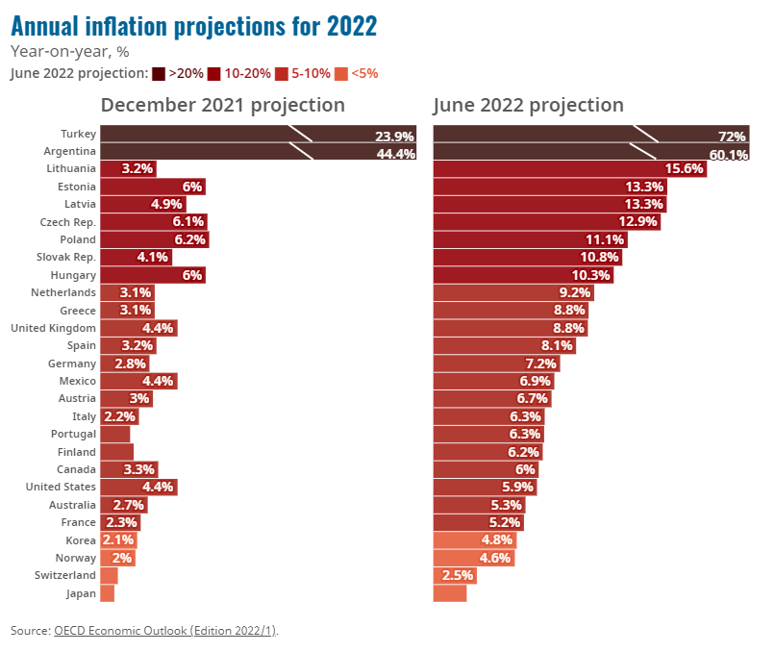
June 2022 Global Economic Outlook
The war in Ukraine has triggered a cost-of-living crisis, affecting people worldwide. When coupled with China’s zero-COVID policy, the war has set the global economy on a course of slower growth and rising inflation - a situation not seen since the 1970s. Rising inflation, largely driven by steep increases in the price of energy and food, is causing hardship for low-income earners and raising serious food security risks in the world’s poorest economies.
Inflationary pressures have intensified
The latest OECD projections show global impact the war is having on inflation, which has already reached a 40 year high in Germany, the United Kingdom and the United States. A gradual reduction in supply chain and commodity price pressures and the impact of rising interest rates should begin to be felt through 2023, but core inflation is nonetheless projected to remain at or above central bank objectives in many major economies at year-end.
Source: OECD, June 2022

Slide 6
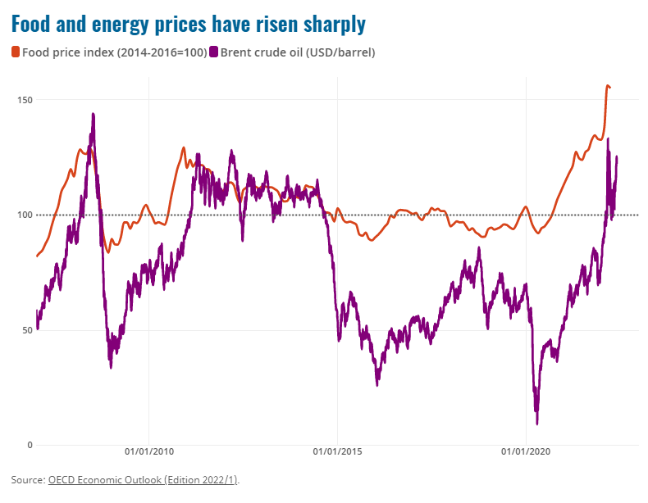
June 2022 Global Economic Outlook
The cost of living crisis will cause further economic hardship unless addressed
Russia and Ukraine are important suppliers in many commodity markets. Together they accounted for about 30% of global wheat exports, 20% for corn, mineral fertilisers and natural gas, and 11% for oil. Prices for these commodities increased sharply after the onset of the war.
Without action, there is high risk of a food crisis. Supply disruptions are rising, particularly threatening low-income countries that are highly dependent on Russia and Ukraine for basic food staples. With public budgets stretched by two years of the pandemic, these countries could struggle to provide food and energy at affordable rates to their populations, risking famine and social unrest.
Source: OECD, June 2022

Slide 7
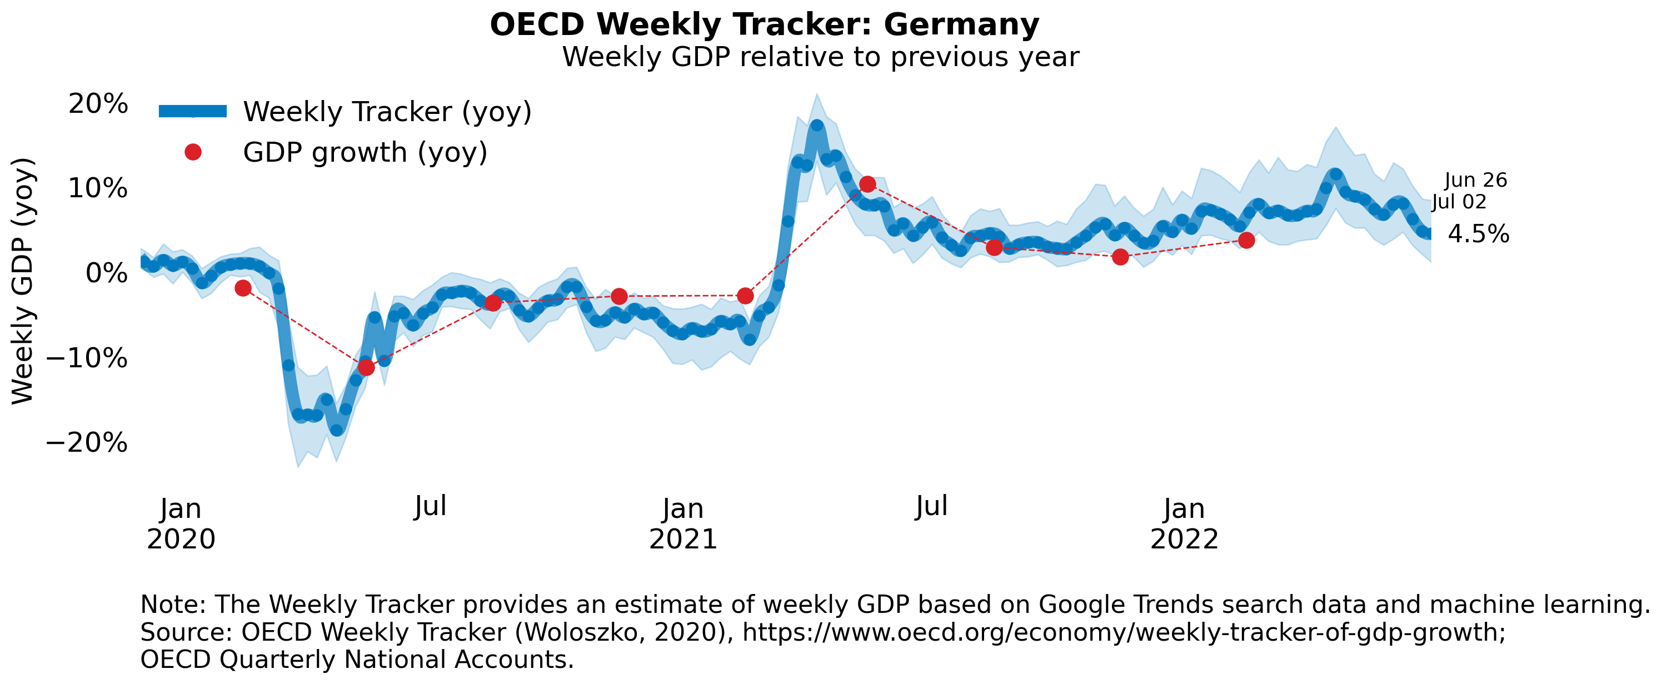
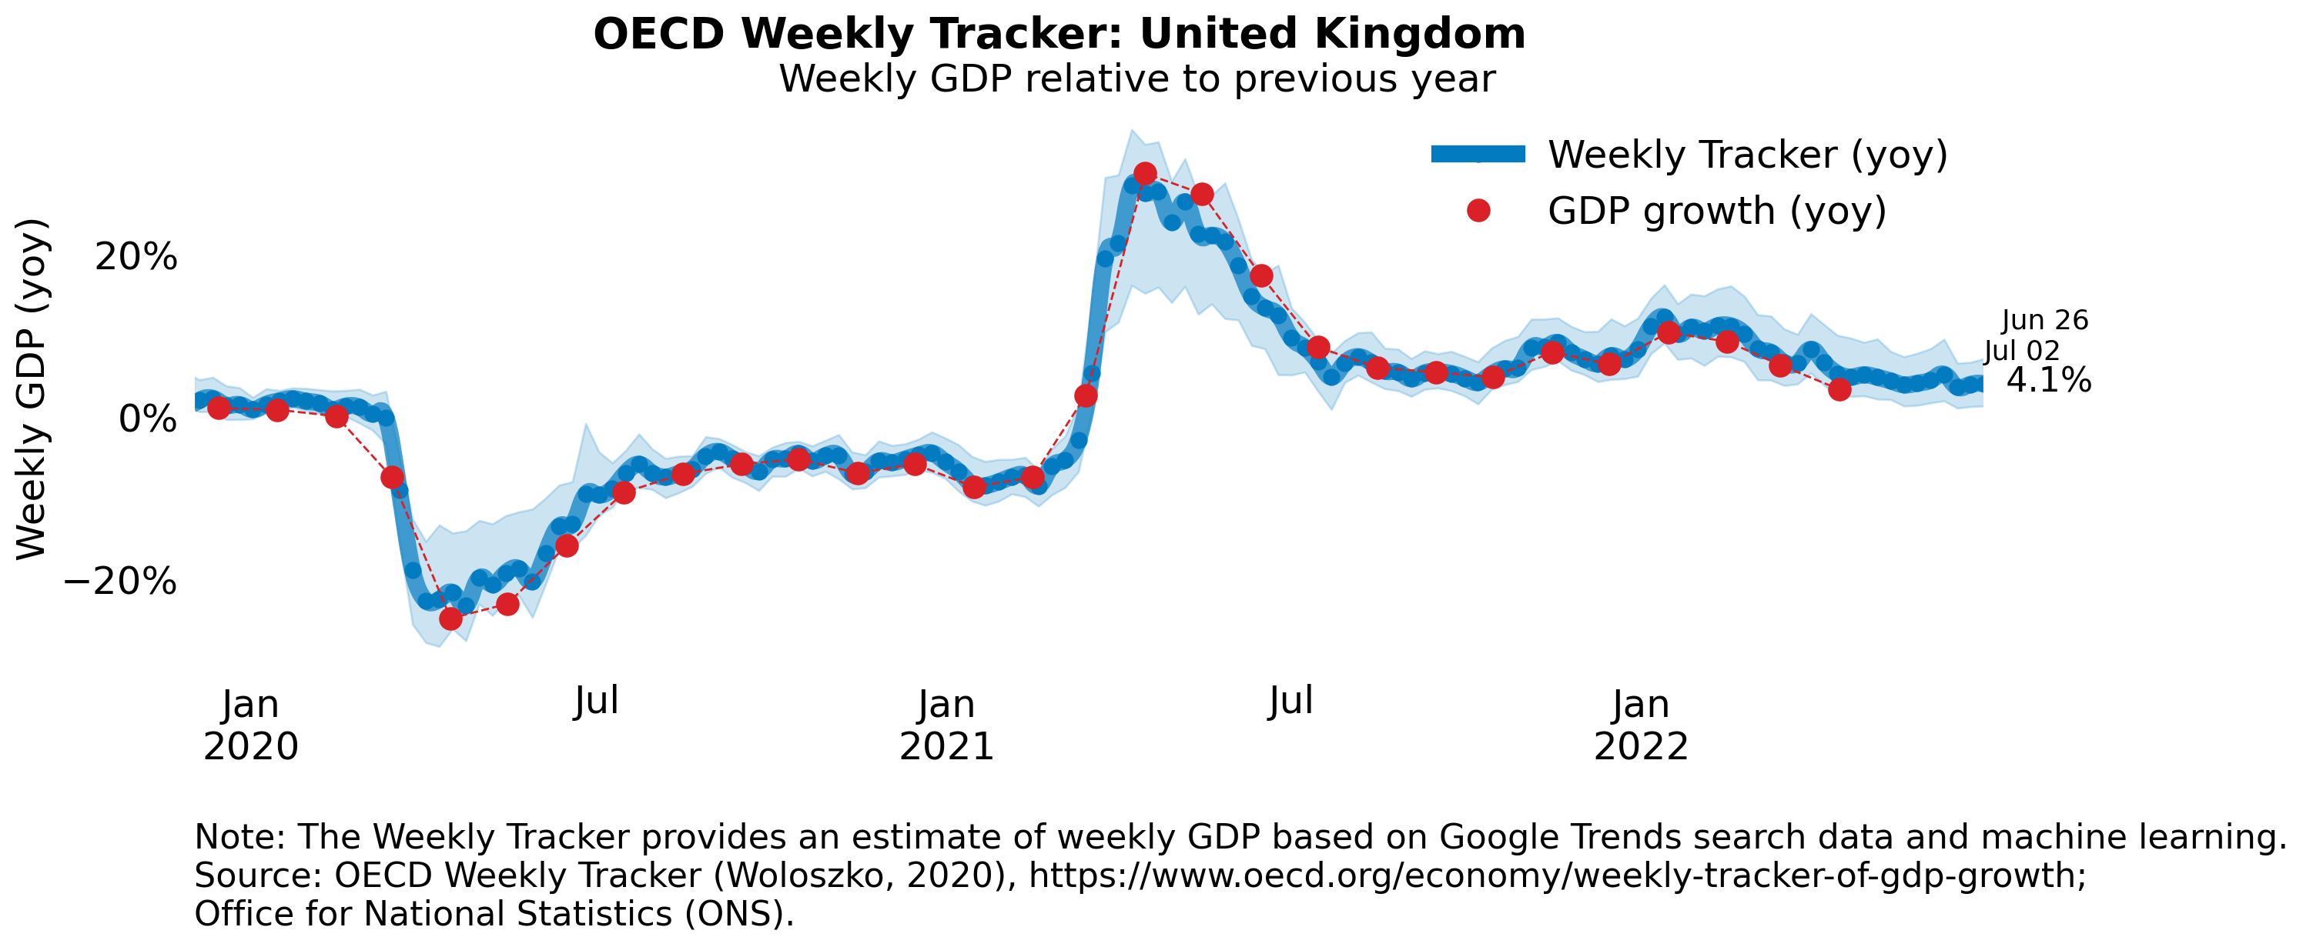
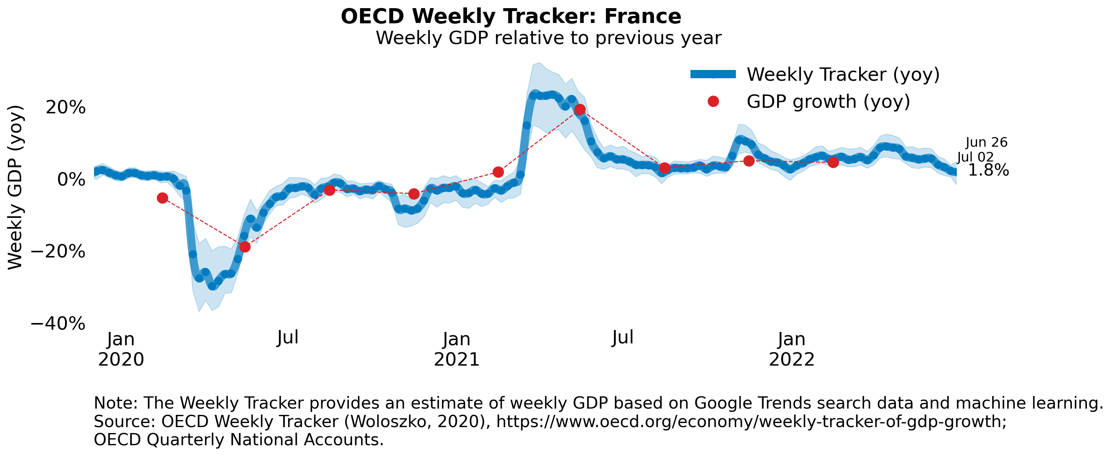
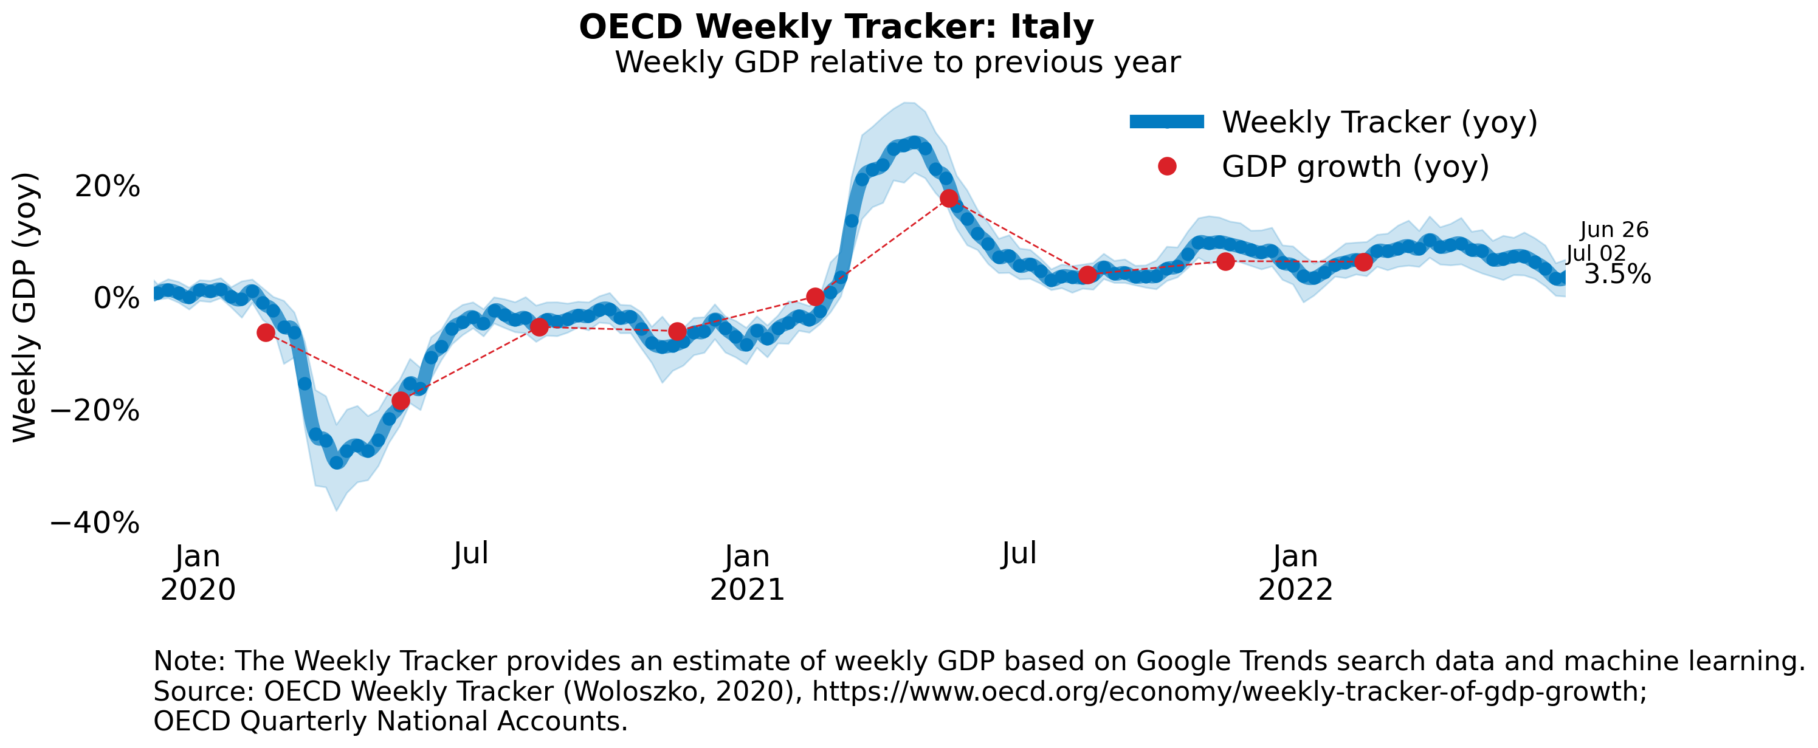
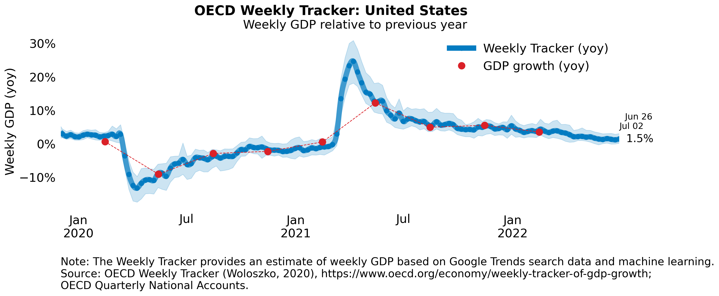
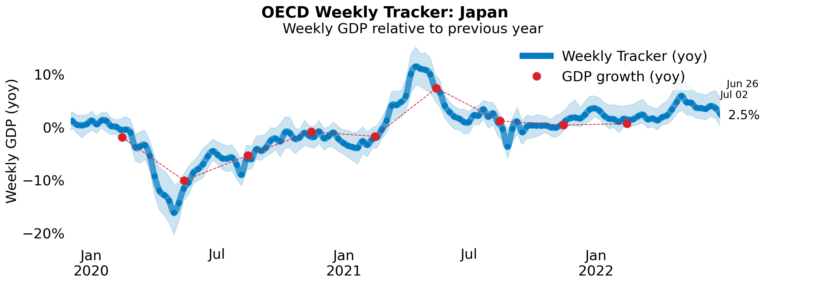
Global Economy OECD GDP Tracker
The Weekly Tracker is an estimate of weekly GDP relative to the pre-crisis trend, which is proxied by the OECD Economic Outlook forecasts.
Source: OECD, June 2022

Slide 8
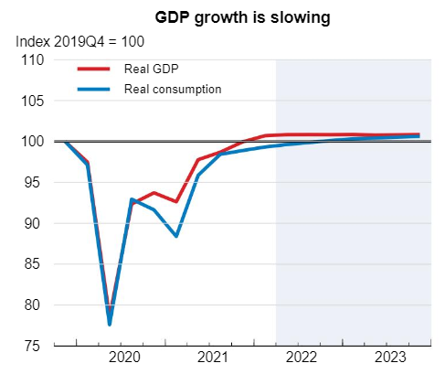
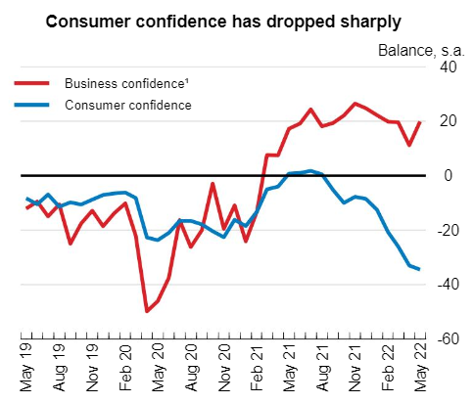
UK GDP is projected to increase in 2022
Private consumption is expected to slow as rising prices erode households’ income. Public investment will weaken in 2022 as supply bottlenecks hamper the implementation of planned investment but is set to rise again in 2023 as these effects subside. A tight labour market will help to keep unemployment low.
GDP is projected to increase by 3.6% in 2022, before stagnating in 2023. Inflation will keep rising and peak at over 10% at the end of 2022 due to continuing labour and supply shortages and high energy prices, before gradually declining to 4.7% by the end of 2023.
Source: OECD, June 2022
Notes:
data

Slide 9
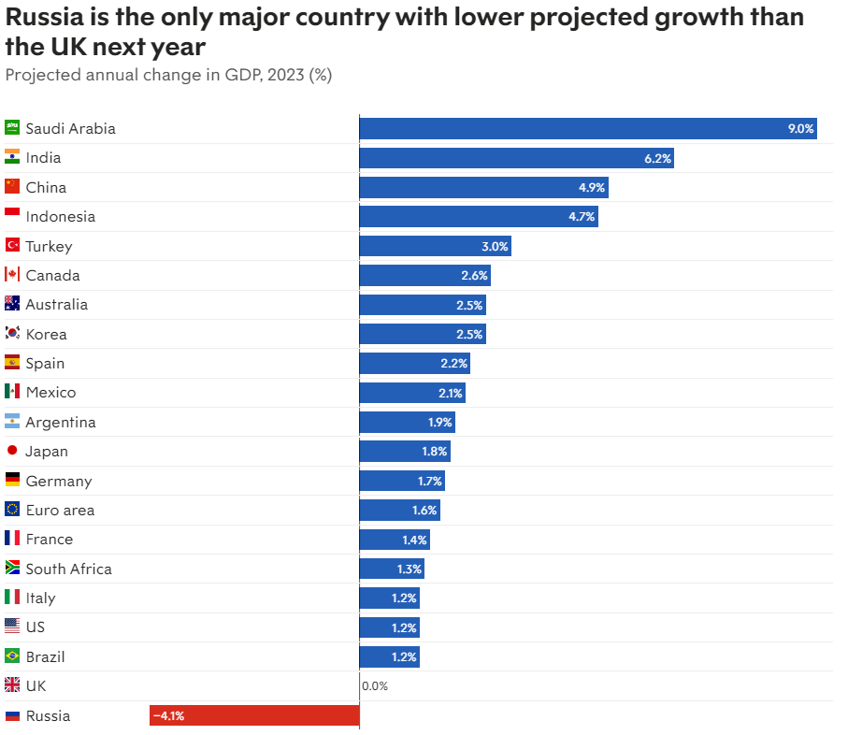
UK set to grow slower than every G20 economy except Russia
The UK is forecast to have the lowest economic growth of any major economy bar Russia next year. These figures show that the economy will come close to recession, with 0.0 per cent growth in GDP projected compared with this year’s figures.
That is worse than every other nation in the G20 group of countries, which are forecast to record at least some economic growth. The exception is Russia, whose economy is expected to contract due to Western sanctions following its invasion of Ukraine.
Russia’s invasion of Ukraine has cut expectations of growth across the world, with large increases in inflation across many advanced economies.
Source: New Statesmen, June 2022
Notes:
Data source

Slide 10
Monthly Spotlight: How do we create new jobs in a time of crisis?
Each month, Berkshire’s economic update focuses on a discussion of importance to our economy.
This month, we feature ‘How do we create new jobs in a time of crisis?’, a discussion which took place as part of the London School of Economics Festival in June.
The panellists were:
Dr Carl Frey, Director of the Future of Work programme at the Oxford Martin School
Dr Anna Valero, Senior Policy Fellow at the Centre for Economic Performance, LSE
Rebecca McDonald, Head of Economics at the Joseph Rowntree Foundation

Slide 11
Monthly Spotlight: How do we create new jobs in a time of crisis?
Carl Frey
The big story over a couple of decades has been deindustrialisation. This is even happening in China - 12m manufacturing jobs have disappeared since 2013. Those jobs are not coming back. Most jobs that people do today were not invented in 1940. So we have to create new jobs today.
We could spend more on R&D – this is important, but not enough.
The most radical innovations come from young, small companies. Large companies tend to be in mature industries, and tend to become more productive in what they already do.
Will technology reduce jobs or create new jobs in new industries? Comparing payroll taxes with taxes on capital, the first have remained stagnant, the second has been falling, which incentivises companies to invest in capital rather than jobs. We need a better balance.
Inventors come from inventor-rich communities; could we spread this wider, even encouraging invention in schools?
New jobs need to be more dispersed across space. New job titles in the 1970s emerged in places with manufacturing heritage; since the 1980s, jobs related to computer technologies have been highly located in skilled cities.

Slide 12
Monthly Spotlight: How do we create new jobs in a time of crisis?
Anna Valero
This is the decisive decade if we are to meet net zero by 2050. Occurring against a background of stagnant living standards and weak productivity.
How can investments for net zero help us to create good jobs?
A new approach to growth is urgently required:
short/medium term, net zero investments boosting short term demand, improving supply and resilience
- longer term, increase innovations and unleash new wages or technical change.
20 years - low carbon is the only feasible form of longer-run growth.
Directly green jobs tend to be held by more educated workers, on permanent contacts. Green jobs tend to command higher wages, but are less likely to be held by women, younger and non-white workers.
Those moving from brown to green jobs over the last decade tend to have done similar work before, are more educated and are of prime working age - so some will find this more difficult than others.

Slide 13
Monthly Spotlight: How do we create new jobs in a time of crisis?
Rebecca McDonald
It is important that we raise the quality of low paid jobs
Insecure work is a big issue.
Underemployment is an issue in in-work poverty.
Unemployment is not low everywhere. Birmingham, Wolverhampton, Blackpool, basic issues of not having a job still exists.

Slide 14
Monthly Spotlight: How do we create new jobs in a time of crisis?
Key takeaways
We have heard a lot about the full employment being experienced by the UK at present. This can lead us to imagine that jobs will take care of themselves.
There are, however, issues that policy makers, including at Berkshire LEP, need to bear in mind:
Not all jobs are good jobs. The ‘great resignation’ of fifty-somethings leaving the labour market after Covid was caused, at least in part, by people wanting to escape low quality jobs.
We need to create new jobs and we need to create them across a wide geography, not just in favoured places such as skilled cities.
New jobs must be green jobs, and these must be open to all, not just the well-educated and not just for white men.
The LEP is thinking about a number of issues, from our role in ‘digital net zero’ to the importance of skills pathways, as we seek to address these challenges.

Slide 15
Employment in the UK Labour Force Survey – June 2022
Key points:
February to April 2022 estimates show an increase in the employment rate and decreases in the unemployment and economic inactivity rates compared with the previous three-month period (November 2021 to January 2022).
Total hours worked increased compared with the previous three-month period but are still just below pre-coronavirus (COVID-19) pandemic levels.
The UK employment rate was estimated at 75.6%, 0.2 percentage points higher than the previous three-month period but 0.9 percentage points lower than before the coronavirus pandemic (December 2019 to February 2020).
The UK unemployment rate was estimated at 3.8%, 0.2 percentage points lower than the previous three-month period, and 0.1 percentage points below pre-coronavirus pandemic levels.
The UK economic inactivity rate was estimated at 21.3%, 0.1 percentage points lower than the previous three-month period, but 1.1 percentage points higher than before the coronavirus pandemic.
Source: ONS, June 2022

Slide 16
Economic and Labour Market Insight: Implications for Thames Valley Berkshire

Slide 17
Claimant Count (Latest data - May 2022)
Total of 17,615 claimants (3.1% of the working age population) in Thames Valley Berkshire
1,670 claimants (2.1% of the working age population) in Bracknell Forest UA
5,385 claimants (5.7% of the working age population) in Slough UA
4,450 claimants (4.2% of the working age population) in Reading UA
1,655 claimants (1.6% of the working age population) in Wokingham UA
2,240 claimants (2.4% of the working age population) in Windsor and Maidenhead UA
2,215 claimants (2.3% of the working age population) in West Berkshire UA
Across Thames Valley Berkshire, claimant unemployment has fallen significantly from 27,935 in May 2021 to 17,615 in May 2022. Slough had 5.7% of its working age population claim unemployment in May 2022, down significantly from 8.3% in May 2021.
Source: ONS, May 2022

Slide 18
Strategic Issues Ministers unveil plan to tackle airport crisis after fresh Heathrow disruption
UK ministers have unveiled a 22-point plan to help tackle the airport staffing crisis after further cancellations at Heathrow raised anxiety over the industry’s ability to cope this summer.
The transport secretary, Grant Shapps, said the government had set out how it was backing aviation, and it was now up to airlines and airports to set realistic schedules.
Most of the cancelled flights were on British Airways services. The airport has yet to recruit many of the additional 1,000 staff it sought for this summer, and passengers using Heathrow in recent weeks have experienced long queues.
Unions and industry figures have predicted that the problems affecting airports are unlikely to be resolved by summer, with potential strikes at Heathrow and around Europe expected.
Tim Alderslade, the chief executive of Airlines UK, said: “The whole sector is working closely with ministers and the [Civil Aviation Authority] to build greater resilience into operations this summer. We will do everything we can to ensure this summer is a success.”
Source: The Guardian, June 2022

Slide 19
An important note on the EMSI figures contained on the following slides: 20, 24, 27, 30, 33, 36 and 39
From February 2022, there has been a methodological change in how EMSI calculates job posting figures compared to those from prior months following a merger between EMSI and Burning Glass Technologies (rebranding to Lightcast).
Those of you who have read previous economic briefings from Thames Valley Berkshire LEP may notice that the job posting figures contained in post-January 2022 briefings are lower across the board – in some cases quite significantly.
This change in methodology does not invalidate previous figures, but it is important to consider when reporting on job posting data longitudinally.

Slide 20
Remote working
In June of 2022, there were 3,707 unique job postings for remote positions at companies based in Berkshire, around 5% more than the figure of 3,536 for the same period one year before.
Compare this with the South-East, in June 2022 there were 18,803 unique remote job postings for remote positions; rising from 17,593 in June of the previous year – an increase of over 7%.
A rise can also be seen at national level, with a recorded 254,800 unique remote job postings in England in June of 2022, rising from 197,912 in June 2021 – an increase of over 29%.
From these figures it’s apparent that the COVID-19 pandemic has, somewhat unsurprisingly, prompted a massive boost in job postings for explicitly remote roles. Berkshire has seen a smaller boost in vacancies which are remote-based than both the South-East and England.
Source: EMSI, June 2022

Slide 21
Local Profiles

Slide 22
Bracknell Forest

Slide 23
Unemployment figures and Notable Business News - June 2022
Claimant unemployment to May 2022 (latest)
1,670 claimants (2.1% of the working age population) in Bracknell Forest UA
Notable business news:
A popular salon has been chosen as a finalist for a UK-wide lifestyle awards celebrating the best of the best throughout England. Among the 28 counties involved, The Colour Palette situated in the small village of Crowthorne, is the only Berkshire salon nominated as a finalist. In 2021 they were crowned the winner at The Muddy Stiletto’s Award’s for Best Beauty Salon and Best Hair Salon with more than 500,000 nominations throughout the categories. The Muddy Stiletto Award winners will be chosen on June 21 and voting finishes on June 15 2022.
Note: The LEP has been previously reporting on COVID-19 case rates in these monthly economic briefings. The dashboards containing this data have been shut down as of this month and, as a result, we will no longer be doing so.

Slide 24
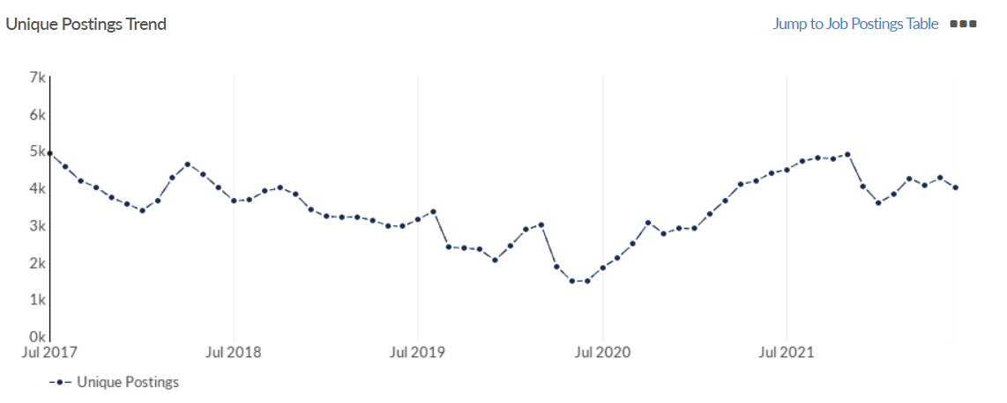
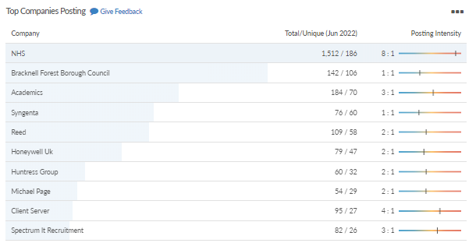
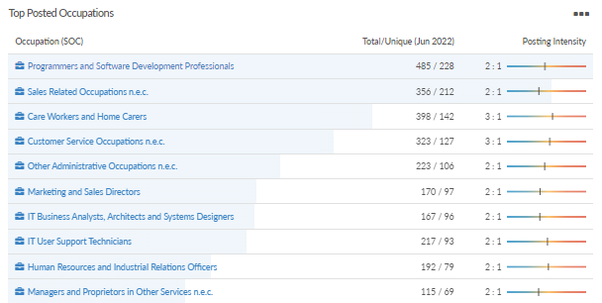
Job posting analytics (EMSI, June 2022)
Unique job postings: 3,995
Total job postings: 9,000
Job posting intensity: 2:1
Unique job postings (June 2021): 4,396

Slide 25
Slough

Slide 26
Unemployment figures and Notable Business News - June 2022
Claimant unemployment to May 2022 (latest)
5,385 claimants (5.7% of the working age population) in Slough UA
Notable business news:
SSE Thermal has published plans to increase electricity generation at its Multifuel Extension Project which is under construction in Slough, Berkshire. The Extension Project consists of a 450,000 tonne energy from waste plant under construction adjacent to a smaller, older heat and power plant which SSE owns. SSE acquired the original Slough Heat and Power Plant, located on the Slough Trading Estate in Berkshire, for £49.25 million in January 2008 – LINK.
Note: The LEP has been previously reporting on COVID-19 case rates in these monthly economic briefings. The dashboards containing this data have been shut down as of this month and, as a result, we will no longer be doing so.

Slide 27
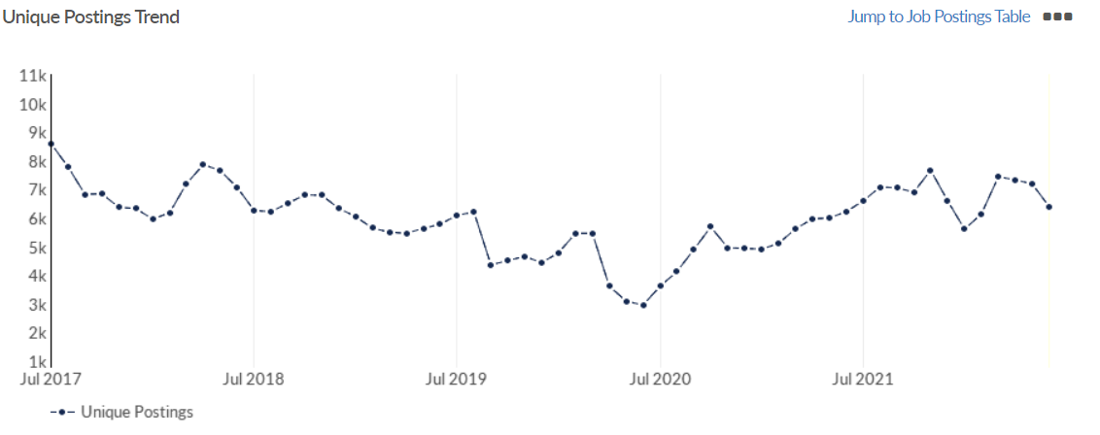
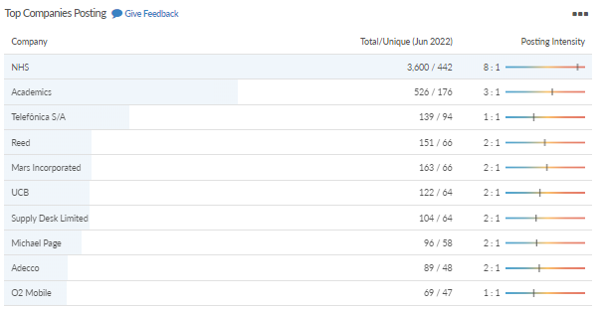
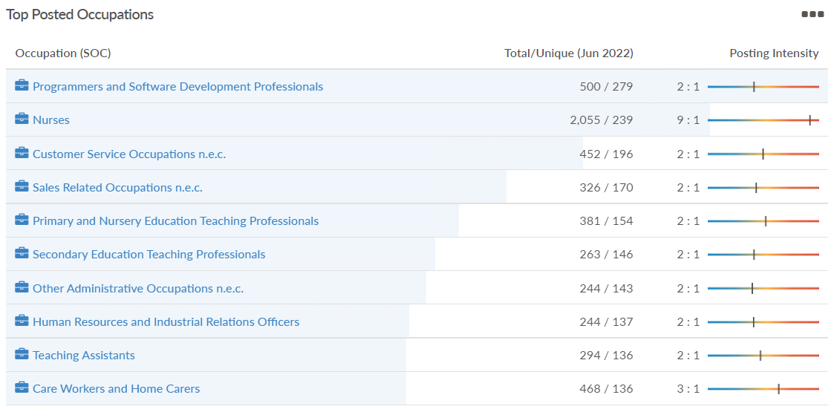
Job posting analytics (EMSI, June 2022)
Unique job postings: 6,396
Total job postings: 14,845
Job posting intensity: 2:1
Unique job postings (June 2021): 6,216

Slide 28
Reading

Slide 29
Unemployment figures and Notable Business News - June 2022
Claimant unemployment to May 2022 (latest)
4,450 claimants (4.2% of the working age population) in Reading UA
Notable business news:
Work on Mercedes-Benz commercial vehicle dealer group Rygor Commercials' new Reading home has begun. Building has started on the firm's custom-designed new site at the Worton Grange Industrial Park in South Reading. Rigg Construction recently broke ground on the £2million project. The site will have a large and modern sales showroom, as well as spacious truck and van workshop areas on the 44,00 square foot site – LINK.
Note: The LEP has been previously reporting on COVID-19 case rates in these monthly economic briefings. The dashboards containing this data have been shut down as of this month and, as a result, we will no longer be doing so.

Slide 30
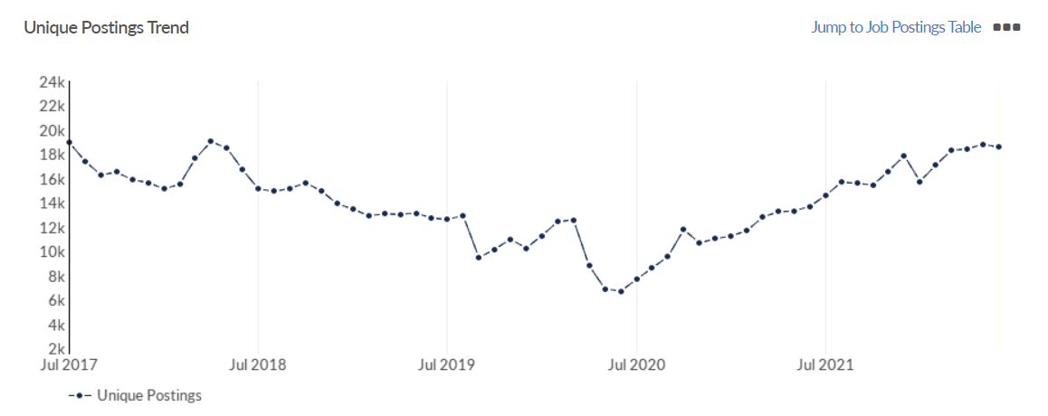
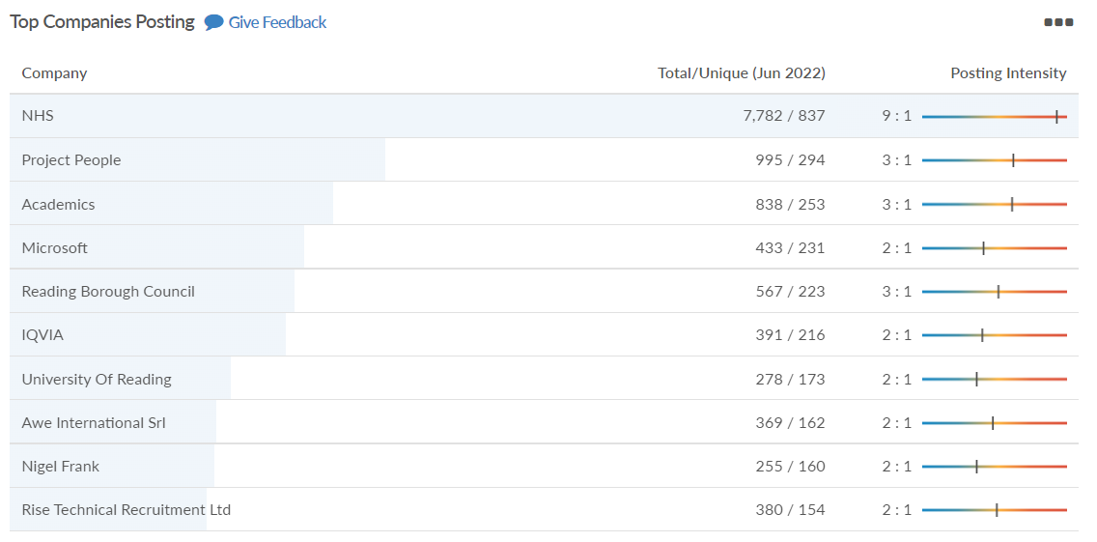
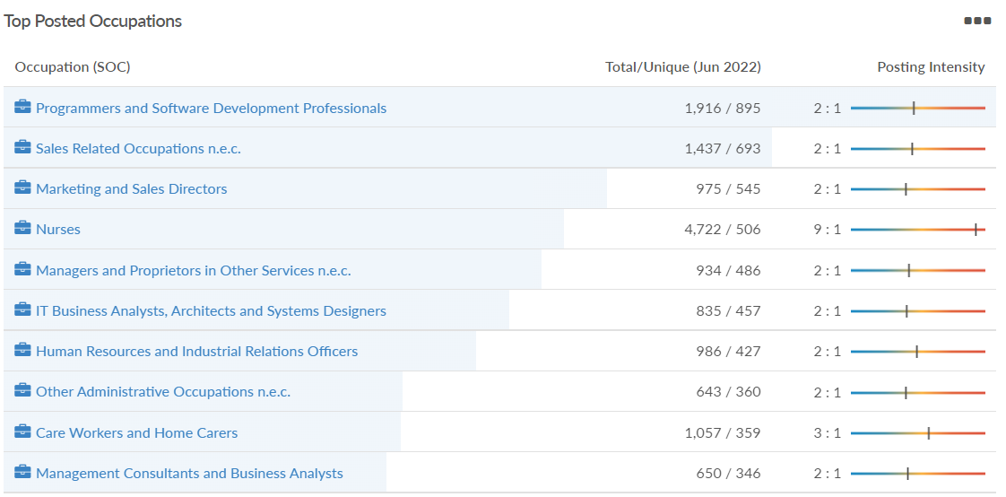
Job posting analytics (EMSI, June 2022)
Unique job postings: 18,570
Total job postings: 43,640
Job posting intensity: 2:1
Unique job postings (June 2021): 13,689

Slide 31
Wokingham

Slide 32
Unemployment figures and Notable Business News - June 2022
Claimant unemployment to May 2022 (latest)
1,655 claimants (1.6% of the working age population) in Wokingham UA
Notable business news:
In the past two years, Stage Fifty, alongside Winnersh Film Studios, has built Farnborough Film Studios and is currently building its third site in the UK, Wycombe Film Studio, to meet the increasing demand for high-quality stage space. Stage Fifty’s second film studio site in the UK, Winnersh Film Studios, will bring an estimated £50m economic boost to the UK economy annually, creating around 500 new jobs in the UK film and production sector, and supporting a further 500 indirect jobs in the supply chain – LINK.
Note: The LEP has been previously reporting on COVID-19 case rates in these monthly economic briefings. The dashboards containing this data have been shut down as of this month and, as a result, we will no longer be doing so.

Slide 33
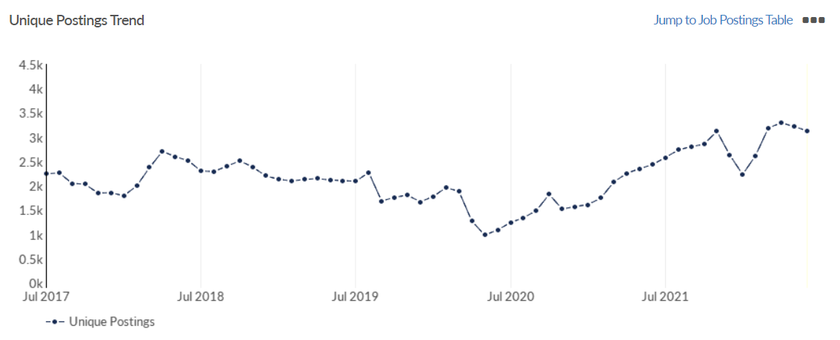
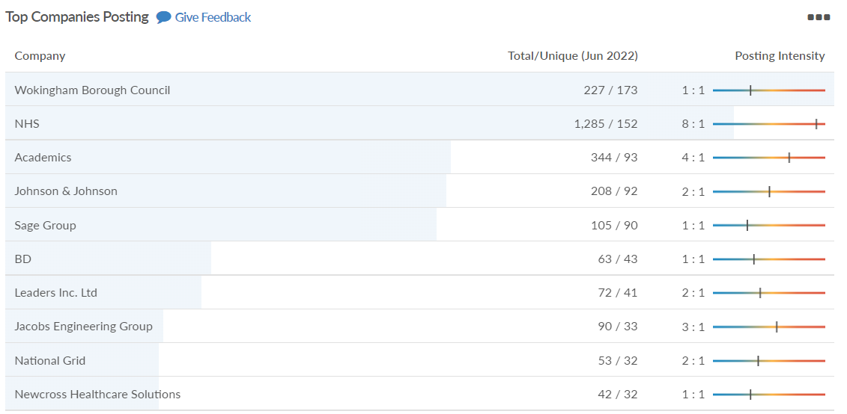
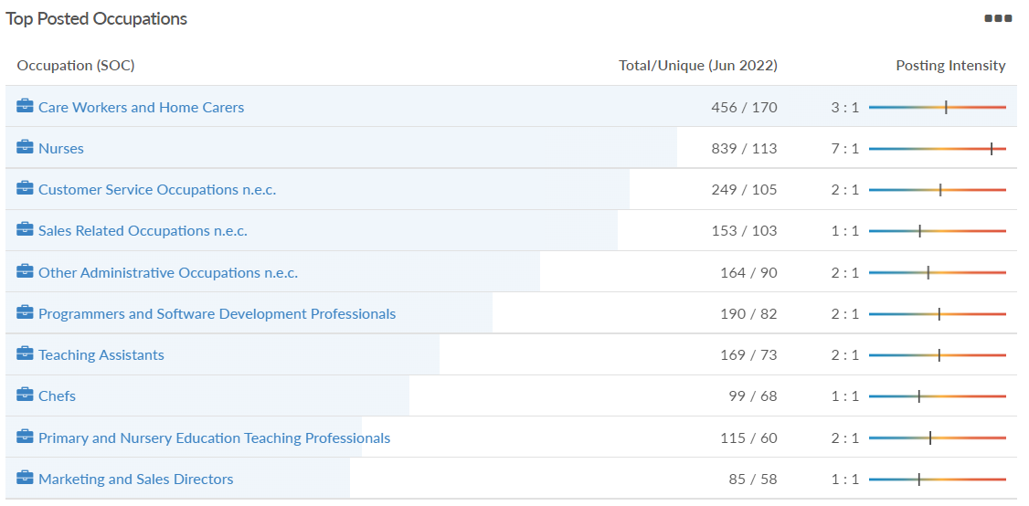
Job posting analytics (EMSI, June 2022)
Unique job postings: 3,131
Total job postings: 6,994
Job posting intensity: 2:1
Unique job postings (June 2021): 2,435

Slide 34
Windsor and Maidenhead

Slide 35
Unemployment figures and Notable Business News - June 2022
Claimant unemployment May 2022 (latest)
2,240 claimants (2.4% of the working age population) in Windsor and Maidenhead UA
Notable business news:
Car manufacturer Genesis Motor UK has opened its first UK headquarters after agreeing a lease on offices in Berkshire. The company appointed South East property consultants Kirkby Diamond to acquire their first UK headquarters. They have now signed a lease to acquire half of the third floor of Maidenhead’s Lantern House. An extensive refit has been carried out ahead of the move. The Korean car company, who will be Lantern House’s first tenants, has signed a 10-year lease on the 3,000 sq. ft office space on Marlow Road in Maidenhead town centre – LINK.
Note: The LEP has been previously reporting on COVID-19 case rates in these monthly economic briefings. The dashboards containing this data have been shut down as of this month and, as a result, we will no longer be doing so.

Slide 36
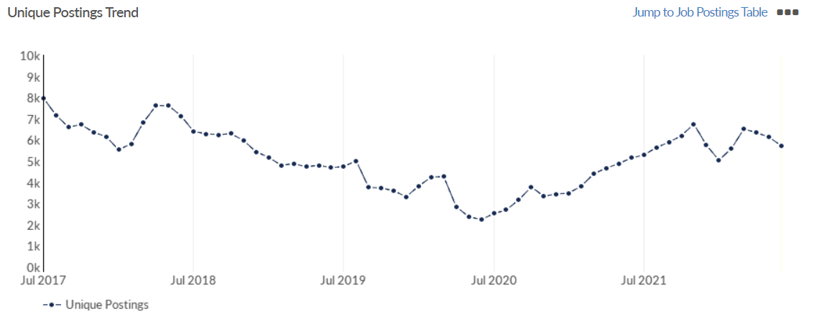
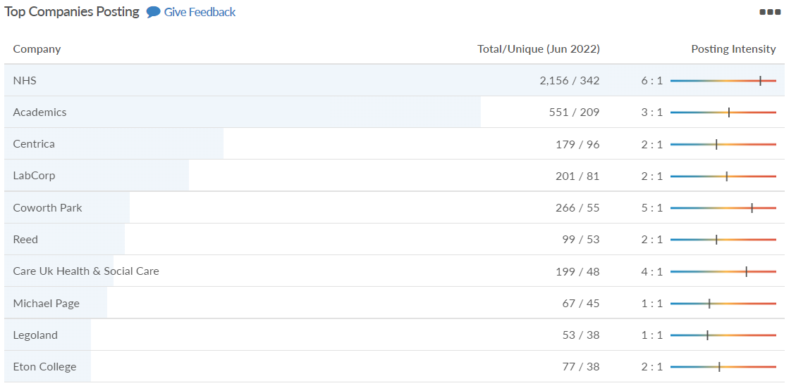
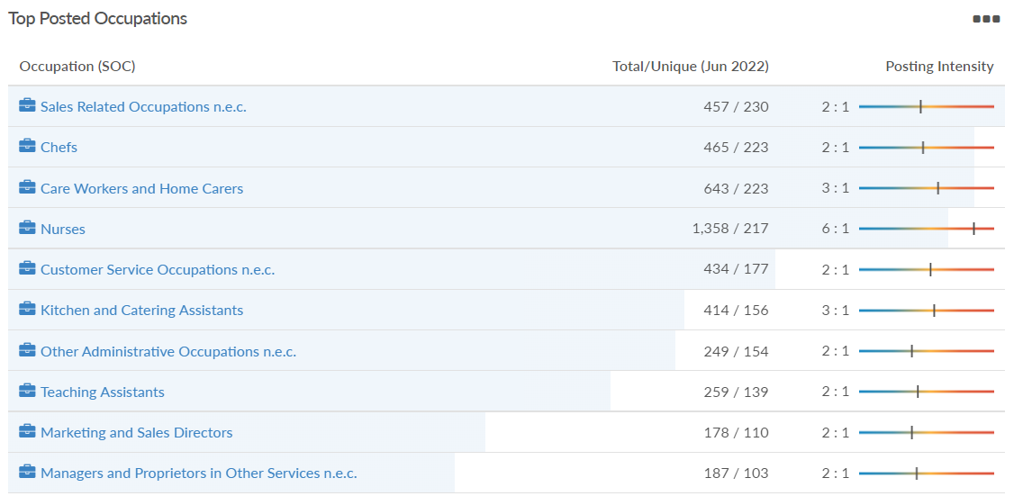
Job posting analytics (EMSI, June 2022)
Unique job postings: 5,721
Total job postings: 12,885
Job posting intensity: 2:1
Unique job postings (June 2021): 5,150

Slide 37
West Berkshire

Slide 38
Unemployment figures and Notable Business News - June 2022
Claimant unemployment to May 2022 (latest)
2,215 claimants (2.3% of the working age population) in West Berkshire UA
Notable business news:
Local community projects are to get a £100k boost following West Berkshire Council's latest funding round for Ward Members. The funding will enable improvements to key infrastructure such as village halls and community centres acknowledging the vital role they play in supporting communities. ​Successful bids include £20k towards playground improvements in Thatcham and £5k towards a new roof on the popular bandstand in Victoria Park in Newbury – LINK.
Note: The LEP has been previously reporting on COVID-19 case rates in these monthly economic briefings. The dashboards containing this data have been shut down as of this month and, as a result, we will no longer be doing so.

Slide 39
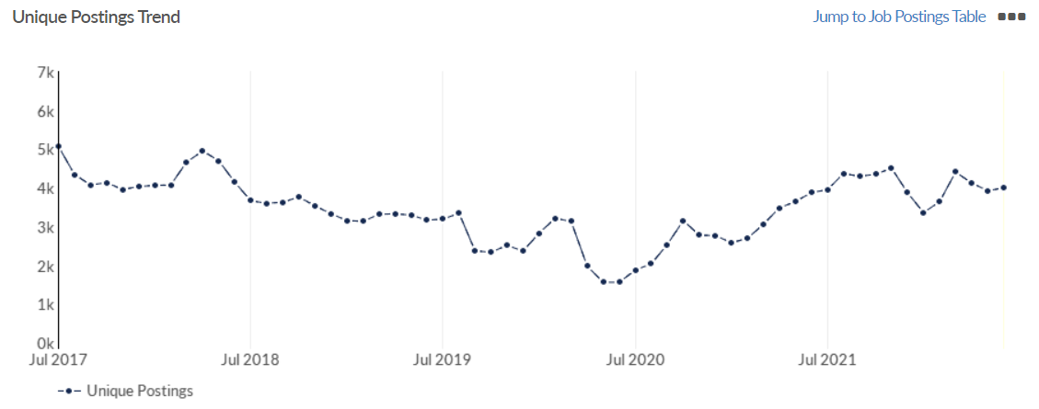
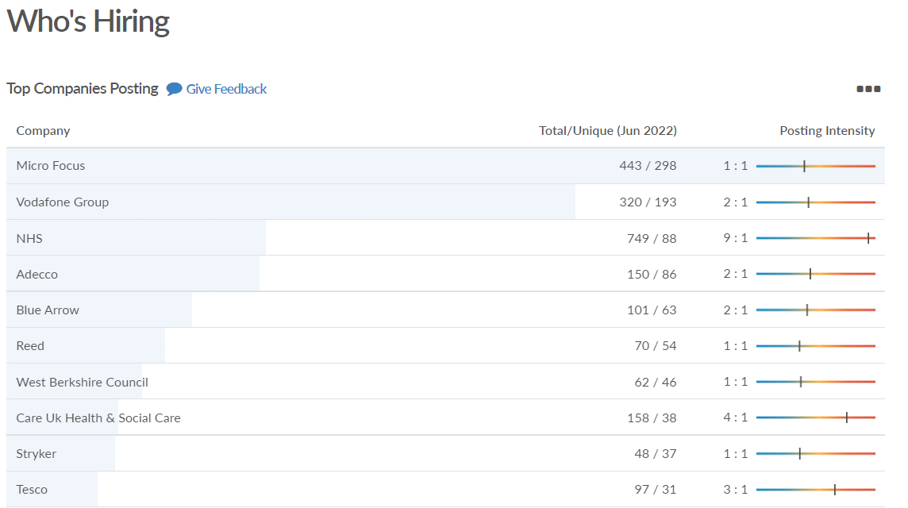
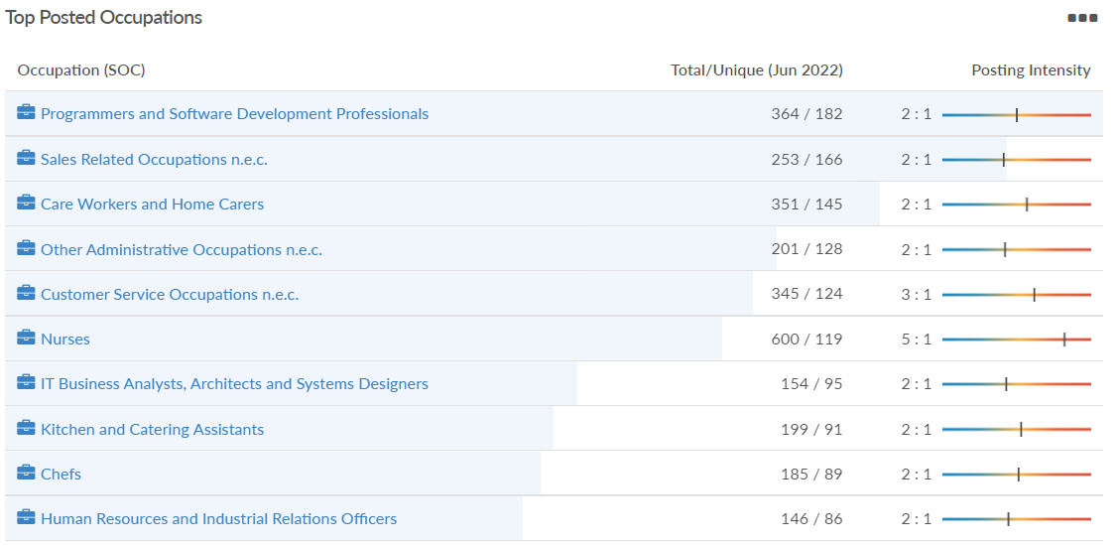
Job posting analytics (EMSI, June 2022)
Unique job postings: 3,997
Total job postings: 7,963
Job posting intensity: 2:1
Unique job postings (June 2021): 3,878

