Slide 1
Thames Valley Berkshire Monthly Economic Briefing
July 2021

Slide 2
Key contents of this month’s briefing
Updated global and UK economic forecasts
Latest furlough, SEISS and claimant count figures by Local Authority
Latest remote working figures for Thames Valley Berkshire
Latest ‘notable business news’ by Local Authority
Latest job posting analytics by Local Authority

Slide 3
Global and National Economy
July 2021

Slide 4
Global Economy
Economic prospects have diverged further across countries since the April 2021 World Economic Outlook (WEO) forecast. Vaccine access has emerged as the principal fault line along which the global recovery splits into two blocs: those that can look forward to further normalization of activity later this year (almost all advanced economies) and those that will still face resurgent infections and rising COVID death tolls. The recovery, however, is not assured even in countries where infections are currently very low so long as the virus circulates elsewhere.
The global economy is projected to grow 6.0 percent in 2021 and 4.9 percent in 2022. The 2021 global forecast is unchanged from the April 2021 WEO, but with offsetting revisions. Prospects for emerging market and developing economies have been marked down for 2021, especially for Emerging Asia. By contrast, the forecast for advanced economies is revised up. These revisions reflect pandemic developments and changes in policy support. The 0.5 percentage-point upgrade for 2022 derives largely from the forecast upgrade for advanced economies, particularly the United States, reflecting the anticipated legislation of additional fiscal support in the second half of 2021 and improved health metrics more broadly across the group.
Source: IMF, July 2021

Slide 5
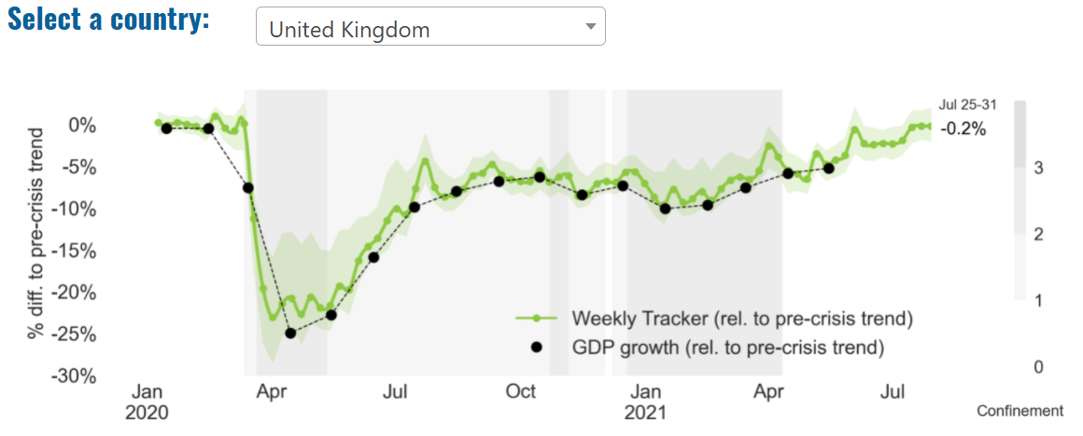
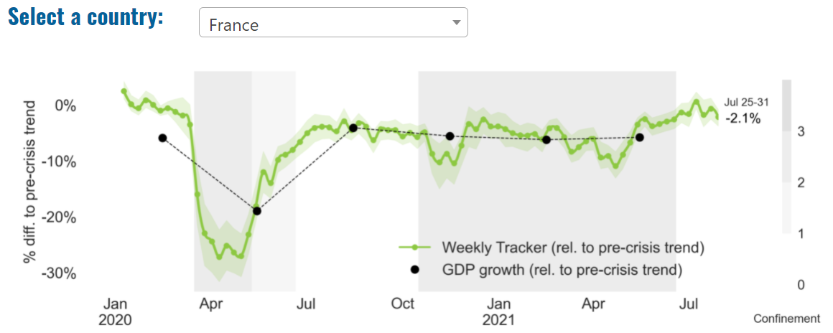
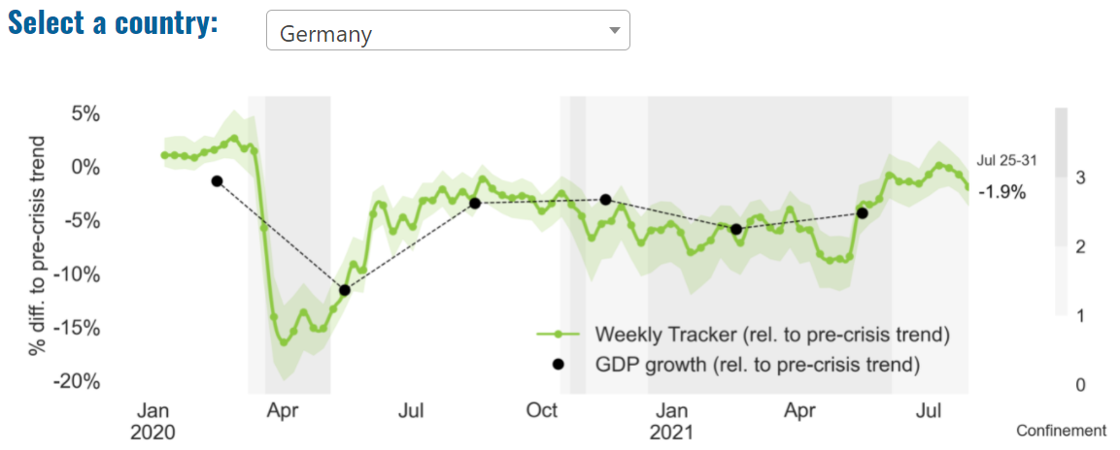
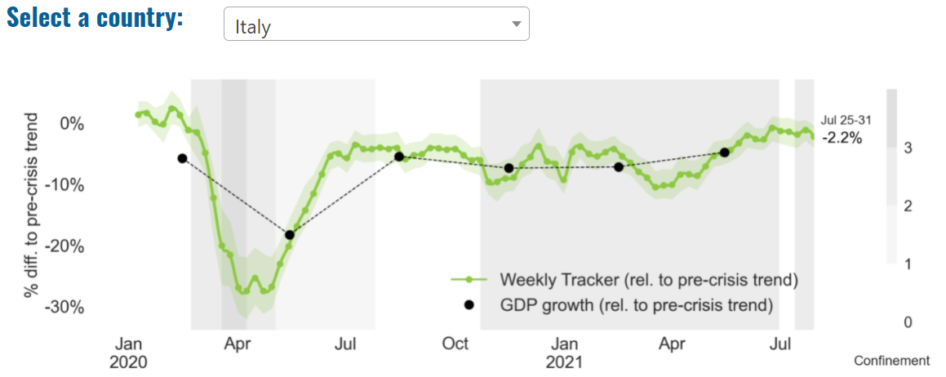
Global Economy – OECD GDP Tracker

Slide 6
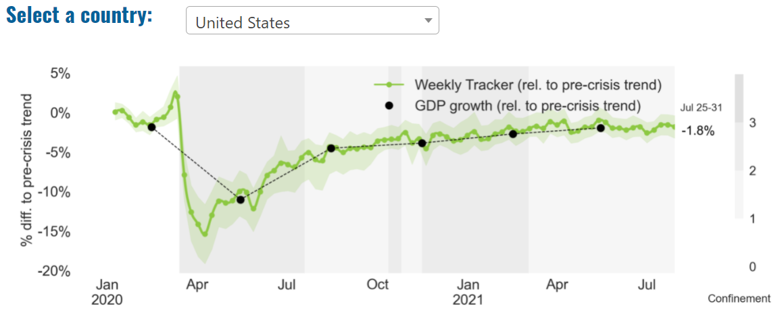
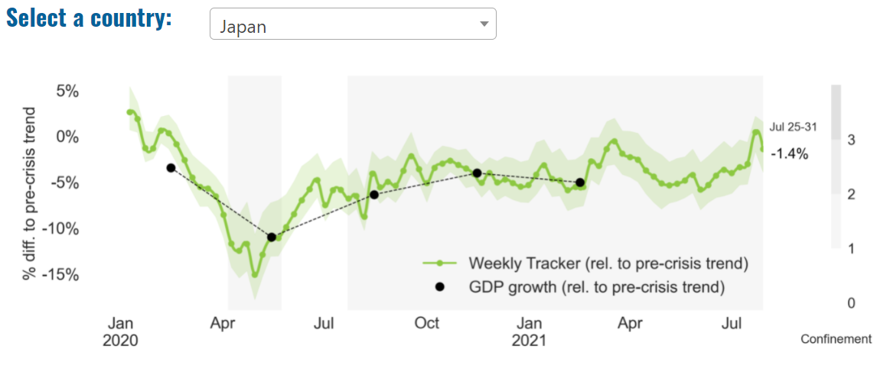
Global Economy – OECD GDP Tracker Continued
China
China is not included within the OECD GDP tracker and so the graph on the left has been compiled using statistics from the IMF and National Bureau of Statistics of China. The 2021 figure is a preliminary figure published by the National Bureau of Statistics of China in January 2021.
Note: The green confidence band shows 95% confidence intervals. The Weekly Tracker is an estimate of weekly GDP relative to the pre-crisis trend, which is proxied by the November 2019 OECD Economic Outlook forecasts. The darkness of the grey background reflects stay-at-home confinement requirement based on the Oxford Blavatnik database (0 - no measures, 1 - recommend not leaving house, 2 - require not leaving house with exceptions, 3 - require not leaving house with minimal exceptions). Source: OECD, July 2021

Slide 7
UK Economy
May’s month-on-month growth of 0.8% disappointed, with little sign of momentum in either April or May outside the sectors which grew due to the lifting of Covid-19 restrictions. With several indicators showing slowing activity after the spring momentum, we expect growth in June of 0.9 per cent, and 4.8 per cent for the second quarter of 2021 overall. With catch-up potential still evident in hospitality, transport, business support and the arts, we forecast growth of 1.9 per cent in the third quarter, still notably above historical trend growth rates. But with Covid-19 cases rising again, and consumer caution evident, the lifting of further restrictions on July 19th risk boosting the economy in the short term at the expense of a longer lasting and more sustainable recovery. Much will depend on the roll-out and efficacy of the vaccines in the context of the Delta variant.
Deloitte’s latest forecast for UK GDP expects stronger growth in 2021 than previously projected, in light of strong economic data in March and April and steady progress in easing restrictions, rolling out vaccinations and a low rate of new COVID-19 infections. The global outlook has also improved, driven by the large US fiscal stimulus and a faster pace of vaccinations in the EU. Deloitte has incorporated a slowdown in the recovery in the final quarter of 2021 and the first quarter of 2022 as the economy returns close to its pre-pandemic size and to reflect to possibility the some restrictions (albeit not as disruptive as the previous lockdowns) may be imposed to prevent a resurgence of the virus.
Sources: NIESR, July 2021; Deloitte, July 2021

Slide 8
UK Economy 2
We expect economic momentum to continue as the remaining restrictions are lifted on 19 July. We are forecasting GDP growth of 7.7% in 2021, with economic activity returning to pre-pandemic levels in Q4 of this year.
Rising Covid-19 cases continue to pose a downside risk to the outlook. Though the link between rising cases and hospitalisations has weakened, evidence suggests that consumer confidence can be impacted by rising case numbers. This may slow the return to normal patterns of leisure spending.
The number of payrolled employees increased for the sixth consecutive month and the headline unemployment rate edged down to 4.7% in the three months to May. Job vacancies are back at pre-pandemic levels, with concerns of labour shortages in some sectors. The end of the furlough scheme has been timed about right with demand picking up and expected to remain strong. While this will minimise the degree of job losses in 2021, there will inevitably be some job losses and this is reflected in our current forecast.
The UK is experiencing a spike in inflation. But this largely the result of base effects whereby current prices are being compared with the depressed prices a year ago at the start of the pandemic. As this is likely to be only a temporary spike, we expect the Bank of England to keep interest rates on hold. Long-term interest rates are expected to drift upwards from the very low levels seen during the pandemic, but we remain in a lower-for-longer interest rate environment
Source: CBRE, July 2021

Slide 9
UK Economy 3
The British economy is growing at its fastest pace in 80 years and could recover its pre-pandemic size by the end of this year, according to a leading economic forecaster.
Buoyed by the vaccine rollout and a bounce back in consumer spending, the EY Item Club said it now expected GDP to grow by 7.6% – which would be the fastest annual growth in national income since 1941. The UK economy shrank by 9.8% in 2020, the worst performance in the G7.
The optimism comes despite the chaos caused by widespread staff shortages as workers self-isolate en-masse after being pinged by NHS test and trace. The “pingdemic” is affecting the running of shops, restaurants, factories and even railway services as bosses struggle to find staff to cover shifts.
Although the economy has proved increasingly resilient through lockdowns, the EY Item Club report came with the health warning that the “future pattern of the pandemic and any renewed pandemic-related restrictions will have a significant bearing on whether the forecast is achieved”.
The UK economy is more dependent on consumer spending on services, such as recreation and leisure activities, which meant that the lockdowns had a greater economic impact than in other countries, said Martin Beck, the EY Item Club’s senior economic adviser. The reopening of these “face-to-face parts of the economy means the UK should have a correspondingly faster recovery”, he said. Source: The Guardian, July 2021

Slide 10
Coronavirus and Recession: Implications for Thames Valley Berkshire

Slide 11
Furloughing (Latest data - June 2021)
28,900 jobs furloughed across Thames Valley Berkshire
3,700 jobs (6% of total eligible employments) furloughed in Bracknell Forest UA
7,100 (10% of total eligible employments) furloughed in Slough UA
4,700 jobs (5% of total eligible employments) furloughed in Reading UA
4,500 jobs (5% of total jobs) furloughed in Wokingham UA
5,200 jobs (8% of total jobs) furloughed in Windsor and Maidenhead
3,700 jobs (5% of total jobs) furloughed in West Berkshire
Source: HMRC, July 2021
Berkshire has a lower-than-average number of furloughed workers, compared to the rest of the UK, because of its relative strength in sectors of industry that can be continued by workers from home.

Slide 12
SEISS (Latest data - June 2021)
Total value of claims made across Thames Valley Berkshire: £80,500,000
Total value of claims made for Bracknell Forest UA – SEISS 4: £12,400,000
Total value of claims made for Slough UA – SEISS 4: £17,500,000
Total value of claims made for Reading UA – SEISS 4: £12,900,000
Total value of claims made for Wokingham – SEISS 4: £12,800,000
Total value of claims made for Windsor and Maidenhead – SEISS 4: £12,200,000
Total value of claims made in West Berkshire – SEISS 4: £12,700,000
Source: HMRC, July 2021

Slide 13
Claimant Count (Latest data - June 2021)
Total of 25,780 claimants (4.5% of the working age population) in Thames Valley Berkshire
2,750 claimants (3.5% of the working age population) in Bracknell Forest UA
7,235 claimants (7.6% of the working age population) in Slough UA
6,350 claimants (5.9% of the working age population) in Reading UA
2,815 claimants (2.7% of the working age population) in Wokingham UA
3,380 claimants (3.7% of the working age population) in Windsor and Maidenhead UA
3,255 claimants (3.4% of the working age population) in West Berkshire UA
Across Thames Valley Berkshire, claimant unemployment has fallen significantly from 28,335 in June 2020 to 25,780 in June 2021. Slough had 7.6% of its working age population claim unemployment in June 2021, down slightly from 7.% in June 2020.
Source: ONS, June 2021

Slide 14
Strategic Issues: Heathrow
Heathrow Airport
Figures released by the UK’s busiest airport, London Heathrow (LHR/EGLL) show that it has lost £2.9bn since the start of the pandemic in 2020. The airport said that the first half if 2021 saw less than 4 million passengers passed through its terminals, something which would have been achieved in less than 3 weeks pre-pandemic. Heathrow did say that demand for air travel was increasing but warned that it could still see fewer passengers in 2021 than it did in 2020 with the ongoing travel restrictions and uncertainty, despite recent changes to the governments traffic light system. Heathrow CEO John Holland-Kaye said: “The UK is emerging from the worst effects of the health pandemic, but is falling behind its EU rivals in international trade by being slow to remove restrictions. Replacing PCR tests with lateral flow tests and opening up to EU and US vaccinated travelers at the end of July will start to get Britain’s economic recovery off the ground.”
Source: UK Aviation News, July 2021

Slide 15
Strategic Issues: Aviation
Aviation:
The London High Court in the UK has turned down the legal challenge filed by Manchester Airports Group (MAG) and other airline companies against the UK Government’s traffic lights system for travelers entering Britain. In June, MAG in the UK reportedly partnered with Irish airline company Ryanair to launch a legal action against the government over the travel traffic light system.
The complaint was filed against the Department for Transport and the Department of Health and Social Care. This legal challenge sought more transparency on how the countries are being classified by the government. The litigation, led by MAG, was also supported by British Airways owner IAG, TUI, EasyJet and Virgin Atlantic in addition to Ryanair. In their appeal to the court, airports and airline companies have raised concerns over the government’s traffic light system, which classifies countries based on their Covid-19 risk. They argued that the decisions were not based on data. Although the court partially accepted the argument against the government, the final decision was given in favour of the government. Source: Airport Technology, July 2021

Slide 16
Demand and Supply Conditions: Businesses, Hiring, Restructuring, Investment, Labour and Skills Supply

Slide 17
Household/Consumer Demand
Slough had an overall recovery index score of 61 at the end of May, putting them in a stronger position in terms of recovery (closer to pre-lockdown levels) than Reading which had a recovery index score of 51.
Source: Centre for Cities, July 2021 (latest release)
Retail sales volumes increased by 0.5% between May and June 2021, and were up 9.5% when compared with their pre-coronavirus (COVID-19) pandemic February 2020 levels. The largest contribution to the monthly increase in June 2021 came from food stores where sales volumes rose by 4.2%, with anecdotal evidence suggesting these increased sales may be linked with the start of the Euro 2020 football championship. Non-food stores reported a fall of 1.7% in sales volumes in June 2021 when compared with May 2021, driven by falls in household goods stores, such as furniture stores and clothing stores.
Automotive fuel sales increased by 2.3% over the month, as people continued to increase their amount of travel; however, they remain 2.1% below their pre-coronavirus pandemic February 2020 levels. The volume of sales for the three months to June 2021 was 12.2% higher than in the previous three months, driven in large part by particularly strong sales in April when non-essential retailing re-opened; strong three-month growth was seen in non-food retailers and automotive fuel sales of 35.8% and 23.6% respectively. The proportion of retail sales conducted online remains substantially higher than before the pandemic, but in June most retail sectors reported a fall in their proportions of online sales as consumers returned to physical stores; the total proportion of sales online decreased to 26.7% in June 2021, down from 28.4% in May 2021.
The large increase in sales volumes in April, followed by a relatively small fall in May, has resulted in the volume of sales for the three months to May 2021 being 8.3% higher than in the previous three months; there was strong growth in automotive fuel sales and non-food retailers of 19.3% and 17.8% respectively. The proportion of retail sales conducted online remains substantially higher than before the pandemic, but in May all retail sectors, with the exception of food stores, reported a fall in their proportions of online sales as consumers returned to physical stores; the total proportion of sales online decreased to 28.5% in May 2021, down from 29.8% in April 2021. In comparison with February 2020, the value of total online retail sales in May 2021 was 58.8% higher, whereas in-store sales were 1.3% lower. Retail sales volumes in May 2021 were 24.6% higher than in May 2020, which was affected by the first national lockdown when the tightest restrictions were in place; however, these growth rates are distorted by base effects and are not a reliable guide. Source: ONS, July 2021 (latest release)

Slide 18
Industries at Risk
MANUFACTURING
28,000 people work in manufacturing in Berkshire – with 11,000 in West Berkshire alone and 2,487,000 across the whole of Great Britain (ONS, 2020)
Half of all UK manufacturing firms have made redundancies. A further 20% plan to make more redundancies in the next six months (Make UK, October 2020)
37% of manufacturers think it will take more than a year to return to normal trading conditions (Make UK, October 2020)
HOSPITALITY & TOURISM
The hospitality and tourism sector in Berkshire employed 35,842 people in 2020 – an increase of 0.8% on the previous year (EMSI, 2021)
In June, ‘Pathways to Recovery’, a report by the All Party Parliamentary Group on Hospitality and Tourism, found that just 11% of hospitality businesses had been able to operate normally during the first lockdown and international tourist arrivals were likely to be down 59% for the year.
Kate Nicholls, CEO of UK Hospitality, told the BBC (December 2020) that 30,000 hospitality businesses – most of them SMEs and one-third of the total – could be lost by the end of 2020.
According to Sky News in December, at least 38,653 hospitality jobs had been lost during the pandemic.
CONSTRUCTION
21,000 people work in construction in Berkshire – with only 1,500 of these working in Bracknell Forest and 2,164,000 across the whole of Great Britain (ONS, 2020)
The level of construction output in August 2020 was 10.8% below the February 2020 level (ONS, 2020)
Construction output grew by 18.5% in the three months to August 2020 compared with the previous three-month period, but this followed 10 consecutive periods of decline (ONS, 2020)
NON-FOOD RETAIL & WHOLESALE
More than 45,000 people work in non-motor vehicle retail in Berkshire – with 12,500 of them working in Reading (EMSI, 2021). The offline retail sector has struggled during the pandemic. At least 39,000 jobs had been lost in retail as of 3 December. Redundancy announcements include 7,000 at Marks and Spencer (August), 4,000 at Debenhams (August) and 4,000 at Boots (July) - Sky News, 2020.
The pre-pandemic trend of on-line shopping has strengthened in 2020; a record total of 31.4% of shopping was done on line in November 2020 (ONS, 2020), a trend that will have profound implications for the high street.
In November, retail sales volume decreased by 3.8% (vs October figures) as a result of COVID-19. Despite this, overall sales remain above their pre-pandemic levels (ONS, 2020).
ARTS, ENTERTAINMENT & RECREATION
12,000 people work in arts, entertainment and recreation in Berkshire. 4,500 of them – more than one third – work in Windsor and Maidenhead and 925,000 across the whole of Great Britain (ONS, 2020)
Between 19 Nov and 1 Dec, 24 per cent of arts, entertainment and recreation venues had temporarily closed or paused trading. (ONS, 2020)
52% of eligible employments in arts, entertainment and recreation were on furlough on 31 July 2020 – a figure that had fallen to 24% as at 31 October. (HMRC, 2020)
AVIATION
Aviation has an estimated value of £28 billion to the UK economy, employing 230,000 workers at over 40 commercial airports. (House of Commons Transport Committee, June 2020)
76,000 people work in over 400 business across Heathrow Airport. Many of these people live in Slough, in Berkshire. (Heathrow local recovery plan, 2020)
There were 5,800 passenger flights in April 2020 compared to 201,000 a year earlier: a reduction of 97%. The impact is several times more severe than the aftermath of the global financial crisis in 2008, when passenger flights reduced by around 67,000 to 134,000 per month. (House of Commons Transport Committee, June 2020)
The UK aviation industry has been hit harder than any European country by the pandemic with IATA calculating that the “coronavirus crisis will cost 780,000 British jobs and cost £46bn in lost GDP.” (International Air Transport Association, 2020).
ADMINISTRATION & SUPPORT
More than 51,000 people in Berkshire work in admin and support services – including 10,000 in Wokingham and 10,000 in West Berkshire and 2,752,000 across the whole of Great Britain (ONS, 2020)
More than 600,000 admin and support workers – 27% of the total – were furloughed as at 31 October (HMRC, 2020)

Slide 19
Industries more likely to be resilient/grow – retail, alcohol manufacturing and cosmetics
Consumer staples
Grocery stores and discount retailers
Alcoholic beverage manufacturing
Cosmetics
Death and funeral services
Sources: Investopedia, July 2021.
From this analysis, it is apparent that (as alluded to in previous monthly reports) IT, and e-commerce by extension, as well as home improvement and fitness related industries and those which have so far demonstrated the greatest resilience in the face of the COVID-19 pandemic and are predicted to see some of the highest growth throughout 2021.

Slide 20
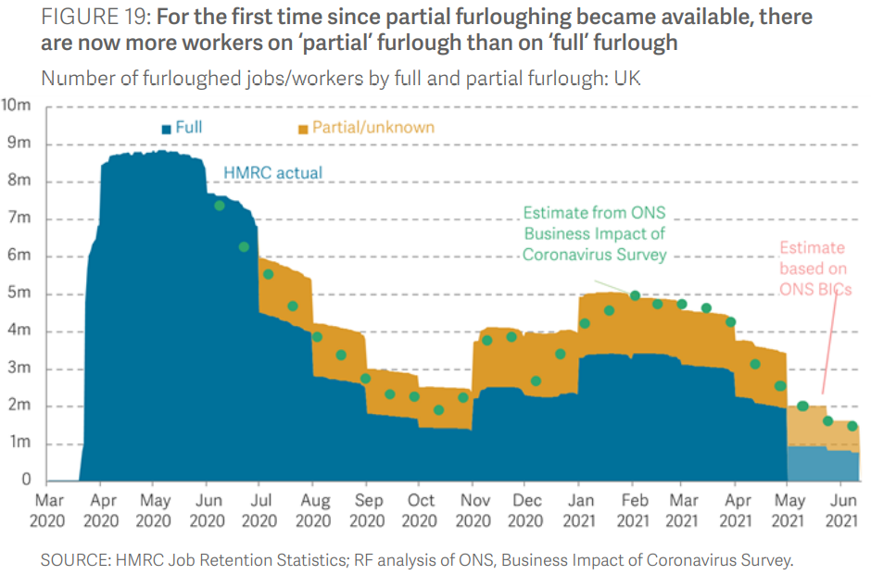
Supply of labour and skills
A Resolution Foundation survey found that in the last week of May, only a minority (49 per cent) of furloughed respondents were ‘fully’ furloughed, down from 73 per cent of furloughed respondents in February. Similarly, the latest data points from ONS’s BICs survey suggests the share of furloughed employees on ‘full’ furlough at the end of May fell below 50 per cent (48.7 per cent) for the first time since the ‘partial’ furlough option became available in July 2020
Source: Resolution Foundation, July 2021

Slide 21
Remote working
In July of 2021, there were 3,388 unique job postings for remote positions at companies based in Berkshire, around 285% more than the figure of 881 for the same period one year previous.
Compare this with the South East, in July 2021 there were 22,166 unique remote job postings for remote positions; rising from 5,641 in July of the previous year – an increase of over 292%
A rise can also be seen at national level, with a recorded 140,915 unique remote job postings in England in July of 2021, rising from 35,824 in July 2020 – an increase of over 293%.
From these figures it’s apparent that the COVID-19 pandemic has, somewhat unsurprisingly, prompted a massive boost in job postings for explicitly remote roles. Berkshire has seen a slightly smaller boost in vacancies which are remote-based than both England and the South East.
Source: EMSI, July 2021

Slide 22
Local Profiles

Slide 23
Bracknell Forest

Slide 24
Impact of COVID-19 up to 9th August 2021
COVID-19 cases (to 9th August 2021) – Source: Public Health Berkshire COVID-19 Dashboard, 9th August 2021
9,969 total cases
36 new cases daily
Claimant unemployment (to June 2021)
2,750 claimants (3.5% of the working age population) in Bracknell Forest UA
Notable business news:
Artificial intelligence is on the cards for a Bracknell-based firm, which has recently partnered with Google. Content Guru, which offers cloud communication services, has teamed up with Google’s AI scheme to improve its customer engagement work. Google’s Cloud Contact Centre Artificial Intelligence (CCAI) work will integrate with Content Guru’s Storm service to support intelligent chatbots and text-to-speech systems. Martin Taylor, deputy CEO at Content Guru, said he was delighted to partner with Google. “Our new partnership will make it even easier for Content Guru’s customers to benefit from the use of AI technologies in their day-to-day contact center and customer engagement operations,” he said.
Source: Wokingham Today, July 2021

Slide 25
Industries hit hardest by COVID shutdown
As illustrated by the above graph, Bracknell Forest has suffered very similarly to Great Britain in terms of the percentage of jobs within industries which have been hit hardest by COVID shutdowns. Thames Valley Berkshire area has seen an additional 0.77% of jobs of jobs affected worst by the COVID shutdowns when compared to Bracknell Forest.
Source: EMSI, March 2021 (definition for industries hit hardest provided on slide 53)

Slide 26
Industry risks and opportunities (2020-2021)
Critical industries
Food and drink retail: 3,234 employees (1% below the national average)
Energy/utilities: 257 employees (65% below the national average)
Health and social care: 6,193 employees (25% below the national average)
Freight/logistics: 515 employees (70% below the national average)
Insurance: 186 employees (69% below the national average)
Banking and financial services: 1,291 employees (13% below the national average)
Sectors most impacted
Hospitality and tourism: 3,743 employees (26% below the national average)
Arts, entertainment and recreation: 1,148 (24% below the national average)
Admin and support: 2,694 (21% below the national average)
Aviation: 0 employees
Non-food retail and wholesale: 8,508 (75% above the national average)
Manufacturing: 1,549 (69% below the national average)
Construction: 1,771 (40% below the national average)
Source: EMSI, January 2021

Slide 27
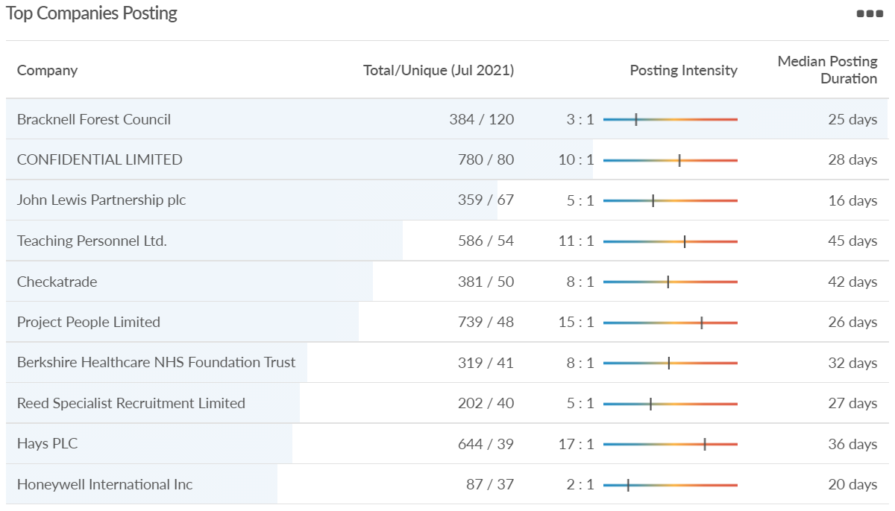
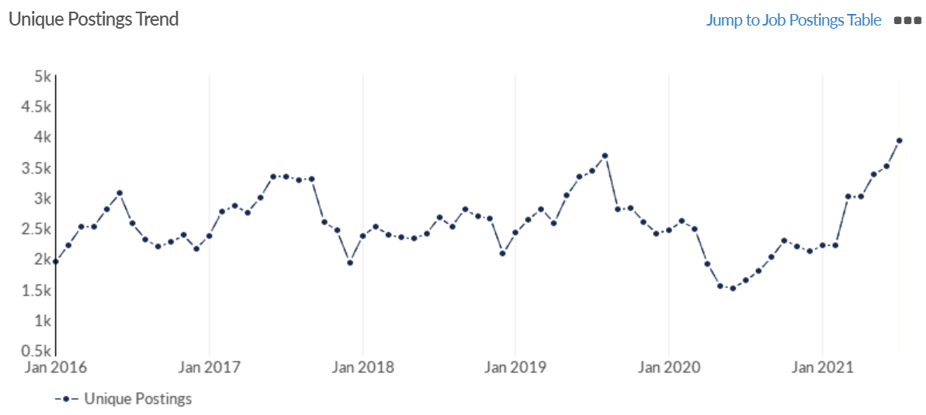
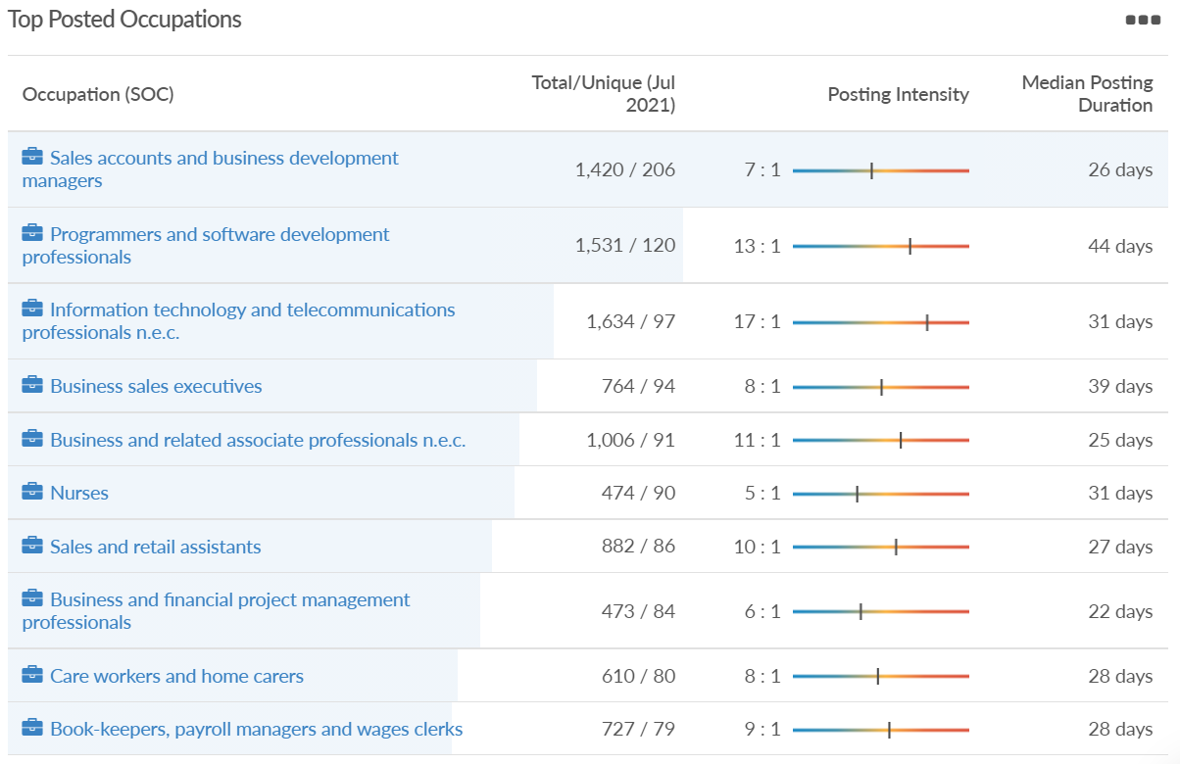
Job posting analytics (EMSI, July 2021)
Unique job postings: 3,937
Total job postings: 31,545
Job posting intensity: 8:1
Unique job postings (July 2020): 1,636

Slide 28
Slough

Slide 29
Impact of COVID-19 up to 9th August 2021
COVID-19 cases (to 9th August 2021) – Source: Public Health Berkshire COVID-19 Dashboard, 9th August 2021
18,164 total cases
32 new cases daily
Claimant unemployment (to June 2021)
7,235 claimants (7.6% of the working age population) in Slough UA
Notable business news:
The bubble tea craze has arrived in Slough following the opening of a new store in Farnham Road. The tea-based concept originated in Taiwan and features tapioca bubbles which make it ‘the drink that you can chew’. Brothers Aadil and Sabeel Asghar decided to launch a CUPP Bubble Tea branch in Farnham Road due to the area’s increasing popularity for food and drink lovers from across Berkshire.
Source: Slough Express, July 2021

Slide 30
Industries hit hardest by COVID shutdown
When compared to both Thames Valley Berkshire and Great Britain, Slough has seen a significantly lower percentage of jobs affected by COVID shutdowns – perhaps somewhat surprising given the LA’s proximity to Heathrow and the almost complete shutdown of the aviation sector.
Source: EMSI, March 2021 (definition for industries hit hardest provided on slide 53)

Slide 31
Industry risks and opportunities (2020-2021)
Critical industries
Food and drink retail: 6,656 employees (47% above the national average)
Energy/utilities: 2,820 employees (174% above the national average)
Health and social care: 8,201 employees (28% below the national average)
Freight/logistics: 4,640 employees (93% above the national average)
Insurance: 121 employees (86% below the national average)
Banking and financial services: 731 employees (65% below the national average)
Sectors most impacted
Hospitality and tourism: 3,780 employees (46% below the national average)
Arts, entertainment and recreation: 442 (79% below the national average)
Admin and support: 9,765 (107% above the national average)
Aviation: 262 employees (16% above the national average)
Non-food retail and wholesale: 6,719 (0% above the national average)
Manufacturing: 5,071 (28% below the national average)
Construction: 2,620 (36% below the national average)
Source: EMSI, January 2021

Slide 32
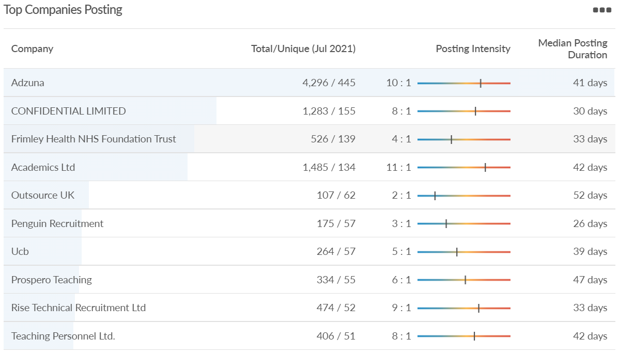
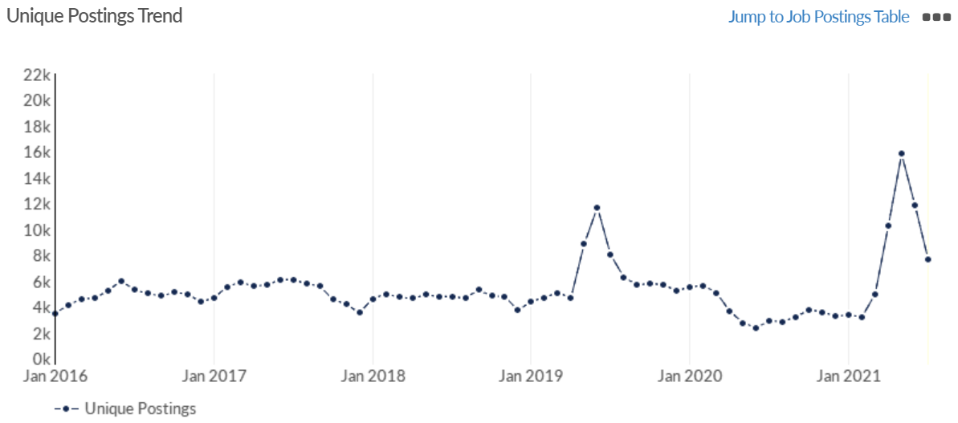
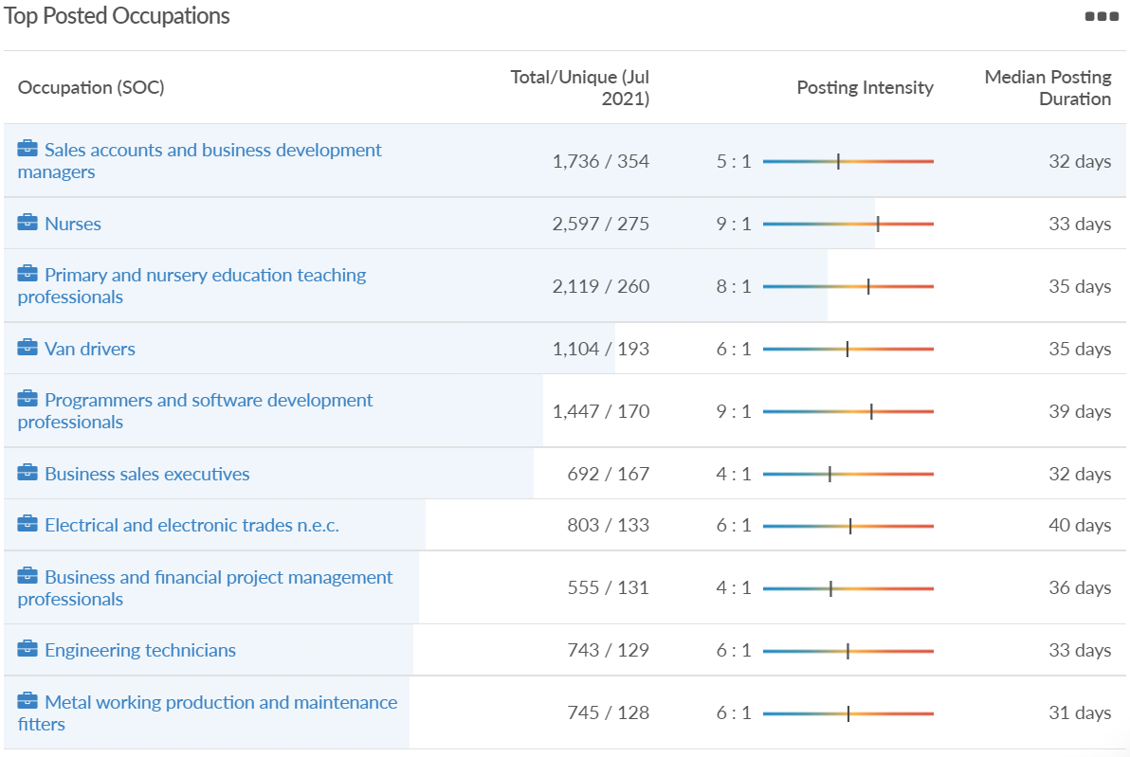
Job posting analytics (EMSI, July 2021)
Unique job postings: 7,688
Total job postings: 44,662
Job posting intensity: 6:1
Unique job postings (July 2020): 2,878

Slide 33
Reading

Slide 34
Impact of COVID-19 up to 9th August 2021
COVID-19 cases (to 9th August 2021) – Source: Public Health Berkshire COVID-19 Dashboard, 9th August 2021
14,905 total cases
84 new case daily
Claimant unemployment (to June 2021)
6,350 claimants (5.9% of the working age population) in Reading UA
Notable business news:
The first UK branch of a Dutch fast food takeaway chain will open in the center of Reading. Chipstar will open at an empty unit next to The Alehouse in the town center after plans were approved last week. The company specialises in Dutch fries and describes itself as ‘potato experts’. It will take over the Grade II-listed unit in Broad Street, which was most recently home to Vape Superstore, and make changes to the shopfront and internal layout. Reading Borough Council approved the plans despite initial concerns over noise, odour and design. Chipstar adapted its proposal during a four-month consultation to address the issues raised, eventually satisfying the council.
Source: BerkshireLive, July 2021

Slide 35
Industries hit hardest by COVID shutdown
Reading has been marginally less affected by the COVID shutdowns as Great Britain has on average, with 15.16% of jobs within industries which have been most severely impacted by the shutdowns. The Local Authority is 1.26% better off than the average of the Thames Valley Berkshire area.
Source: EMSI, March 2021 (definition for industries hit hardest provided on slide 53)

Slide 36
Industry risks and opportunities (2020-2021)
Critical industries
Food and drink retail: 6,192 employees (11% above the national average)
Energy/utilities: 3,350 employees (163% above the national average)
Health and social care: 13,464 employees (5% below the national average)
Freight/logistics: 1,513 employees (49% below the national average)
Insurance: 2,076 employees (100% above the national average)
Banking and financial services: 1,688 employees (34% below the national average)
Sectors most impacted
Hospitality and tourism: 6,567 employees (25% below the national average)
Arts, entertainment and recreation: 1,811 (31% below the national average)
Admin and support: 9,212 (58% above the national average)
Aviation: <10 employees
Non-food retail and wholesale: 8,626 (18% above the national average)
Manufacturing: 2,000 (77% below the national average)
Construction: 2,273 (55% below the national average)
Source: EMSI, January 2021

Slide 37
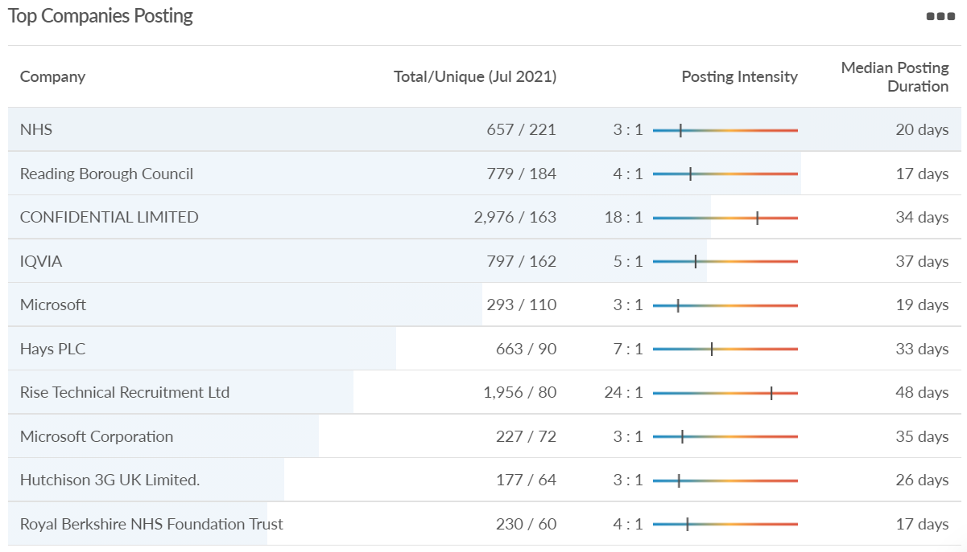
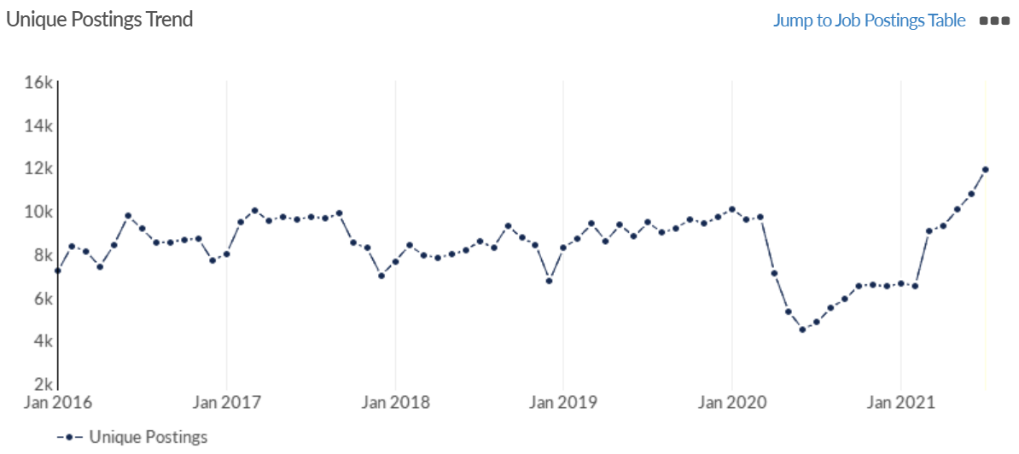
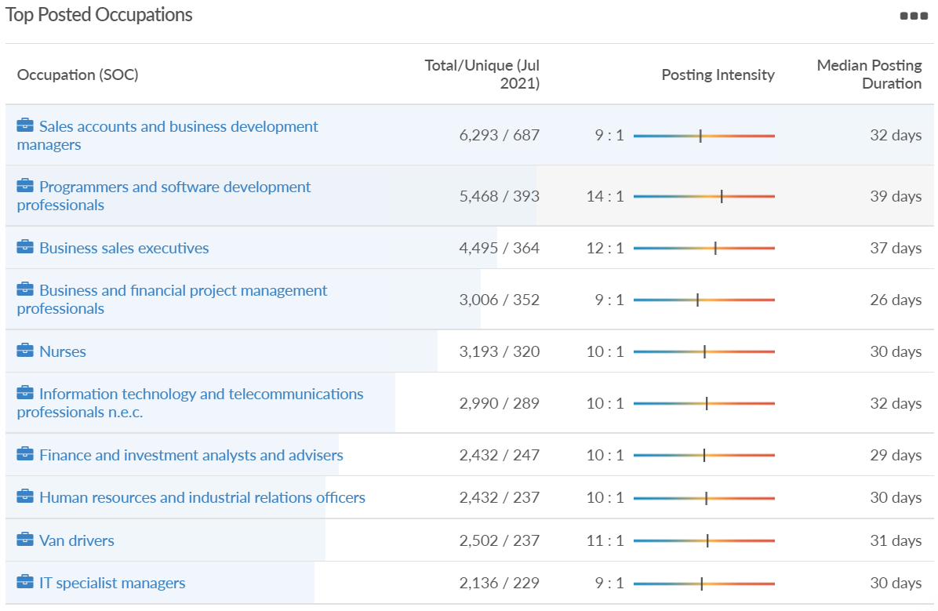
Job posting analytics (EMSI, July 2021)
Unique job postings: 11,889
Total job postings: 116,771
Job posting intensity: 10:1
Unique job postings (June 2020): 4,821

Slide 38
Wokingham

Slide 39
Impact of COVID-19 up to 9th August 2021
COVID-19 cases (to 12th August 2021) – Source: Public Health Berkshire COVID-19 Dashboard, 9th August 2021
11,597 total cases
52 new cases daily
Claimant unemployment (to June 2021)
2,815 claimants (2.7% of the working age population) in Wokingham UA
Notable business news:
Another store is closing its doors in Wokingham as FatFace bids farewell to the town center next month. On Saturday, August 28, it will close its doors on Market Place for the last time. FatFace has been alerting customers to the news on its receipts, which read: “We have taken the difficult decision to close our doors on the 28th of August. “We would love you to keep shopping with us.” It is not clear yet whether jobs will be lost.
Source: Wokingham Today, July 2021

Slide 40
Industries hit hardest by COVID shutdown
Wokingham is in a similar position to Slough in that is has been significantly less affected by the COVID shutdowns than both the Thames Valley Berkshire area and Great Britain as a whole. This is likely due to the high levels of employment from the Tech sector (Microsoft etc. based at TVP) as this industry is able to work well from home.
Source: EMSI, March 2021 (definition for industries hit hardest provided on slide 53)

Slide 41
Industry risks and opportunities (2020-2021)
Critical industries
Food and drink retail: 3,883 employees (17% below the national average)
Energy/utilities: 1,434 employees (35% above the national average)
Health and social care: 7,283 employees (38% below the national average)
Freight/logistics: 886 employees (64% below the national average)
Insurance: 453 employees (48% below the national average)
Banking and financial services: 423 employees (80% below the national average)
Sectors most impacted
Hospitality and tourism: 5,410 employees (25% below the national average)
Arts, entertainment and recreation: 1,831 (16% below the national average)
Admin and support: 6,432 (33% above the national average)
Aviation: 0 employees
Non-food retail and wholesale: 6,494 (6% below the national average)
Manufacturing: 3,731 (48% below the national average)
Construction: 3,115 (26% below the national average)
Source: EMSI, January 2021

Slide 42
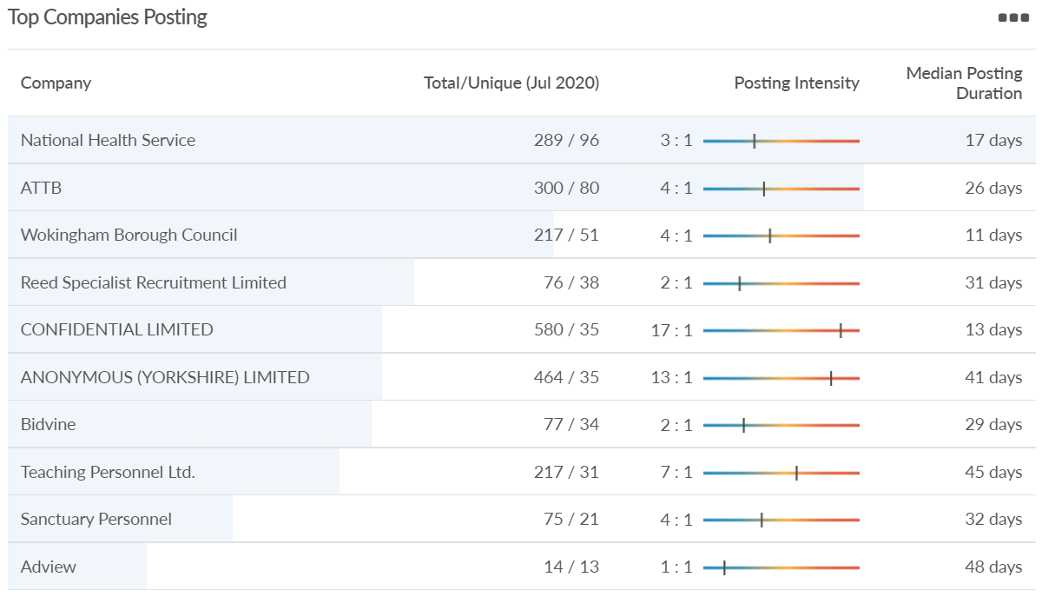
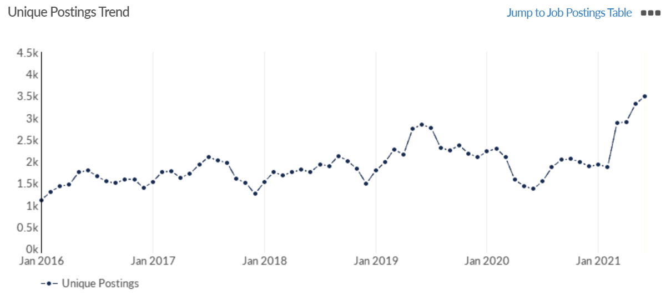
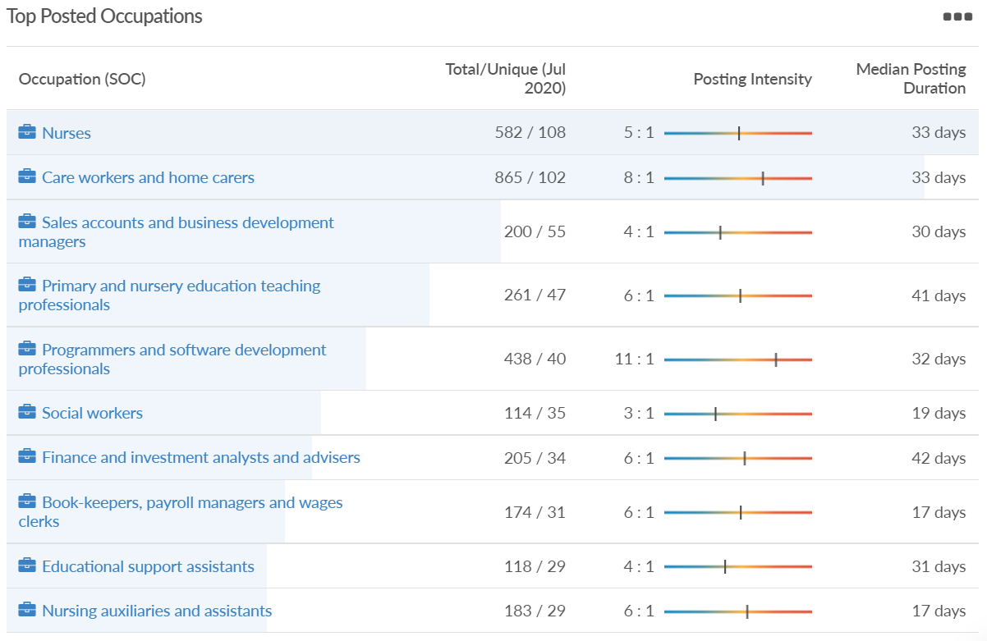
Job posting analytics (EMSI, July 2021)
Unique job postings: 3,650
Total job postings: 22,168
Job posting intensity: 6:1
Unique job postings (July 2020): 1,545

Slide 43
Windsor and Maidenhead

Slide 44
Impact of COVID-19 up to 9th August 2021
COVID-19 cases (to 9th August 2021) – Source: Public Health Berkshire COVID-19 Dashboard, 9th August 2021
11,285 total cases
44 new cases daily
Claimant unemployment (to June 2021)
3,775 claimants (4.1% of the working age population) in Windsor and Maidenhead UA
Notable business news:
Members of the Royal Borough of Windsor & Maidenhead development management panel gave the go-ahead to transform the "tired and outdated" Star House in Maidenhead. Plans were previously submitted back in May by Legal & General (LGIM) to turn the 112,000 sq ft old office block on Grenfell Road into an "attractive and sustainable" work complex. Star House is the former home of communications giant Three which moved to a new building in Green Park, Reading.
Source: BerkshireLive, July 2021

Slide 45
Industries hit hardest by COVID shutdown
Windsor and Maidenhead appears to be the most severely affected of all the Local Authorities which make up Berkshire in terms of percentage of jobs hit hardest by the COVID shutdowns. This is likely due in part to the enormous hit the leisure/tourism sector has taken and how key of an employer Legoland Windsor to the region.
Source: EMSI, March 2021 (definition for industries hit hardest provided on slide 53)

Slide 46
Industry risks and opportunities (2020-2021)
Critical industries
Food and drink retail: 3,733 employees (17% below the national average)
Energy/utilities: 882 employees (13% below the national average)
Health and social care: 8017 employees (29% below the national average)
Freight/logistics: 748 employees (68% below the national average)
Insurance: 434 employees (48% below the national average)
Banking and financial services: 1,252 employees (39% below the national average)
Sectors most impacted
Hospitality and tourism: 9,437 employees (35% above the national average)
Arts, entertainment and recreation: 4,516 (117% above the national average)
Admin and support: 4,207 (10% below the national average)
Aviation: 11 employees (95% below the national average)
Non-food retail and wholesale: 7,834 (18% above the national average)
Manufacturing: 2,523 (64% below the national average)
Construction: 6,201 (54% above the national average)
Source: EMSI, January 2021

Slide 47
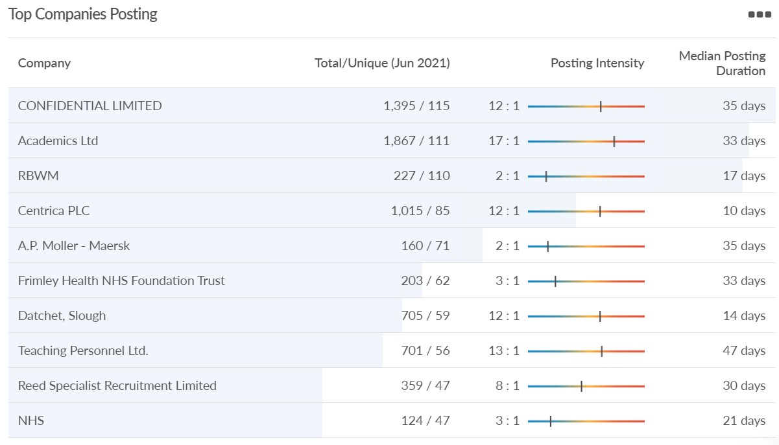
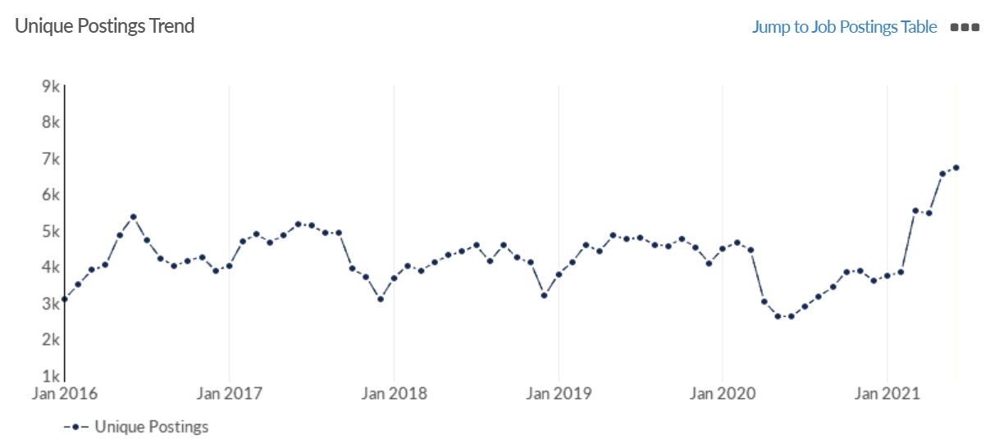
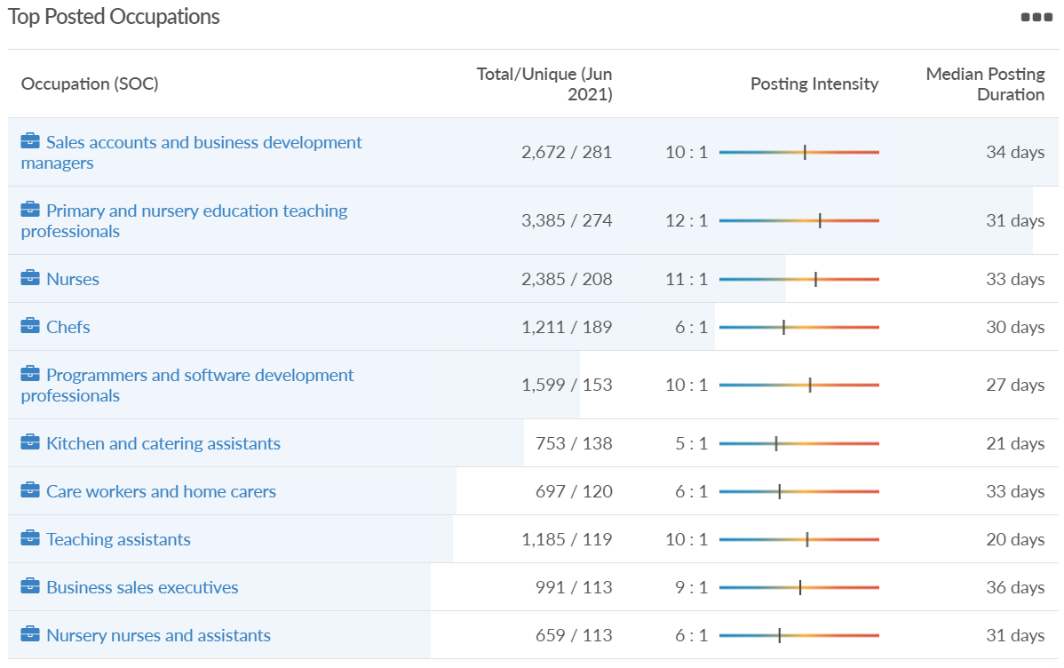
Job posting analytics (EMSI, June 2021)
Unique job postings: 6,739
Total job postings: 57,732
Job posting intensity: 9:1
Unique job postings (June 2020): 2,621

Slide 48
West Berkshire

Slide 49
Impact of COVID-19 up to 9th August 2021
COVID-19 cases (to 9th August 2021) – Source: Public Health Berkshire COVID-19 Dashboard, 9th August 2021
9,029 total cases
38 new case daily
Claimant unemployment (to June 2021)
3,255 claimants (3.4% of the working age population) in West Berkshire UA
Notable business news:
A Home Bargains store will be opening in Newbury in the autumn. The discount retailer, which already has more than 500 stores across the UK, will open at the Newbury Retail Park in October. It will open in the units previously occupied by Next and New Look. The store, which is due to open on Saturday, October 16, 2021, sells a range of homewares, health and beauty, clothes, gifts, toys, furniture, garden equipment and DIY. Notices up at the site said the retailer is currently recruiting for staff to work at the branch when it open.
Source: Newbury Today, July 2021

Slide 50
Industries hit hardest by COVID shutdown
While West Berkshire hasn’t been as fortunate as Slough in terms of how great of a percentage of jobs have been directly affected by the COVID shutdown, it has fared significantly better than the Thames Valley Berkshire area and better than Great Britain.
Source: EMSI, March 2021 (definition for industries hit hardest provided on slide 53)

Slide 51
Industry risks and opportunities (2020-2021)
Critical industries
Food and drink retail: 4,289 employees (17% below the national average)
Energy/utilities: 1,343 employees (14% above the national average)
Health and social care: 6,773 employees (48% below the national average)
Freight/logistics: 1,574 employees (43% below the national average)
Insurance: 262 employees (73% below the national average)
Banking and financial services: 692 employees (71% below the national average)
Sectors most impacted
Hospitality and tourism: 6,617 employees (18% below the national average)
Arts, entertainment and recreation: 2,674 (10% above the national average)
Admin and support: 4,803 (11% below the national average)
Aviation: <10 employees
Non-food retail and wholesale: 8,432 (9% above the national average)
Manufacturing: 11,330 (41% above the national average)
Construction: 4,813 (3% above the national average)
Source: EMSI, January 2021

Slide 52
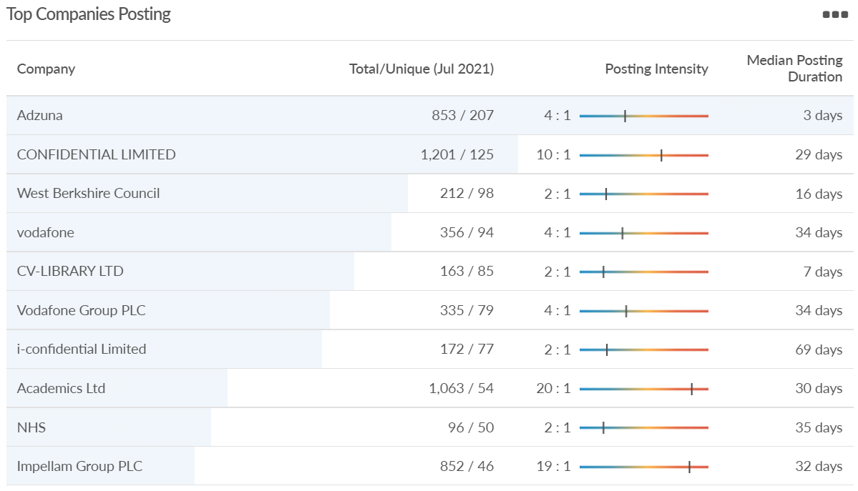
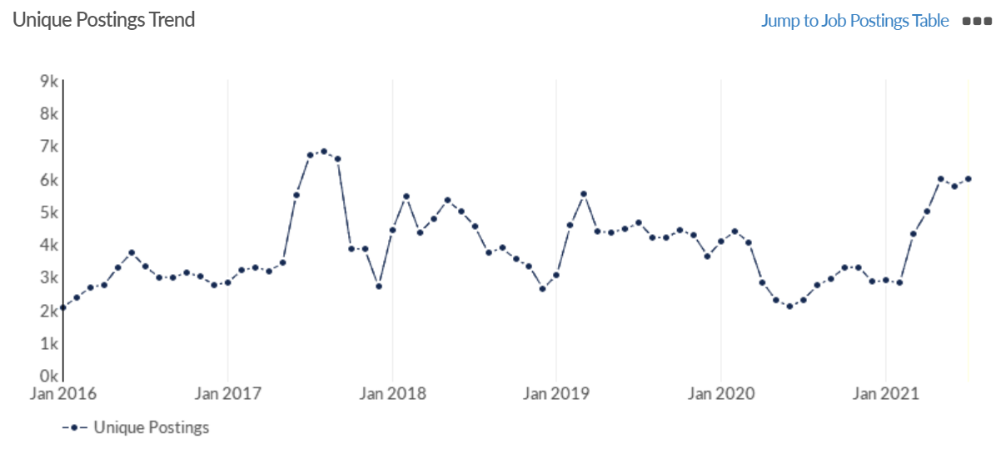
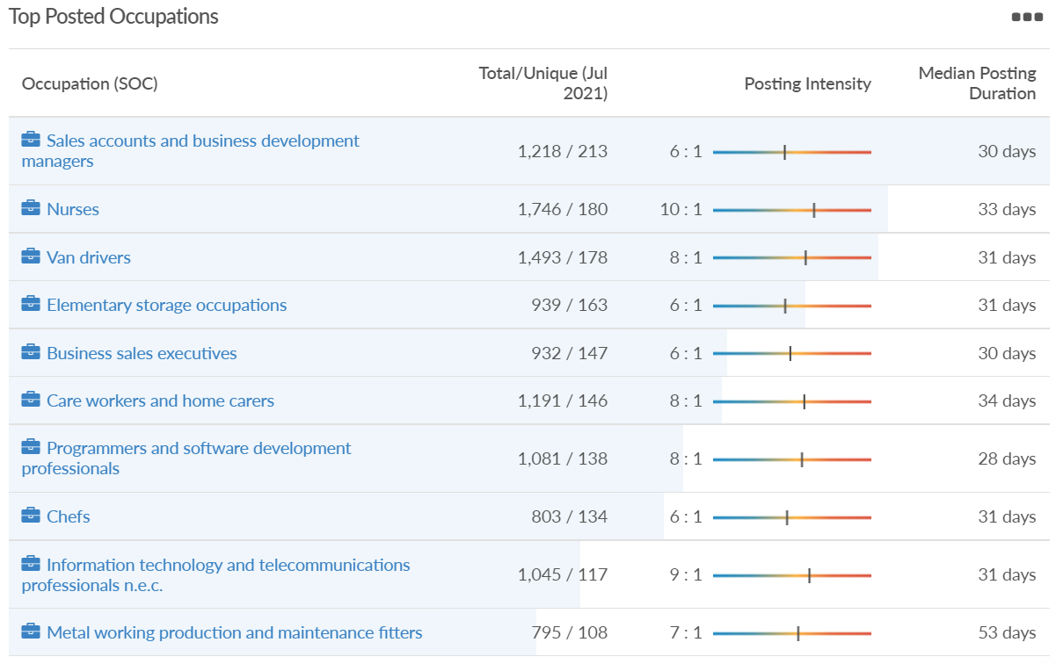
Job posting analytics (EMSI, July 2021)
Unique job postings: 5,995
Total job postings: 39,227
Job posting intensity: 7:1
Unique job postings (June 2020): 2,306

Slide 53
Definitions
Source: Institute for Fiscal Studies, April 2020

