Slide 1
Thames Valley Berkshire Monthly Economic Briefing
April 2022

Slide 2
2022 Refresh
Following on from stakeholder feedback as well as discussions within the LEP over the course of the last year, we have decided to make some additions to the content of our economic briefings, whilst still continuing to report on the bulk of the areas we were last year.
Each month, we aim to have a themed feature. This month we will be looking at the Resolution Foundations’ ‘Advantage Britain’ event.
These monthly economic briefings are constantly evolving documents and their content is dictated in part by data/information requests from our readers.
If there is an economic aspect not currently covered within these reports which you think would be beneficial to include/expand upon (or you have any queries), we will do our best to help. Please contact Dex in the LEP’s research team at dexterlevick@thamesvalleyberkshire.co.uk.

Slide 3
Key contents of this month’s briefing
Updated global and UK economic forecasts
Monthly Event Spotlight – Resolution Foundations’ ‘Advantage Britain’ event.
Key points from the latest Labour Force Survey data
Latest claimant count figures by Local Authority
Latest remote working figures for Thames Valley Berkshire
Latest ‘notable business news’ by Local Authority
Latest job posting analytics by Local Authority

Slide 4
Global and National Economy
April 2022

Slide 5
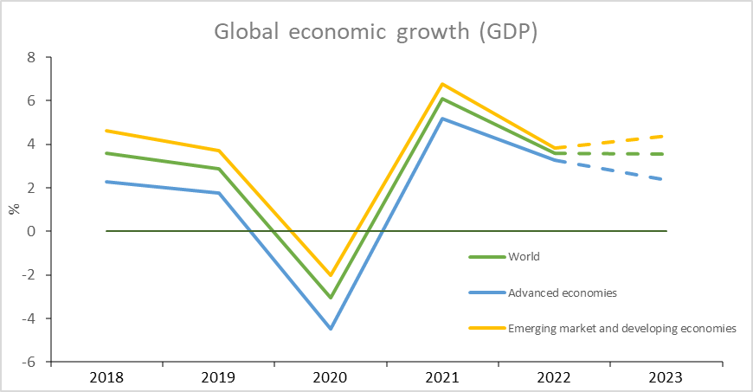
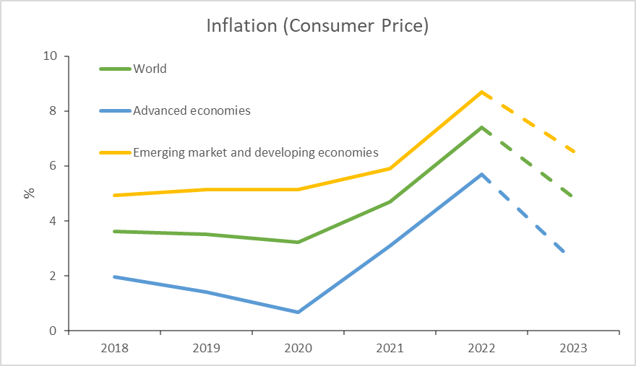
Global Economy
Global growth outlook
Worldwide, the economy has been hugely impacted by the war in Ukraine because of the spill over effect it has had on global markets. The economic damage is mainly reflected in two aspects – a slowing in global growth and rapid increase in inflation.
Global growth is projected to slow from an estimated 6.1 percent in 2021 to 3.6 percent in 2022 and 2023. This is 0.8 and 0.2 percentage points lower for 2022 and 2023 than projected in January. Beyond 2023, global growth is forecast to decline to about 3.3 percent over the medium term.
Also, war-induced commodity price increases and broadening price pressures have led to 2022 inflation projections of 5.7 percent in advanced economies and 8.7 percent in emerging market and developing economies—1.8 and 2.8 percentage points higher than projected last January.
Source: IMF, April 2022

Slide 6
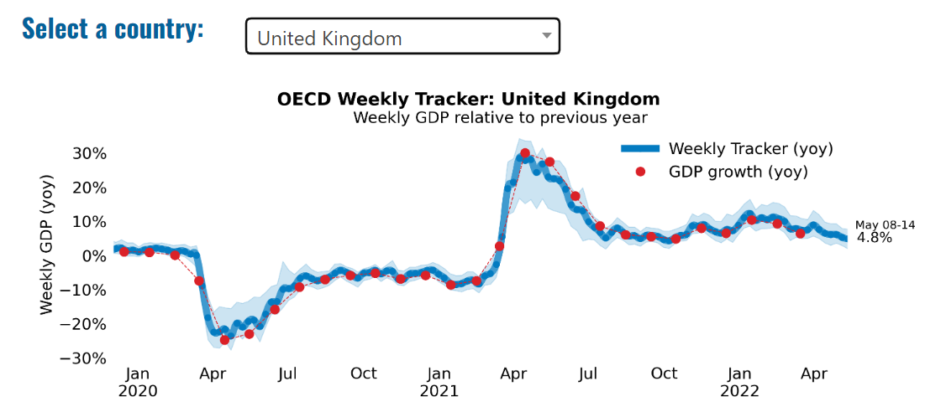
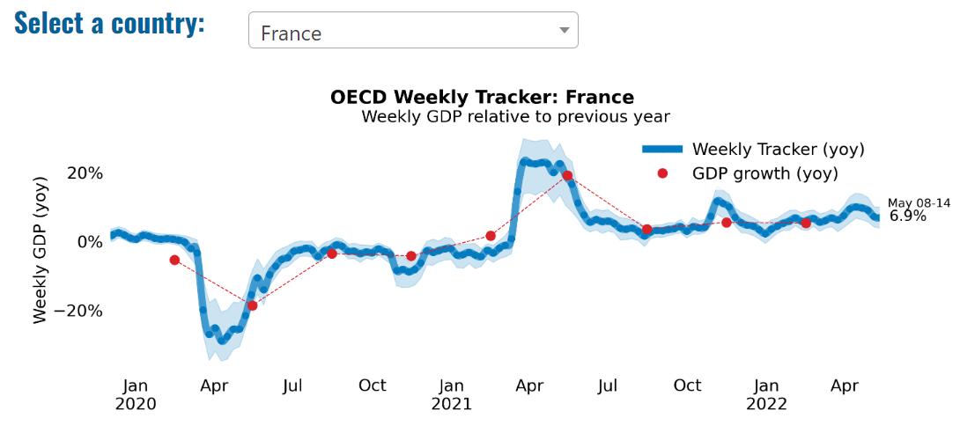
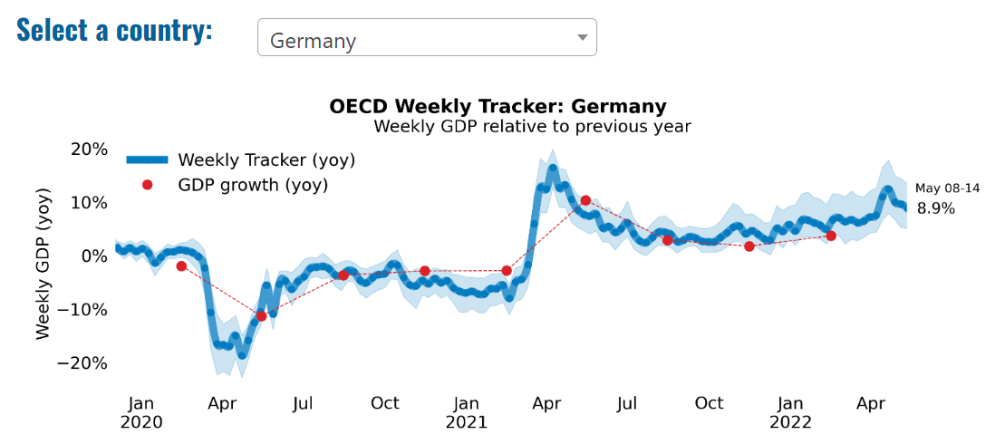
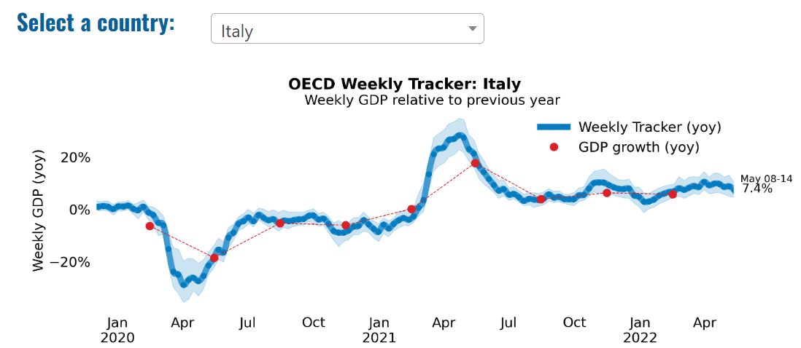
Global Economy – OECD GDP Tracker

Slide 7
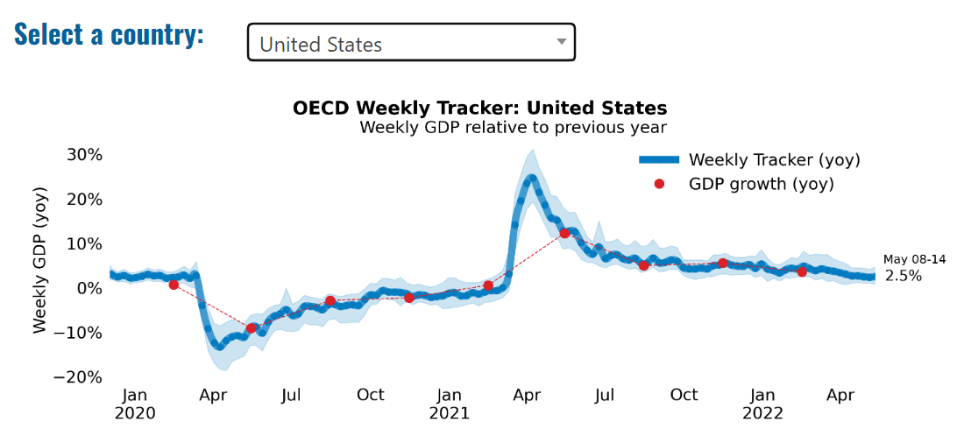
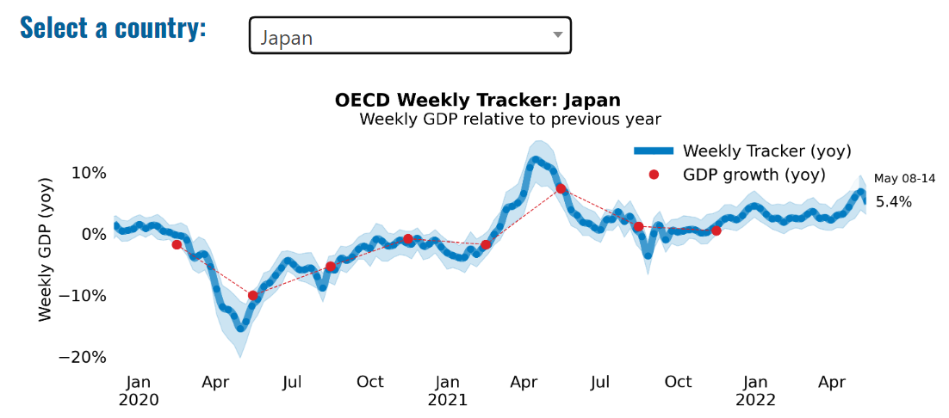
Global Economy – OECD GDP Tracker Continued
Note: The green confidence band shows 95% confidence intervals. The Weekly Tracker is an estimate of weekly GDP relative to the pre-crisis trend, which is proxied by the November 2019 OECD Economic Outlook forecasts. The darkness of the grey background reflects stay-at-home confinement requirement based on the Oxford Blavatnik database (0 - no measures, 1 - recommend not leaving house, 2 - require not leaving house with exceptions, 3 - require not leaving house with minimal exceptions).
Source: OECD, April 2022

Slide 8
UK Economy
In the UK, growth momentum is expected to slow during the course of 2022 as the impact of the cost of living crisis is felt. Overall growth in the UK for 2022 could reach 3.9%, before slowing to 1.1% in 2023.
Consumer spending is expected to be heavily affected by the squeeze on incomes, as household budgets come under unprecedented pressures from rising costs and an increasing tax burden. This could cause a marked slowdown in annual consumption growth, from 6.2% in 2021, to 4.3% in 2022 and only 0.5% in 2023. Yael Selfin, the Chief Economist at KPMG UK said:
“Lower-income households are particularly vulnerable to this year’s rise in utility costs, with those in the lowest income band potentially standing to lose more than 8% of their disposable income.”
The conflict in Ukraine has led to rising energy prices, which remains the biggest single driver of rising inflationary pressures with the pre-announced increase this month. This pressure could see inflation peak at 8.8% this summer and average 7.9% in 2022, before moderating to 4.1% on average in 2023.
Source: KPMG, April 2022
Notes:
data

Slide 9
UK Economy 2
There is a 54% increase in the energy price cap in April, which took the average annual gas and electricity bill close to £2,000. The rising cost of gas and electricity pushed household energy bills to record levels which resulted in higher inflation.
UK inflation (CPI) soared from 7% in March to 9% in April – its highest level for more than 40 years.
Source: The Guardian, April 2022
Notes:
Data source

Slide 10
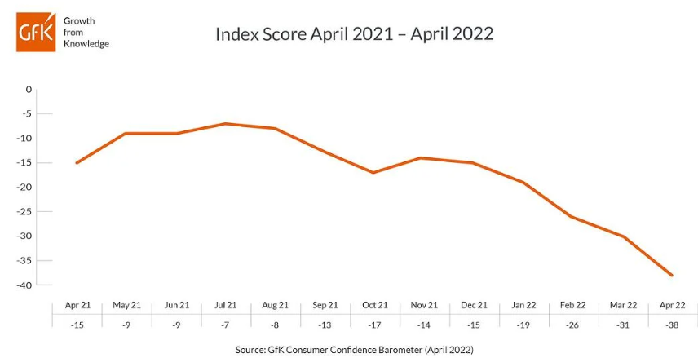
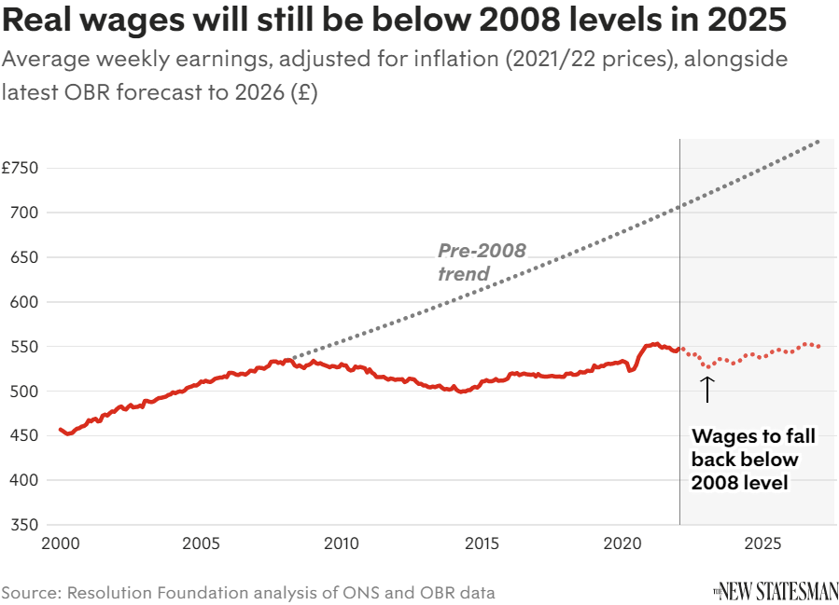
UK Economy 3
The cost-of-living crisis is forcing households to cut back on spending to cope with price rises in food and fuel. Inflation is at the highest rate for 40 years, while the current fall in real wages is set to continue until late 2023.
Data from market research firm GfK’s consumer confidence barometer (tracks UK consumers' views of their finances and the economy), revealed the consumer confidence in April fell to its second-lowest level in almost 50 years. The only month sentiment was worse was in July 2008, during the global financial crisis.
Source: New Statesman, April 2022

Slide 11
Monthly Spotlight: Advantage Britain
Each month, Berkshire’s economic update focuses on a discussion of importance to our economy.
This year, we feature ‘Advantage Britain’, a discussion at the Resolution Foundation which took place on 28 April and which considers the UK’s economic strengths, areas of future economic growth and our ability to adapt to new opportunities.
Chaired by Lord David Willetts, President of the Resolution Foundation, the discussants were Rupert Harrison, Portfolio Manager at Black Rock, Tera Allas, Director of Research and Economics at McKinsey, and Krishan Shah, Economist at the Resolution Foundation.
The key observations from the discussion are contained in the following slides.

Slide 12
Monthly Spotlight: Advantage Britain
Krishan Shah
It is important to avoid the trap of thinking that UK is just a financial services economy, and the route to revitalising is to reindustrialise. We need to think about how the UK’s strengths have changed over time?
The UK’s strengths are in services, which were worth $418bn dollars in 2019, amounting to around 45% of total exports. UK is the most heavily weighted towards services among economies of comparative size. The UK is strong in financial services and pensions, but also in intellectual property, and personal/recreational services, including education and health. We are also strong in several goods categories, including beverages, aircraft, pharmaceuticals and artworks, adding $65bn to UK exports.
Of course, some categories are set to grow in future, including life sciences, net zero and low carbon technologies, so an economic strategy needs to exploit growth opportunities that are adjacent to our current strengths.
Service sectors tend to benefit from agglomeration effects. This means activity may become concentrated across different parts of the country , possibly reinforcing regional gaps.

Slide 13
Monthly Spotlight: Advantage Britain
Rupert Harrison
Much of the UK’s success is based on its openness, to people, to ideas, not just in financial services but also in science.
Some countries that are reliant on manufacturing, especially exports to China, countries such as Germany, might struggle in the future. Chinese growth is slowing rapidly; US-China tensions will make it hard to develop a business model around exports to China. Service exporters are more geared towards the Atlantic, Europe and the emerging world.
A large part of the UK’s productivity problem is based in non-traded sectors, such as logistics, warehouses, care, the public sector. These sectors have a disproportionate number of low wage workers. Industrial strategy in UK should be focused around remote care, prefab construction, more productive hospitality.
There is a regional implications of service specialisation. We may be about to see economic geography change over next 20 years, as result of remote working. A new type of regional strategy is possible, so areas can focus on quality of life, allowing people to continue to work in high-paying export sector because they don’t have to commute into London anymore.
It’s possible that we are at the beginning of a new wave of offshoring of services. We haven’t yet thought through what that means for the UK.

Slide 14
Monthly Spotlight: Advantage Britain
Tera Alas
We face a number of mega trends:
First, the profitability of existing sectors, where is growth still happening. Manufacturing and China will still have the biggest growth and largest profit pools by 2030. Not so much will be open to exporters, but the UK is not as well placed as we could be to take advantage of the opportunities that are there.
Second, the changing shape of global trade. We are the second largest exporter of services in the world, and services trade is growing faster than goods trade; ICT and financial services are growing two to three times as fast as goods trade.
Demographic change, particularly ageing. There will be a massive increase in demand for healthcare and pharmaceutical type services and products., especially as we deliver more and more of health services digitally. China has a big ageing problem - 40% of people in the world with dementia live in China, because of its age profile.
Climate change. There is a shifting of capital expenditure from polluting to green sectors. Quite a lot of this is in manufacturing. We have a lot of basic industries, especially in northern England, which if they manage to pivot to serve the new green Cap-X revolution, could allow for new opportunities.
Digitisation and data. The UK might not be great at automating manufacturing, but in services, we are out there. Two thirds of services were delivered remotely before the pandemic; this is now 80% of services.

Slide 15
Monthly Spotlight: Advantage Britain
Key takeaways from the Advantage Britain seminar for Berkshire:
Life sciences are set to grow in future. An economic strategy for the UK needs to exploit growth opportunities that are adjacent to our current strengths in the wider services sector.
Demographic change, particularly ageing, could mean more demand for both life sciences and pharmaceuticals, and digital services, areas of strength for Berkshire, as we deliver more and more of health services digitally.
We may be about to see a new economic geography, as result of remote working. Places like Berkshire, with its access to green spaces, could focus on quality of life issues, allowing people to base themselves here but work for high-paying, London-based companies. This could bring new people to spend in the Berkshire economy as consumers, boosting the service sector, but those people might not necessarily work here. There would clearly be pros and cons to such a strategy.

Slide 16
Employment in the UK: Labour Force Survey – April 2022
Key points:
December 2021 to February 2022 estimates show a decrease in the unemployment rate, while the employment rate was largely unchanged and the economic inactivity rate increased, compared with the previous three-month period (September to November 2021).
Total hours worked increased compared with the previous three-month period but are still below pre-coronavirus (COVID-19) pandemic levels.
The UK employment rate was estimated at 75.5%, largely unchanged from the previous three-month period and 1.1 percentage points lower than before the coronavirus pandemic (December 2019 to February 2020).
The UK unemployment rate was estimated at 3.8%, 0.2 percentage points lower than the previous three-month period, and 0.1 percentage points below pre-coronavirus pandemic levels.
The UK economic inactivity rate was estimated at 21.4%, 0.2 percentage points higher than the previous quarter, and 1.2 percentage points higher than before the coronavirus pandemic.
Source: ONS, April 2022

Slide 17
Economic and Labour Market Insight: Implications for Thames Valley Berkshire

Slide 18
Claimant Count (Latest data - April 2022)
Total of 17,920 claimants (3.1% of the working age population) in Thames Valley Berkshire
1,750 claimants (2.2% of the working age population) in Bracknell Forest UA
5,345 claimants (5.7% of the working age population) in Slough UA
4,470 claimants (4.2% of the working age population) in Reading UA
1,750 claimants (1.6% of the working age population) in Wokingham UA
2,310 claimants (2.5% of the working age population) in Windsor and Maidenhead UA
2,295 claimants (2.4% of the working age population) in West Berkshire UA
Across Thames Valley Berkshire, claimant unemployment has fallen significantly from 30,395 in April 2021 to 17,920 in April 2022. Slough had 5.7% of its working age population claim unemployment in April 2022, down significantly from 8.9% in April 2021.
Source: ONS, April 2022

Slide 19
Strategic Issues: Heathrow
Heathrow Airport:
Five million passengers travelled through London Heathrow Airport (LHR) in April 2022, with outbound leisure travellers and Brits cashing in airline travel vouchers driving the recovery in passenger demand which is expected to last throughout the summer. As a result, Heathrow has increased its 2022 forecast from 45.5 million passengers to nearly 53 million – a 16 per cent increase on the airport’s previous assumptions.
To maintain the service passengers expect over the summer, the airport will be reopening Terminal 4 by July 2022 and are already recruiting up to 1,000 new security officers.
The ongoing war in Ukraine, higher fuel costs, continuing travel restrictions for key markets like the U.S. and the potential for a further variant of concern creates uncertainty going forward. Together with the warning from the Bank of England that inflation is set to pass 10 per cent and that the UK economy will likely ‘slide into recession’ means we are taking a realistic assessment that travel demand will reach 65 per cent of pre-pandemic levels overall for the year (2022).
Source: International Airport Review, April 2022

Slide 20
An important note on the EMSI figures contained on the following slides: 21, 25, 28, 31, 34, 37 and 40
From February 2022, there has been a methodological change in how EMSI calculates job posting figures compared to those from prior months following a merger between EMSI and Burning Glass Technologies.
Those of you who have read previous economic briefings from Thames Valley Berkshire LEP may notice that the job posting figures contained in post-January 2022 briefings are lower across the board – in some cases quite significantly.
This change in methodology does not invalidate previous figures, but it is important to consider when reporting on job posting data longitudinally.

Slide 21
Remote working
In April of 2022, there were 4,216 unique job postings for remote positions at companies based in Berkshire, around 37% more than the figure of 3,070 for the same period one year before.
Compare this with the South-East, in April 2022 there were 20,291 unique remote job postings for remote positions; rising from 16,286 in April of the previous year – an increase of over 25%.
A rise can also be seen at national level, with a recorded 164,608 unique remote job postings in England in April of 2022, rising from 111,061 in April 2021 – an increase of over 48%.
From these figures it’s apparent that the COVID-19 pandemic has, somewhat unsurprisingly, prompted a massive boost in job postings for explicitly remote roles. Berkshire has seen a larger boost in vacancies which are remote-based than the South-East, but a smaller one than in England as whole.
Source: EMSI, April 2022

Slide 22
Local Profiles

Slide 23
Bracknell Forest

Slide 24
Unemployment figures and Notable Business News - April 2022
Claimant unemployment (to April 2022)
1,750 claimants (2.2% of the working age population) in Bracknell Forest UA
Notable business news:
Bracknell's biggest office letting of the year sees a training provider move into the top floor of an Arlington Square property. The 9,848 sq. ft fourth floor at Three Arlington Square has been leased by iHasco, who are relocating from another location in Bracknell – LINK.
Note: The LEP has been previously reporting on COVID-19 case rates in these monthly economic briefings. The dashboards containing this data have been shut down as of this month and, as a result, we will no longer be doing so.

Slide 25
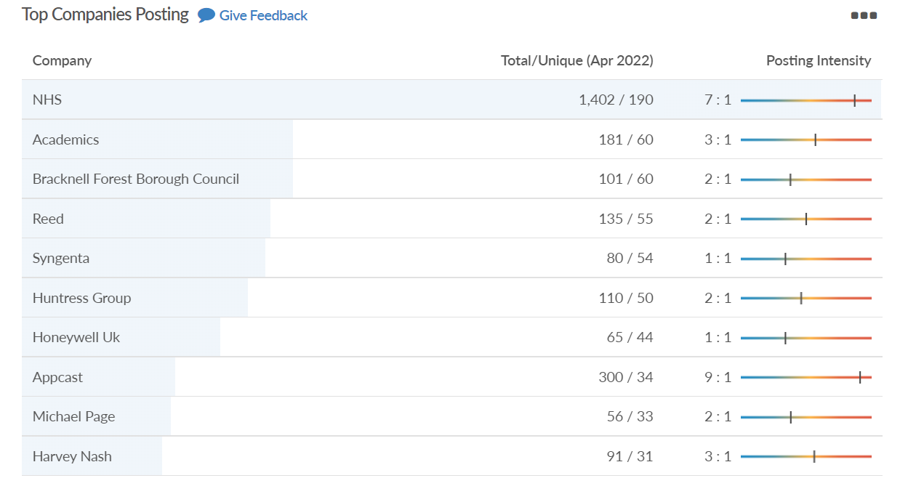
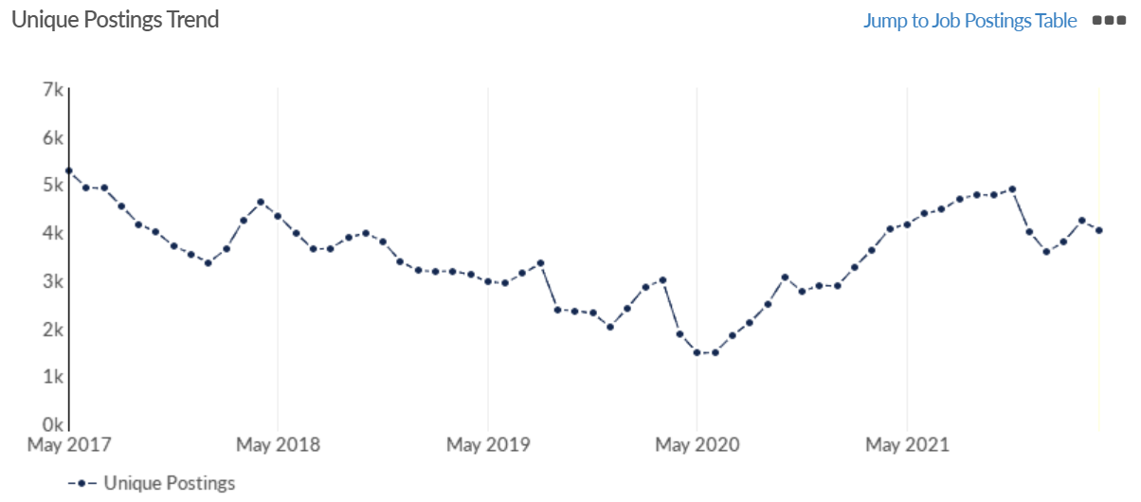
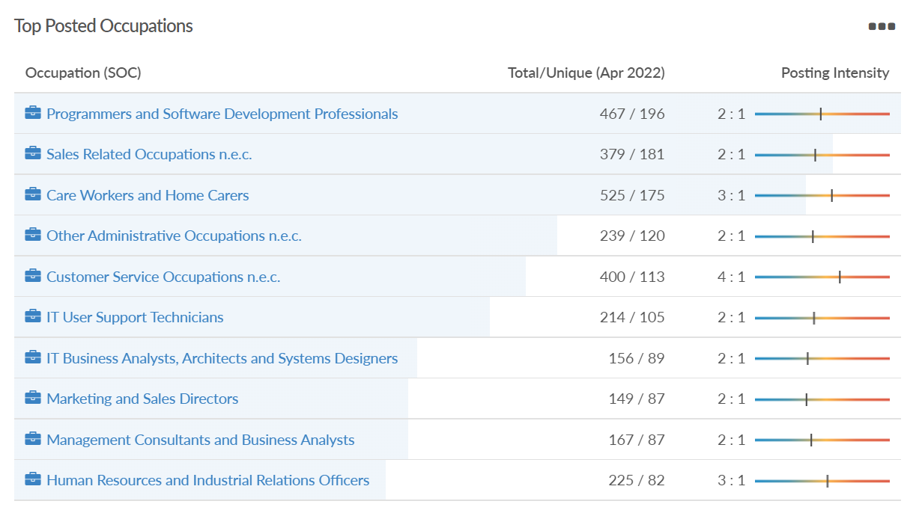
Job posting analytics (EMSI, April 2022)
Unique job postings: 4,044
Total job postings: 9,915
Job posting intensity: 2:1
Unique job postings (April 2021): 4,066

Slide 26
Slough

Slide 27
Unemployment figures and Notable Business News - April 2022
Claimant unemployment (to April 2022)
5,345 claimants (5.7% of the working age population) in Slough UA
Notable business news:
SEGRO held their ‘Together SEGRO’ event at Slough Trading Estate. Customers heard all about Responsible SEGRO & the benefits it can bring from Luc Griffiths MRICS & Jo Jackson. Guest speaker Alison Webster, who is the Chief Executive of Berkshire Local Enterprise Partnership talked about the Levelling Up agenda and development opportunities across Berkshire – LINK.
Note: The LEP has been previously reporting on COVID-19 case rates in these monthly economic briefings. The dashboards containing this data have been shut down as of this month and, as a result, we will no longer be doing so.

Slide 28
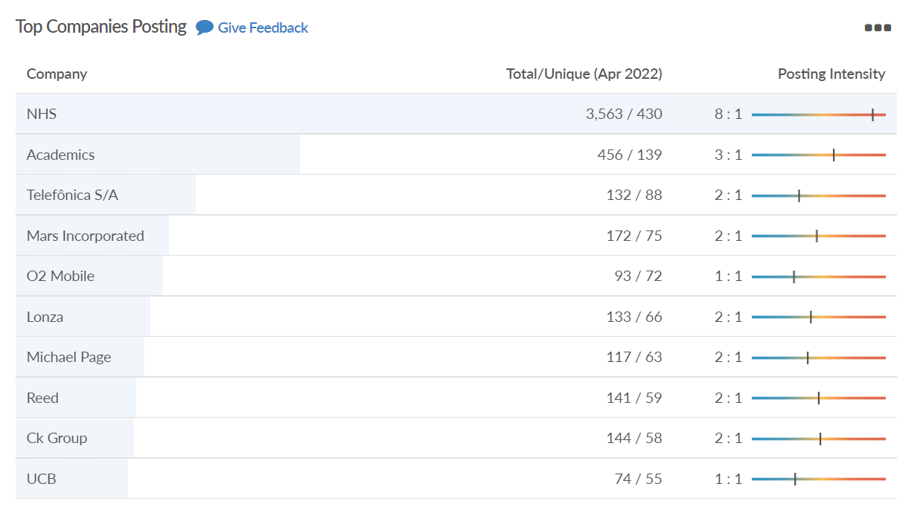
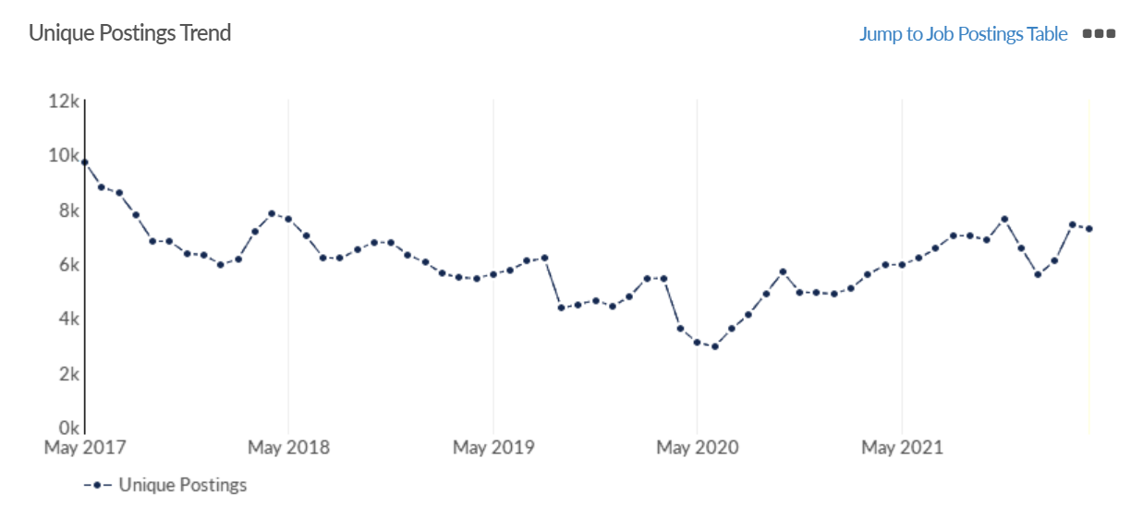
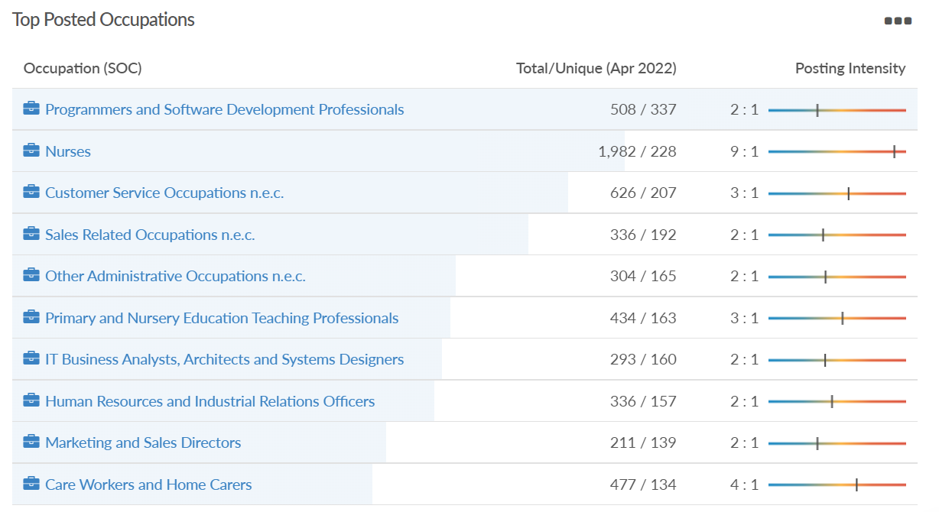
Job posting analytics (EMSI, April 2022)
Unique job postings: 7,289
Total job postings: 17,385
Job posting intensity: 2:1
Unique job postings (April 2021): 5,945

Slide 29
Reading

Slide 30
Unemployment figures and Notable Business News - April 2022
Claimant unemployment (to April 2022)
4,470 claimants (4.2% of the working age population) in Reading UA
Notable business news:
EY Reading has moved to new offices, which have been designed to facilitate the firm’s transition to a hybrid working model by providing a modern, collaborative and tech enabled office environment for its people and clients. The new office at R+ Reading on Blagrave Street is home to over 750 people and maintains the firm’s location in the heart of the town, in close proximity to key transport links – LINK.
Note: The LEP has been previously reporting on COVID-19 case rates in these monthly economic briefings. The dashboards containing this data have been shut down as of this month and, as a result, we will no longer be doing so.

Slide 31
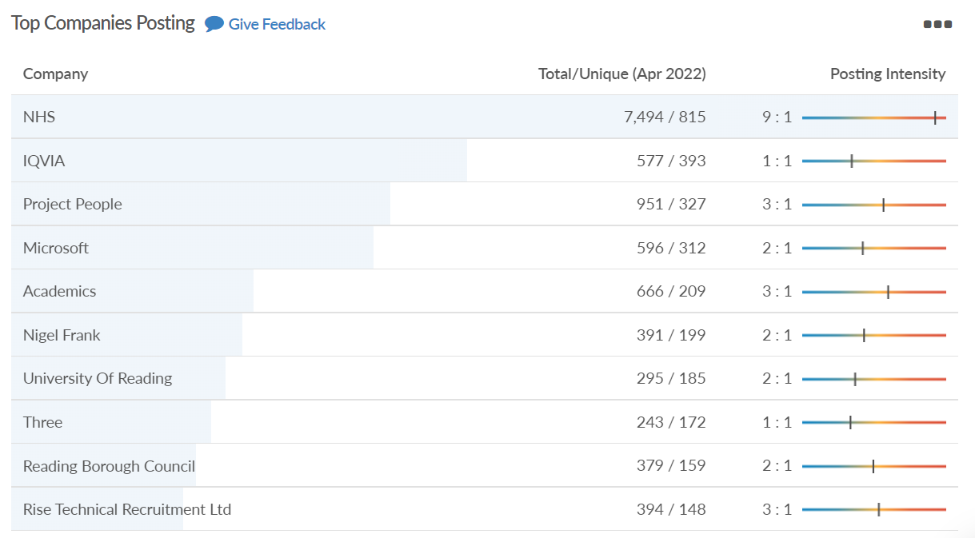
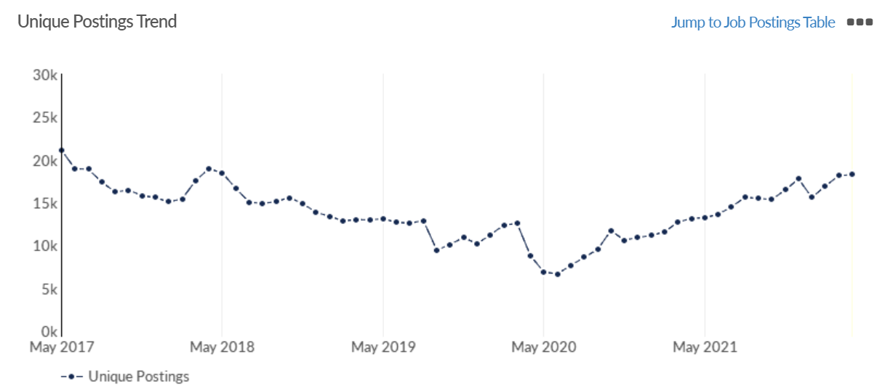
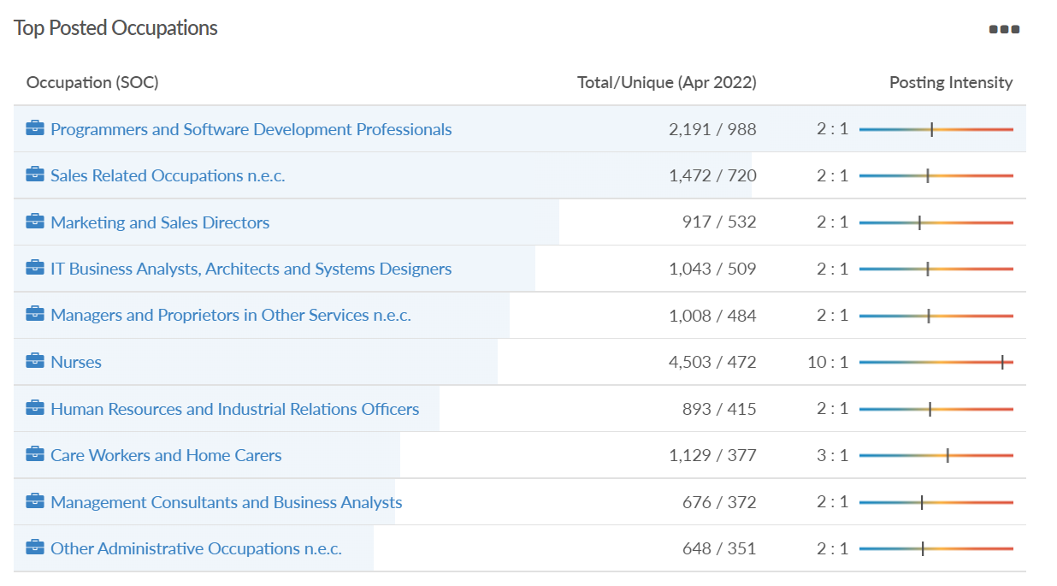
Job posting analytics (EMSI, April 2022)
Unique job postings: 18,260
Total job postings: 44,036
Job posting intensity: 2:1
Unique job postings (April 2021): 13,152

Slide 32
Wokingham

Slide 33
Unemployment figures and Notable Business News - April 2022
Claimant unemployment (to April 2022)
1,750 claimants (1.6% of the working age population) in Wokingham UA
Notable business news:
A Thames Valley-based building society is celebrating after winning an award for its mortgage services for the third year in a row. Newbury Building Society, which has a branch on Broad Street in Wokingham, scooped the title of Best Specialist Mortgage Provider at the 2022 British Bank Awards in central London earlier this month. The Society was also shortlisted for Best Building Society, which they won in 2021, and Best Savings Provider – LINK.
Note: The LEP has been previously reporting on COVID-19 case rates in these monthly economic briefings. The dashboards containing this data have been shut down as of this month and, as a result, we will no longer be doing so.

Slide 34
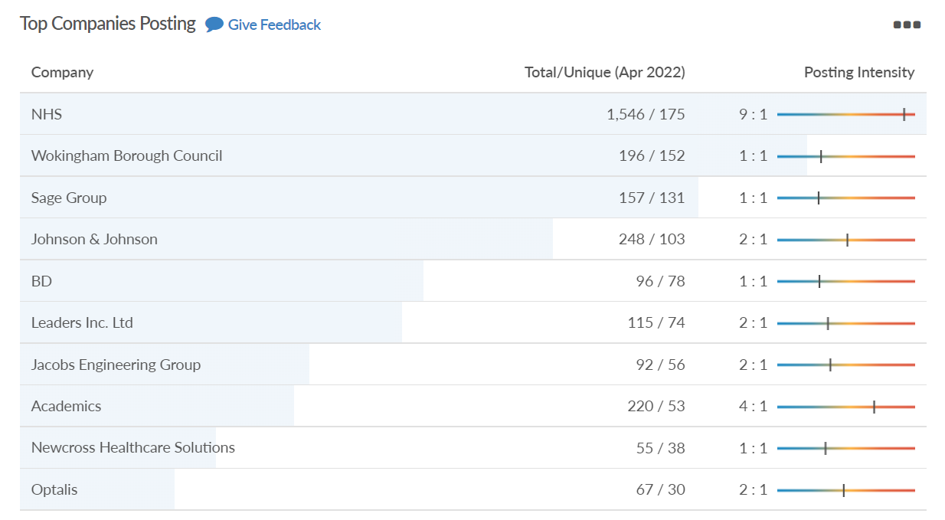
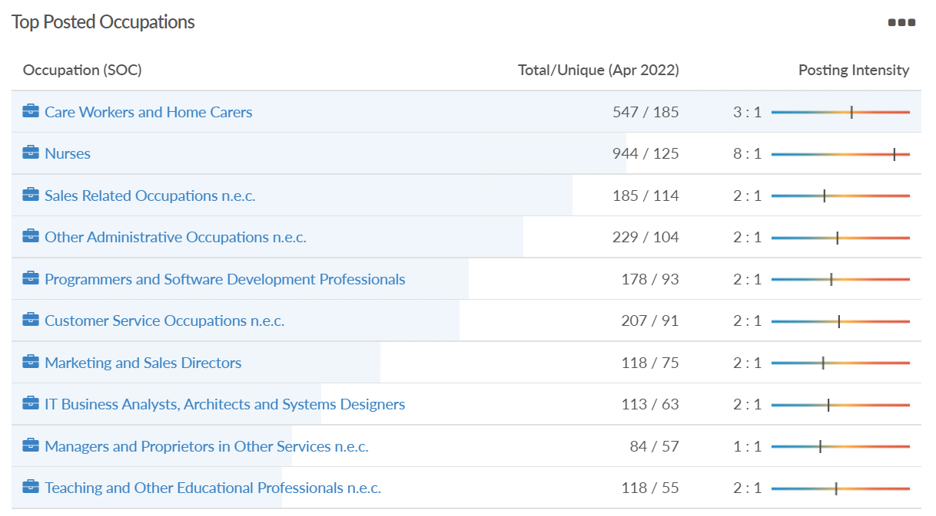
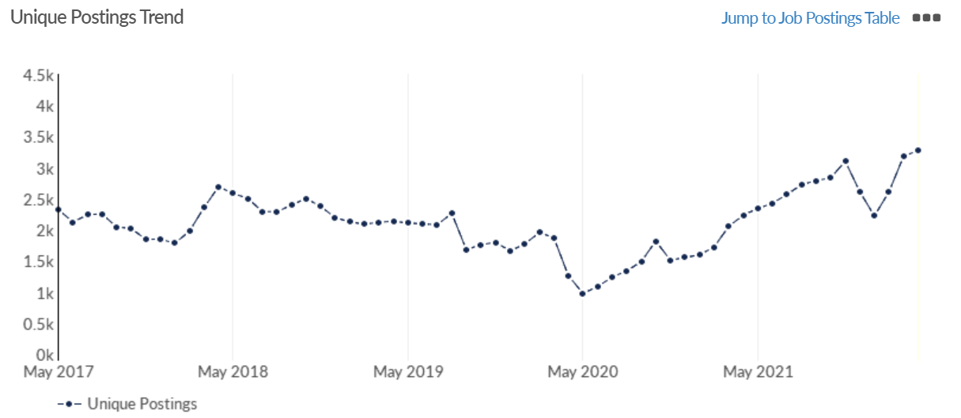
Job posting analytics (EMSI, April 2022)
Unique job postings: 3,278
Total job postings: 7,675
Job posting intensity: 2:1
Unique job postings (April 2021): 2,239

Slide 35
Windsor and Maidenhead

Slide 36
Unemployment figures and Notable Business News - April 2022
Claimant unemployment (to April 2022)
2,310 claimants (2.5% of the working age population) in Windsor and Maidenhead UA
Notable business news:
Flexible space operator MyWorkSpot has signed a second site at York House, Maidenhead. The whole building, comprising 11,000 sq. ft of grade A space, has been taken on a 15-year lease from Hawk Investment – LINK.
Note: The LEP has been previously reporting on COVID-19 case rates in these monthly economic briefings. The dashboards containing this data have been shut down as of this month and, as a result, we will no longer be doing so.

Slide 37
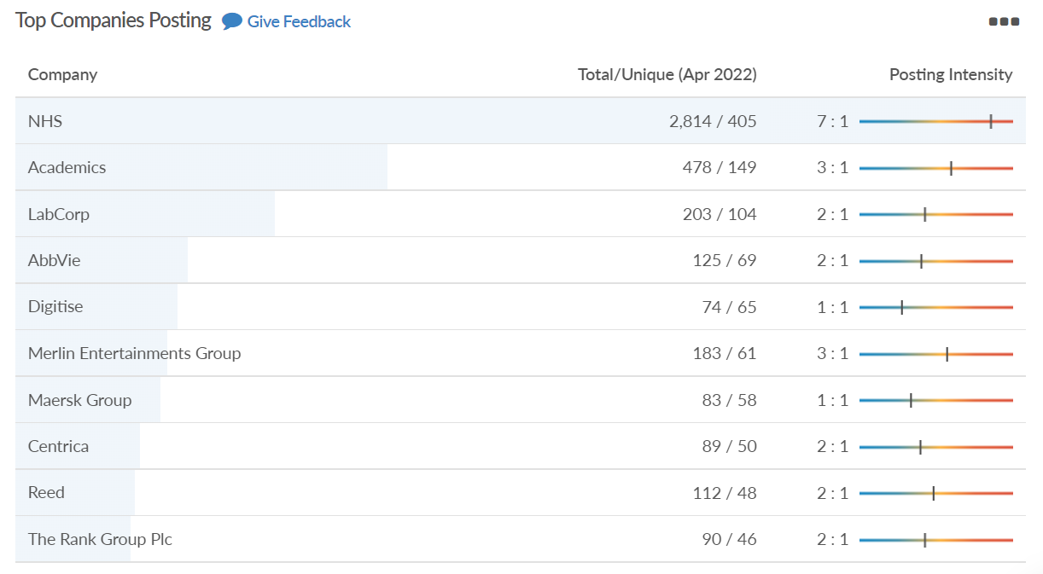
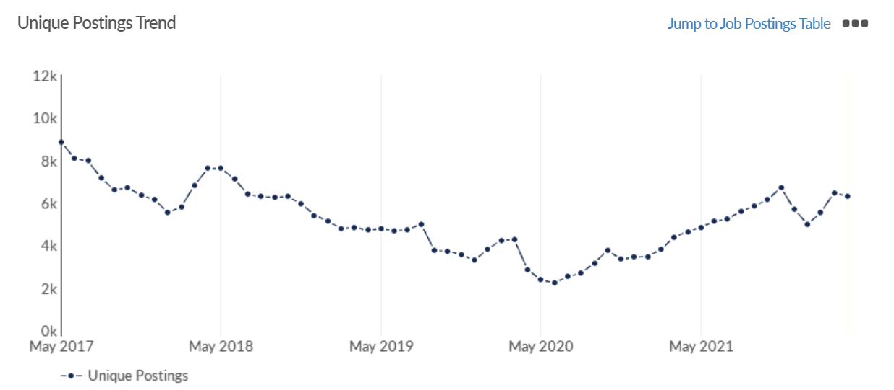
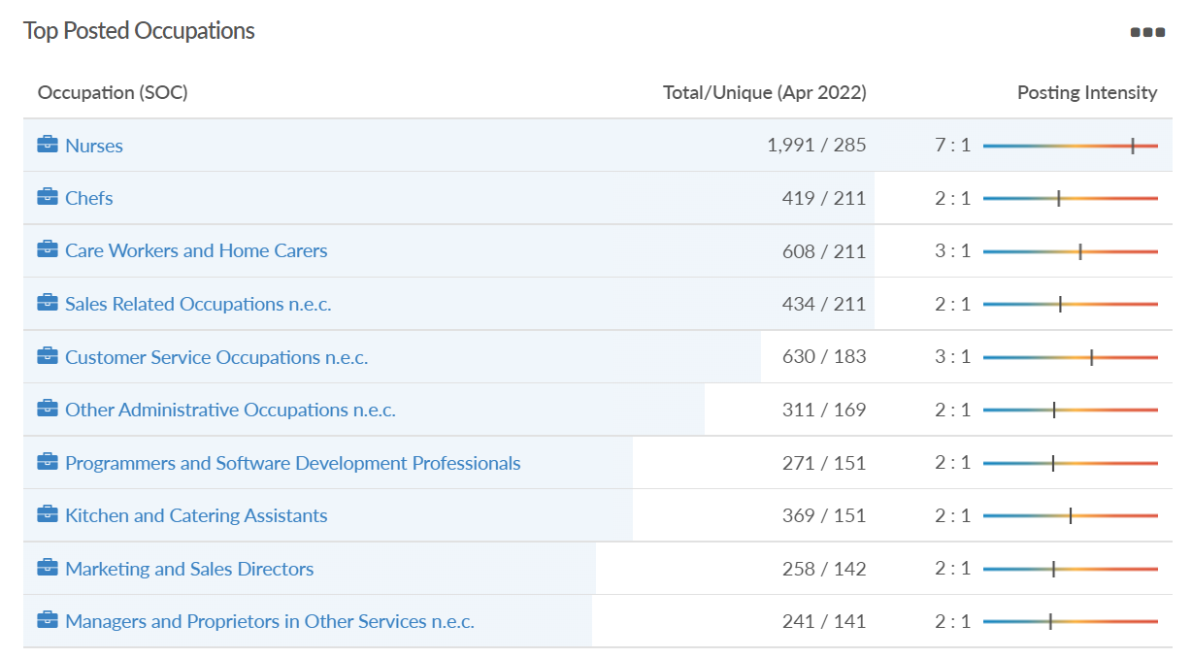
Job posting analytics (EMSI, April 2022)
Unique job postings: 6,297
Total job postings: 15,346
Job posting intensity: 2:1
Unique job postings (April 2021): 4,648

Slide 38
West Berkshire

Slide 39
Unemployment figures and Notable Business News - April 2022
Claimant unemployment (to April 2022)
2,295 claimants (2.4% of the working age population) in West Berkshire UA
Notable business news:
The last available commercial space at 4 The Sector in Newbury has been let. The 19,262 square feet of space has been snapped up by Novuna Vehicle Solutions which is one of the UK's top 10 largest leasing companies with over 100,000 vehicles ranging from cars and vans to HGVs, trucks and plant equipment – LINK.
Note: The LEP has been previously reporting on COVID-19 case rates in these monthly economic briefings. The dashboards containing this data have been shut down as of this month and, as a result, we will no longer be doing so.

Slide 40
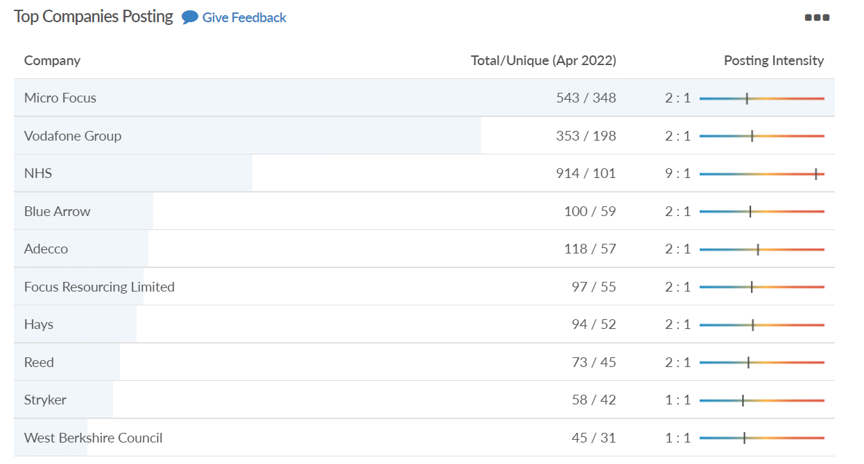
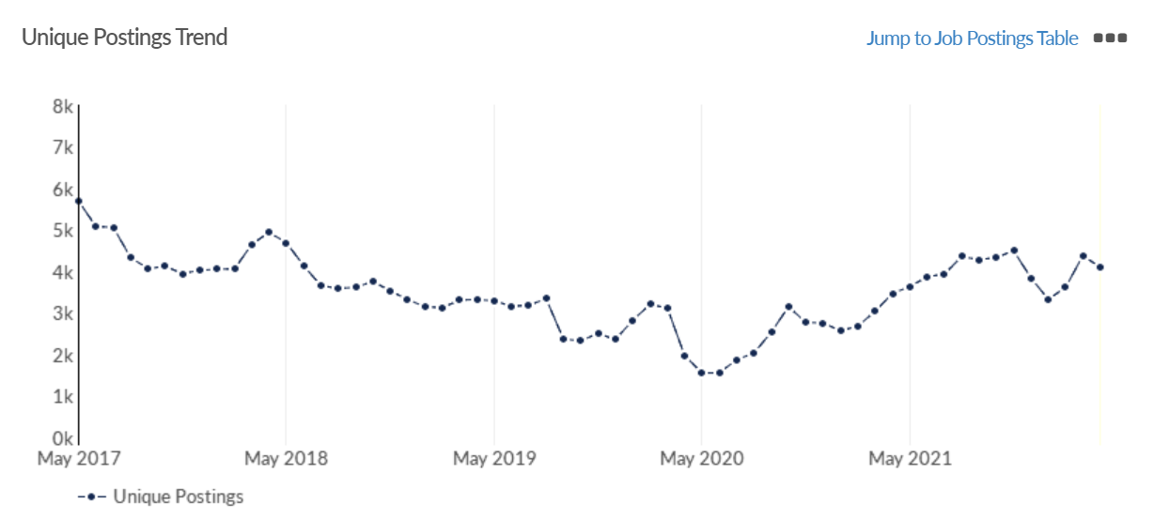
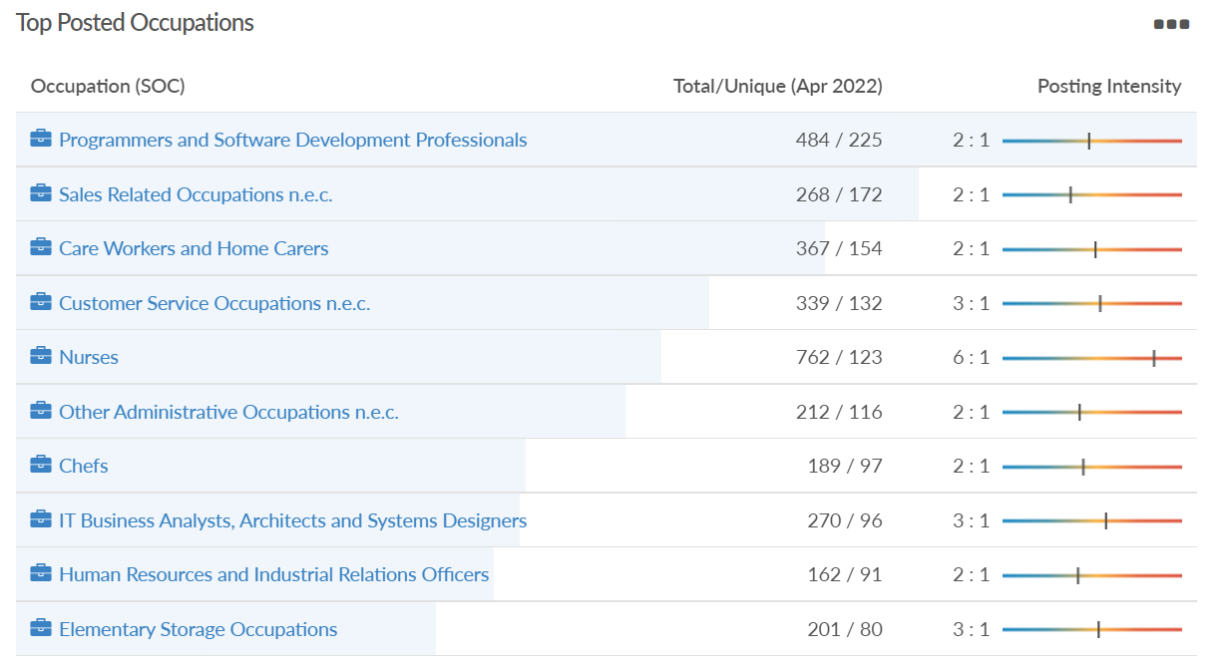
Job posting analytics (EMSI, April 2022)
Unique job postings: 4,098
Total job postings: 9,259
Job posting intensity: 2:1
Unique job postings (April 2021): 3,470

